Slide 1
PHASE 1 PROJECT PRESENTATION TITLE: AIRCRAFT RISK EVALUATION
Name: Lyster Kwamboka
Email: kwambokalyster20@gmail.com

Slide 2
Goals
Business questions
Objectives
Which flight operations have the highest risk of fatal injuries?
What aircraft is safer and less likely to get accidents?
Which are the locations safe for aircraft navigation?
What are the optimal number of engines sufficient for ensuring the stability and safety of aircraft operations?
Analyze the Total fatal injuries by the purpose of flight
Identify aircraft models and makes with a higher likelihood of severe accidents or operational failures.
Investigate for the locations that have historically proven risky for aircraft operations, highlighting potential geographic safety concerns.
Determine the number of engines sufficient for ensuring the stability and safety of aircraft operations.

Slide 3
Project workflow
Loading and inspecting the data
Data cleaning
Data visualization
Findings
Conclusions
Recommendations

Slide 4
Loading and inspecting the data
The packages matplotlib,pandas and numpy were imported.
Checked for the duplicates,summary statistics,missing values,erroneous values and identified the rows and columns contained in the dataset
The dataset had a total of 31 columns and 88889 rows.
From the information the data types were objects and floats
Most columns had missing values which we delt with in the data cleaning part

Slide 5
Data cleaning
The data was analyzed using the VSCode code editor, with essential libraries such as matplotlib and pandas being imported
The irrelevant columns were dropped also those that had a lot of missing values.
Filled in the missing values of the categorical columns with the string ‘unknown’ and for the numerical columns with 0.
Stripped all white spaces
Added more columns that would enable better visualizations

Slide 6
Data Visualization
Visualizations were created using matplotlib within the ipynb file, while additional visualizations shown below, were developed using Tableau.
The visualizations addressed the objectives.

Slide 7
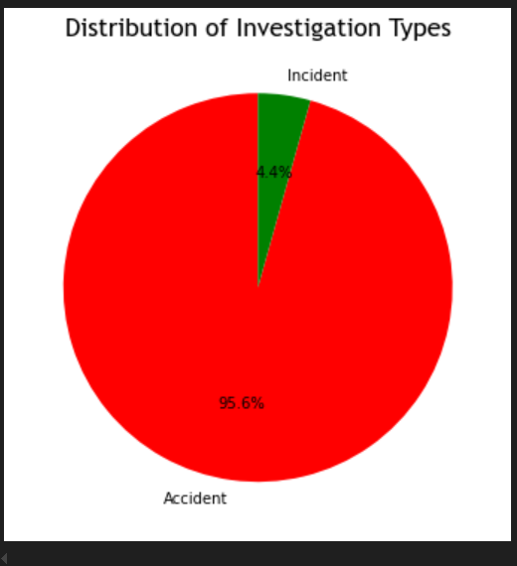
Graphical representation using a pie chart for the proportion of Accidents and Incidents
Notes:
This visualization offers a clear comparison of the two categories that effectively display proportions, making it straightforward to convey that most investigation types are accidents which takes 95.6% of the investigation type and incidents take 4.4% of the investigation type.

Slide 8
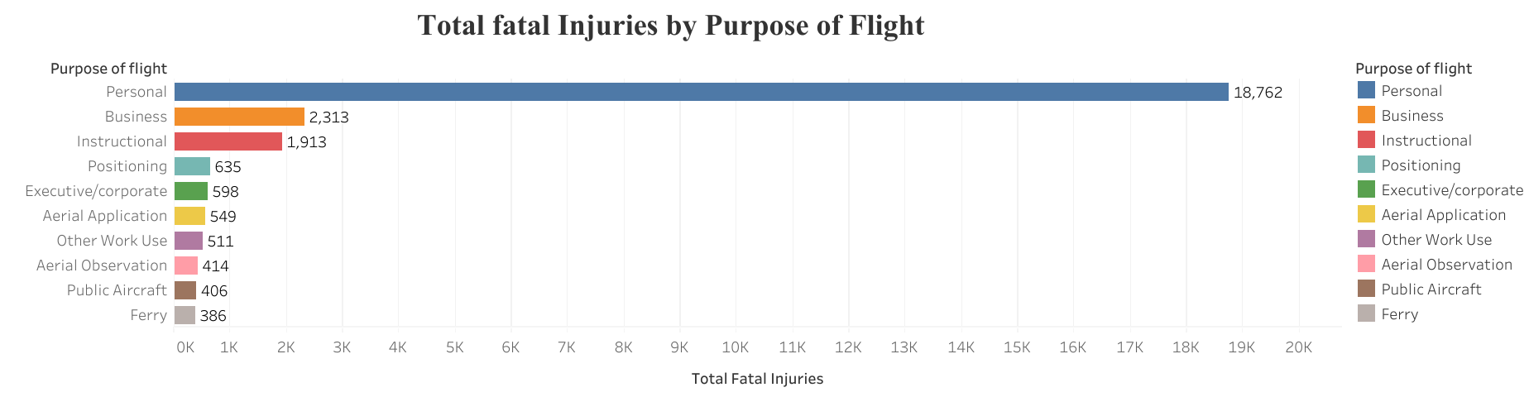
Objective 1: To analyze the Total Fatal Injuries by the Purpose of Flight.
Notes:
From the above figure we can see the personal flight purpose is more prone to fatal accidents.

Slide 9
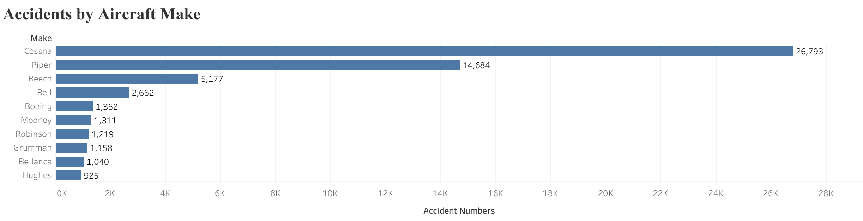
Objective 2.1:Identify aircraft make with a higher likelihood of accidents
Notes:
From the figure above, it can be clearly seen that the Make with the most accident occurrences is Cessna with 26793 number of accidents followed by Piper with 14684 number of accidents

Slide 10
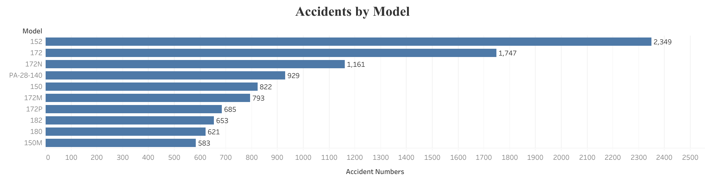
Objective 2.2 :Identify aircraft models with the highest likelihood of accidents
Notes:
From the figure above, it can be clearly that the Model with the most accident occurences is the 152 model with 2349 number of accidents followed by 172 model with 1747 number of accidents.

Slide 11
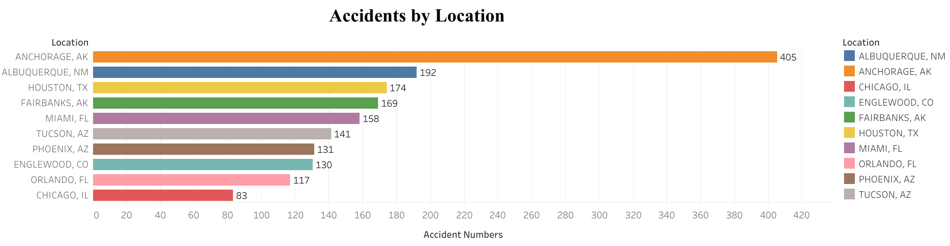
Objective 3:Investigate the locations that have historically proven risky for aircraft operations
Notes:
The figure above shows Anchorage as the most risky location for aircraft operations and Orlando and Chicago being among the locations safer for aircraft operations.

Slide 12
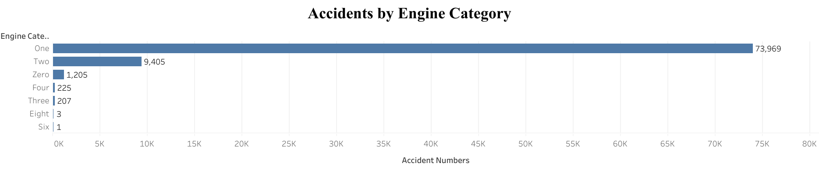
Objective 4:Determine the number of engines sufficient for ensuring the stability and safety of aircraft operations.
Notes:
From the figure we can clearly see that the Aircrafts with more than 4 engines have lesser occurrences of accidents. This could also mean that those aircrafts with less than four engines have a greater probability of accidents.

Slide 13
Findings
The personal flight purpose is more prone to fatal accidents with a total of 18762 Total Fatal injuries.
The accidents takes 95.6% of the investigation done while the incidences take 4.4% of the investigation done.
The Model with the most accident occurences is the 152 model with 2348 number of accidents followed by 172 model with 1744 number of accidents.
The Make with the most accident occurences is Cessna with 26793 number of accidents followed by Piper with 14684 number of accidents.
Anchorage is the most risky location for aircraft operations while Orlando and Chicago are among the locations safer for aircraft operations.

Slide 14
Conclusions
The personal flight purpose is more prone to fatal accidents.
The aircraft model with the highest number of accidents is the 152 model, followed by the 172 model.
In terms of aircraft make, Cessna has the most accident occurrences, followed by Piper. Geographically, Anchorage is identified as the riskiest location for aircraft operations, while Orlando and Chicago are comparatively safer.
Aircraft with more than four engines show fewer accidents, suggesting that opting for planes with four or more engines may reduce the likelihood of accidents.

Slide 15
Recommendations
Avoid aircraft makes and models that have high accident rates, including brands like Cessna and Piper.
Locations with a high risk of accidents should be avoided.This can help airlines to ensure the stability and safety of their aircraft operations.
Opting for aircraft with four or more engines, which is considered the optimal number for stable and safe flights, can help minimize the risk of accidents.
Prioritize and focus on the commercial and business flight operations where regulatory oversight and safety protocols must exist.

