Slide 1
Strongly-typed System F in GHC
Stephanie Weirich
University of Pennsylvania
Chalmers FP seminar
June 2019
https://github.com/sweirich/challenge/debruijn/

Slide 2

Confession
I used to be afraid of de Bruijn indices

Slide 3
What to expect from this talk
How to implement the Simply-Typed Lambda Calculus (STLC) using de Bruijn indices
takeaway: a general interface for substitution makes this much less scary
The above, but with a strongly-typed representation
takeaway: we can refine the general interface above to show that substitution preserves types
The above, but for System F
takeaway: singletons library automates all of the boilerplate
caveat: there are still some dragons here!

Slide 4
What not to expect
I will not be able to explain everything. These slides, the full source code, and a full explanation are available on github.
I assume that you are already familiar with some topics (STLC & System F) and can read Haskell data types, type classes and functions.
https://github.com/sweirich/challenge/debruijn/

Slide 5
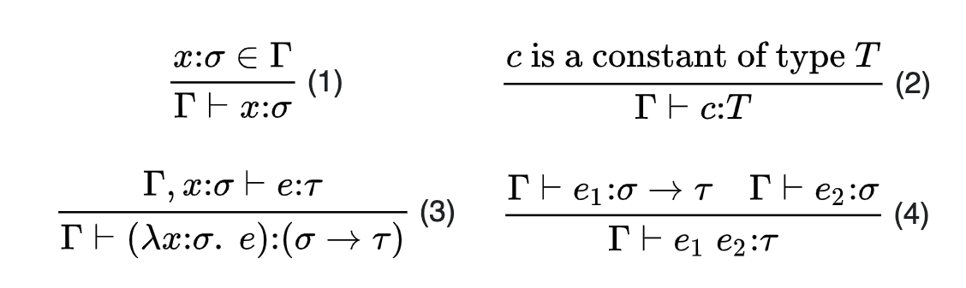
The Simply-Typed Lambda Calculus (STLC)
Let's develop a generic framework for working with de Bruijn indices, starting from a simple example
https://en.wikipedia.org/wiki/Simply_typed_lambda_calculus

Slide 6
Abstract Syntax of STLC
data Ty = IntTy | Ty :-> Ty
data Exp where
IntE :: Int -> Exp -- constant int, like "3"
VarE :: Idx -> Exp -- de Bruijn index (nat)
LamE :: Ty -> Exp -> Exp -- "\(x::ty) -> e"
AppE :: Exp -> Exp -> Exp -- "e1 e2"
Simple.hs

Slide 7
Abstract Syntax Examples
\(x :: Int -> Int) -> x 3
LamE (IntTy :-> IntTy) (AppE (VarE 0) (IntE 3))
\(x :: Int) -> \(y :: IntTy) -> x
LamE IntTy (LamE IntTy (VarE 1))
\(x :: t1) -> (\(y :: t2) -> x y) x
LamE t1 (AppE (LamE t2 (AppE (VarE 1) (VarE 0))) (VarE 0)

Slide 8
Small-step reduction, closed terms
step :: Exp -> Maybe Exp
step (IntE x) = Nothing
step (VarE n) = error "Unbound Variable"
step (LamE t e) = Nothing
step (AppE e1 e2) = Just $ stepApp e1 e2 where
stepApp :: Exp -> Exp -> Exp
stepApp (IntE x) e2 = error "Type error"
stepApp (VarE n) e2 = error "Unbound variable"
stepApp (LamE t e1) e2 = ???? – do a beta redex
stepApp (AppE e1' e2') e2 = AppE (stepApp e1' e2') e2
Simple.hs

Slide 9
Beta-reduction w/ de Bruijn indices
stepApp (LamE t e1) e2 = ???? -- substitute e2 into e1
Simple case: no binders in e1
… replace occurrences of "Var 0" with e2
… if e1 is not closed, decrement all other variables (we've removed a binder)
Towards generality: what if we need to traverse under a binder?
…replace occurrences of "Var 1" under the binder with e2
…if e1 is not closed, decrement variables >= 2 in e1, but leave 0 alone
…if e2 is not closed, increment free variables in e2 by 1

Slide 10
Beta-reduction w/ de Bruijn indices
stepApp (LamE t e1) e2 = ???? -- substitute e2 into e1
Simple case: no binders in e1
… replace occurrences of "Var 0" with e2
… if e1 is not closed, decrement all other variables (we've removed a binder)
Towards generality: what if we need to traverse under n binders?
…replace occurrences of "Var n" under the binder with e2
…if e1 is not closed, decrement variables >= n+1 in e1, but leave 0..n-1 alone
…if e2 is not closed, increment free variables in e2 by n
Notes:
When things get scary, let's just close our eyes. We can ignore the details.

Slide 11
Abstract substitutions
Substitution affects multiple indices, so view as a function from indices to expressions
type Idx -- index type, like Nat
type Sub -- abstract type, like "Idx -> Exp"
applySub :: Sub -> Idx -> Exp
-- apply substitution to index
lift :: Sub -> Sub
-- increase the binding level

Slide 12
Interface for substitution
type Idx
type Sub -- abstract t
applySub :: Sub -> Idx -> Exp -- use with index
lift :: Sub -> Sub -- go under binder
subst :: Sub -> Exp -> Exp
subst s (IntE x) = IntE x
subst s (VarE x) = applySub s x
subst s (LamE ty e) = LamE ty (subst (lift s) e)
subst s (AppE e1 e2) = AppE (subst s e1) (subst s e2)

Slide 13
Generic Interface for substitution
type Idx
type Sub a -- generalize AST type
class SubstDB a where
var :: Idx -> a -- var constructor
subst :: Sub a -> a -> a -- AST traversal
applySub :: SubstDB a => Sub a -> Idx -> a
lift :: SubstDB a => Sub a -> Sub a
singleSub :: a -> Sub a -- create a substitution
Subst.hs

Slide 14
Using the library
import Subst
instance SubstDB Exp where
var = VarE
subst s (IntE x) = IntE x
subst s (VarE x) = applySub s x
subst s (LamE ty e) = LamE ty (subst (lift s) e)
subst s (AppE e1 e2) = AppE (subst s e1) (subst s e2)
Simple.hs

Slide 15
Small-step reduction, closed terms
step :: Exp -> Maybe Exp
step (IntE x) = Nothing
step (VarE n) = error "Unbound Variable"
step (LamE t e) = Nothing
step (AppE e1 e2) = Just $ stepApp e1 e2 where
stepApp :: Exp -> Exp -> Exp
stepApp (IntE x) e2 = error "Type error"
stepApp (VarE n) e2 = error "Unbound variable"
stepApp (LamE t e1) e2 = subst (singleSub e2) e1
stepApp (AppE e1' e2') e2 = AppE (stepApp e1' e2') e2
Simple.hs

Slide 16
A strongly-typed AST
Use types to rule out errors

Slide 17
Strongly-typed AST for STLC
The "typing context" nth Ty in list is type of nth bound variable
data Ty = IntTy | Ty :-> Ty
data Exp :: [Ty] -> Ty -> Type where
IntE :: Int -> Exp g IntTy
VarE :: Idx g t -> Exp g t
LamE :: Sing (t1 :: Ty) -> Exp (t1:g) t2
-> Exp g (t1 :-> t2)
AppE :: Exp g (t1 :-> t2) -> Exp g t1
-> Exp g t2
Index selects a type from the context (& must be in range)
Add a new type to the context in the body of the lambda (via cons)
I'll come back to this
SimpleTyped.hs

Slide 18
Small-step reduction, closed terms
step :: Exp '[] t -> Maybe (Exp '[] t)
step (IntE x) = Nothing
step (VarE n) = case n of {} -- impossible
step (LamE t e) = Nothing
step (AppE e1 e2) = Just $ stepApp e1 e2 where
stepApp :: Exp '[] (t1 :-> t2) -> Exp '[] t1 -> Exp '[] t2
-- stepApp (IntE x) e2 = error "Type error"
stepApp (VarE n) e2 = case n of {} -- impossible
stepApp (LamE t e1) e2 = subst (singleSub e2) e1
stepApp (AppE e1' e2') e2 = AppE (stepApp e1' e2') e2
SimpleTyped.hs

Slide 19
TYPED substitution library
-- A reference to a specific type in the list
data Idx (g :: [Ty]) (t::Ty) :: Type where
Z :: Idx (t:g) t
S :: Idx g t -> Idx (u:g) t
-- Substitution applies to indices in g1
-- and produces terms in g2
type Sub (g1 :: [Ty]) (g2 :: [Ty])
applySub :: Sub g1 g2 -> Idx g1 t -> Exp g2 t
subst :: Sub g1 g2 -> Exp g1 t -> Exp g2 t
SubstTyped.hs

Slide 20
Generic typed substitution library
type Sub (a::[k]->k->Type) (g1 :: [k]) (g2 :: [k])
class SubstDB (a :: [k] -> k -> Type) where
var :: Idx g t -> a g t
subst :: Sub a g1 g2 -> a g1 t -> a g2 t
singleSub :: a g t -> Sub a (t:g) g
Subst.hs

Slide 21
Generic interface for substitution
Same code as before, only the types change
instance SubstDB Exp where
var :: Idx g t -> Exp g t
var = VarE
subst :: Sub Exp g1 g2 -> Exp g1 t -> Exp g2 t
subst s (IntE x) = IntE x
subst s (VarE x) = applySub s x
subst s (LamE ty e) = LamE ty (subst (lift s) e)
subst s (AppE e1 e2) = AppE (subst s e1) (subst s e2)
SubstTyped.hs

Slide 22
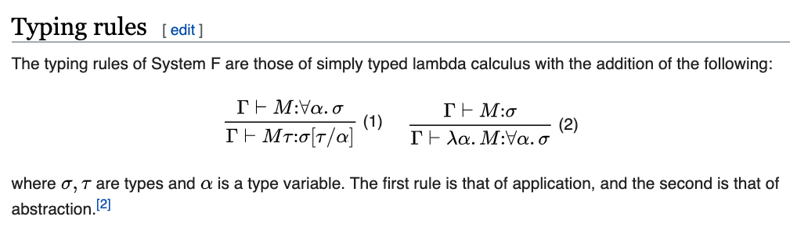
From STLC to System F
https://en.wikipedia.org/wiki/System_F

Slide 23
Strongly-typed System F
data Ty = IntTy | Ty :-> Ty | VarTy Idx | PolyTy Ty
data Exp :: [Ty] -> Ty -> Type where
IntE :: Int -> Exp g IntTy
VarE :: Idx g t -> Exp g t
LamE :: Π (t1 :: Ty) -> Exp (t1:g) t2
-> Exp g (t1 :-> t2)
AppE :: Exp g (t1 :-> t2) -> Exp g t1
-> Exp g t2
(more)
Variable index for "alpha"
Same indices as STLC: Not tracking scoping of type variables
No change to existing STLC data constructors
More constructors to come
SimpleTyped.hs

Slide 24
System F types
data Ty = IntTy | Ty :-> Ty | VarTy Idx | PolyTy Ty
instance SubstDB Ty where
var = VarTy
subst s IntTy = IntTy
subst s (t1 :-> t2) = subst s t1 :-> subst s t2
subst s (VarTy x) = applySub s x
subst s (PolyTy t) = PolyTy (subst (lift s) t)
Poly.hs

Slide 25
System F types in types
$(singletons [d|
data Ty = IntTy | Ty :-> Ty | VarTy Idx | PolyTy Ty
instance SubstDB Ty where
var = VarTy
subst s IntTy = IntTy
subst s (t1 :-> t2) = subst s t1 :-> subst s t2
subst s (VarTy x) = applySub s x
subst s (PolyTy t) = PolyTy (subst (lift s) t)
|])
Poly.hs

Slide 26
System F terms
data Ty = IntTy | Ty :-> Ty | VarTy Idx | PolyTy Ty
data Exp :: [Ty] -> Ty -> Type where
…
TyApp :: Exp g (PolyTy t1)
-> Sing (t2 :: Ty)
-> Exp g (Subst (SingleSub t2) t1)
TyLam :: Exp (IncList g) t
-> Exp g (PolyTy t)
Singleton type for Ty, via singletons library
Promoted versions of "subst" and "singleSub", via singletons library
Increment all type variables in the context (def. not shown)
PolyTyped.hs

Slide 27
Term substitution
instance SubstDB Exp where
var = VarE
subst s (IntE x) = IntE x
subst s (VarE x) = applySub s x
subst s (LamE ty e) = LamE ty (subst (lift s) e)
subst s (AppE e1 e2) = AppE (subst s e1) (subst s e2)
subst s (TyLam e) = TyLam (subst (incTy s) e)
subst s (TyApp e t) = TyApp (subst s e) t

Slide 28
Here be dragons!
substTy :: forall g s ty. Sing (s :: Sub Ty) -> Exp g ty
-> Exp (Map (Subst s) g) (Subst s ty)
substTy s (IntE x) = IntE x
… -- other cases
substTy s (TyLam (e :: Exp (IncList g) t))
= TyLam (substTy (sLift s) e) -- TYPE ERROR
-- Have: Exp (Map (Subst (Lift s)) (IncList g)) (Subst (Lift s) t)
-- TyLam :: Exp (IncList (Map (Subst s) g)) (Subst (Lift s) t)
-> Exp (Map (Subst s) g) (Subst s (PolyTy t)

Slide 29
Oops: Need a type equality
GHC cannot show two types involving "Subst" equal
Map (Subst (Lift s)) (IncList g) ~
IncList (Map (Subst s) g)
In Coq or Agda we would prove properties of substitution
Haskell is not a proof assistant, so that route is unavailable
What can we do?

Slide 30
Haskell is not a proof assistant
Get type class constraint solver to prove it?
Works for simple properties, but not here
Check the property at runtime?
Runtime cost for doing the check, runtime cost for propagating the context
Solution(?) add an "axiom" to use during type checking
Implemented by unsafeCoerce, carefully marked in a separate file
This is dangerous; an invalid axiom could cause GHC to segfault
Justify axiom via external means (Coq proofs, QuickCheck tests, etc.)
prop_axiom1 :: Sub Ty -> [Ty] -> Bool
prop_axiom1 s g = map (subst (lift s)) (incList g) == incList (map (subst s) g)

Slide 31
Conclusions
Can implement substitution via de Bruijn indices in a generic way, simplifying development
Singletons is an impressive tool for type-level programming, especially with promoted type classes
But, Strongly-typed System F demonstrates the limit of what we can do in Dependent Haskell without extending the built-in proof theory

Slide 32
References

Slide 33
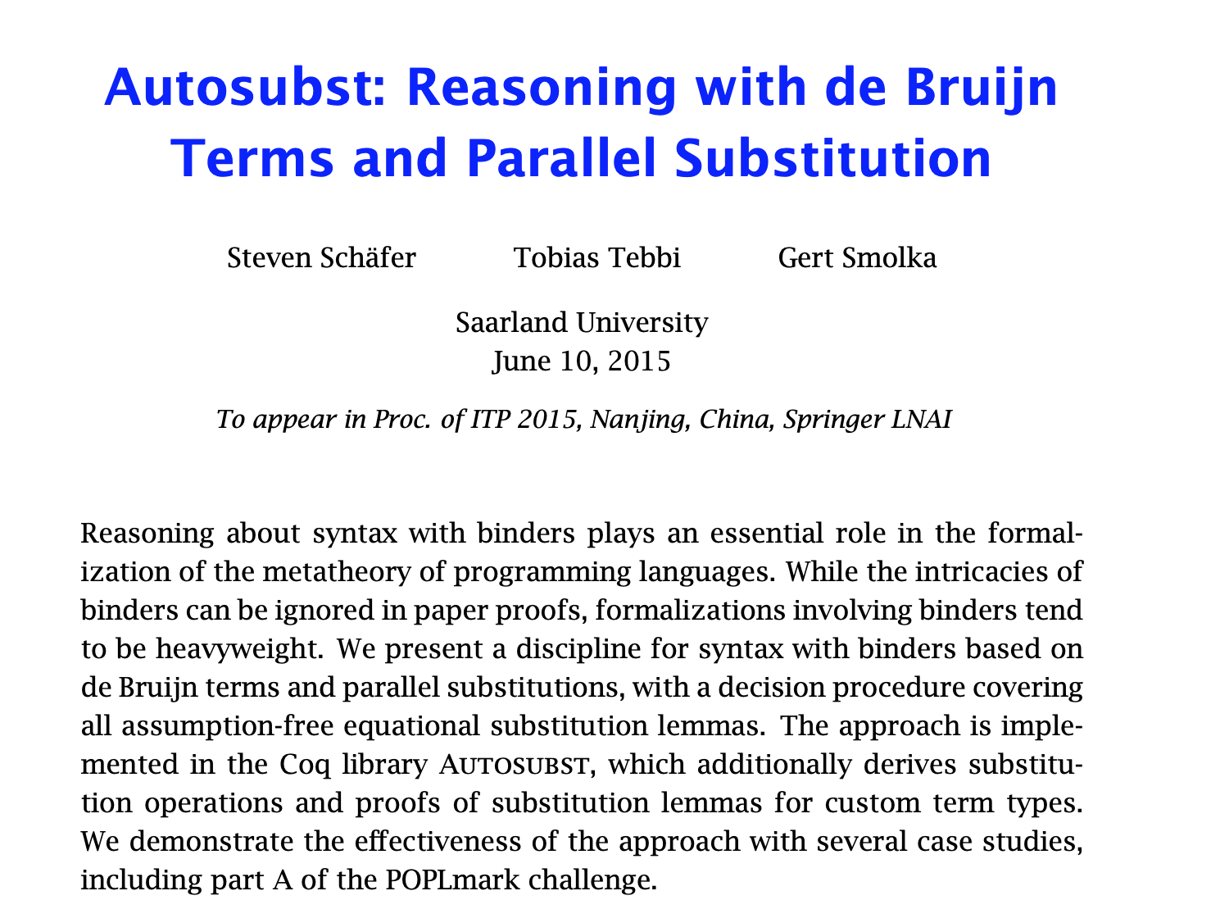

Slide 34
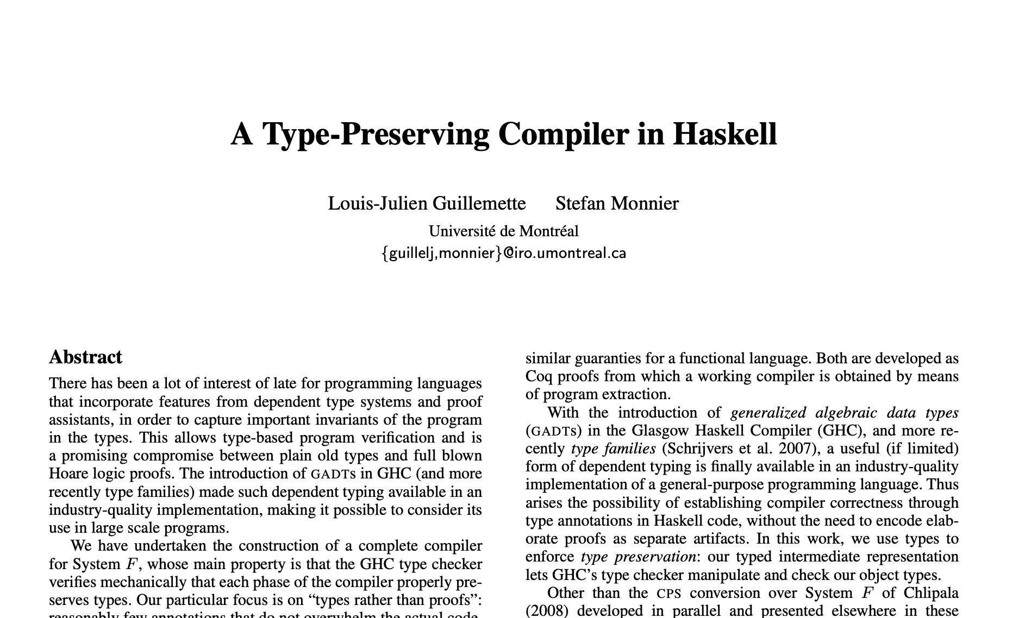
Strongly-typed System F in Haskell
ICFP 2008

Slide 35
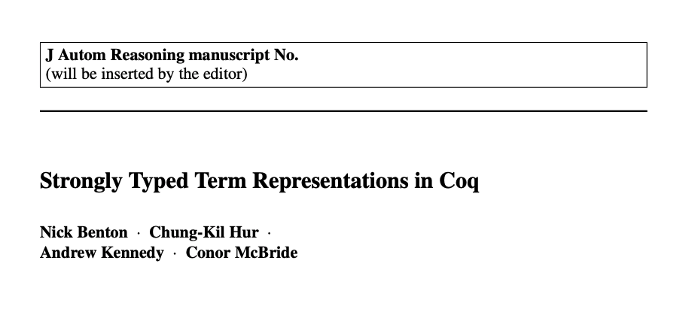
Strongly-typed System F in Coq
JAR August 2012, Volume 49, Issue 2, pp 141-159

