Slide 1
Digital-Twin Based Bus Line Timetable Scheduling Problem
This part by Andrea (李照)

Slide 2
Overview
Abstract of project.
Architecture improvement.
Changes in G-Tree.
Issue and solutions.
Use route to generate time schedule.
Use directed edges.
Analysis of the result.

Slide 3
Abstract of Project
Use Cargo to simulate bus line running to generate the bus line timetable schedule.
Why use simulator?
Test algorithm in simulation environment to save time and money.
Students’ behavior may change, in order to design new algorithms.
Open to expand. Generate dynamic time schedule.
Test human control with algorithm, and measure effects.
Compare different algorithms, find the better one.
Train an heuristic algorithm, use simulator to adjust parameters.

Slide 4
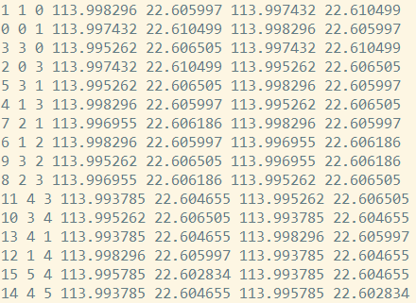

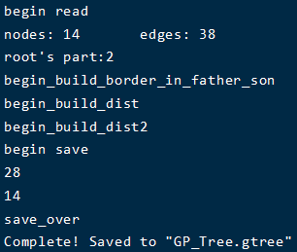
Architecture Improvement
The issue: how to make the route static?
The G-Tree builder in Cargo doesn’t support directed graph.
Modify G-Tree builder and .edges .rnet files to add penalty.

Slide 5
Issue and Solutions
Big issue: RSP isn’t equal to BSP!
RSP uses algorithm to generate route, instead of arranging time.
BSP’s route is static, the problem is to arrange time.
Two solutions:
Use route to generate time schedule.
Use directed edges to make the route static.

Slide 6
Solution – Use Route to Generate Schedule
From the result, we can know where the bus is at specific time.
Inversely, for a specific time and station, we can know whether there needs a bus!
If we can design algorithm to arrange time schedule, make the station s at time t has n buses, we can solve this issue.

Slide 7
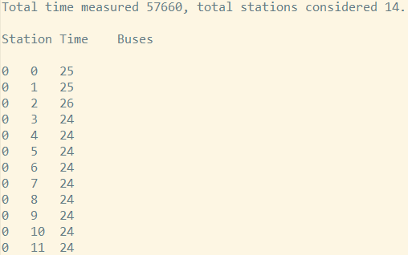
Solution – Use Route to Generate Schedule
But this solution is difficult:
The algorithm should make sure the route is static, and make sure the arrangement should be correct.
The solution adds bias to the simulation.
We don’t know the direction of bus.

Slide 8
标题和包含图表的内容布局

Slide 9
包含表格的两栏内容布局
此处是第一个项目要点
此处是第二个项目要点
此处是第三个项目要点
类 | 组 1 | 组 2
类 1 | 82 | 95
类 2 | 76 | 88
类 3 | 84 | 90

Slide 10
标题和包含 SmartArt 的内容布局
步骤 1 标题
任务描述
步骤 2 标题
任务描述
步骤 3 标题
任务描述

Slide 11
添加幻灯片标题 - 1

Slide 12
添加幻灯片标题 - 2

Slide 13
添加幻灯片标题 - 3

Slide 15
添加幻灯片标题 - 4

Slide 16
添加幻灯片标题 - 5

