Slide 1
Digital-Twin Based Bus Line Timetable Scheduling Problem
This part by Andrea (李照)

Slide 2
Overview
Abstract of project.
Architecture improvement.
Changes in G-Tree.
Issue and solutions.
Use route to generate time schedule.
Use directed edges.
Analysis of the result.

Slide 3
Abstract of Project
Use Cargo to simulate bus line running to generate the bus line timetable schedule.
Why use simulator?
Test algorithm in simulation environment to save time and money.
Students’ behavior may change, in order to design new algorithms.
Open to expand. Generate dynamic time schedule.
Test human control with algorithm, and measure effects.
Compare different algorithms, find the better one.
Train an heuristic algorithm, use simulator to adjust parameters.

Slide 4
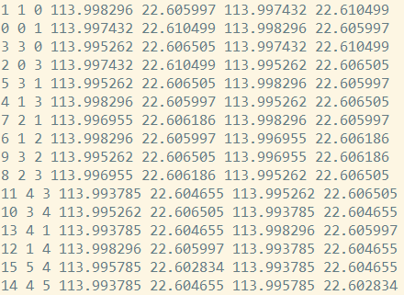

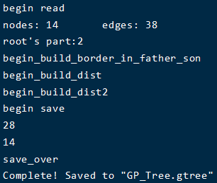
Architecture Improvement
The issue: how to make the route static?
The G-Tree builder in Cargo doesn’t support directed graph.
Modify G-Tree builder and .edges .rnet files to add penalty.

Slide 5
Issue and Solutions
Big issue: RSP isn’t equal to BSP!
RSP uses algorithm to generate route, instead of arranging time.
BSP’s route is static, the problem is to arrange time.
Two solutions:
Use route to generate time schedule.
Use directed edges to make the route static.

Slide 6
Solution – Use Route to Generate Schedule
From the result, we can know where the bus is at specific time.
Inversely, for a specific time and station, we can know whether there needs a bus!
If we can design algorithm to arrange time schedule, make the station s at time t has n buses, we can solve this issue.

Slide 7
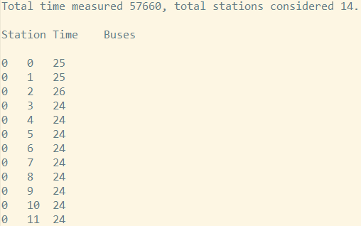
Solution – Use Route to Generate Schedule
But this solution is difficult:
The algorithm should make sure the route is static, and make sure the arrangement should be correct.
The solution adds bias to the simulation.
We don’t know the direction of bus.

Slide 8
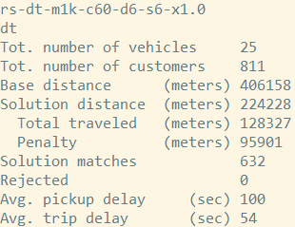
Solution – Directed Edges
After modified the map files and G-Tree builder, we can use directed edges to add penalty.
The bus shouldn’t go back, otherwise the penalty would be very large.
Define different edges and rnet to represent different bus lines.
The problem solved, and we got expected result!
This result is from bilateral_arrangement algorithm.

Slide 9
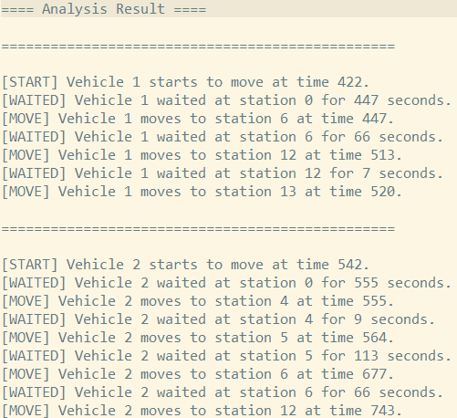
Solution – Directed Edges
We then use this result to do analysis.
Start is the initialized time of bus.
Waited means the waiting time at station.
Move means the vehicle goes to next stop.

Slide 10
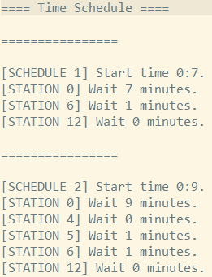
Solution – Directed Edges
Finally, we can use this analysis to generate time schedule.
For each bus departure, we arrange a time schedule.
We don’t need 25 buses, but only 25 departures.
Start time from 0:0, because simulation starts at 0:0.
In realistic situation, change the simulation initial time.
If wait at some station, then stop here for a few minutes.
Wait time 0 means don’t wait, pick and just leave.
For not presented stations, means no students here waiting for picking up.

Slide 11
Analysis of Result
The most match rate: grabby, 86.7% picked up.
The least waiting time: nearest_neighbor, 64 seconds delay.
The least delay time: grasp16, 34 seconds delay.
For 811 students in simulation for 1 hour and 57 seconds, only 25 departures of buses can pick up 86.7% students.

