Slide 1
Digital Twin for Logistics / Transport Optimization
Problem Definition & Model Architecture by Andrea

Slide 2
Abstract: What We Are Doing
To solve the problem in school bus: current time arrangement doesn’t work well.
Outline of project:
- Problem definition
- Digital-twin based architecture
- Data collection and simulation
- Algorithm to arrange schedule
- Architecture: simulator, database, algorithm
- Cargo test and result present

Slide 3
Problem Definition
Previous definition: ridesharing problem, uses simulation to arrange route. In bus situation, the route is constant while time arrangement is dynamic: use simulation to arrange time schedule.
This is a bus line timetable setting problem (BLTSP) instead of RSP.
But they have a lot of commons, so we can still use RSP model with penalty algorithm to make route fix.
J. Pan, G. Li and J. Hu, "Ridesharing", Proceedings of the VLDB Endowment, vol. 12, no. 10, pp. 1085-1098, 2019. Available: 10.14778/3339490.3339493.

Slide 4
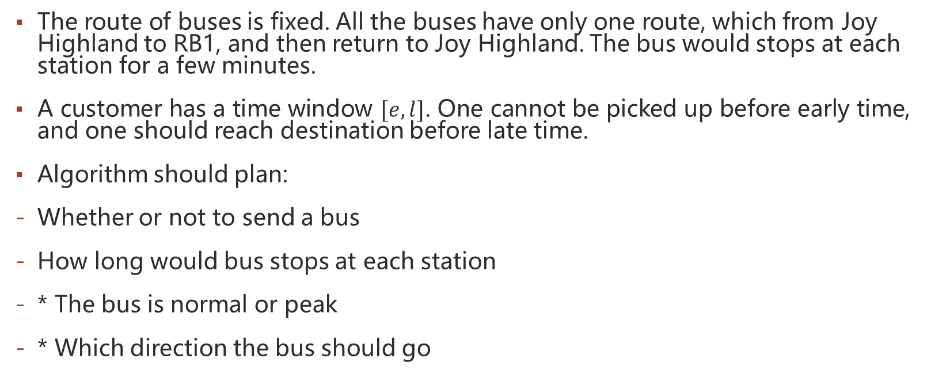
Problem Definition: BLTSP
The route of buses is fixed. All the buses have only one route, which from Joy Highland to RB1, and then return to Joy Highland. The bus would stops at each station for a few minutes.
A customer has a time window $[e, l]$. One cannot be picked up before early time, and one should reach destination before late time.
Algorithm should plan:
Whether or not to send a bus
How long would bus stops at each station
* The bus is normal or peak
* Which direction the bus should go

Slide 5
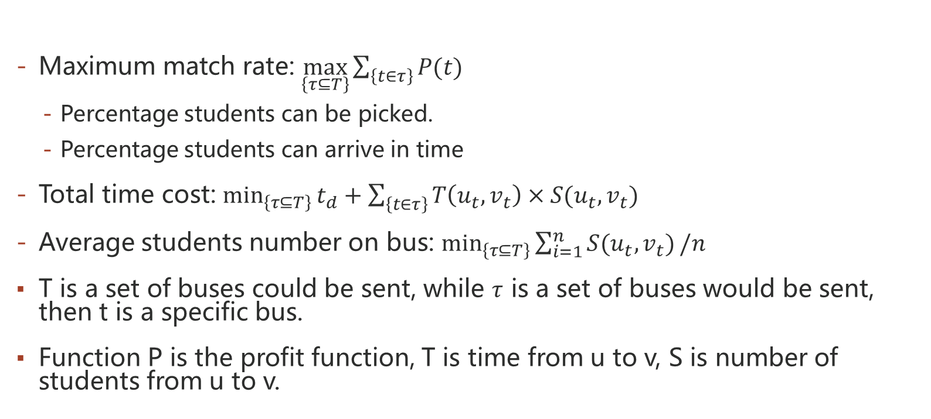
Optimization Goals
Maximum match rate: $\max_{\left\{τ⊆T\right\}}\sum_{\left\{t∈τ\right\}}{P(t)}$
Percentage students can be picked.
Percentage students can arrive in time
Total time cost: $\min_{\left\{τ⊆T\right\}}{t_{d}+\sum_{\left\{t∈τ\right\}}{T\left(u_{t},v_{t}\right)×S(u_{t},v_{t})}}$
Average students number on bus: $\min_{\left\{τ⊆T\right\}}{\sum_{i=1}^{n}{S(u_{t},v_{t})}/n}$
T is a set of buses could be sent, while $τ$ is a set of buses would be sent, then t is a specific bus.
Function P is the profit function, T is time from u to v, S is number of students from u to v.

Slide 6
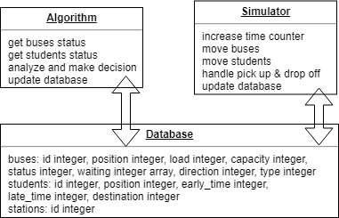
Digital-twin Based Architecture
Three parts of architecture: algorithm, simulator, and database.
Algorithm and simulator can communicate through in-memory database.

Slide 7
Details of Database
Position: the id of station, but how can we know whether the bus is at station of just left the station? Use status of bus.
Load is current students on bus, while capacity is the upper limit of load.
Status: -1means bus doesn’t work now, 0 means running on the way (just left the bus station), 1 means at station and waiting.
Waiting: integer array, stores waiting time at each station, unit in second.
Direction: 0 means from Joy Highland to RB1, 1 means from RB1 to Joy Highland.
Type: 0 means normal, 1 means peak.

Slide 8
Architecture: Algorithm
The message algorithm could know:
Current buses status
How many students are waiting at each station
Course schedule to predict in-coming students and destinations, etc.
The message algorithm could not know:
Exact destination of students
Time window of students

Slide 9
Architecture: Simulator
Simulator and algorithm are running in parallel by multi-thread, so they can run well on distributed systems.
Synchronization of data: use database transaction isolation, repeatable read would be enough for our design.
Pseudo code of Simulator:
initial & read input / write data to database
loop:
start simulator threads
wait all tasks finish
write result to file

Slide 10
Architecture: Database
Use in-memory database to speedup simulation.
Use transaction isolation to synchronize data.

Slide 11
Summary
We already finish:
Collect and simulate with read data from school bus.
Run Cargo [VLDB2019] system and get result of simulation (PLAN A).
Finish the database design (PLAN B).
Future schedule:
Design more algorithms to arrange schedule (PLAN A).
Build up a new simulation platform (PLAN B).

