Slide 1
Penetration Testing

Slide 2
Environment Settings
Chapter 1

Slide 3
Server
External VPS server: hide from detection.
VPS security settings:
IPtables
Terraform/Red Baron

Slide 4
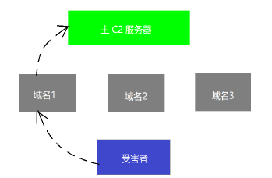
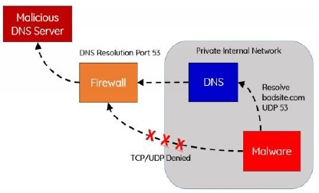
Key Toolkit
Metasploit
Cobalt Strike
Powershell Empire
dnscat2: dns encrypted tunnel.

Slide 5
Key Toolkit
p0wnedShell: attacking PowerShell.
Pupy Shell: remote manage and post-penetration.
PoshC2: red team co-operation.
Merlin: HTTP/2 framework like Empire.
Nishang: script and payload collection.
http://thehackerplaybook.com/get.php

Slide 6
Information Gathering
Chapter 2

Slide 7
Environment Audit
Network structure and diff.
HTTPScreenshot: Web application audit.
Shodan: network service to scan vulnerabilities.
Censys.io: auditing network services.
KNOCK: subdomain scan.
Sublist3r: directory free subdomain scan.
Github / Git Leaks: source code leak.
Bucket Finder: bucket leak utility.

Slide 8
Environment Audit
tko-subs: subdomain hijack.
HostileSubBruteforcer
autoSubTakeover
SimplyEmail: email address scan.

Slide 9
Email
1.4 亿密码泄露（2017年）： https://thehackernews.com/2017/12/data-breach-password-list.html
Adobe 信息泄露（2013年）： https://nakedsecurity.sophos.com/2013/11/04/anatomy-of-a-password-dis
aster-adobes-giant-sized-cryptographic-blunder/
Pastebin Dumps： http://psbdmp.ws/
Exploit.In Dump

Slide 10
OSINT
OSINT 链接合集: https://github.com/IVMachiavelli/OSINT_Team_Links
OSINT 框架: http://osintframework.com/

Slide 11
Web Application Exploiting
Chapter 3

Slide 12
SRC / Vulnerability Bounty
HackerOne
BugCrowd
SynAck
Company (eBay) Vulnerability Bounty
PoC is limited

Slide 13
Web Application Exploiting
Browser: firefox / chrome / safari
Wappalyzer: web module analysis
Builtwith: web analysis
Retire.JS: vulnerable JavaScript scan
Burp Suite: web packet analysis

Slide 14
Network Scan
Burp Suite: spider and audit.
OWASP ZAP: Burp like (free).
Dirbuster: web directory / file scan.
Gobuster: light weight Dirbuster like.
Wordlist: https://github.com/danielmiessler/SecLists/tree/master/Discovery/Web-Content

Slide 15
XSS
User update data concatenate to HTML script.
XSS can:
Steal Cookies
Force user download.
Redirect user.
XSS obfuscation:
https://github.com/foospidy/payloads/tree/master/other/xss
https://www.owasp.org/index.php/XSS_Filter_Evasion_Cheat_Sheet
BeEF: browser vulnerability exploiting.

Slide 16
XSS
Blind XSS:
XSS Hunter
DOM based XSS:
Use comment / review to post XSS.
XSS is stored in server.
From XSS to shell:
https://github.com/Varbaek/xsser

Slide 17
NoSQL Injection
NoSQL database: Couch / MongoDB.
https://github.com/swisskyrepo/PayloadsAllTheThings/tree/master/NoSQL%20Injection
https://blog.websecurify.com/2014/08/hacking-nodejs-andmongodb.html
https://www.owasp.org/index.php/Testing_for_NoSQL_injection

Slide 18
Deserialization Vulnerability
NodeJS: https://cve.mitre.org/cgi-bin/cvename.cgi?name=CVE-2017-5941
{"thp":"_$$ND_FUNC$$_function(){require('child_process').exec('DO SYSTEM COMMANDS HERE’, function(error, stdout, stderr) {console.log(stdout)});}"}
https://opsecx.com/index.php/2017/02/08/exploiting-node-js-deserialization-bug-for-remote-code-execution/
https://github.com/luin/serialize
https://snyk.io/test/npm/node-serialize?severity=high&severity=medium&severity=low
https://blog.websecurify.com/2017/02/hacking-node-serialize.html

Slide 19
Template Injection
{{value}} type template is initialized with user parameters.
{{2*2}} is calculated by server.
http://blog.portswigger.net/2015/08/server-side-template-injection.html
https://hawkinsecurity.com/2017/12/13/rce-via-spring-engine-ssti/

Slide 20
JavaScript & RCE
Remote Code Execution: webshell
Use reverse shell to get a shell.
nc –lvnp 8888

Slide 21
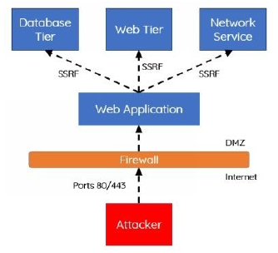
SSRF
Server side request post.

Slide 22
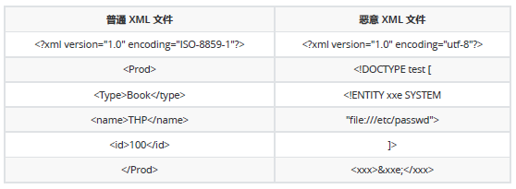
XXE
XXE: XML External Entity
XXE-OOB: use DTD file to define XML entity.
https://gist.github.com/staaldraad/01415b990939494879b4
https://github.com/danielmiessler/SecLists/blob/master/Fuzzing/XXE-Fuzzing.txt

Slide 23
Network Attack
Chapter 4

Slide 24
Attacking a System
Access session scan: password spray attack.
Spray: spray.sh
http://bit.ly/2EJve6N
Ruler: additional process
https://github.com/sensepost/ruler
Gain permission in intranet.
Responder: https://github.com/lgandx/Responder
MultiRelay: http://g-laurent.blogspot.com/2016/10/introducing-responder-multiray-10.html
Kerberos: burst intranet password.

Slide 25
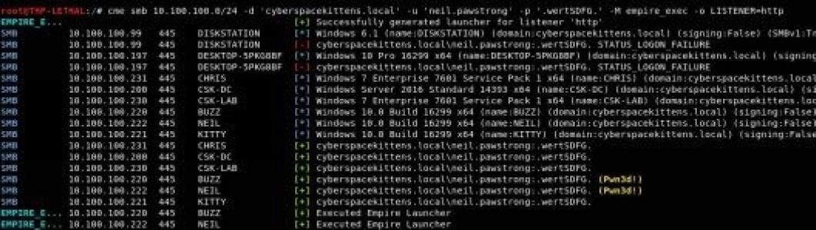
CME Scan
CrackMapExec scan intranet for access point.
RTFM: collect server information.

Slide 26
Privilege Escalation
http://insecure.org/search.html?q=privilege%20escalation
https://bugs.chromium.org/p/project-zero/issues/list?can=1&q=escalation&colspec=ID+Type+Status+Priority+Milestone+Owner+Summary&cells=ids
linpeas.sh
Check privilege escalation and other vulnerabilities.

Slide 27
Windows Information Gathering
Windows network credential:
https://github.com/samratashok/nishang/blob/master/Gather/Get-WebCredentials.ps1
Collect Windows credential:
https://github.com/peewpw/Invoke-WCMDump/blob/master/Invoke-WCMDump.ps1
Collect cookies:
https://github.com/sekirkity/browsergather
Remote server password:
https://github.com/fireeye/SessionGopher

Slide 28
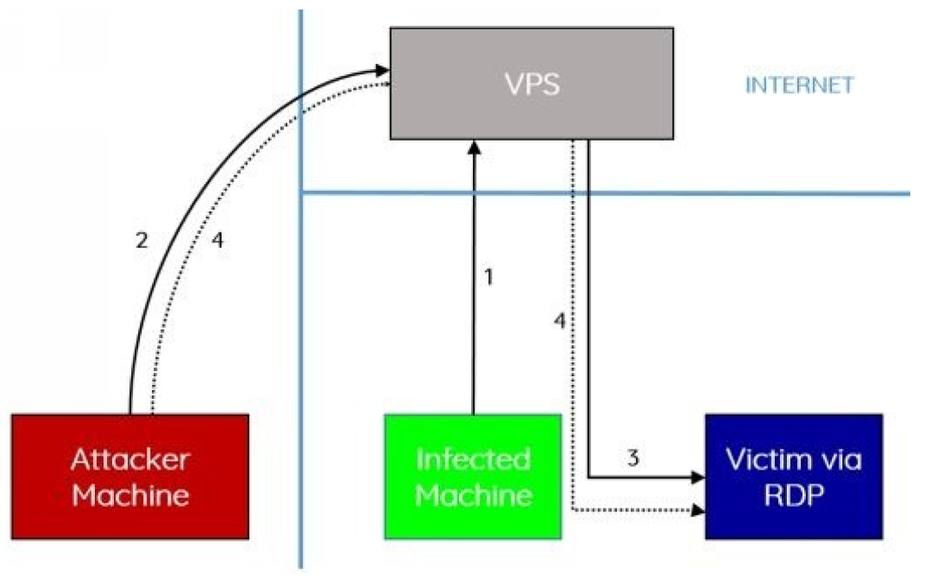
Intranet Access
Gain access to different host in intranet.
Dump linux process:
https://github.com/huntergregal/mimipenguin

Slide 29
Intranet Access
Linux establish tunnel:
https://artkond.com/2017/03/23/pivoting-guide/#vpn-over-ssh
Linux vulnerability audit:
https://github.com/rebootuser/linenum
Yet another Linux vulnerability scan tool:
https://github.com/mzet-/linux-exploit-suggester

Slide 30
Other Attacking Methods
Chapter 5

Slide 31
Social Engineering
Doppelganger Domain
Phishing: PDF / PPT / DOC macro script
Supply chain attack

Slide 32

Physical Attack

Slide 33
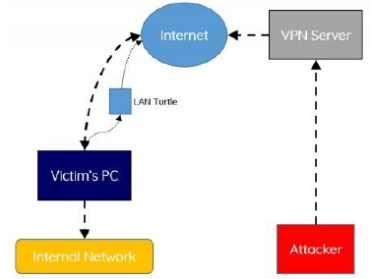
Physical Attack
ID card copy: proxmark3
http://hackerwarehouse.com/product/proxmark3-rdv2-kit/
Lock picks
LAN turtle: https://shop.hak5.org/products/lan-turtle

Slide 34
Physical Attack
QuickCreds: https://www.youtube.com/watch?v=Aatp5gCskvk
Fake WiFi: https://www.wifipineapple.com/pages/nano
Bash Bunny: https://bashbunny.com/downloads
Bunny Tap: https://www.youtube.com/watch?v=Aatp5gCskvk

Slide 35
Reference
The Hacker Playbook
Other links in PPT

