Slide 1
Sea Turtle Threat Intelligence Report
Prepared by: Onaopemipo David Olugbemiro
Date: October 2025

Slide 2
Executive Summary
This report documents the investigation of the Sea Turtle threat actor group based on data extracted from the MISP threat intelligence platform. Sea Turtle, a Turkish-linked espionage group, has conducted multiple DNS hijacking and credential theft operations against government and critical infrastructure targets in Europe. By analyzing Indicators of Compromise (IOCs) and mapping them to MITRE ATT&CK, this report reveals how Sea Turtle leverages VPN-based access, malicious C2 servers, and rented hosting infrastructure to mask its operations. The findings provide actionable recommendations to improve detection, mitigation, and defense strategies for National CERT and partner organizations.

Slide 3

Project Objective
This report provides an in-depth analysis of a sophisticated espionage group known as Sea Turtle, also referred to as Teal Kurma or Marbled Dust. This threat actor has been active since at least 2017 and has primarily targeted governmental, telecommunications, and critical infrastructure organizations across Europe and the Middle East. The group is associated with state-sponsored campaigns focused on credential theft, DNS hijacking, and persistent access to registrar systems.
This report documents the investigation process using real-world intelligence feeds obtained from the MISP platform, which helped identify Indicators of Compromise (IOCs), attack infrastructure, and mapped observed behaviors to the MITRE ATT&CK framework. The intelligence gathered provides actionable recommendations for defensive measures that can be adopted by National CERTs.
The main objective of this project is to investigate the Sea Turtle threat actor using threat intelligence data extracted from MISP. The analysis aims to uncover their attack infrastructure, identify key indicators of compromise, and align their tactics, techniques, and procedures (TTPs) with the MITRE ATT&CK framework. The goal is to produce a comprehensive threat profile that supports early detection and mitigation of potential Sea Turtle activities.

Slide 4
Investigation method
To gather essential intelligence on the threat actor group, the cybersecurity threat intelligence team used Docker Compose to deploy live threat feeds from MISP in a containerized environment on Kali Linux. The active feeds and event lists in MISP provided unique UUIDs linked to each threat actor, offering detailed information needed to profile their tactics, infrastructure, and possible involvement in specific attacks. This setup allowed the team to analyze and attribute threat activities using real-time intelligence.
Additionally, the MISP event feed data was cross-referenced with the MITRE ATT&CK framework to uncover deeper insights into the Sea Turtle threat actor's tactics, techniques, and procedures (TTPs). Furthermore, research reports from Cisco Talos provided critical details vital for detecting, containing, and neutralizing these threats.

Slide 5
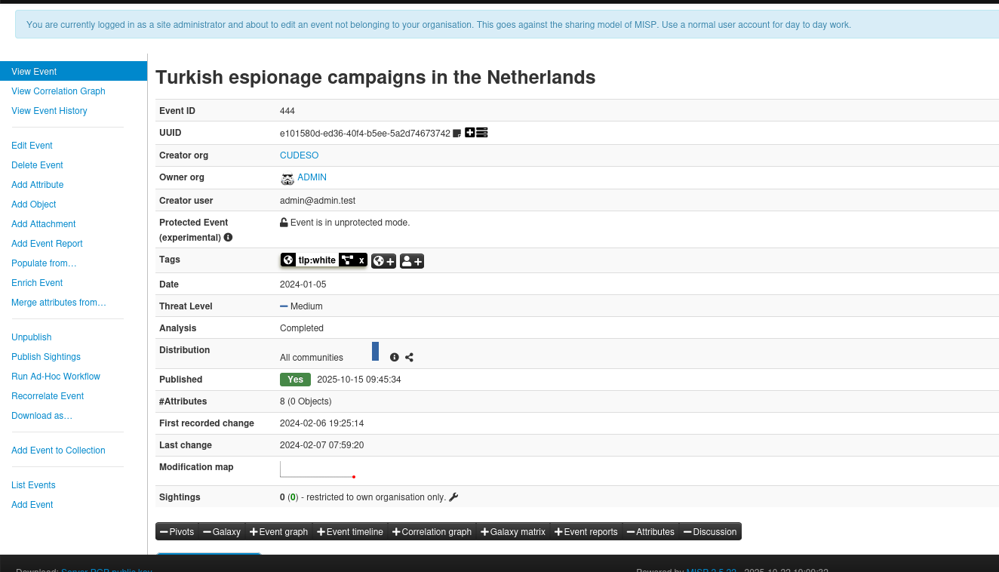
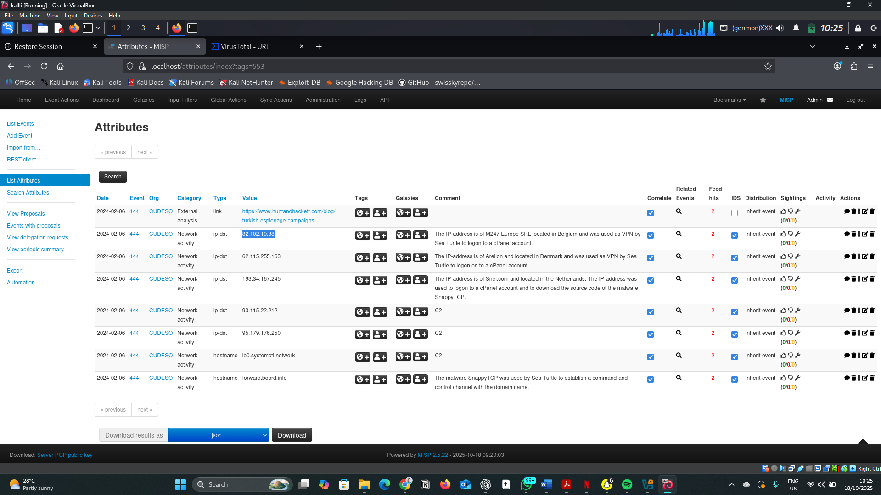
Key Findings
Sea Turtle relies on commercial VPN & hosting providers (M247, Arelion, Vultr, Snel.com).
Infrastructure mainly located in Belgium, Denmark, Netherlands, and Germany.
Uses SnappyTCP malware for Command & Control (C2) communication.
Conducts DNS hijacking for credential theft from registrar accounts.
Notes:
By using commercial hosting infrastructure, Sea Turtle blends its operations with legitimate traffic, making detection harder.

Slide 6
Indicators of Compromise (IOCs)
Type (IOCs) | Hosting/ Location | Description(confidence)
82.102.19.88 | M247 Europe SRL (Belgium) | VPN login infrastructure (Medium)
193.34.167.245 | Snel.com BV (Netherlands) | Malware host (High)
95.179.176.250 | Vultr Holdings (Netherlands) | C2 server (High).
forward.boord.info | Cloudflare (US) | SnappyTCP C2 domain (High).
62.115.255.163 | Arelion Sweden AB (Denmark) | Carrier VPN; reused in multiple campaigns (Medium)
93.115.22.212 | MVPS LTD (Netherlands) | Explicitly tagged C2 server (High)
lo0.systemctl.network | Localhost (artifact) | Likely decoy or beacon string in malware

Slide 7
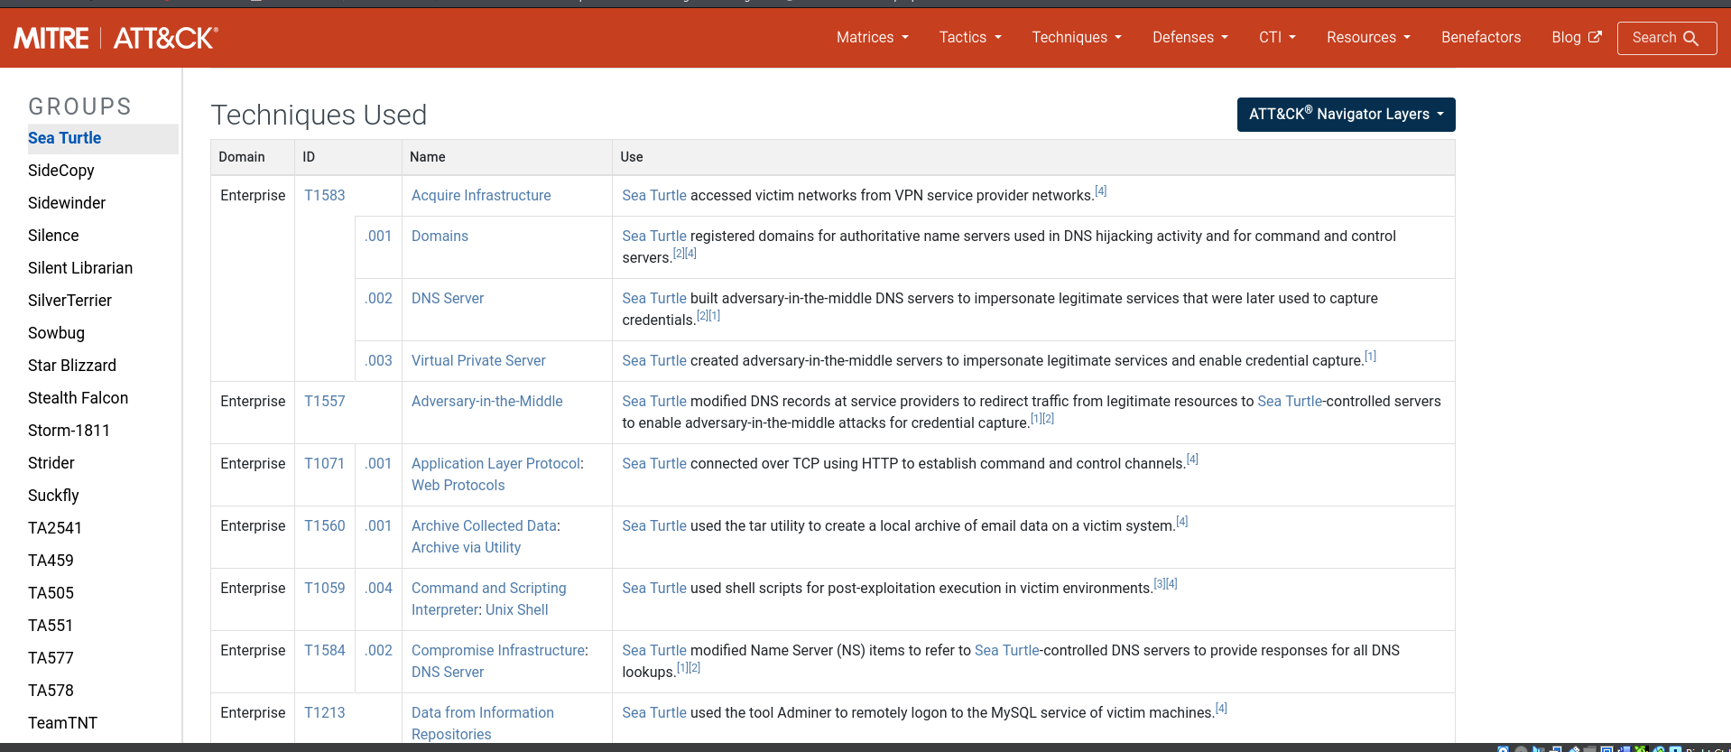
MITRE ATT&CK Mapping
Initial Access: Valid Accounts (T1078).
Command & Control: Application Layer Protocol: Web (T1071.001).
Persistence: Modify Authentication Process (T1556).
Defense Evasion: Use of Commercial Hosting (T1583.003).
Impact: DNS Hijack / Defacement (T1565.002).

Slide 8
Mitigations & Recommendations
Enable registry lock and DNSSEC for domains.
Enforce Multi-Factor Authentication (MFA) on registrar accounts.
Block IOCs (IPs/domains) through firewall and IDS rules.
Integrate MISP & VirusTotal threat feeds for continuous monitoring.
Monitor DNS record and SSL certificate changes regularly.

Slide 9
Conclusion
Sea Turtle remains a persistent espionage threat using DNS hijacking and credential theft.
Abuse of commercial hosting conceals its infrastructure.
Strong identity controls and DNS integrity checks are vital defenses.
CERT collaboration and threat intelligence sharing improve resilience.

