Slide 1
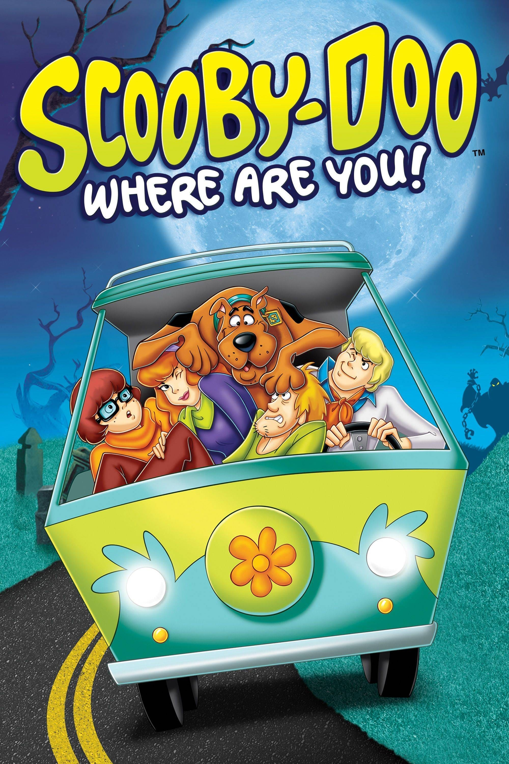
Mini Game Project: Scooby-Doo Mystery Maze
Designed & Developed
By
Lyubomira Dimitrova

Slide 2
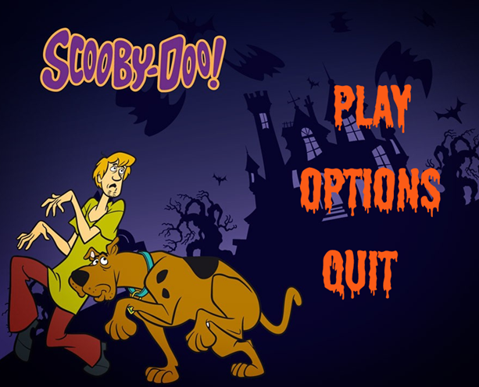
Menu Design and Audio Integration
The menu design effectively makes use of the brand's resources to provide players a recognizable and engaging way to start the game. The buttons for 'PLAY', 'OPTIONS', and 'QUIT' are visually appealing and easy for users due to the use of strong, theme typefaces. Nonetheless, the menu's interactive features and visual cues may be improved.

Slide 3

Sound Design
The snack collecting sound and theme music provide a nostalgic and enjoyable element to the sound design. However, this also has things to improve, such as, the volume control so it can suit player preferences, there could have been a volume control meter, so players can lower the music or sounds from the menu. Unfortunately, Scooby-Doo being an old-fashioned cartoon, its sound effects and even song are with this old style, which lowers the clarity of the sounds. Although, with the years gone by, Warner Bros improved the songs and the sound quality of the cartoon quite a lot.

Slide 4
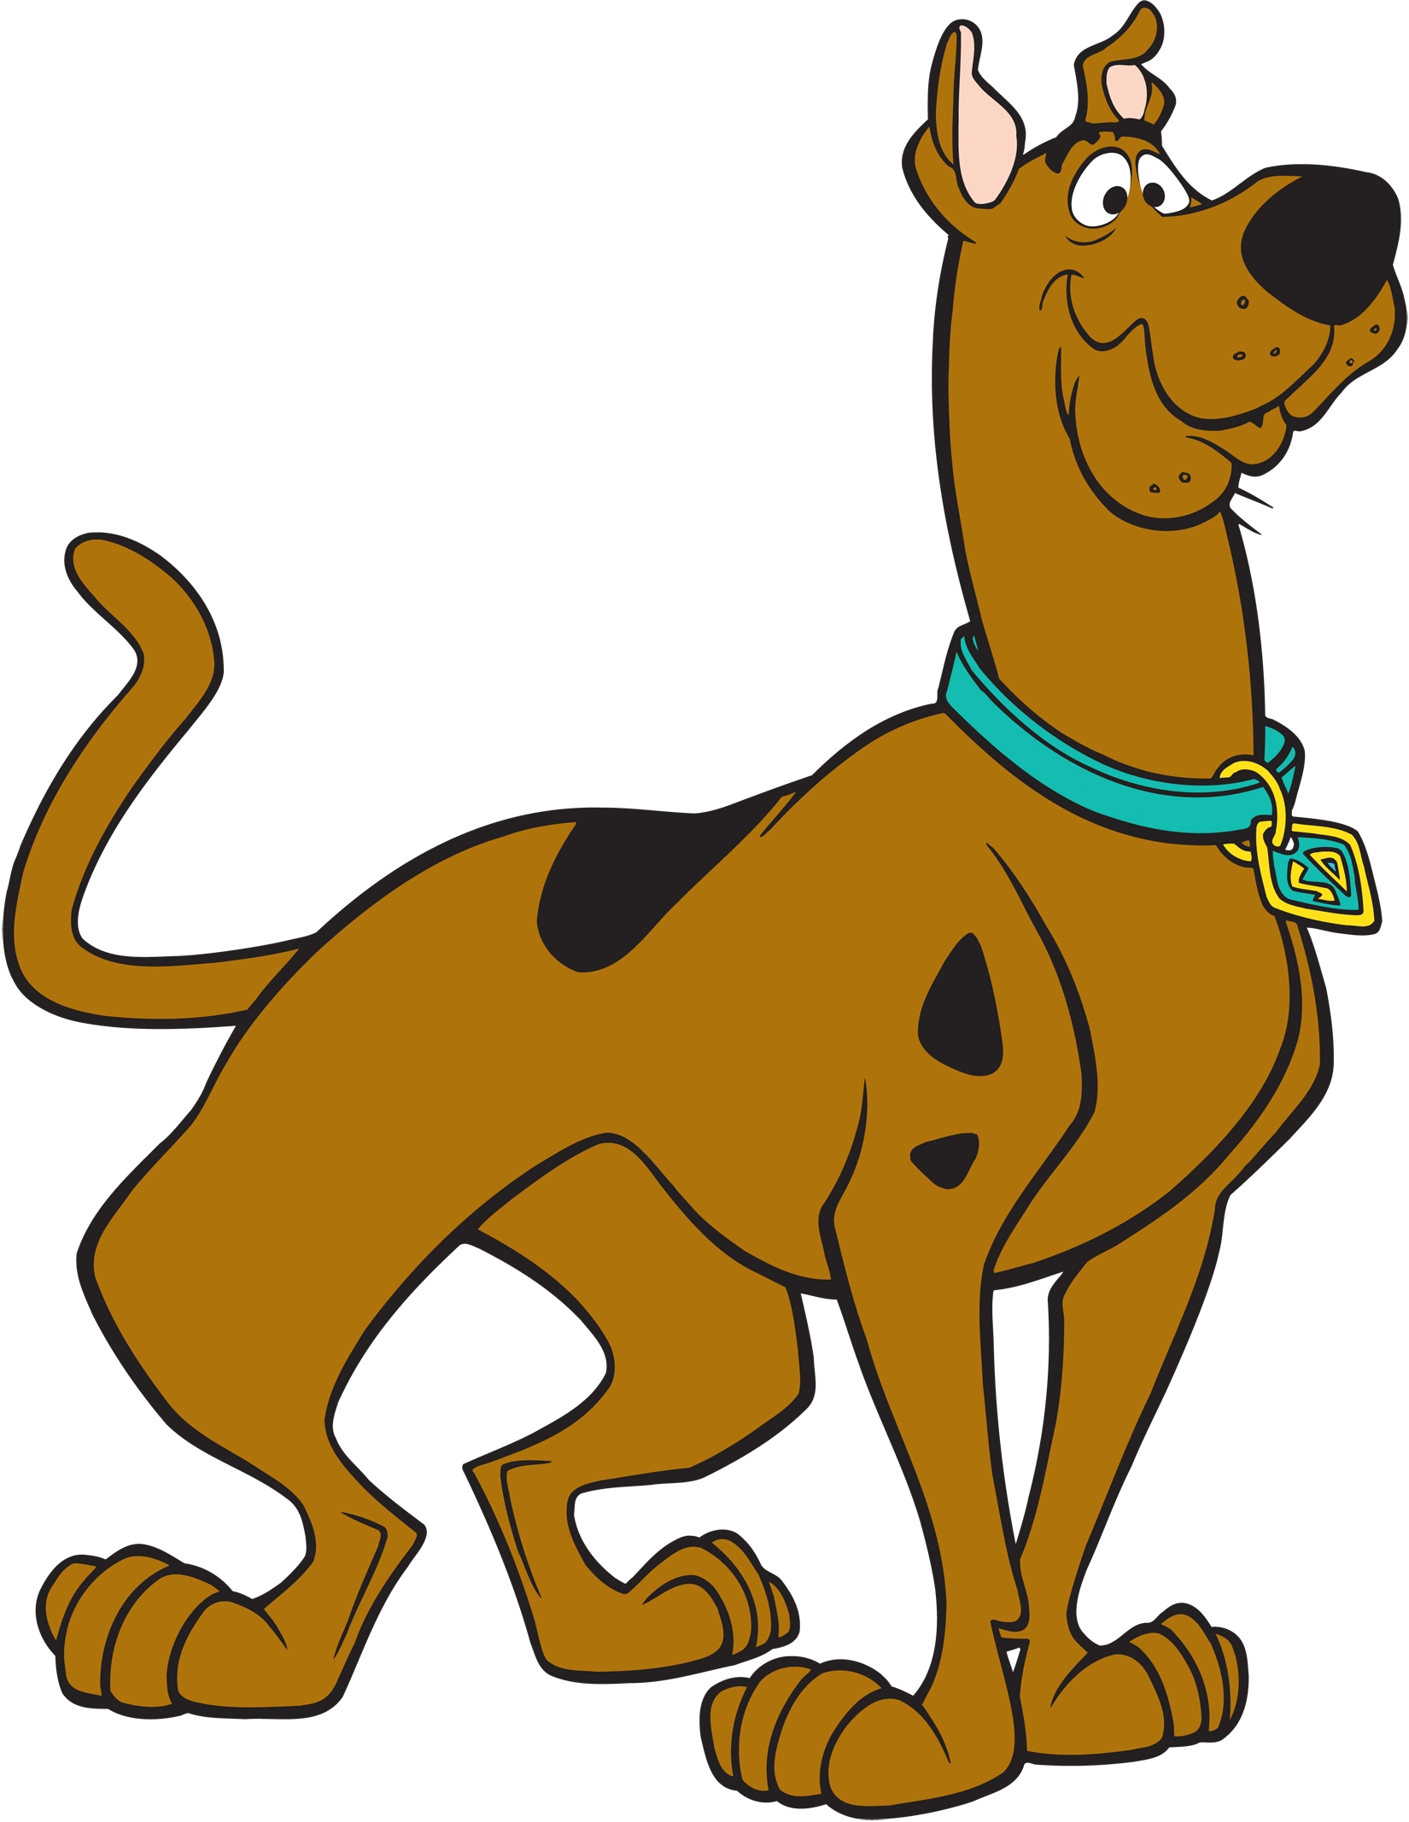
Introduction
"Scooby-Doo Mystery Maze" is a 3D maze adventure game inspired by the beloved "Scooby-Doo" cartoon series. Designed to captivate both fans of the original series and new players. Players must make their way through challenging mazes in a mystery setting, gather Scooby snack bones for guidance, and stay clear of phantoms that prowl around. The main goal of the game is to get to a Scooby Snacks box. "Scooby-Doo Mystery Maze" is an example of a game that combines technical programming, artistic design, and demonstration of Artificial Intelligence in Video Games.

Slide 5
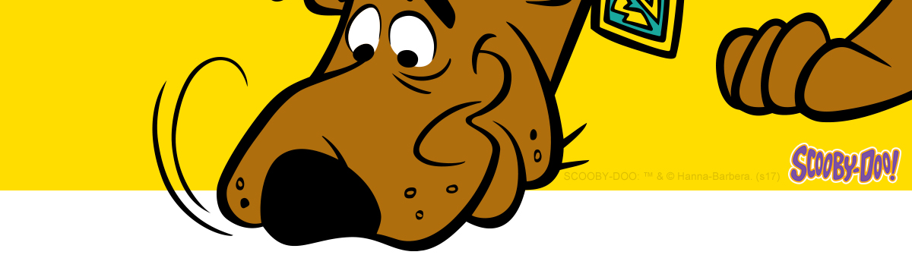

Game Design
The mazes in "Scooby-Doo Mystery Maze" are at the heart of the game's design. A wide range of algorithms are used in their generation, each providing a distinct element of depth and complexity. The player's character has sensitive controls and agile movement mechanics that allow it to blend in well with the "Scooby-Doo" environment. As the main enemies, the phantoms provide the game an extra dimension of excitement and strategy. Gathering the Scooby snacks helps as it shows you the route to the end point, similar to a cheat but its role in the game is to demonstrate the usage of the ''pathfinding ai''.

Slide 6
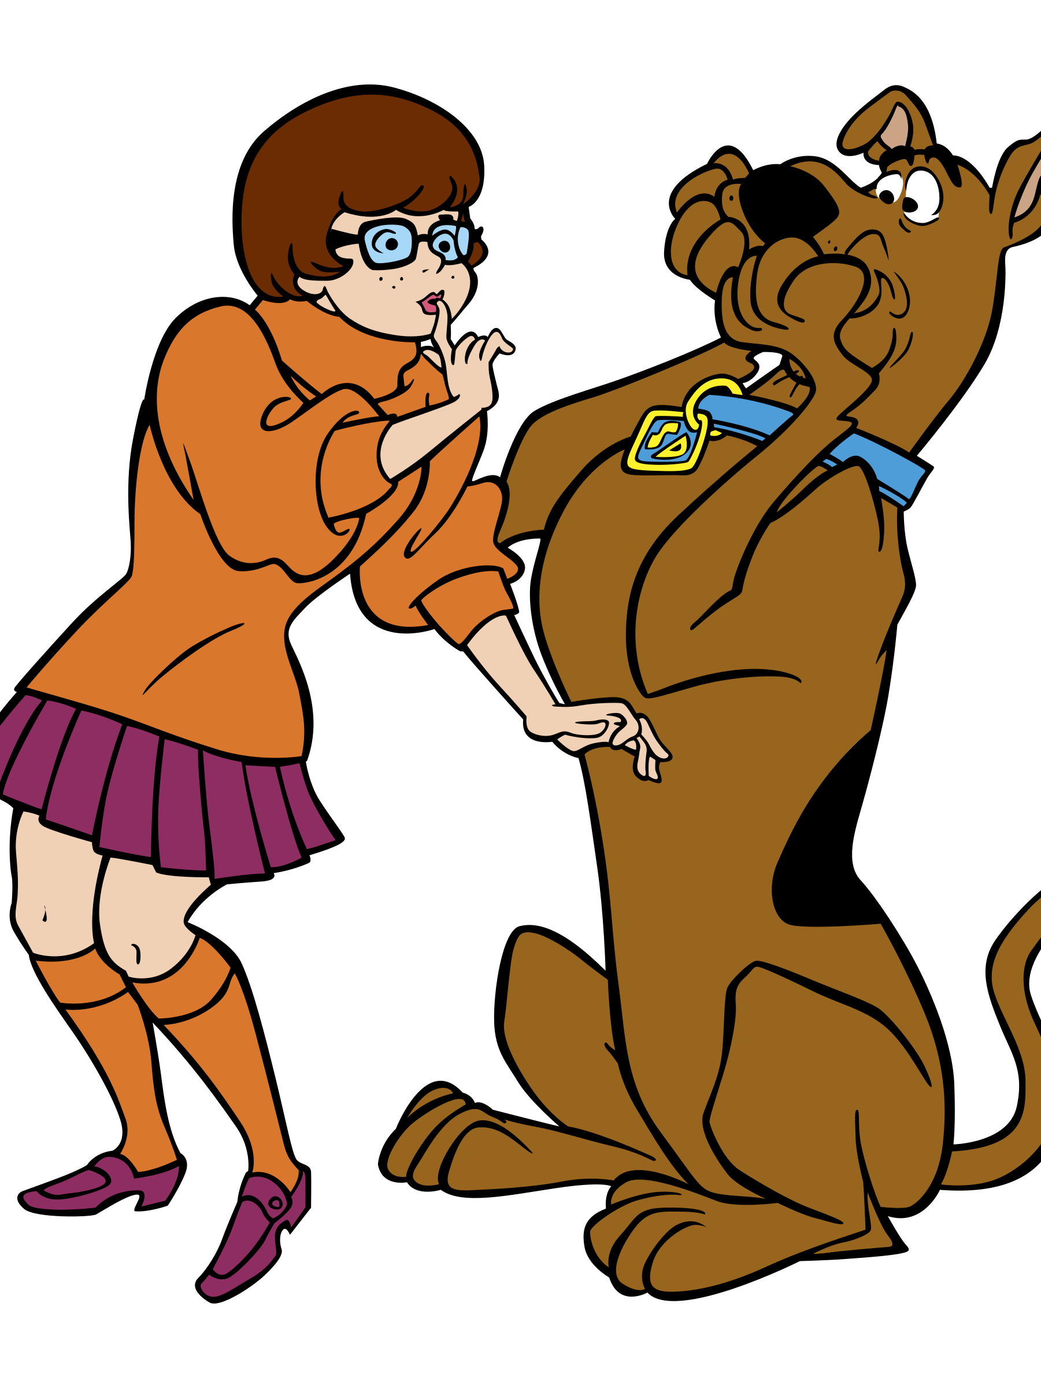
The Algorithms used in this project:
The recursive backtracking algorithm takes part in the Recursive Maze Generator Script. Its functionality is to create a trail by recursively examining nearby unexplored cells after beginning at a random spot. When it comes to a dead end, however, the algorithm goes back to the previous intersection and takes a diversion. This approach creates mazes with lengthy, twisting routes and a few dead ends, making them difficult to navigate and providing a straight-forward exploration experience.
The algorithm used in the Tree Maze Generator script is the Spanning Tree Algorithm. This algorithm helps with creating a maze by connecting cells without forming loops. The functionality behind this approach is that it picks at random which walls to knock down, so that every cell in the maze is connected. Moreover, the resultant mazes usually consist of several routes that lead to dead ends and have a branching pattern. The player must now make more decisions because of the increased complexity.

Slide 7
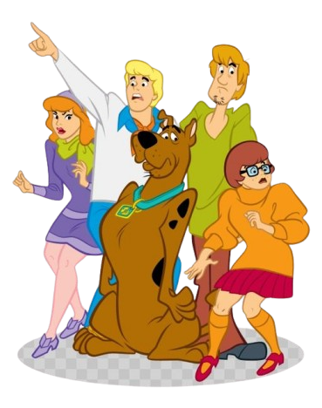
The Algorithms used in this project:
The Recursive Tree Maze Generator script is a combination of recursive and tree-based methods. They combine the Depth-First Search (DFS) of recursive backtracking with the branching of tree methods, creating mazes that are intricate and complex.
The Basic Maze Generator script implements a simpler and more direct approach to maze generation. It involves more straightforward logic that helps with the wall removal. However, mazes from this algorithm might be less complex and more suitable for players that are new to the maze games.
In conclusion, these algorithms combine in "Scooby-Doo Mystery Maze" to produce a variety of game experiences. As stages are completed, players will come across a variety of labyrinth kinds, each with its own set of obstacles and navigational techniques. This diversity, together with the dynamic aspects of phantom enemies and Scooby snacks, makes the gameplay interesting and fun.

Slide 8
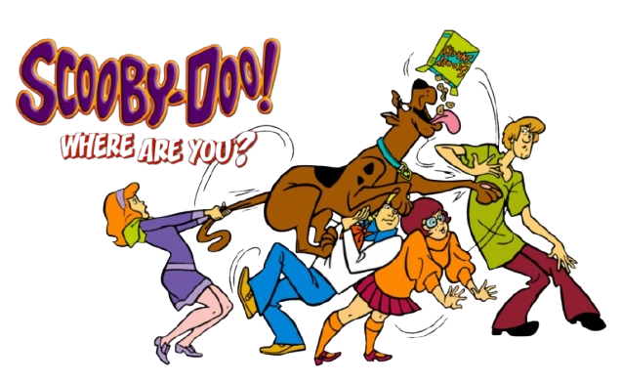
Technical Implementations
An important technological component is the maze development, which uses algorithms like TreeMazeGenerator and RecursiveMazeGenerator for a variety of layouts. The phantoms' AI, which controls their movements and interactions inside the maze, is handled by the GhostManager script. The DrawNavMeshPath script controls player navigation by utilising Unity's NavMesh engine to provide effective and accurate pathfinding. The MenuManager script makes sure that the UI is easy to use.

Slide 9
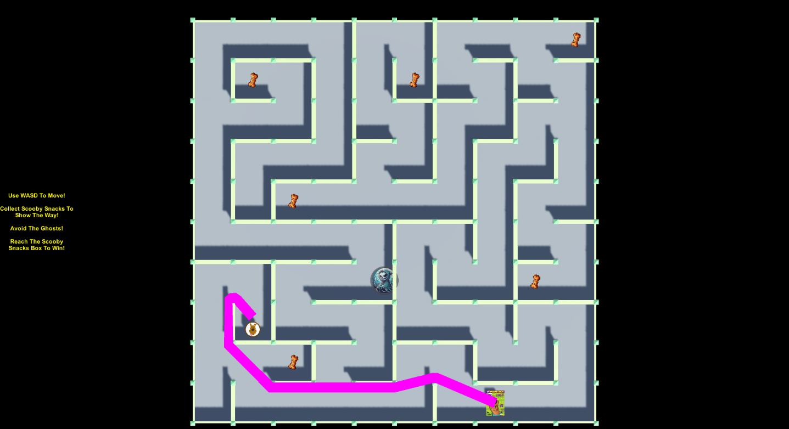
User Interface and Experience
To begin with, the design of the game is not something quite extraordinary or anything really special, but it is simple enough to represent a maze game. As stated, the main focus for this project is not the design but the implementation and demonstration of Artificial Intelligence in Video Games. The mazes in "Scooby-Doo Mystery Maze" are designed to give players just the right amount of excitement and suspense. The whole labyrinth pattern is visible to players from above due to the game's top-down visual style. This viewpoint helps players plan the best route to the destination while also heightening the tension as they keep an eye on the roving ghosts if they decide not to pick up the scooby snacks for navigation. Of course, picking scooby snacks is optional. Also, there is a brief hint on the left side of the screen, introducing the controls to the player, what will happen if the player collects the Scooby snack and what is the goal of the game.
The maze's walls are illustrated in a distinctive manner. In addition to acting as collectibles that add to the player's progress and overall score, the floating Scooby Snack cookies are placed in strategic locations to help players along the way.
Phantoms stroll around the corridors of the maze, their designs evoking a ghostly appearance. Their presence creates a dynamic element of complexity that forces players to react quickly and sometimes back off in order to avoid being captured. The stakes of every movement choice increase since the game ends if the player makes contact with a phantom.
A box of Scooby Snacks indicates the end of the maze. As players gather the floating Scooby Snack cookies, the road to this box becomes apparent, offering a momentary glimpse into the maze's design and aiding in path planning.

Slide 10
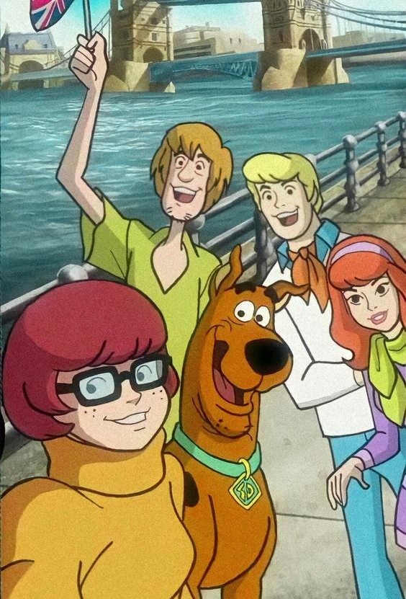
Thank you for your attention!

Slide 11
References
Character Profile Wikia (2019). Scooby-Doo. Available at: https://characterprofile.fandom.com/wiki/Scooby-Doo (Accessed: 13 Feb. 2025).
DeviantArt (2020). Scooby-Doo and the gang by MinionFan1024 on DeviantArt. Available at: https://www.deviantart.com/minionfan1024/art/Scooby-Doo-and-the-gang-860789482 (Accessed: 13 Feb. 2025).DeviantArt (2024).
Scooby-Doo by VitSmirnov on DeviantArt. Available at: https://www.deviantart.com/vitsmirnov/art/Scooby-Doo-1112059439 (Accessed: 13 Feb. 2025).Dimitrova,.
L. (n.d.). In-game screenshots from Scooby-Doo Mystery Maze.
Personal collection.Facebook (2022). Scooby-Doo - Scooby is on the case, looking for clues in your Timeline. Available at: https://www.facebook.com/scoobydoo/photos/scooby-is-on-the-case-looking-for-clues-in-your-timeline/10155695783450961/ (Accessed: 13 Feb. 2025).
Freebie Supply (2025). Scooby-Doo Logo PNG Transparent & SVG Vector - Freebie Supply. Available at: https://freebiesupply.com/logos/scooby-doo-logo-7/ (Accessed: 13 Feb. 2025).
Maze Generation Algorithms (n.d.). Recursive Backtracking & Spanning Tree Algorithms. Available at: https://www.astrolog.org/labyrnth/algrithm.htm (Accessed: 13 Feb. 2025).
OpenGameArt (n.d.). Free 2D and 3D game assets. Available at: https://opengameart.org/ (Accessed: 13 Feb. 2025).
Pinterest (2015). Scooby-Doo Pictures. Available at: https://www.pinterest.com/pin/395683517238188494/ (Accessed: 13 Feb. 2025).Pixabay (n.d.).
Royalty-free cartoon and maze graphics. Available at: https://www.pixabay.com/ (Accessed: 13 Feb. 2025).
PNGItem (2019). Scooby-Doo PNG Images, Transparent Scooby-Doo Image Download - PNGItem. Available at: https://www.pngitem.com/so/scooby-doo/ (Accessed: 13 Feb. 2025).
Russell, S., & Norvig, P. (2020). Artificial Intelligence: A Modern Approach (4th ed.).
Pearson.Unity Technologies (n.d.). Game development screenshots (Unity Editor & NavMesh). Available at: https://unity.com/ (Accessed: 13 Feb. 2025).
UN, U. (2025). Blocked. Wallpapers.com. Available at: https://wallpapers.com/wallpapers/scooby-doo-and-norville-rogers-8zf1uetmxq9o58q7.html (Accessed: 13 Feb. 2025).
Warner Bros. (n.d.). Scooby-Doo character artwork. Available at: https://www.warnerbros.com/tv/scooby-doo (Accessed: 13 Feb. 2025).
X (formerly Twitter) (2025). Scooby-Doo post. Available at: https://x.com/Pegasus_pegs/status/1879321502300131753 (Accessed: 13 Feb. 2025).

