Slide 1
Functions and Statements
f(x)
SoftUni Team
Technical Trainers
Software University
https://softuni.bg

Slide 2
Table of Contents
Declaring and Invoking Functions
Nested Functions
Value vs Reference Types
First-class Functions
Arrow Functions
Naming and Best Practices

Slide 3
Have a Question?
sli.do
#js-front-end

Slide 4

Functions Overview
Definition and Objectives

Slide 5
Functions in JS
A function is a named subprogram designed to perform a particular task
Functions are executed when they are called. This is known as invoking a function
Values can be passed into functions and used within the function
Use camelCase
Parameter
function printStars(count) {
console.log("*".repeat(count));
}

Slide 6
Why Use Functions?
More manageable programming
Splits large problems into small pieces
Better organization of the program
Improves code readability and understandability
Avoiding repeating code
Improves code maintainability
Code reusability
Using existing functions several times

Slide 7
Declaring and Invoking Functions
{…}
Notes:
Add Image!

Slide 8
Declaring Function
Functions can be declared in two ways:
Function declaration (recommended way)
Function expression (useful in functional programming)
function printText(text){
console.log(text);
}
let printText = function(text){
console.log(text);
}

Slide 9
Declaring Function
Functions can have parameters
Functions always return a value (custom or default)
Name
Parameters
function printText(text){
console.log(text);
}
Body

Slide 10
Invoking a Function
Functions are first declared, then invoked (many times)
Functions can be invoked (called) by their name
function hLine() {
console.log("----------");
}
Function Declaration
Function Invocation
hLine();

Slide 11
Invoking a Function (2)
Invocation from another function:
Self-invocation (recursion):
function printDocument() {
printLabel();
printContent();
}
Function invoking functions
function countDown(x) {
console.log(x);
if (x > 0) { countDown(x - 1); }
}
Function invoking itself

Slide 12
Functions Without Parameters
Does not receive arguments when invoked
The result is always the same (unless it reads data from outside)
function printHeader() {
console.log('~~~- {@} -~~~');
console.log('~- Certificate -~');
console.log('~~~- ~---~ -~~~');
}
printHeader(); // Output is always the same

Slide 13
Functions With Parameters
Can receive any number and type of arguments when invoked
function multiply(a, b) {
console.log(a*b);
}
multiply(5, 7); // 35
Pass two numbers
Pass array of strings
function printName(nameArr) {
console.log(nameArr[0] + ' ' + nameArr[1]);
}
printName(['John', 'Smith']); // John Smith

Slide 14
Problem : Format Grade
Write a function that receives a grade between 2.00 and 6.00 and prints a formatted line with grade and description
Grade < 3.00 → Fail
Grade >= 3.00 and < 3.50 → Poor
Grade >= 3.50 and < 4.50 → Good
Grade >= 4.50 and < 5.50 → Very good
Grade >= 5.50 → Excellent
Input | Output
3.33 | Poor (3.33)
4.50 | Very good (4.50)
2.99 | Fail (2)

Slide 15
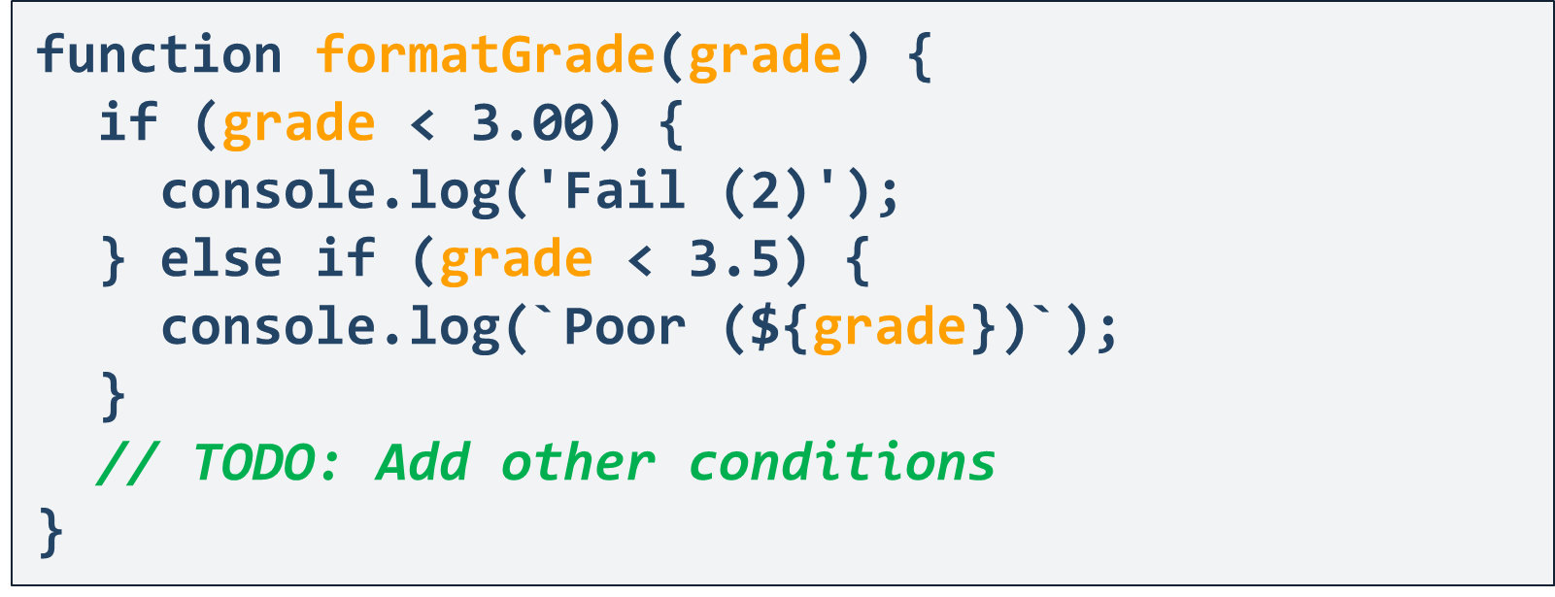
Solution: Format Grade

Slide 16
Problem : Math Power
Create a function that calculates the result of a number, raised to the given power
Print the result to the console
Input | Output | Details
2,8 | 256 | 2⁸=2*2*2*2*2*2*2*2=256
3,4 | 81 | 3⁴=3*3*3*3=81

Slide 17
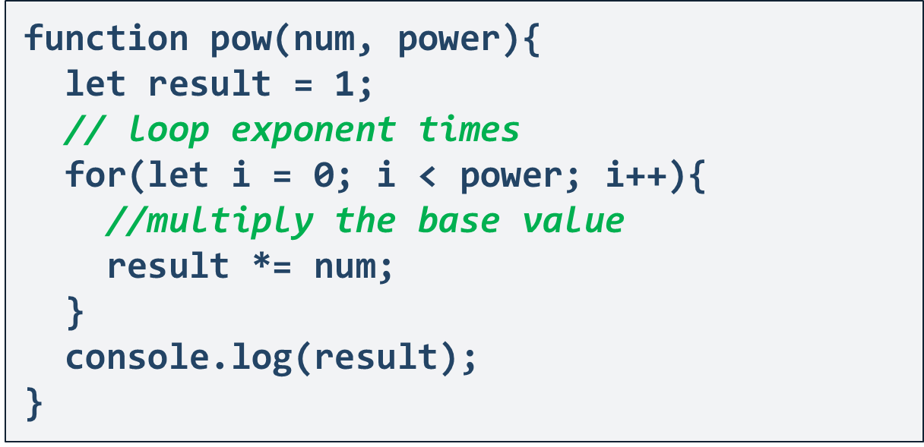
Solution: Math Power

Slide 18
Returning Values

Slide 19
The Return Statement
The return keyword immediately stops the function's execution
Returns the specified value to the caller
function readFullName(firstName, lastName) {
return firstName + " " + lastName;
}
const fullName = readFullName("John","Smith");
console.log(fullName) //John Smith

Slide 20
Using the Return Values
Return value can be:
Assigned to a variable
Used in expression
Passed to another function
let max = getMax(5, 10);
let total = getPrice() * quantity * 1.20;
multiply(getMax(5,10), 20)

Slide 21
Returning Values: Examples
Check if array index is valid:
Does the student pass the exam:
function isValid(index, arr) {
if (Number.isInteger(index) && index >= 0 && index < arr.length) {
return true;
} else {
return false;
}
}
function pass(grade) {
return grade >= 3;
}

Slide 22
Problem : Repeat String
Create a function that takes a string and a number n and returns the string repeated n times
Return the result as a string
Input | Output
"abc", 3 | abcabcabc
"String", 2 | StringString

Slide 23
Solution: Repeat String
function repeat(str, n) {
let result = '';
for (let i = 0; i < n; i++) {
result += str;
}
return result;
}

Slide 24
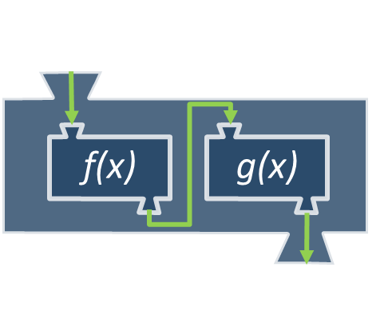
Nested Functions

Slide 25
Nested Functions: Example
Functions can be nested, i.e. hold other functions
function swapElements(arr) {
for (let i = 0; i < arr.length/2; i++) {
swap(arr, i, arr.length - 1 - i);
}
console.log(arr.join(' '));
function swap(elements, i, j) {
let temp = elements[i];
elements[i] = elements[j];
elements[j] = temp;
}
}
Nested function

Slide 26
Problem: Print Certificate
Write a function that receives a grade and an array, containing two strings and prints a formatted certificate
If the student failed, print "Student does not qualify"
printCertificate(5.25, ['Peter', 'Carter']);
// ~~~- {@} -~~~
// ~- Certificate -~
// ~~~- ~---~ -~~~
// Peter Carter
// Very good (5.25)

Slide 27
Solution: Print Certificate
Use the functions we declared in earlier examples:
function printCertificate(grade, nameArr) {
if (pass(grade)) {
printHeader();
printName(nameArr);
formatGrade(grade);
} else {
let msg = `${nameArr[0]} ${nameArr[1]} does not qualify`;
console.log(msg);
}
}

Slide 28
Functional Programming in JS
f(x)
'
'
First Class

Slide 29
First-Class Functions
First-class functions are treated like any other variable
Passed as an argument
Returned by another function
Assigned as a value to a variable
The term "first-class" means that something is just a value. A first-class function is one that can go anywhere that any other value can go - there are few to no restrictions.
Michael Fogus, Functional Javascript

Slide 30
First-Class Functions
Can be passed as an argument to another function
function sayHello() {
return "Hello, ";
}
function greeting(helloMessage, name) {
return helloMessage() + name;
}
console.log(greeting(sayHello, "JavaScript!"));
// Hello, JavaScript!

Slide 31
First-Class Functions
Can be returned by another function
We can do that, because we treated functions in JavaScript as a value
function sayHello() {
return function () {
console.log('Hello!');
}
}

Slide 32
First-Class Functions
Can be assigned as a value to a variable
const write = function () {
return "Hello, world!";
}
console.log(write());
// Hello, world!

Slide 33
Arrow Functions
() => {}

Slide 34
Arrow Functions
Special shorthand syntax for declaration
They operate in the context of their enclosing scope
Useful in functional programming
let increment = x => x + 1;
console.log(increment(5)); // 6
"=>" (arrow)
let increment = function(x) {
return x + 1;
}
This is the same as the function above
let sum = (a, b) => a + b;
console.log(sum(5, 6)); // 11

Slide 35

Naming and Best Practices

Slide 36
Naming Functions
Use meaningful names
Should be in camelCase
Names should answer the question:
What does this function do?
If you cannot find a good name for a function, think about whether it has a clear intent
Self explaining
findStudent, loadReport, add
Puzzling
Method1, DoSomething, handleStuff, DirtyHack

Slide 37
Naming Function Parameters
Function parameter names:
Preferred form: [Noun] or [Adjective] + [Noun]
Should be in camelCase
Should be meaningful
Unit of measure should be obvious
firstName, report, speedKmH, usersList, fontSizeInPixels, font
p, p1, p2, populate, LastName, last_name, convertImage

Slide 38
Functions – Best Practices
Each function should perform a single, well-defined task
A name should describe that task in a clear and non-ambiguous way
Avoid functions longer than one screen
Split them into several shorter functions
function printReceipt(){
printHeader();
printBody();
printFooter();
}
Self documenting and easy to test

Slide 39


Code Structure and Code Formatting
Make sure to use correct indentation
Leave a blank line between functions and after blocks
Always use curly brackets for conditional and loop bodies
Avoid long lines and complex expressions
function sum() {
// some code…
// some more code…
}
function sum()
{
// some code…
// some more code…}

Slide 40
Problem: Simple Calculator
Write a function that receives three parameters and calculates the result, depending on a given operator
The operator can be 'multiply', 'divide', 'add', 'subtract'
The input comes as three parameters - two numbers and an operator as a string
Bonus task: use arrow functions for the solution
Input
Output
5, 10, 'multiply'
50

Slide 41
Solution: Simple Calculator
function solve(a, b, operator) {
switch (operator) {
case 'multiply':
multiply(a, b);
break;
//TODO: other cases
}
function multiply(a, b) { // …body }
//TODO: other operations
}

Slide 42

Summary
…
…
…
Functions:
Break large programs into simple functions that solve small sub-problems
Consist of declaration and body
Are invoked by their name
Can accept parameters

Slide 43
Questions?
Notes:
43

Slide 44














SoftUni Diamond Partners

Slide 45

Educational Partners

Slide 46
Trainings @ Software University (SoftUni)
Software University – High-Quality Education, Profession and Job for Software Developers
softuni.bg
Software University Foundation
softuni.foundation
Software University @ Facebook
facebook.com/SoftwareUniversity
Software University Forums
forum.softuni.bg
Notes:
46

Slide 47

License
This course (slides, examples, demos, exercises, homework, documents, videos and other assets) is copyrighted content
Unauthorized copy, reproduction or use is illegal
© SoftUni – https://about.softuni.bg/
© Software University – https://softuni.bg
Notes:
47

