Slide 1
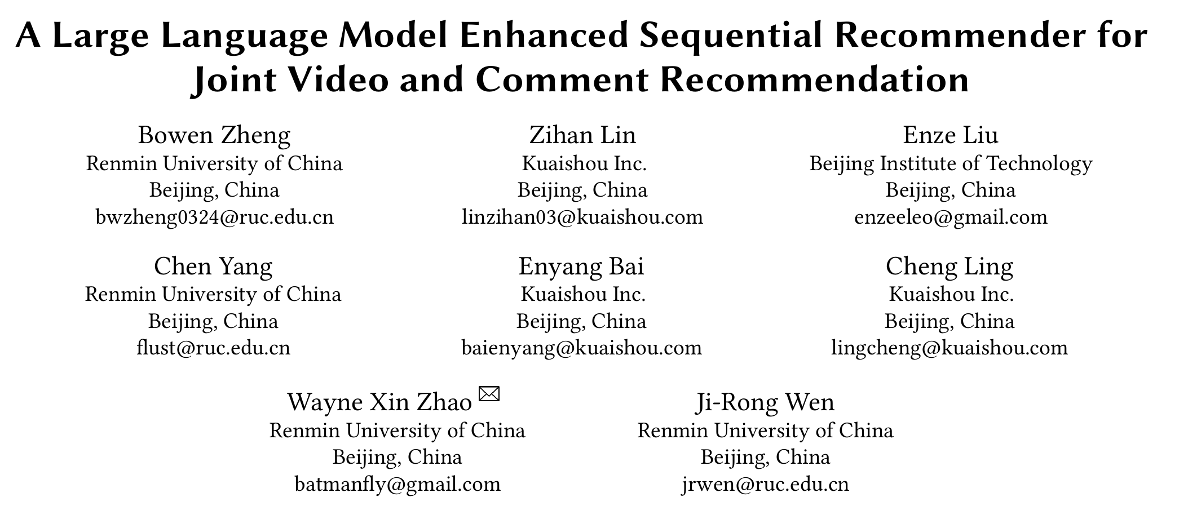
[1] A Large Language Model Enhanced Sequential Recommender for Joint Video and Comment Recommendation. Arxiv 2403.13574

Slide 2
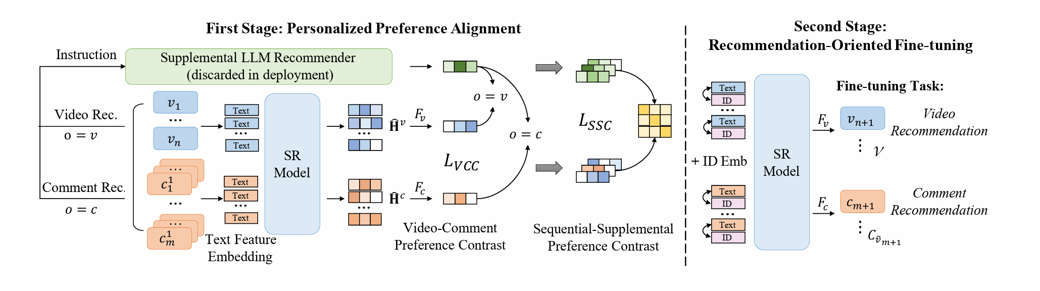


1.1 Overview
Dataset: KuaiShou
First Stage: Personalized Preference Alignment
LLM backbone: chatGLM3
Second Stage:Recommendation-Oriented Fine-tuning
SR backbone: MHA

Slide 3
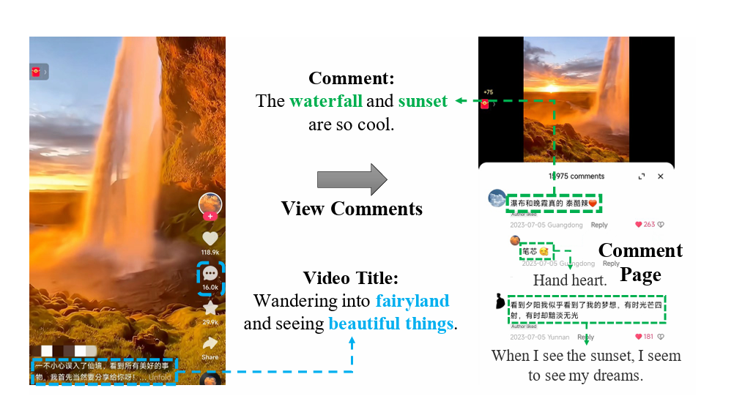
2.1 Motivation
Reading or writing comments on interesting videos has become an essential part of the viewing experience on online video platforms like KuaiShou.
Existing video recommender systems primarily model user interaction behaviors with videos, lacking consideration of comments in user behavior modeling.
On the KuaiShou platform, over 60% of users regularly view corresponding comments when watching videos and express their interests through comments.

Slide 4
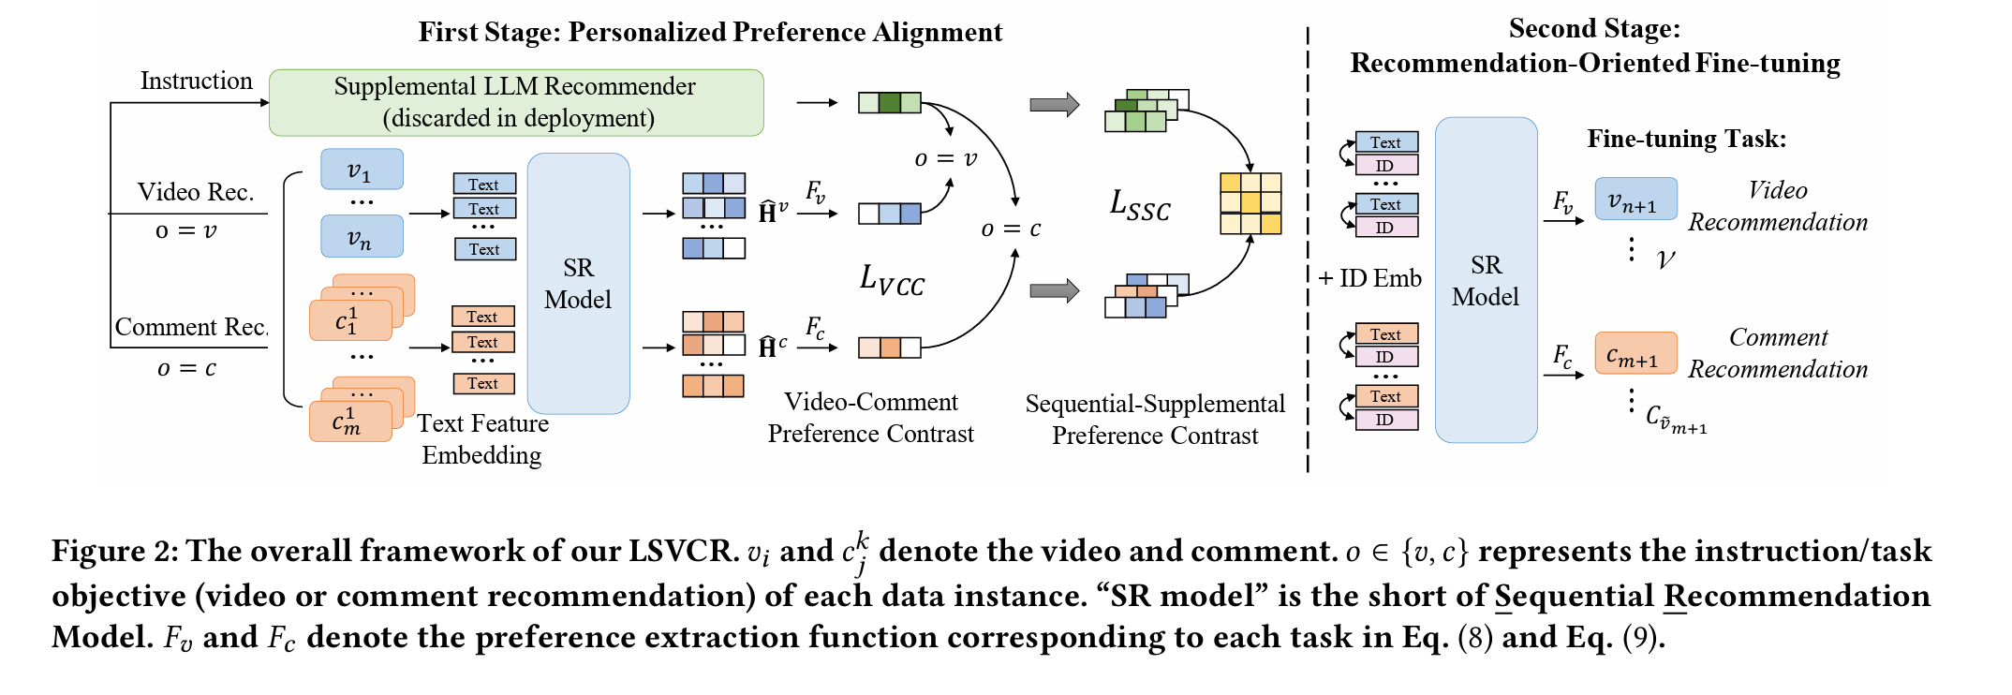
3.1 Framework of LSVCR

Slide 5
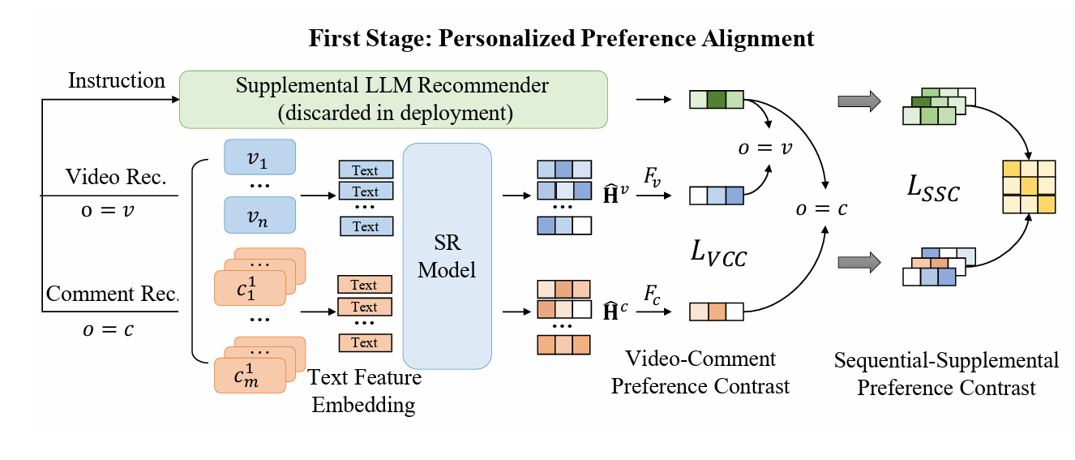

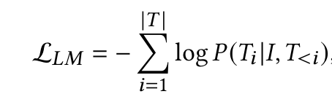

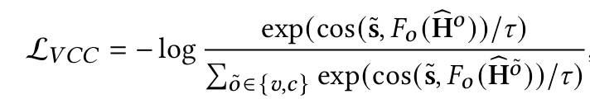

3.2 First Stage

Slide 6
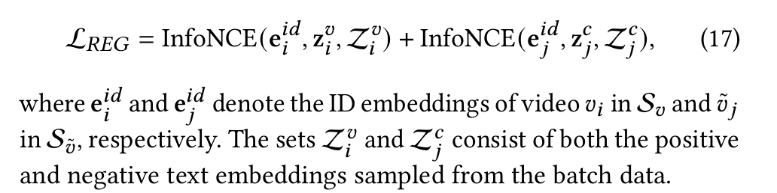
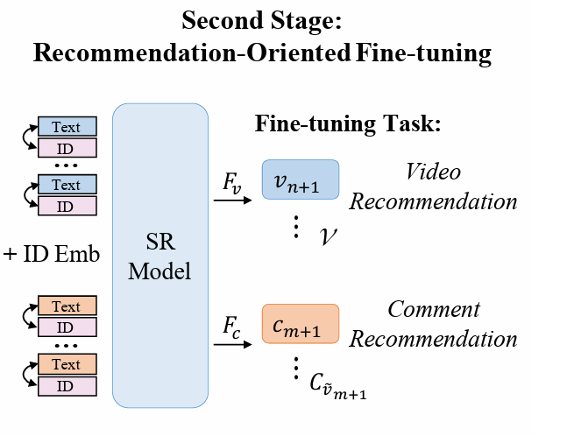
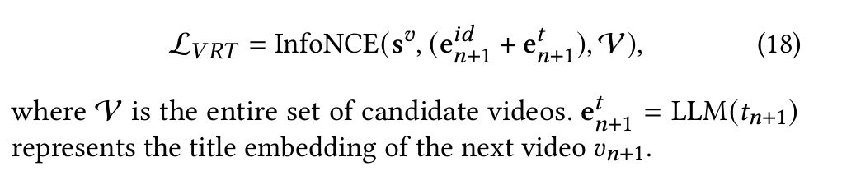
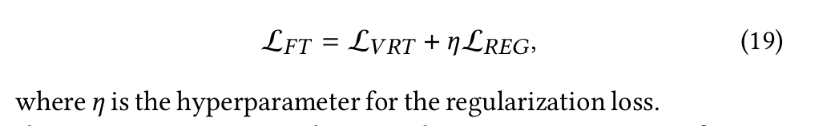
3.2 Second Stage
Notes:
Fatigue 疲劳

Slide 7
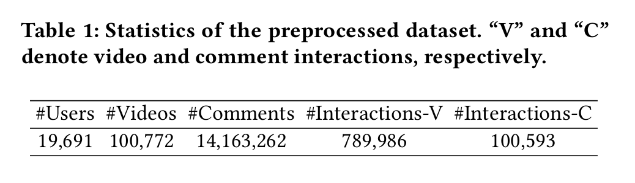
4 Experiment
Datasets : KuaiShou
Overall Results
Ablation Study
Further Analysis
Online A/B Testing
Notes:
Fatigue 疲劳

Slide 8
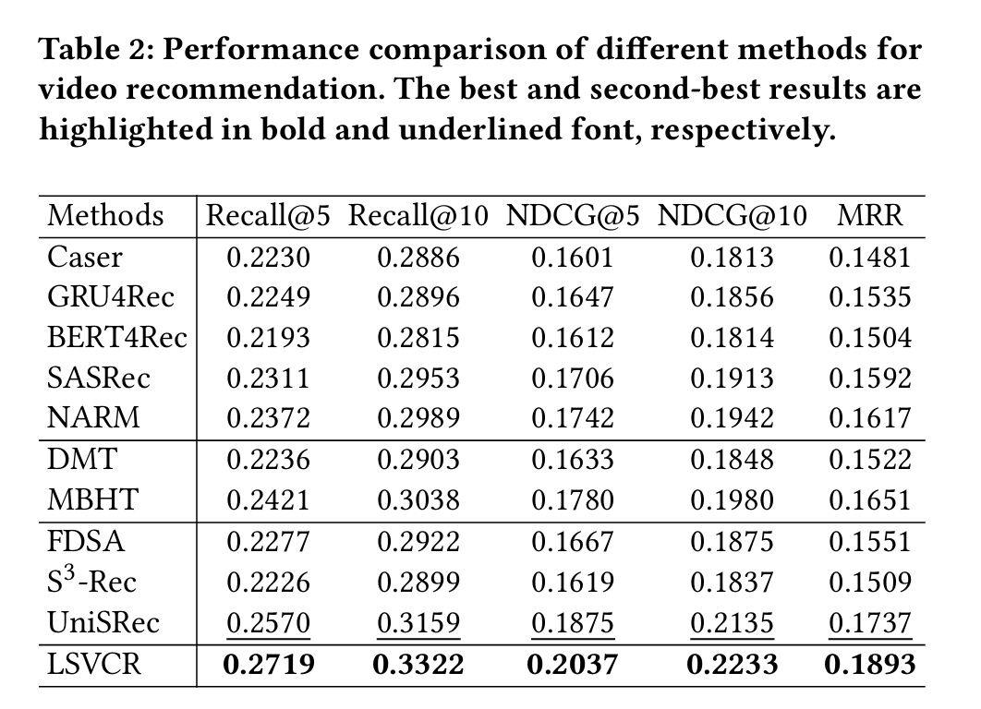
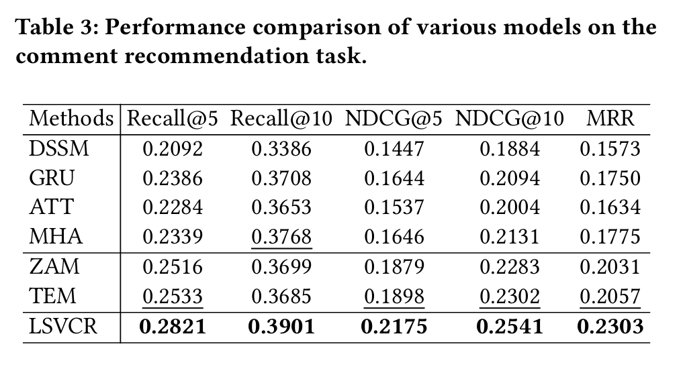
4.1 Overall Results
Notes:
Fatigue 疲劳

Slide 9
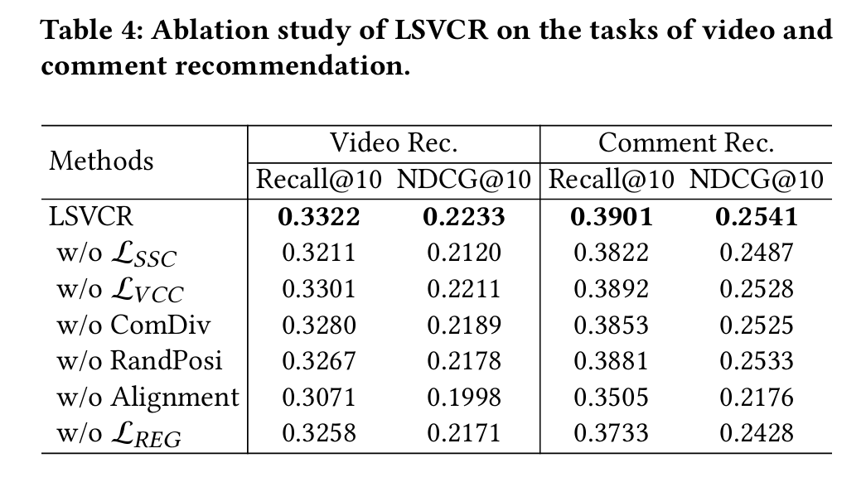
4.2 Ablation Study
Notes:
Fatigue 疲劳

Slide 10
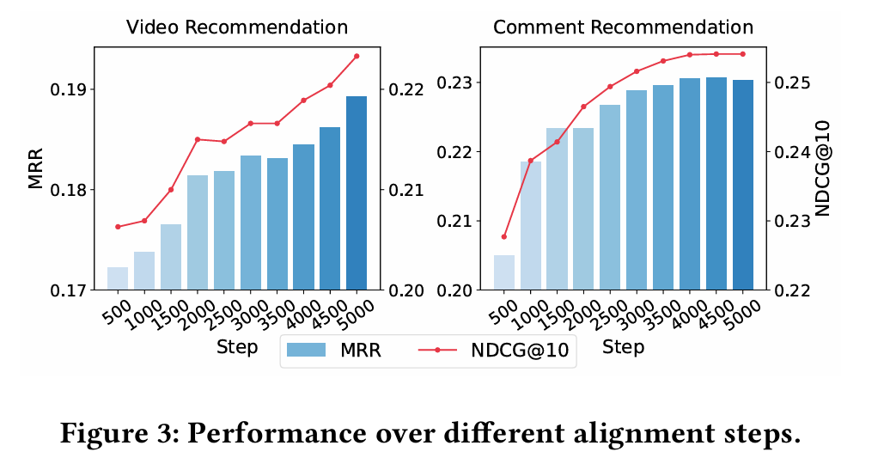
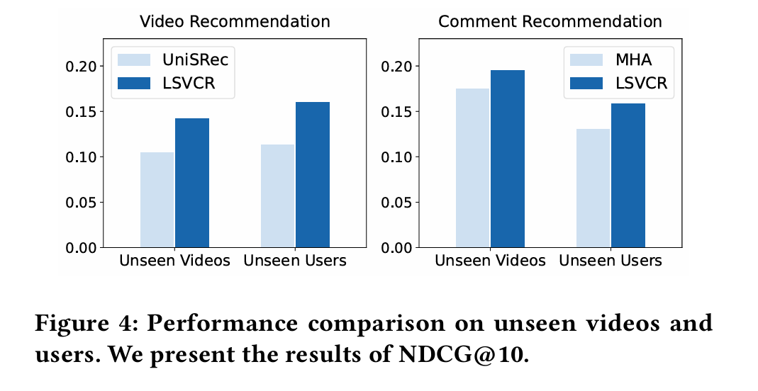
4.3 Further Analysis
Notes:
Fatigue 疲劳

Slide 11
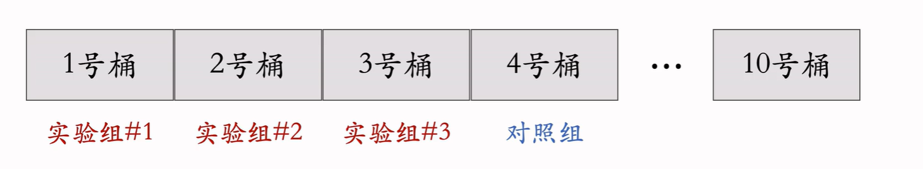
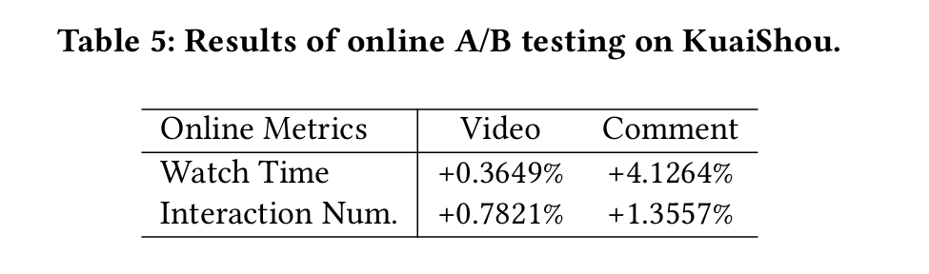
4.4 Online A/B Testing
Notes:
Fatigue 疲劳

Slide 12
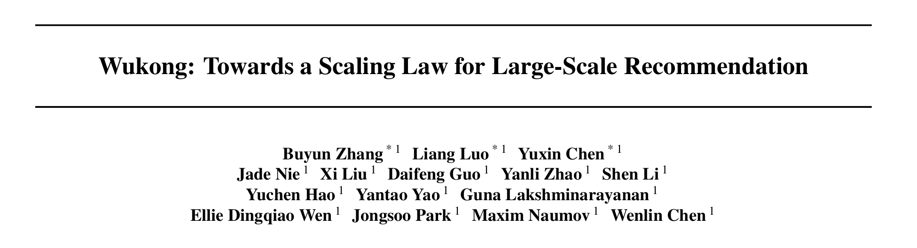
[2] Wukong: Towards a Scaling Law for Large-Scale Recommendation arxiv.org/pdf/2403.02545.pdf

Slide 13
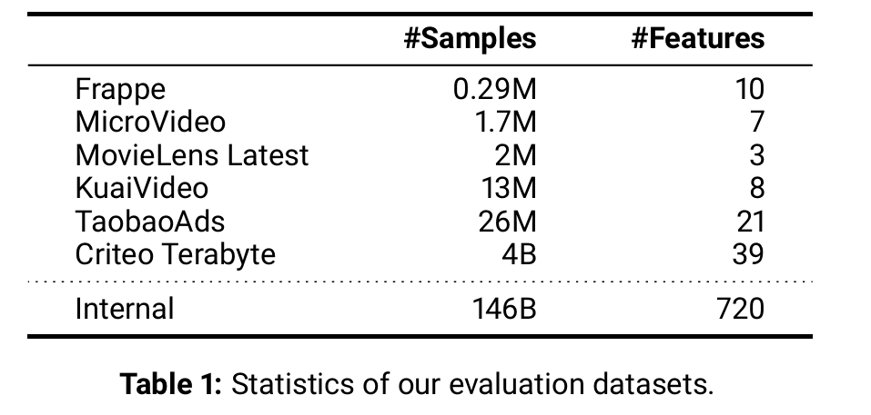
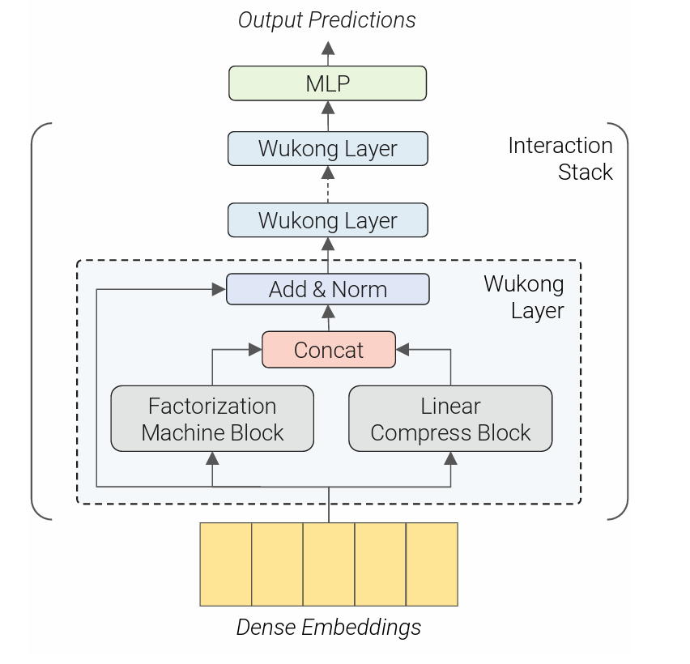
1.1 Overview
Datasets:
Achieved:
Scaling Law in Recommendation
Implication on Resource-Limited Research and Businesses
Practically Serving Scaled-up Models
Limited:
Not be able to reach a level of complexity where the limit applies.
Unknown principles

Slide 14
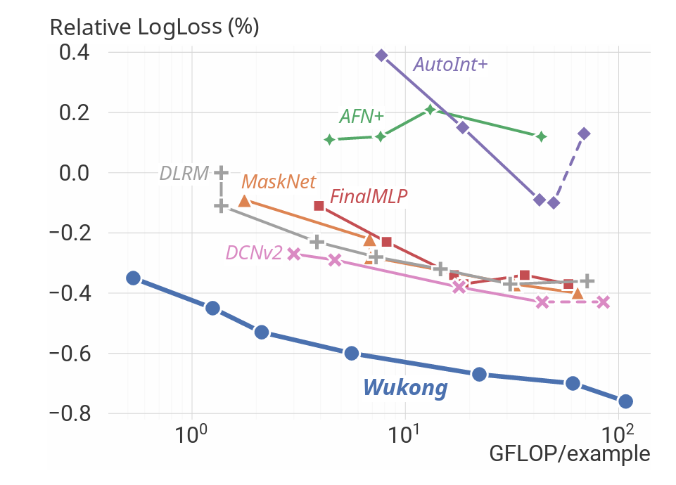
2.1 Motivation
The scaling law plays an important role in the sustainable improvement of model quality.
The recommendation models to date have not exhibited the scaling laws observed in the domain of large language models.
This limitation poses significant challenges in adapting these models to increasingly complex real-world datasets.
Notes:
Fatigue 疲劳

Slide 15
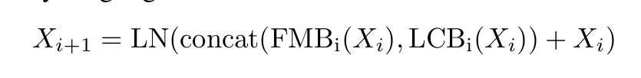


3.1 Framework of LSVCR
Notes:
Fatigue 疲劳

Slide 16
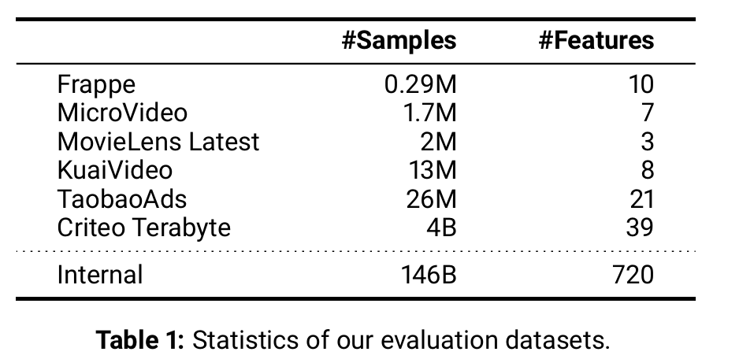
4 Experiment
Datasets
Evaluation on a Public Datasets
Evaluation on an Internal Dataset
Ablation
Notes:
Fatigue 疲劳

Slide 17
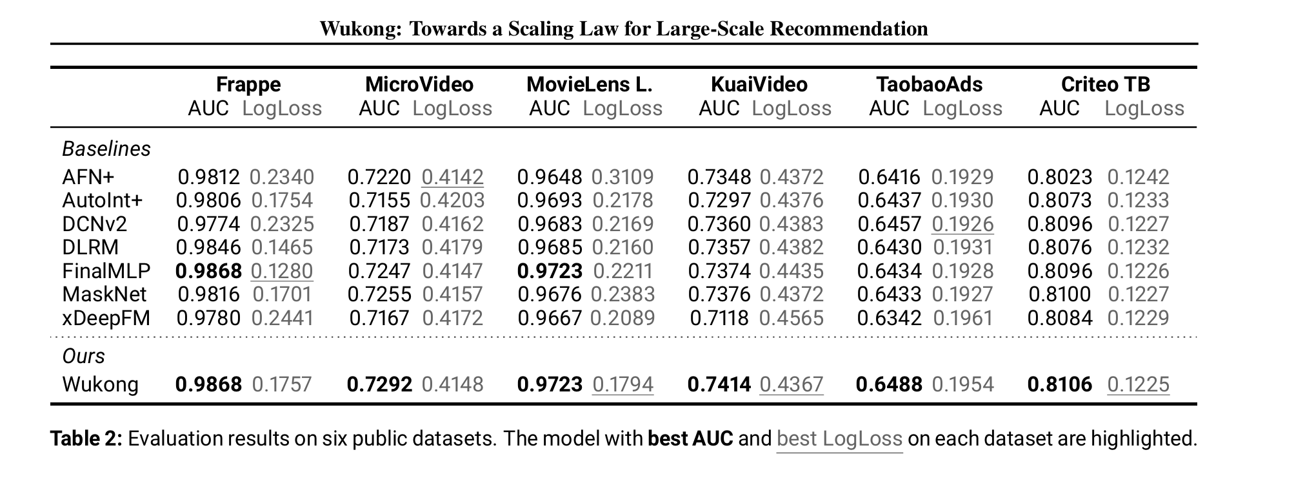
4.1 Evaluation on a Public Datasets
Notes:
Fatigue 疲劳

Slide 18
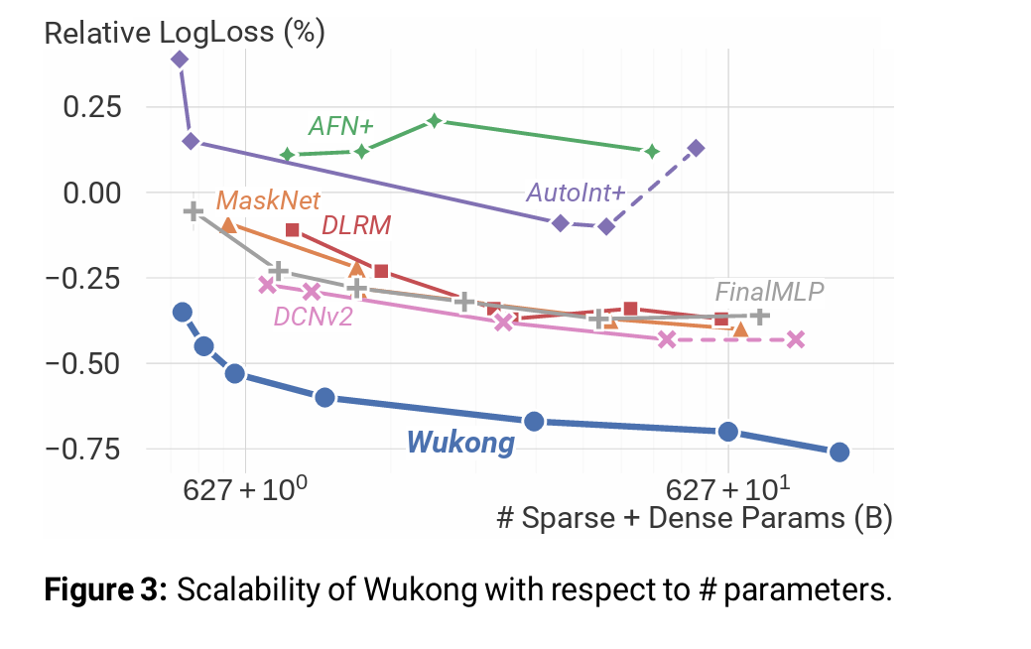
4.2 Evaluation on a Internal Datasets
Notes:
Fatigue 疲劳

Slide 19
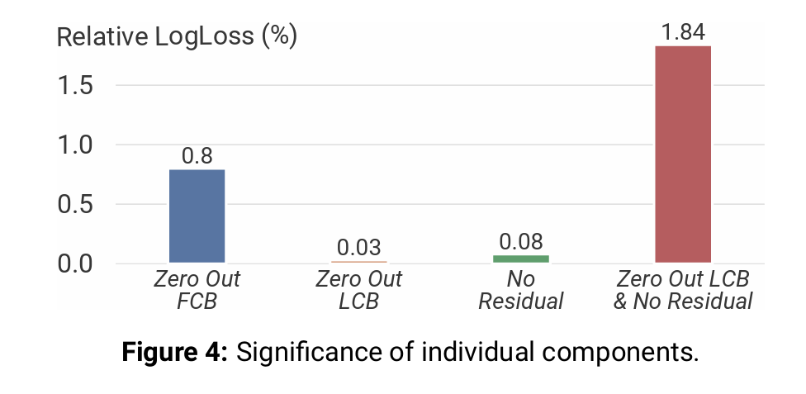
4.3 Ablation Study
Notes:
Fatigue 疲劳

Slide 20
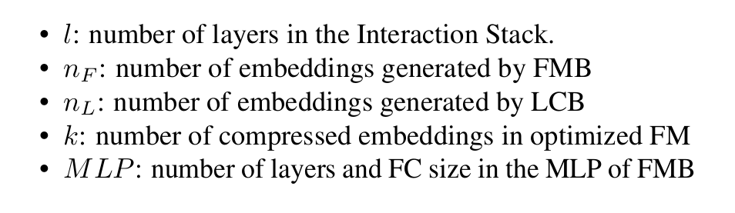
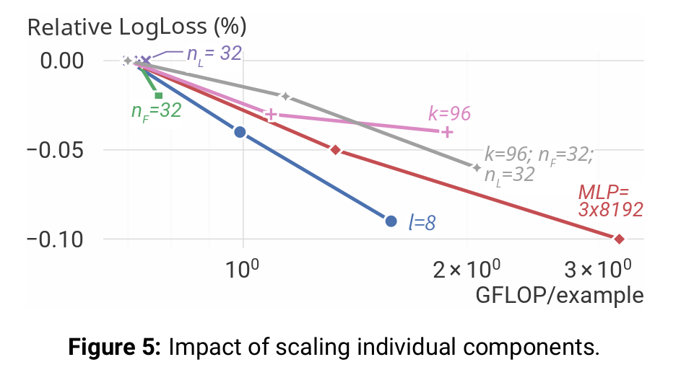


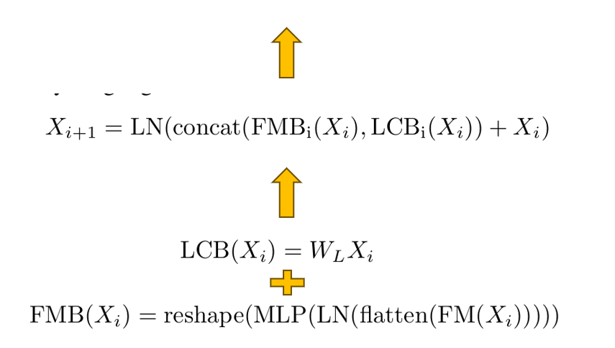
4.3 Ablation Study
Low rank
Notes:
Fatigue 疲劳

Slide 21
Thank You!
Q&A

