Slide 1
How can Bellabeat
play it smart?
Google Data Analytics Capstone Project
Lyzet Flores
09/08/2023

Slide 2
Presentation Agenda
Project Overview
Data overview
Data Analysis
Insights
Recommendations

Slide 3
Project Overview
Goal:
Finding and understanding smart technology industry trends to better inform Bellabeat for a stronger marketing strategy
Questions:
What trends are present in
What are some trends in smart device usage?
How do they apply to Bellacar customers?
How can these trends improve Bellacat marketing team strategy?

Slide 4
Data Overview
30 FitBit Users
FitBit Tracker Data
Collected via Amazon Mechanical Turk over 30 days
Physical Activity Activity Steps Intensity | Heart Rate Heart Rate Calories | Sleep Monitoring Weight Sleep

Slide 5
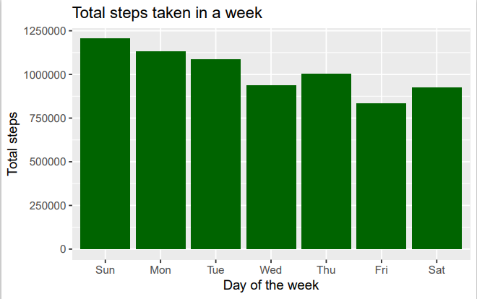
Trends in the data
Here we can see that Sunday was the day users were most active.
Taking the summary of the data we found out that the average amount of steps users took was 8.319 which is in the average amount that is recommended of 6,000 steps a day.

Slide 6
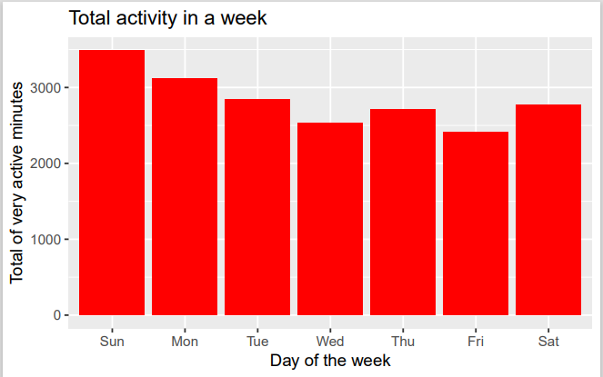
Trends in the data
Trends in the data Cont.
Looking at the amount of calories per day we can see that the pattern continues,
Sunday is the most active day.
From the summary of the data we found out that the average amount of active minutes is 23.21 minutes which is less than the recommended 30 minutes.

Slide 7
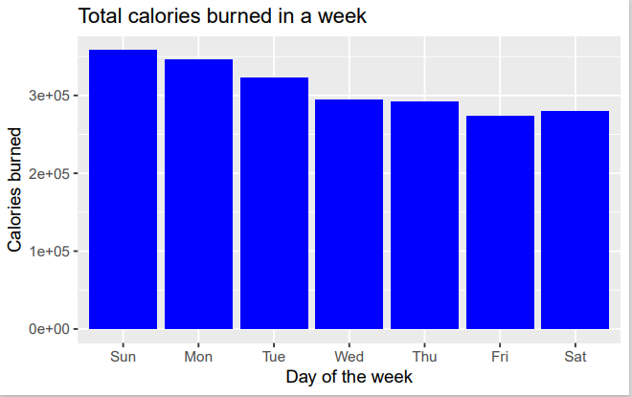
Trends in the data
Trends in the data cont.
Sunday is the most active day of the week for the month.
This might mean be because of the start of the week and the incentive to be active decreases as the days pass.

Slide 8
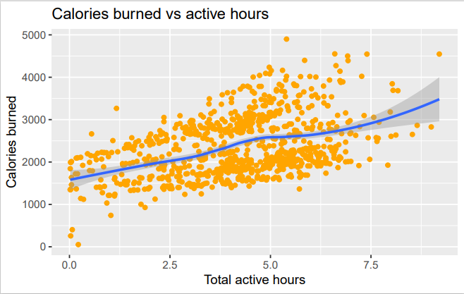
Relationships in the data
As the hours of activity increase we can see the amount of calories increase as well.

Slide 9
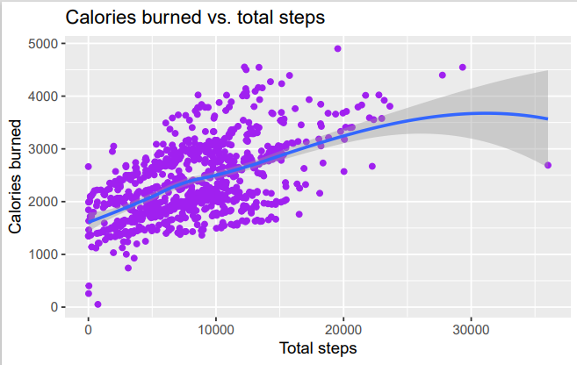
Relationships in the data
As the amount of steps increase the calories burned does the same..

Slide 10
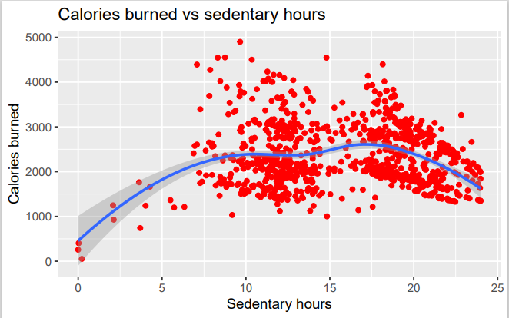
Relationships in the data
In this chart however, the relationship between the amount of calories and the sedentary hours is confusing which we did not expect to see. The relationship pretty clear until it hits that 15 hour mark.

Slide 11
Insights
To keep the users motivated throughout the week and keep them engaged with the products:
Bellabeat could make personalized milestones for users which would give them a motivation to keep up with their physical activities and use the products.
Including some sort of “push” on the products, like a buzz or notification, for users during the week or during long sedentary moments.
Having a point system on the products would give incentive to the users to keep up with their activity and making sure their products are recording their activity.

Slide 12
Recommendations/ Actions
Having options for the versatility of the products such as different straps, and chargers.
To strengthen the accuracy of the calculations of future analysis, it would help if Bellabeats would have users include their height during their initial start-up process.
Offering some connection between users, as to encourage users to use the products to motivate one another.

Slide 13
Thank you!
Lyzet Flores
lyzet.flores@gmail.com

