Slide 1
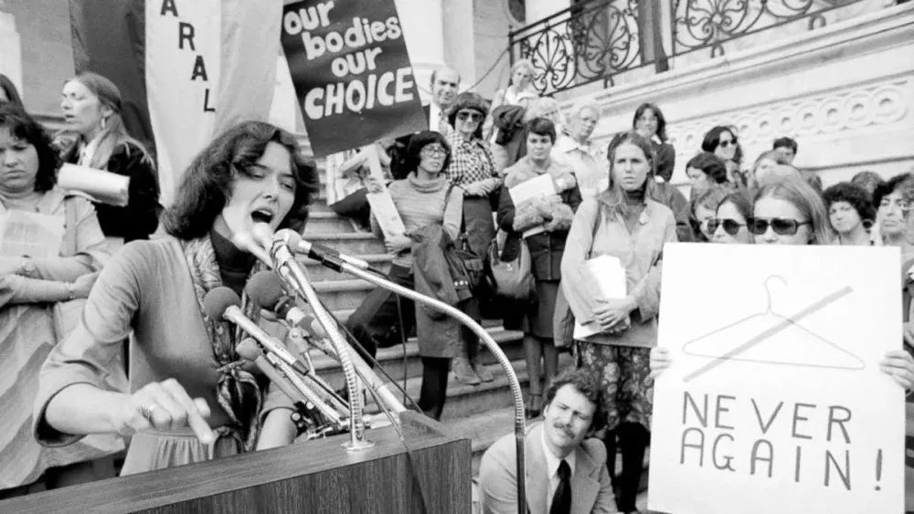
Abortion-line struggle in America
Reporter: Lin Zilong
Notes:
Hello, everyone. Today my topic is about abortion and America’s line struggle.

Slide 2
CONTENTS
The abortion history of America
Abortion case-Roe v. Wade
Line struggle behind abortion
Notes:
Here is the contents.

Slide 3
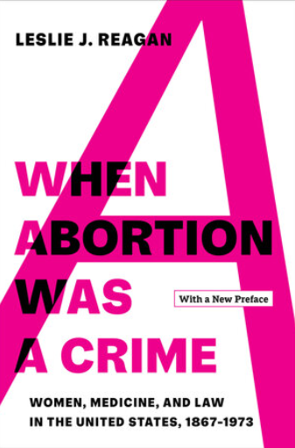
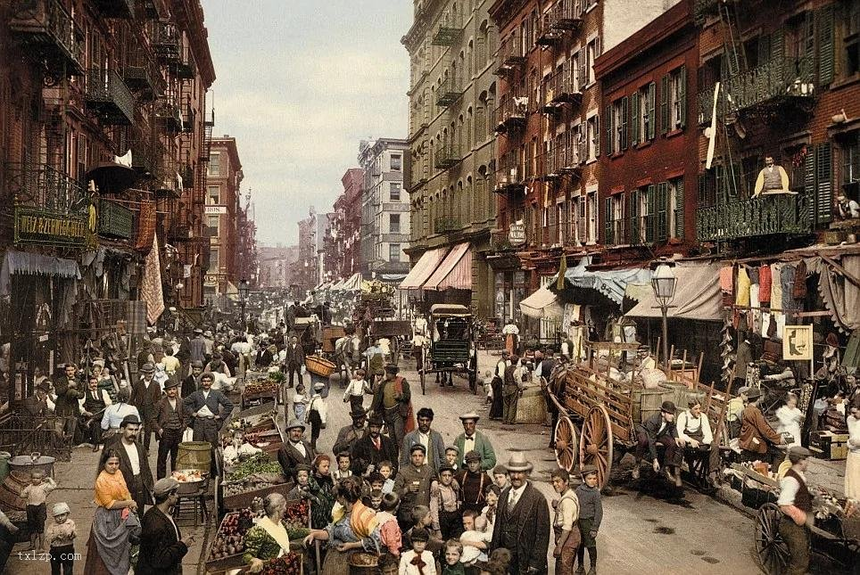
The abortion history of America
A book about abortion history American street in 1820
Notes:
Regan, a history professor, has written a book about the history of abortion in America. Before 1880, abortion was not an serious topic for society. In those days, children were the future workforce of their families but many children did not live to become a workforce, so many families decided whether to abort or not depending on their financial situation.

Slide 4
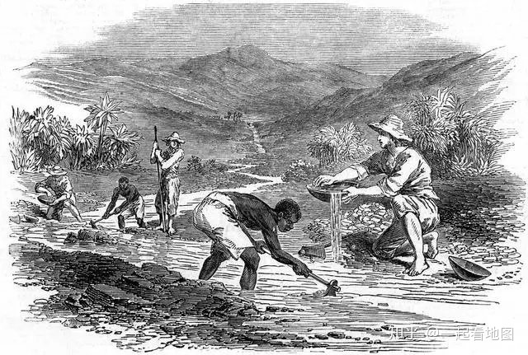
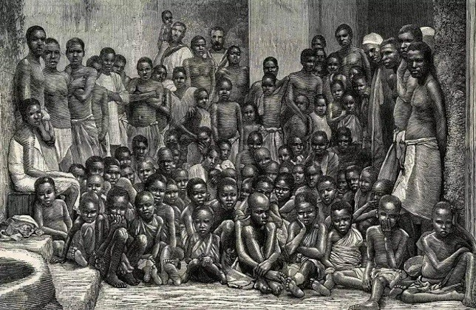
The abortion history of America
Western Development
Black slaves
Westward movement
Black immigration
Panic of locals
Enactment of abortion laws
Notes:
After the Civil War, America developed rapidly, and many immigrants came into the country. Some natives fear immigrants outnumber them so some states introduced abortion law.

Slide 5
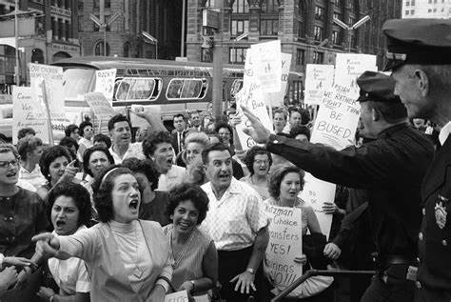
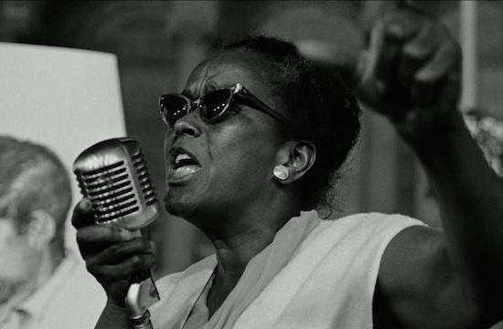
Abortion case-Roe v. Wade
American women in the Civil Rights Movement
Who Roe is?
Who Wade is?
Notes:
By the 1960s to 1970s, Women's rights groups took up abortion as a political goal to fight for, and then came this Roe v. Wade. So who is Roe and Who is Wade? Roy was a Texas girl who became pregnant by accident. Wade is the prosecutor of the government in this case.

Slide 6
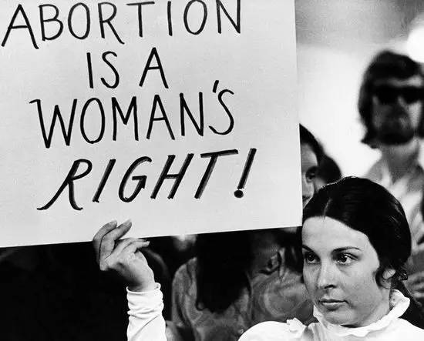
Abortion case-Roe v. Wade
Get pregnancy
Get a rape certificate
Rejected by the police
Go to underground clinic
Stopped by police
Sue the government
Notes:
At the time, Texas law banned abortion except in cases of rape. Roy went to the police to get a rape certificate, but was refused and had to go to an underground clinic, but the clinic was then banned by the police. Eventually Roe decided to sue the government on the grounds that the government violated her right to privacy. Because when the police banned the clinic, they exposed the privacy of her pregnaucy.

Slide 7
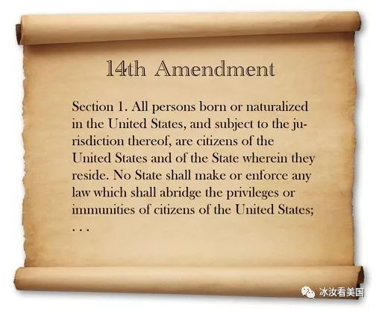
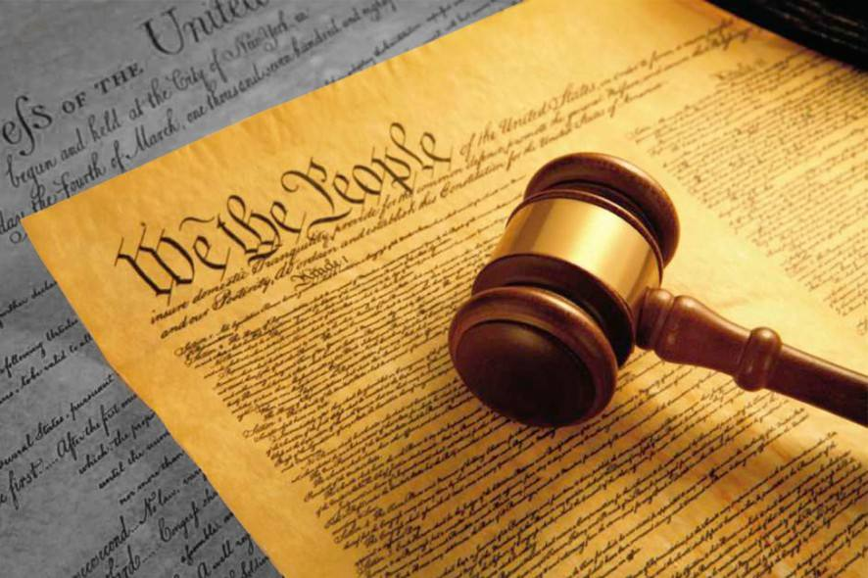
Abortion case-Roe v. Wade
Win
The right to privacy
The right to freedom
Notes:
Finally, The Supreme Court ruled in favor of Roe. The reason is that the abortion law violates the Constitution which contains the right to privacy so that abortion law is invalid.

Slide 8
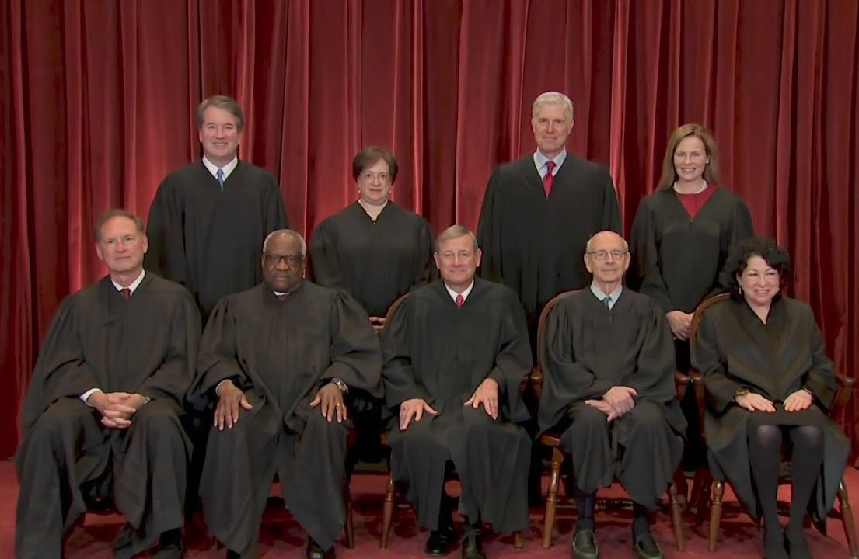
Line struggle behind abortion
What Unconstitutional Review is?
U.S. Justices, nominated by the President, serve for life
Why Roe v. Wade was overturned?
Notes:
So, why the Supreme Court can declare Laws invalid. The reason is that the Supreme Court has the power of unconstitutional review ,which means that they can review any legal decision. If the legal decision is considered to be unconstitutional, it will be invalid.
So, who represent the Supreme Court? The Justices, who are nominated by the president and serve for life.
However the case of Roe v. Wade was overturned last year, because nowadays, five of the nine justices are conservative who agree with the Republican party.

Slide 9

Line struggle behind abortion
Republican Party
Democratic Party
Giving local state governments rights
Giving central
governments rights
Notes:
.
There two parties in America. The Republican Party think that local governments should have right to make laws while the Democratic Party think that the local governments should not have right.

Slide 10
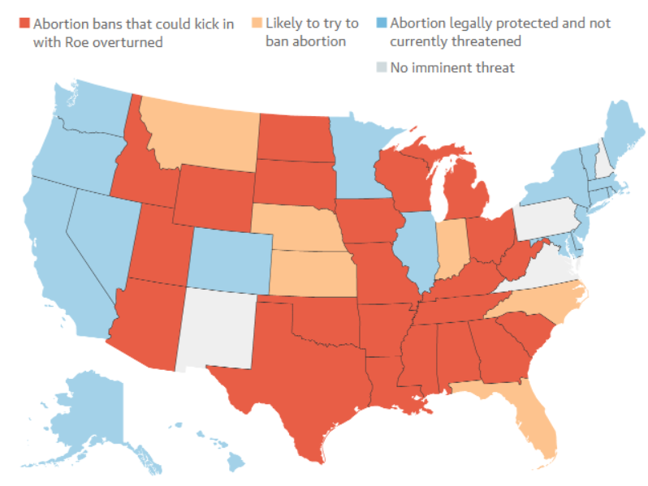
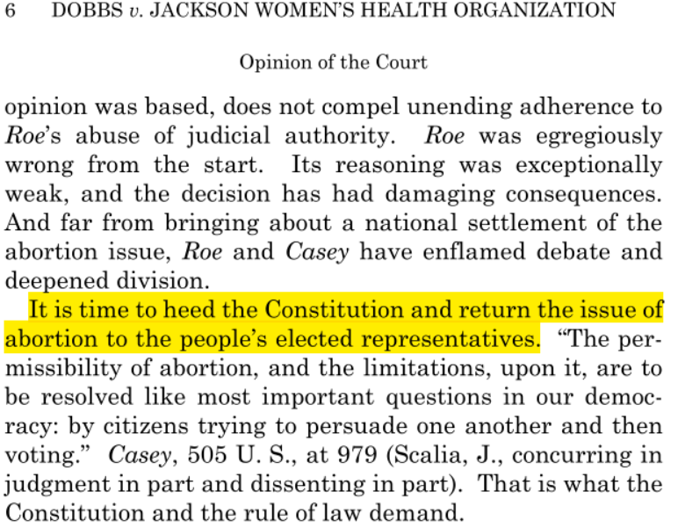
Line struggle behind abortion
Judgment delivered by Judge Atoli
Attitudes toward abortion
Notes:
This is the judgment by Atoli last year. We can see the highlight part suggests that the central government should return abortion issue to local government. Consequently, behind the abortion law, this is a struggle between two policies. This the abortion situation in America now.

Slide 11
My opinions
Abortion
Women right
Health issue
Legislation
Notes:
In my opinion ,I think that we should not ban abortion because abortion is women’s right. Additionally, I think abortion is a health issue not a political issue, so we need to protect abortion by legislation.

Slide 12
Thank you

