Slide 1

Real-Time Voice-Guided Grasping System
A multimodal assistive vision framework for users with visual impairments—integrating object detection, hand tracking, and depth estimation to guide users through everyday grasping tasks in real time via voice.
COMPUTER VISION
ASSISTIVE TECHNOLOGY
MULTIMODAL SYSTEMS

Slide 2
Research Background and Core Contributions
Problem Statement
Three Core Contributions
Existing assistive vision systems mainly focus on scene description and lack the ability to translate high-level semantics into fine-grained motion guidance. This system focuses on: detecting target objects → tracking the user's hand → estimating spatial relationships → generating real-time voice instructions.
Multi-backend hot-swapping evaluation framework
All three perception modules support runtime keyboard switching (keys 1/2/3), allowing direct algorithm comparison without restarting.
Automatic camera calibration based on detected objects
Dynamically infer the pixel-to-centimeter ratio from objects with known dimensions (e.g., A4 paper = 21cm), without manual calibration.
End-to-end multimodal voice interaction pipeline
Integrates Whisper speech recognition, rule-based NLU, and TTS output, with a 1.2-second cooldown mechanism to prevent repeated announcements.

Slide 3
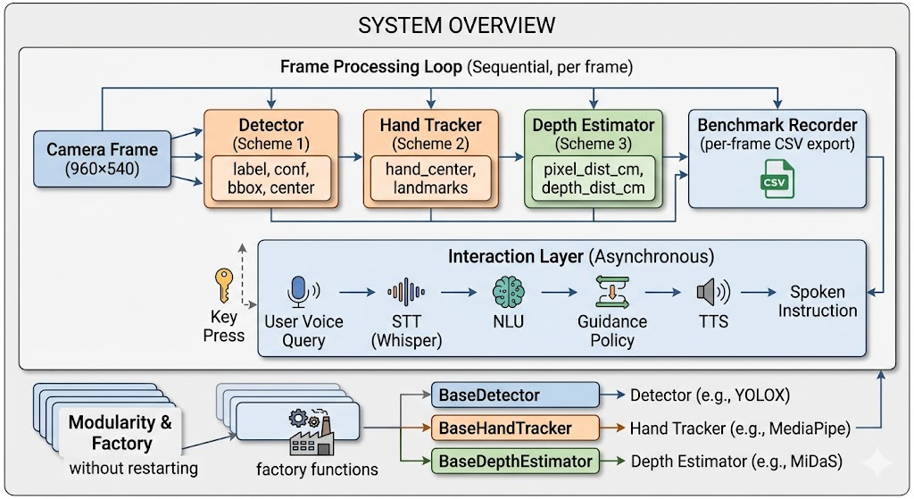
System Architecture Overview
Each frame of image data is processed by three parallel perception modules before merging into the benchmark recorder, while the voice interaction layer responds asynchronously to user queries, enabling decoupled operation between scene perception and voice guidance. Each module is encapsulated with an abstract base class, supporting factory function instantiation and runtime hot swapping.

Slide 4
Data Preparation
Target Classes and Pretrained Models
Benchmark Data Collection
The system is limited to four COCO household object classes: pen, paper, cup, mobile phone. All YOLO and SSD models use COCO 2017 offline pretrained weights, while MiDaS and MediaPipe use officially released weights and require no fine-tuning.
Detection Latency
Hand Tracking Latency
det_ms
hand_ms
Runtime Calibration References
Object
Known Width (cm)
Depth Estimation Latency
Confidence and Distance
Cup
8.5
depth_ms
det_conf / pixel_dist_cm / depth_dist_cm
Mobile phone
7.2
A4 paper
21.0
Frame-level metrics are written to the benchmark recorder in real time and can be exported at any time as a timestamped CSV file for offline analysis.
Other (default)
≈0.18 cm/px

Slide 5



Algorithm Design: Three Core Perception Modules
Option 1: Object Detection
Option 2: Hand Tracking
Option 3: Distance / Depth Estimation
YOLO11s (default): CSP backbone, highest accuracy
YOLOv8 n/s/m: speed-accuracy ablation comparison
SSD MobileNet v2: OpenCV DNN, no additional dependencies
MediaPipe Hands (default): 21-point 3D skeleton, highest accuracy
YOLO-Pose: extracts wrist keypoints, strong robustness to occlusion
MediaPipe Holistic: full-body context for stable hand tracking
Pixel baseline: 2D Euclidean distance × cm/px ratio, O(1) without GPU
MiDaS: monocular depth fusion, Z-axis perception, approximately 83MB model
MiDaS updates the depth map every 3 frames to reduce CPU overhead.
Candidate targets are sorted by area × confidence, and the optimal detection box is selected.
The hand center is the mean of the pixel coordinates of all keypoints.

Slide 6



Depth Estimation: MiDaS Fusion Solution
Why is Z-axis perception needed?
In top-down or oblique scenes, the hand and the target are at a distance of ≈0 in 2D pixel space, but are actually 15–20 cm apart along the Z axis. The pixel baseline will incorrectly report "arrived," while MiDaS can detect and report the vertical gap.
3D distance formula
where , the inverse depth values are normalized to [0,1] within each frame before taking the difference.
Frame-skipping optimization: run MiDaS inference once every 3 frames and reuse the previous depth map for the intermediate frames, effectively reducing computational overhead in slow hand-motion scenarios.

Slide 7

Guidance Strategy and Voice Interaction
Voice Interaction Layer
01
Decision State Machine
STT (Whisper)
16kHz recording, CLI preferred, fallback to Python API
No hand or target detected
Manhattan distance < 120px
02
"Please place the hand and target object in the frame"
"Stop, target is within grasp range, grasp immediately"
NLU (Rule Matching)
Four intent types: scene description / target selection / direction query / grasp confirmation
Horizontal offset dominant
Vertical offset dominant
03
TTS Output
dx > 60px → "Move left"; dx < -60px → "Move right"
dy > 50px → "Move down"; dy < -50px → "Move up"
pyttsx3 → MiniMax API → macOS say, 1.2-second cooldown
Stability filtering: Maintain a command queue of length 4; only when the same command is consistent for 4 consecutive frames is it marked as "stable", effectively suppressing command jitter caused by detection noise.

Slide 8

System Implementation Highlights
Pipeline Scheduling
QuerySnapshotPipeline sequentially executes the three perception modules, stores the results in snapshots, and submits them to the baseline recorder. The camera loop runs at the native frame rate (target 960×540), and the speech layer responds asynchronously to key events.
Runtime Hot Switching
Keys 1/2/3 cycle through the detector, hand tracker, and depth estimator backends respectively. New instances are created in place, and the pipeline continues running without interruption.
Performance Overlay Display
The live video window displays detection boxes, hand skeletons, direction guidance arrows, and four rows of performance metrics, using exponential moving average (α=0.1) to smooth updates.
Test Coverage
7 test modules cover core components such as config, geometry, NLU, guidance, and pipeline, with a pytest coverage threshold of ≥80%.

Slide 9
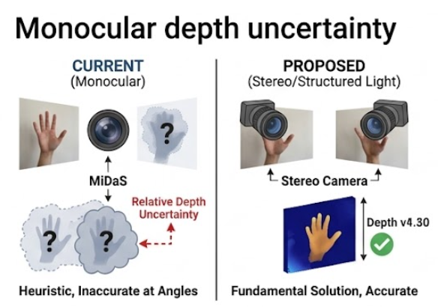
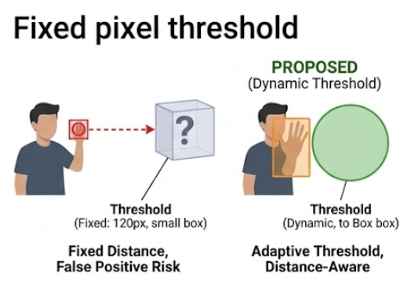
Discussion and Limitations
Core Technical Challenges
Monocular depth uncertainty
MiDaS outputs relative inverse depth, and the current calibration is a heuristic solution that may become inaccurate at different camera angles or distances. Stereo cameras or structured light sensors could fundamentally solve this problem.
Fixed pixel threshold
The 120px near threshold was tuned for a fixed camera distance. A dynamic threshold adapted based on bounding box size is a possible improvement direction.
Single-hand, single-target assumption
In cluttered scenes, multiple candidate targets are selected using the highest-confidence box strategy, which may not match the user's intent.

Slide 10

Conclusion and Future Work
This system implements real-time voice-guided grasping assistance for visually impaired users, integrating three hot-swappable CV pipelines and a unified evaluation framework. Key design decisions include automatic cm/px calibration, 4-frame stability filtering, and coordinate mirroring correction.
Continuous Guidance
Evolve from query-driven interaction to continuous real-time directional broadcast, supporting step-by-step motion correction.
Depth-Adaptive Threshold
Combine target object size information to dynamically adjust the near threshold and improve MiDaS depth accuracy.
Robust NLU
Replace keyword matching with a lightweight intent classifier or a small language model to support negation and novel vocabulary.
Benchmark Data Analysis
Complete backend quantitative comparison experiments to verify the performance trade-offs of each module in latency and accuracy.

