Slide 1
Introduce Some Quantum Algorithms
Reporter: 吕征宇 B20200342

Slide 2
Contents
Review
QAOA
Shor Algorithm
Grover‘s Searching Algorithm
Review some knowledge about quantum
With an example about “Traveling Santa Problem”
Integer Factorization （Program is using 15 as default value）
With an example about “Sudoku”

Slide 3
Review
Compare Qbit and a bit
Defination
Bit : 0 or 1
Qbit: $q=a\left|0>+b\right|1> , where a^{2}+b^{2}=1$
Qbit: 𝑞=𝑎|0>+𝑏|1> , 𝑤ℎ𝑒𝑟𝑒 𝑎^2+𝑏^2=1
Operation
Bit : And , Or , Not and etc. classical logic gate
Qbit: Superposition, Quantum Measurement, and Entanglement by using Unitary Matrix

Slide 4
Review
Compare Qbit and a bit
Defination
2 Bit : 00 or 01 or 10 or 11
2 Qbit:
$q_{0}=\left[\begin{matrix}a \\ b\end{matrix}\right]$, $q_{1}=\left[\begin{matrix}c \\ d\end{matrix}\right]$
𝑞_0=[■8(𝑎@𝑏)], 𝑞_1=[■8(𝑐@𝑑)]
$q=q_{0}⊗q_{1}=\left[\begin{matrix}a\left[\begin{matrix}c \\ d\end{matrix}\right] \\ b\left[\begin{matrix}c \\ d\end{matrix}\right]\end{matrix}\right]=\left[\begin{matrix}ac \\ ad \\ bc \\ bd\end{matrix}\right]=ac\left|00>+ad\right|01>+bc\left|10>+bd\right|11>,$ $where {\left|ac\right|}^{2}+{\left|ad\right|}^{2}+{\left|bc\right|}^{2}+{\left|bd\right|}^{2}=1$
𝑞=𝑞_0⊗𝑞_1=[■8(𝑎[■8(𝑐@𝑑)]@𝑏[■8(𝑐@𝑑)] )]=[■8(𝑎𝑐@𝑎𝑑@𝑏𝑐@𝑏𝑑)]=𝑎𝑐|00>+𝑎𝑑|01>+𝑏𝑐|10>+𝑏𝑑|11>, 𝑤ℎ𝑒𝑟𝑒 |𝑎𝑐|^2+|𝑎𝑑|^2+|𝑏𝑐|^2+|𝑏𝑑|^2=1

Slide 5
Review
Linear algebra for
quantum computing
Quantum State (described as a vector)
$$q=a\left|0>+b\right|1> , where a^{2}+b^{2}=1, and also q=\left[{a \atop b}\right]$$
𝑞=𝑎|0>+𝑏|1> , 𝑤ℎ𝑒𝑟𝑒 𝑎^2+𝑏^2=1, 𝑎𝑛𝑑 𝑎𝑙𝑠𝑜 𝑞=[𝑎¦𝑏]
Basic Operation is Matrix Multiplication , where the operation matrix satisfied $U^{T}U={UU}^{T}=I$, that’s why quantum computing is reversible operation
Basic Operation is Matrix Multiplication , where the operation matrix satisfied 𝑈^𝑇 𝑈=〖𝑈𝑈〗^𝑇=𝐼 , that’s why quantum computing is reversible operation
$U^{T}=U^{−1}$ , $U$ called Unitary Matrix, actually $U$ is a Gate
𝑈^𝑇=𝑈^(−1) , 𝑈 called Unitary Matrix, actually 𝑈 is a Gate
Example:
At the state s, $q_{s}=\left[{a_{s} \atop b_{s}}\right]$, operation $U_{2×2}$, next state $q_{s+1}=Uq_{s}=\left[{a_{s+1} \atop b_{s+1}}\right]$
At the state s, 𝑞_𝑠=[𝑎_𝑠¦𝑏_𝑠 ], operation 𝑈_(2×2), next state 𝑞_(𝑠+1)=𝑈𝑞_𝑠=[𝑎_(𝑠+1)¦𝑏_(𝑠+1) ]
And you can also get state s by using $q_{s}=U^{T}q_{s+1}=\left[{a_{s} \atop b_{s}}\right]$ from s+1
And you can also get state s by using 𝑞_𝑠=𝑈^𝑇 𝑞_(𝑠+1)=[𝑎_𝑠¦𝑏_𝑠 ] from s+1

Slide 6
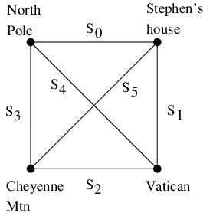
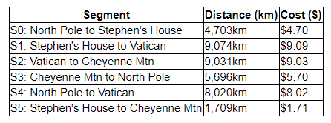
QAOA
Quantum Approximate Optimization Algorithm
Traveling Santa Problem as an example
Formulating the Problem
Santa has some problems
limited food to his reindeers
limited homes he can visited
some people he doesn’t like because they track him

Slide 7
QAOA
Quantum Approximate Optimization Algorithm
Traveling Santa Problem as an example
Formulating the Problem
Where he plans to visit
Stephen Jordan's house (Seattle, Washington)
The pope (Vatican City)
NORAD (Cheyenne Mountain, Colorado),where he wants to put coal in the stockings because people here track him every year

Slide 8
QAOA
Quantum Approximate Optimization Algorithm
Traveling Santa Problem as an example
Formulating the Problem
How can he do
Carefully choosing his route to minimize cost . (The reindeer expend on calorie per kilometer flown. Reindeer fuel costs $0.03 per carrot and each carrot contains 30 calories.)
Start and End must at the North Pole(his home is there)

Slide 9

QAOA
Quantum Approximate Optimization Algorithm
Traveling Santa Problem as an example
Formulating the Problem
Convert to math problem
Define $x_{i}$ is the route $i∈\left[0,5\right]$ he chooses, then the cost can be shown as $C=\sum_{i}{x_{i}C_{i}}$, where $C_{i}$ is route $i$ ‘s cost and $C$ is total cost of the journey
Define 𝑥_𝑖 is the route 𝑖∈[0,5] he chooses, then the cost can be shown as 𝐶=∑_𝑖▒〖𝑥_𝑖 𝐶_𝑖 〗, where 𝐶_𝑖 is route 𝑖 ‘s cost and 𝐶 is total cost of the journey
Total possible plan is $2^{6}$ to $x_{0},…x_{5}$, but only 3 is valid itineraries
Total possible plan is 2^6 to 𝑥_0,…𝑥_5, but only 3 is valid itineraries

Slide 10
QAOA
Quantum Approximate Optimization Algorithm
Traveling Santa Problem as an example
Formulating the Problem
Convert to math problem
These possible routes in logic can be described as $\sum_{j=0}^{5}{x_{j}}=4$
These possible routes in logic can be described as ∑_(𝑗=0)^5▒𝑥_𝑗 =4
where $x_{0}=x_{2}, x_{1}=x_{3} ,x_{4}=x_{6}$ in logic
where 𝑥_0=𝑥_2, 𝑥_1=𝑥_3 ,𝑥_4=𝑥_6 in logic

Slide 11
QAOA
Quantum Approximate Optimization Algorithm
Traveling Santa Problem as an example
Formulating the Problem
Convert to math problem
we recast this as a problem of finding the ground state of a classical Ising model as follows $z_{0},…,z_{5}∈\{−1,1\}$
we recast this as a problem of finding the ground state of a classical Ising model as follows 𝑧_0,…,𝑧_5∈{−1,1}
we map from $x_{0},…,x_{5}$to $z_{0},…,z_{5}$by $z_{j}=1−2x_{j}$
we map from 𝑥_0,…,𝑥_5 to 𝑧_0,…,𝑧_5 by 𝑧_𝑗=1−2𝑥_𝑗
if $x_{j}=0$ then $z_{j}=1$ and if $x_{j}=1$ then $z_{j}=−1$. We thus wish to solve the following problem.
if 𝑥_𝑗=0 then 𝑧_𝑗=1 and if 𝑥_𝑗=1 then 𝑧_𝑗=−1. We thus wish to solve the following problem.

Slide 12
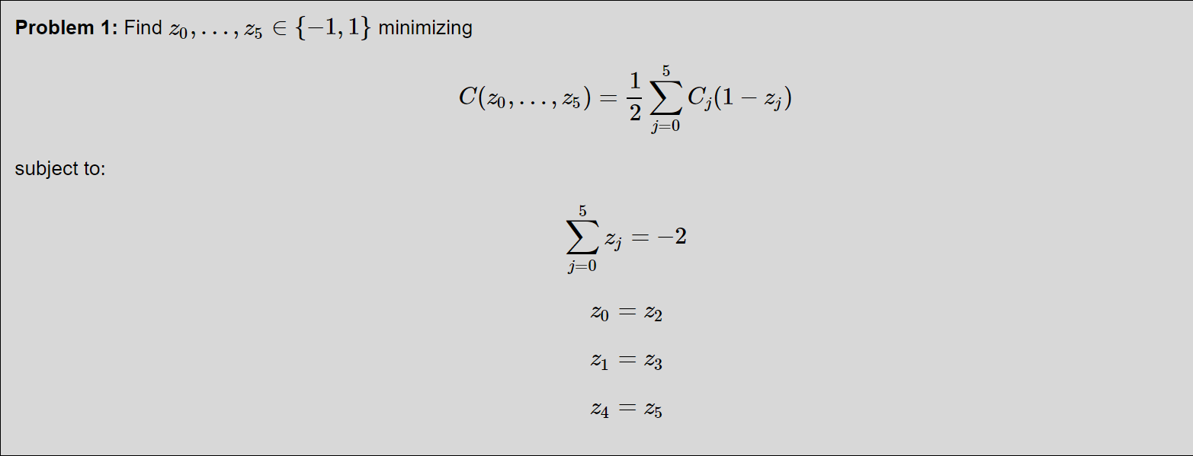
QAOA
Quantum Approximate Optimization Algorithm
Traveling Santa Problem as an example
Formulating the Problem

Slide 13
QAOA
Quantum Approximate Optimization Algorithm
Traveling Santa Problem as an example
Formulating the Problem
Convert to math problem
To convert into an unconstrained optimization problem we may add penalties to the cost function for violated constraints: $1−z_{i}z_{j}=\left\{\begin{aligned}0, z_{i}=z_{j} \\ 2, z_{i}≠z_{j}\end{aligned}\right.$
To convert into an unconstrained optimization problem we may add penalties to the cost function for violated constraints: 1−𝑧_𝑖 𝑧_𝑗={█(0, 𝑧_𝑖=𝑧_𝑗@2, 𝑧_𝑖≠𝑧_𝑗 )┤
And ${\left(2+\sum_{j=0}^{5}{z_{j}}\right)}^{2}=\left\{\begin{matrix}0 & ,\sum_{j=0}^{5}{z_{j}}=2 \\ at least 2 & ,otherwise\end{matrix}\right.$
And (2+∑_(𝑗=0)^5▒𝑧_𝑗 )^2={■8(0&,∑_(𝑗=0)^5▒𝑧_𝑗 =2@𝑎𝑡 𝑙𝑒𝑎𝑠𝑡 2&,𝑜𝑡ℎ𝑒𝑟𝑤𝑖𝑠𝑒)┤
Minimum cost is at home : $x_{0}=x_{1}=x_{2}=x_{3}=x_{4}=x_{5}=0$
Minimum cost is at home : 𝑥_0=𝑥_1=𝑥_2=𝑥_3=𝑥_4=𝑥_5=0
Maximum cost is pass all route : $x_{0}=x_{1}=x_{2}=x_{3}=x_{4}=x_{5}=1$
Maximum cost is pass all route : 𝑥_0=𝑥_1=𝑥_2=𝑥_3=𝑥_4=𝑥_5=1
Thus making a new cost function to ensure that all constraint-violating assignments are costlier than any valid assignment, and $p>\frac{1}{2} 38.25, and$ $p=20$
Thus making a new cost function to ensure that all constraint-violating assignments are costlier than any valid assignment, and 𝑝>1/2 38.25, 𝑎𝑛𝑑 𝑝=20
$H=\frac{1}{2}\sum_{j=0}^{5}{C_{j}\left(1−z_{j}\right)}+p\left(1−z_{0}z_{2}\right)+p\left(1−z_{1}z_{3}\right)$+ $p\left(1−z_{4}z_{5}\right)$+ $p{\left(2+\sum_{j=0}^{5}{z_{j}}\right)}^{2}$
𝐻=1/2 ∑_(𝑗=0)^5▒〖𝐶_𝑗 (1−𝑧_𝑗 ) 〗+𝑝(1−𝑧_0 𝑧_2 )+𝑝(1−𝑧_1 𝑧_3 )+ 𝑝(1−𝑧_4 𝑧_5 )+ 𝑝(2+∑_(𝑗=0)^5▒𝑧_𝑗 )^2

Slide 14
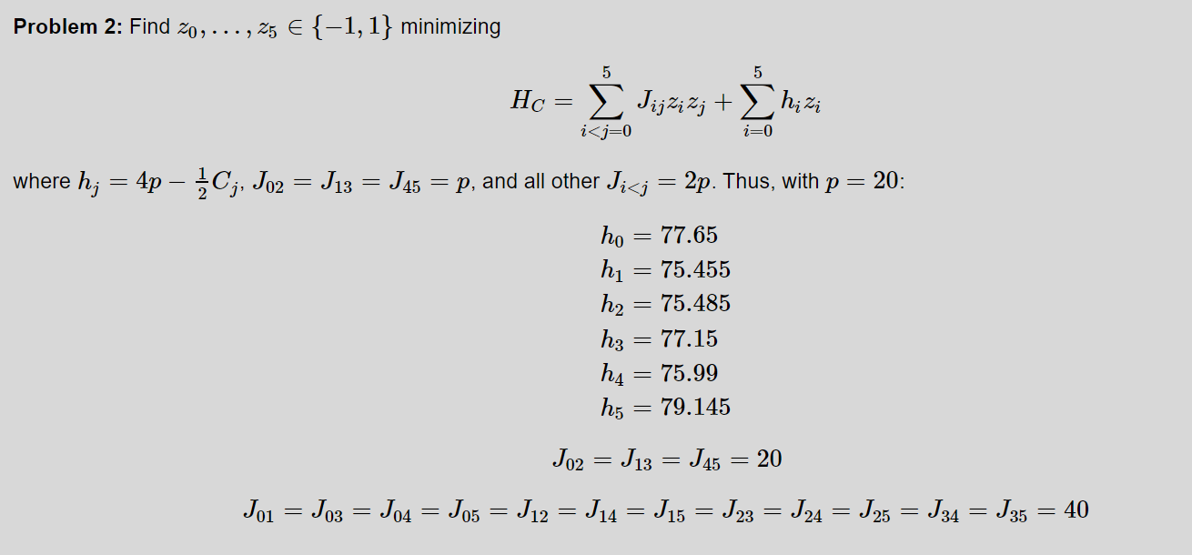
QAOA
Quantum Approximate Optimization Algorithm
Traveling Santa Problem as an example
Formulating the Problem

Slide 15
QAOA
Quantum Approximate Optimization Algorithm
Traveling Santa Problem as an example
Solving the Problem
Solving the Problem(Convert to Quantum Problem)
In QAOA one attempts to do this by interspersing time evolutions according to the Hamiltonian $H_{c}$ with time evolutions induced by some "driver" Hamiltonian, which we will take to be $H_{0}=−\sum_{i=0}^{n−1}{X_{i}}$, where n is the number of qubits.
In QAOA one attempts to do this by interspersing time evolutions according to the Hamiltonian 𝐻_𝑐 with time evolutions induced by some "driver" Hamiltonian, which we will take to be 𝐻_0=−∑24_(𝑖=0)^(𝑛−1)▒𝑋_𝑖 , where n is the number of qubits.
This system is initialized to the uniform superposition ${\left(\frac{|0>+|1>}{\sqrt{2}}\right)}^{⊗n}=\frac{1}{\sqrt{2^{n}}}\sum_{x∈{\left\{0,1\right\}}^{n}}{|x>}$
This system is initialized to the uniform superposition ((|0>+|1>)/√2)^(⊗𝑛)=1/√(2^𝑛 ) ∑8_(𝑥∈{0,1}^𝑛)▒〖|𝑥>〗
Then we implement the unitary time evolutions $e^{−iH_{0}t}$ and $e^{−iH_{c}t}$ as quantum circuits by breaking them down into elementary gates, implementing $e^{−iH_{0}t}$ as a quantum circuit $e^{−iH_{0}t}=\prod_{j=0}^{n−1}{e^{−iX_{j}t}}$
Then we implement the unitary time evolutions 𝑒^(−𝑖𝐻_0 𝑡) and 𝑒^(−𝑖𝐻_𝑐 𝑡) as quantum circuits by breaking them down into elementary gates, implementing 𝑒^(−𝑖𝐻_0 𝑡) as a quantum circuit 𝑒^(−𝑖𝐻_0 𝑡)=∏24_(𝑗=0)^(𝑛−1)▒𝑒^(−𝑖𝑋_𝑗 𝑡)

Slide 16
QAOA
Quantum Approximate Optimization Algorithm
Traveling Santa Problem as an example
Code example from Microsoft using QDK
This the final main function.
You can try it in you laptop!
It costs not much compute power to run.
It will try many times to find a lowest cost route in the route graph.(We let it try 12 times!)
Where to get it
https://github.com/microsoft/Quantum/tree/main/samples/simulation/qaoa
Environment
VS2019 Community
.Net Core 3.1
QDK

Slide 17
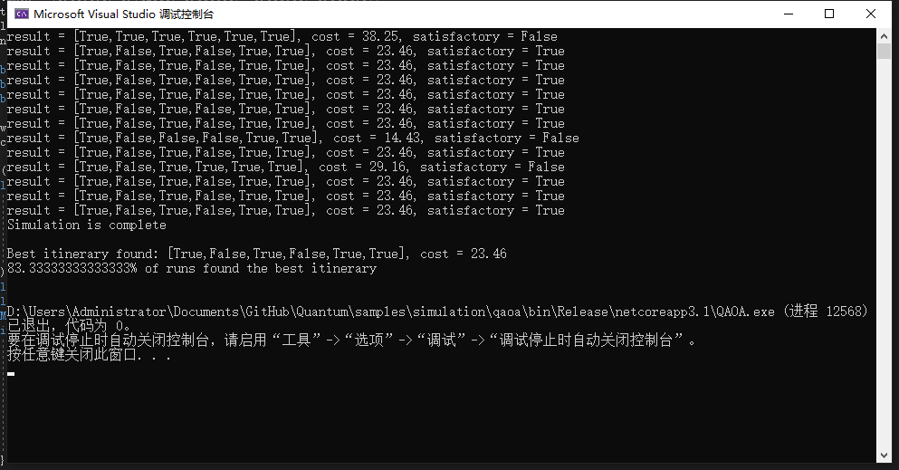
QAOA
Quantum Approximate Optimization Algorithm
Traveling Santa Problem as an example
Results
12 Times！

Slide 18
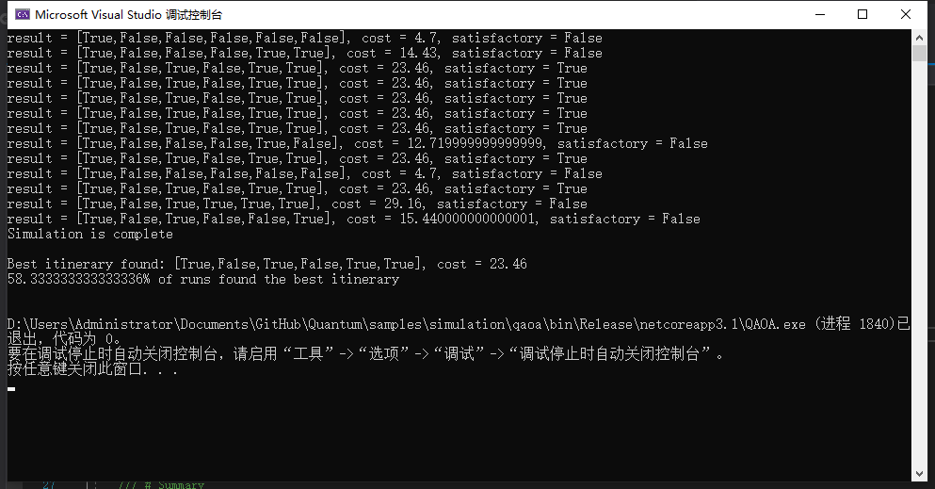
QAOA
Quantum Approximate Optimization Algorithm
Traveling Santa Problem as an example
Results
12 Times！

Slide 19

QAOA
Quantum Approximate Optimization Algorithm
Traveling Santa Problem as an example
Results
12 Times！

Slide 20
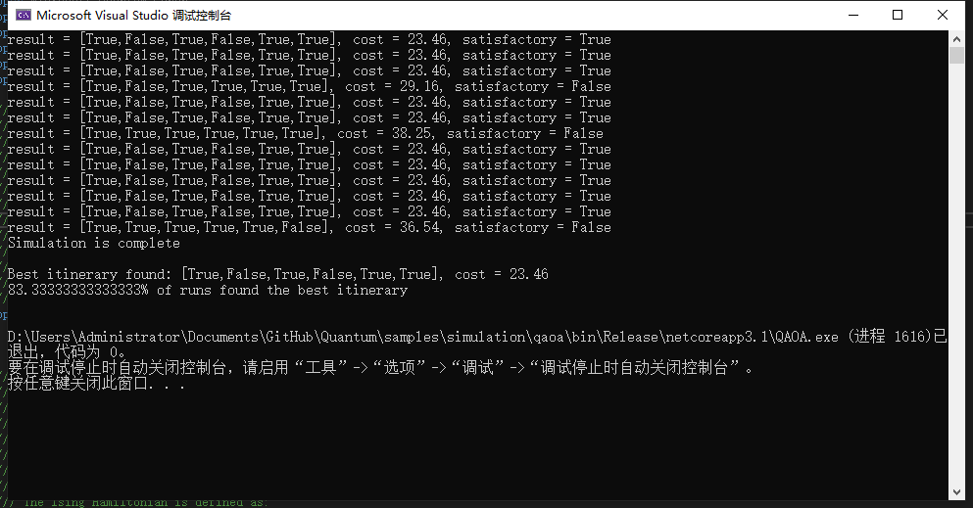
QAOA
Quantum Approximate Optimization Algorithm
Traveling Santa Problem as an example
Results
12 Times！

Slide 21
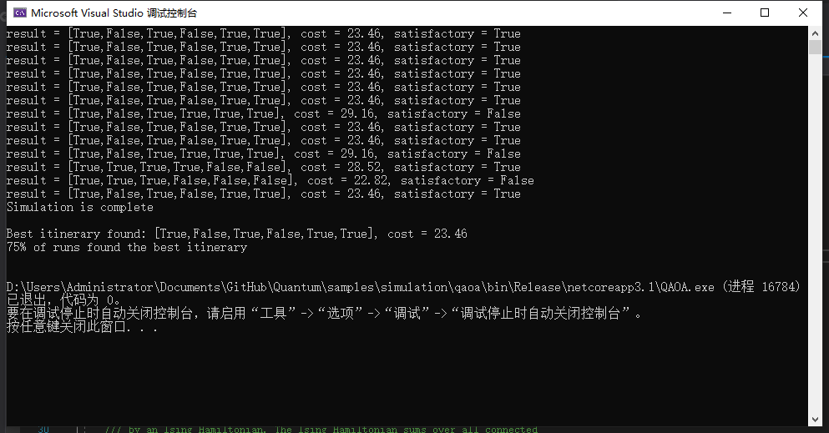
QAOA
Quantum Approximate Optimization Algorithm
Traveling Santa Problem as an example
Results
12 Times！

Slide 22
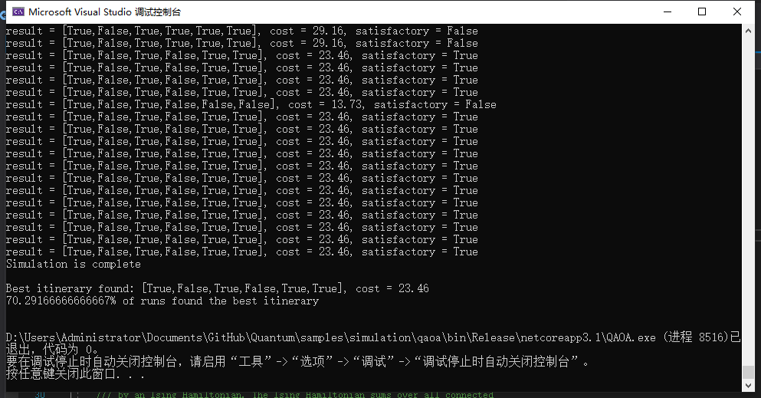
QAOA
Quantum Approximate Optimization Algorithm
Traveling Santa Problem as an example
Results
12000 Times！

Slide 23
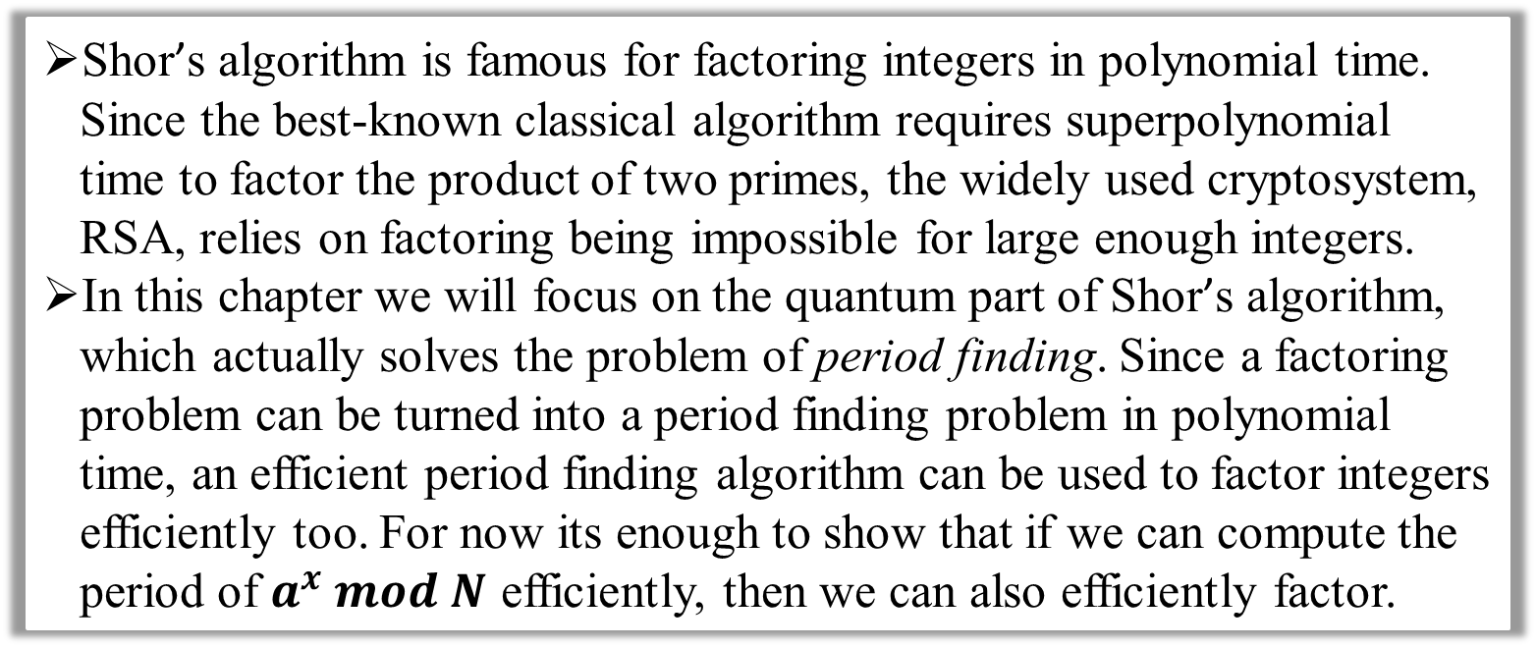
Shor
Shor's algorithm
Integer Factorization
Background
Shor’s algorithm is famous for factoring integers in polynomial time. Since the best-known classical algorithm requires superpolynomial time to factor the product of two primes, the widely used cryptosystem, RSA, relies on factoring being impossible for large enough integers.
In this chapter we will focus on the quantum part of Shor’s algorithm, which actually solves the problem of period finding. Since a factoring problem can be turned into a period finding problem in polynomial time, an efficient period finding algorithm can be used to factor integers efficiently too. For now its enough to show that if we can compute the period of $a^{x} mod N$ efficiently, then we can also efficiently factor.

Slide 24
Shor
Shor's algorithm
Integer Factorization
Formulating the Problem
To factor N
Need to find $a$ satisfied $gcd\left(a,N\right)=1$
Need to find 𝑎 satisfied 𝑔𝑐𝑑(𝑎,𝑁)=1
Find the minimum $r$ satisfied $a^{r}=1 \left(mod N\right)$
Find the minimum 𝑟 satisfied 𝑎^𝑟=1 (𝑚𝑜𝑑 𝑁)
If $r$ is an even number, let $x=a^{\frac{r}{2}}\left(mod N\right)$. If $x+1≠0\left(mod N\right)$, then $\left\{p,q\right\}=\left\{gcd\left(x+1,N\right),gcd\left(x−1,N\right)\right\}$, else find another $a$ and repeat above steps.
If 𝑟 is an even number, let 𝑥=𝑎^(𝑟/2) (𝑚𝑜𝑑 𝑁). If 𝑥+1≠0(𝑚𝑜𝑑 𝑁), then {𝑝,𝑞}={𝑔𝑐𝑑(𝑥+1,𝑁),𝑔𝑐𝑑(𝑥−1,𝑁)}, else find another 𝑎 and repeat above steps.
Indeed to an Quantum Turning Machine
Compute ability is relay on the number of Qbits
4 Qbits- Computer means $2^{4−1}$ time powerful than 1 Qbit- Computer
4 Qbits- Computer means 2^(4−1) time powerful than 1 Qbit- Computer
So the time complexity of integer factorization can be reduce from $O\left(e^{cn^{\frac{1}{3}}{\left(logn\right)}^{\frac{2}{3}}}\right)$ to $O\left(n^{2}\left(logn\right)\right)$ where n is the bit number of an integer
So the time complexity of integer factorization can be reduce from 𝑂(𝑒^(𝑐𝑛^(1/3) (𝑙𝑜𝑔𝑛)^(2/3) ) ) to 𝑂(𝑛^2 (𝑙𝑜𝑔𝑛)) where n is the bit number of an integer

Slide 25
Shor
Shor's algorithm
Integer Factorization
The Solution
Use quantum phase estimation on the unitary operator: $U|y⟩≡|a_{y}mod N⟩$
Use quantum phase estimation on the unitary operator: 𝑈|𝑦⟩≡|𝑎_𝑦 𝑚𝑜𝑑 𝑁⟩
To see how this is helpful, let’s work out what an eigenstate of $U$ might look like. If we started in the state $|1⟩$, we can see that each successive application of $U$ will multiply the state of our register by $a (mod N)$, and after r applications we will arrive at the state $|1⟩$ again.
To see how this is helpful, let’s work out what an eigenstate of 𝑈 might look like. If we started in the state |1⟩, we can see that each successive application of 𝑈 will multiply the state of our register by 𝑎 (𝑚𝑜𝑑 𝑁), and after r applications we will arrive at the state |1⟩ again.
So a superposition of the states in this cycle ( $|u_{0}⟩$ ) would be an eigenstate of U : $\left|u_{0}\right\rangle =\frac{1}{\sqrt{r}}\sum_{k=0}^{r−1}{|a^{k}mod N⟩}$
So a superposition of the states in this cycle ( |𝑢_0⟩ ) would be an eigenstate of U : |𝑢_0 ⟩=1/√𝑟 ∑_(𝑘=0)^(𝑟−1)▒〖|𝑎^𝑘 𝑚𝑜𝑑 𝑁⟩〗

Slide 26
Shor
Shor's algorithm
Integer Factorization
The Solution
This eigenstate has an eigenvalue of 1, which isn’t very interesting. A more interesting eigenstate could be one in which the phase is different for each of these computational basis states. Specifically, let’s look at the case in which the phase of the $k$-th state is proportional to $k.$
This eigenstate has an eigenvalue of 1, which isn’t very interesting. A more interesting eigenstate could be one in which the phase is different for each of these computational basis states. Specifically, let’s look at the case in which the phase of the 𝑘-th state is proportional to 𝑘.
$$\left|u_{s}\right\rangle =\frac{1}{\sqrt{r}}\sum_{k=0}^{r−1}{e^{−\frac{2π sik}{r}}|a^{k}mod N⟩}$$
|𝑢_𝑠 ⟩=1/√𝑟 ∑_(𝑘=0)^(𝑟−1)▒〖𝑒^(−(2𝜋 𝑠𝑖𝑘)/𝑟) |𝑎^𝑘 𝑚𝑜𝑑 𝑁⟩〗
$$U\left|u_{s}\right\rangle =e^{\frac{2πsi}{r}}\left|u_{s}\right\rangle$$
𝑈|𝑢_𝑠 ⟩=𝑒^(2𝜋𝑠𝑖/𝑟) |𝑢_𝑠 ⟩
$$s∈\left[0,r−1\right]$$
𝑠∈[0,𝑟−1]

Slide 27
Shor
Shor's algorithm
Integer Factorization
The Solution
Very conveniently, if we sum up all these eigenstates, the different phases cancel out all computational basis states except $|1⟩$:
Very conveniently, if we sum up all these eigenstates, the different phases cancel out all computational basis states except |1⟩:
$$\frac{1}{\sqrt{r}}\sum_{s=0}^{r−1}{\left|u_{s}\right\rangle }=\left|1\right\rangle$$
1/√𝑟 ∑24_(𝑠=0)^(𝑟−1)▒|𝑢_𝑠 ⟩ =|1⟩

Slide 28
Shor
Shor's algorithm
Integer Factorization
The Solution
The Quantum Circuit of the quantum part of Shor’s Algorithm and the Code is at https://github.com/microsoft/Quantum/tree/main/samples/algorithms/integer-factorization

Slide 29
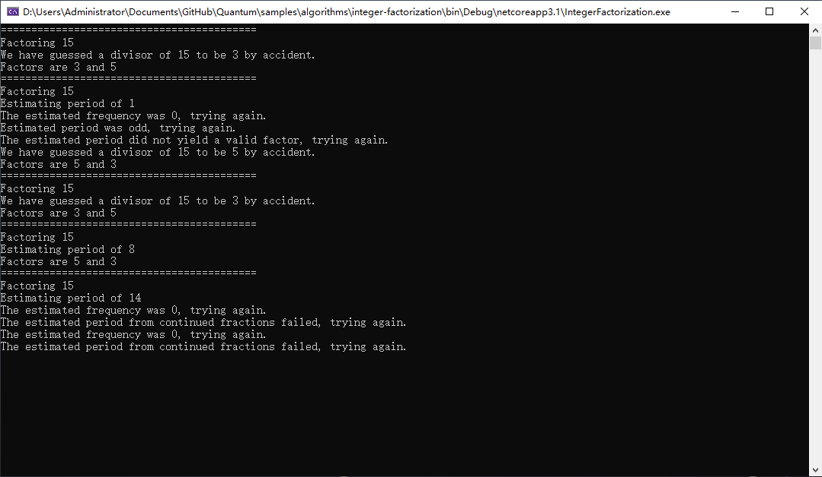
Shor
Shor's algorithm
Integer Factorization
Running Result
This example is by using 15 as the integer to factorization
It has a certain probability of error, but it will success most of the time
Using the QDK to simulate quantum is easy and convenient
Also you can use the Qiskit whitch is the package of IBM and programming with using Python

Slide 30
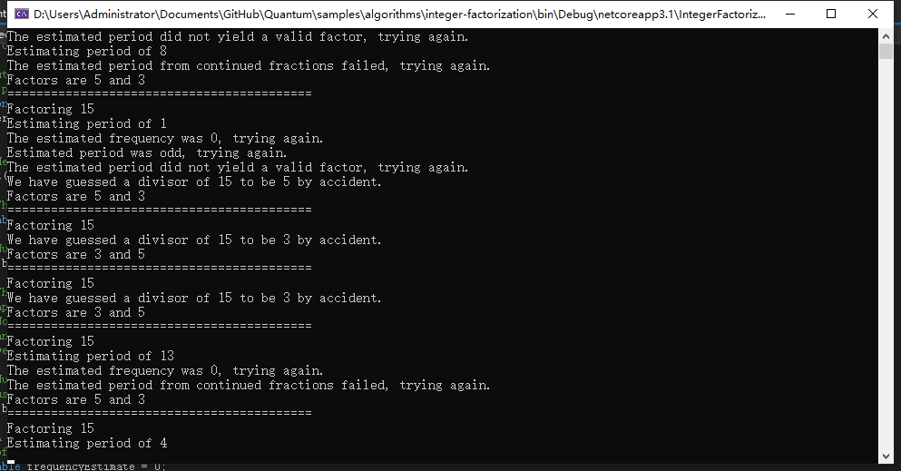
Shor
Shor's algorithm
Integer Factorization
Running Result

Slide 31
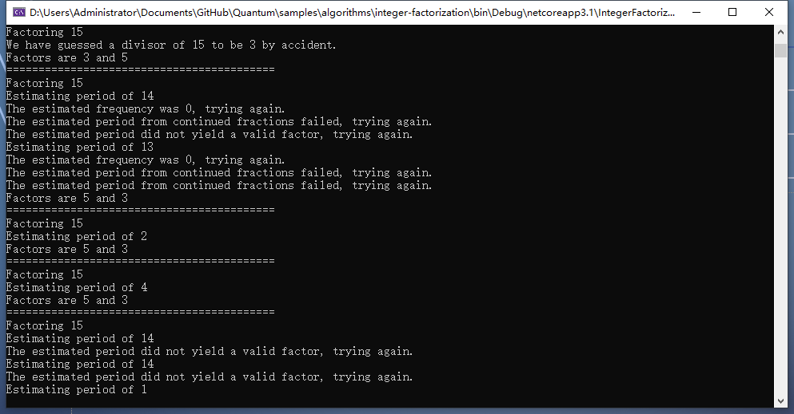
Shor
Shor's algorithm
Integer Factorization
Running Result

Slide 32
Grover
Grover Search
Search Alogrithm
About Sudoku
Sudoku is a mathematical game originated from Switzerland in the 18th century. It is a kind of logic game that uses paper and pen to calculate. Players need to infer the numbers of all the remaining spaces according to the known numbers on the 9 × 9 board, and ensure that the numbers in each row, column and thick line Palace (3 * 3) contain 1-9 and are not repeated.
Sudoku board is a nine palace, each house is divided into nine small grids. In this 81 lattice, given a certain number and problem-solving conditions, using logic and reasoning, fill in 1-9 numbers in other spaces.

Slide 33
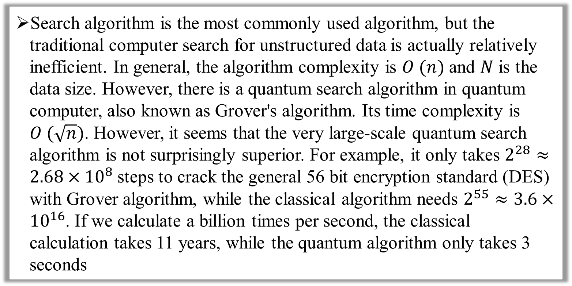
Grover
Grover Search
Search Alogrithm
Compared with classical algorithm
Search algorithm is the most commonly used algorithm, but the traditional computer search for unstructured data is actually relatively inefficient. In general, the algorithm complexity is $O (n)$ and $N$ is the data size. However, there is a quantum search algorithm in quantum computer, also known as Grover's algorithm. Its time complexity is $O (\sqrt{n})$. However, it seems that the very large-scale quantum search algorithm is not surprisingly superior. For example, it only takes $2^{28}≈{2.68×10}^{8}$steps to crack the general 56 bit encryption standard (DES) with Grover algorithm, while the classical algorithm needs $2^{55}≈3.6×{10}^{16}$. If we calculate a billion times per second, the classical calculation takes 11 years, while the quantum algorithm only takes 3 seconds

Slide 34
Grover
Grover Search
Search Alogrithm
Sudoku solution using Grover’s Search Alogrithm
What makes Grover’s algorithm so powerful is how easy it is to convert a problem to an oracle of this form. There are many computational problems in which it’s difficult to find a solution, but relatively easy to verify a solution. For example, we can easily verify a solution to a sudoku by checking all the rules are satisfied.
By understanding an example of solving the game of sudoku, we can have some idea to how and where to use it in the future.

Slide 35
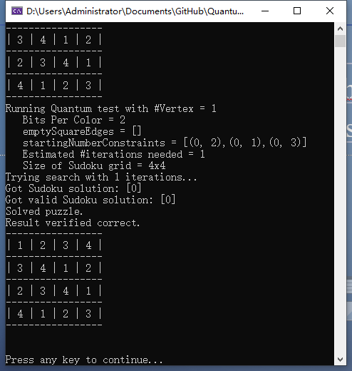
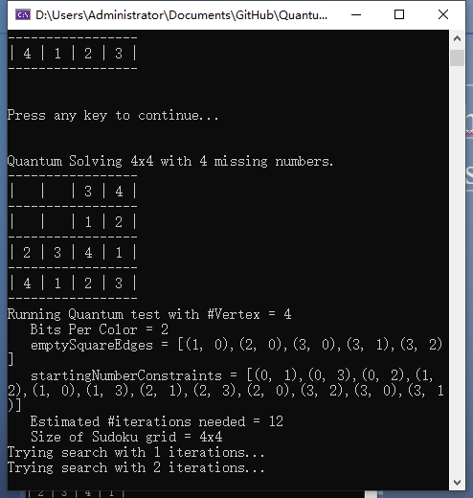
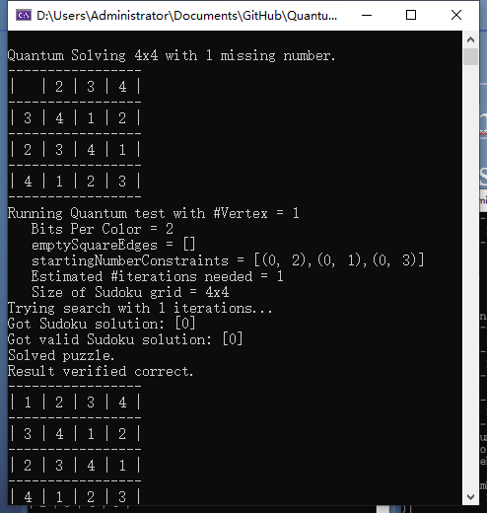
Grover
Grover Search
Search Alogrithm
Running results

Slide 36
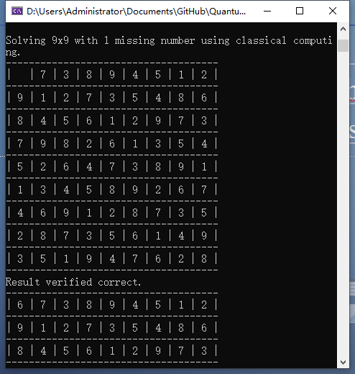
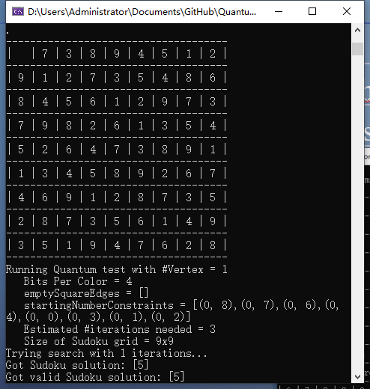
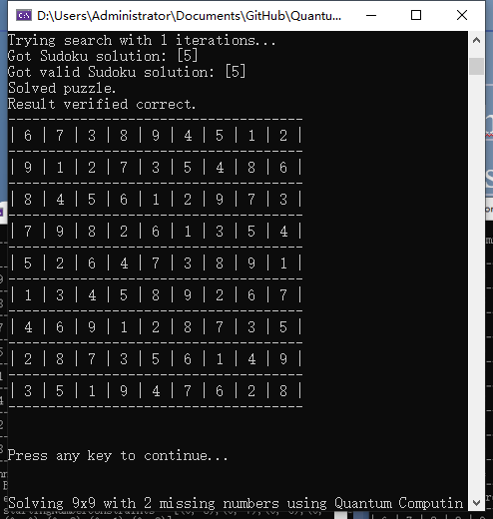
Grover
Grover Search
Search Alogrithm
Running results

Slide 37
Conclution
Overview
Quantum computing, which is used to accelerate the solution of classical problems, may have some advantages. But it can not reduce the complexity of the problem in theory.
Advantage
The calculation is fast and can simulate the actual physical problems.
It is generally considered that the study of quantum is an exploration of the physical world, and quantum simulation of micro particles is appropriate.
Disadvantage
At present, quantum computing resources are limited, and it is extremely difficult to make multi qubit computers.
The ability to solve classical problems is limited and programming is not easy.

