Slide 1
PHISHING SIMULATION
Credential Harvesting Attack & Awareness
Beta Team | COSC-3411 | ITAP
Tool: zphisher v2.3.5
For Educational Use Only — COSC-3411 Course Project

Slide 2
WHAT IS PHISHING?
#1
91%
$4.9B
3.4B
Cause of Data Breaches
Attacks start with email
Lost to phishing in 2023
Phishing emails sent daily
Definition: Phishing is a social engineering attack where an attacker impersonates a trusted entity to trick victims into revealing credentials, financial data, or personal information.
Attack Flow:
1. Attacker sets up
fake login page
2. Sends phishing
link to victim
3. Victim enters
credentials
4. Attacker captures
username & password
→
→
→
Beta Team | COSC-3411

Slide 3
TOOL OVERVIEW — ZPHISHER
Key Features
Project Structure
35+ Templates
zphisher/
├── zphisher.sh # main script
├── auth/
│ ├── ip.txt # victim IP log
│ └── usernames.dat # credentials
├── scripts/ # page templates
├── Dockerfile
└── README.md
Facebook, Google, Microsoft, PayPal & more
3 Tunneling Options
Localhost, Cloudflared, LocalXpose
Auto Credential Capture
IP + username + password saved to file
No Dependencies Needed
Self-contained bash script
Custom Port Support
Configurable port forwarding
Bash
PHP
Cloudflared
Kali Linux
Beta Team | COSC-3411

Slide 4
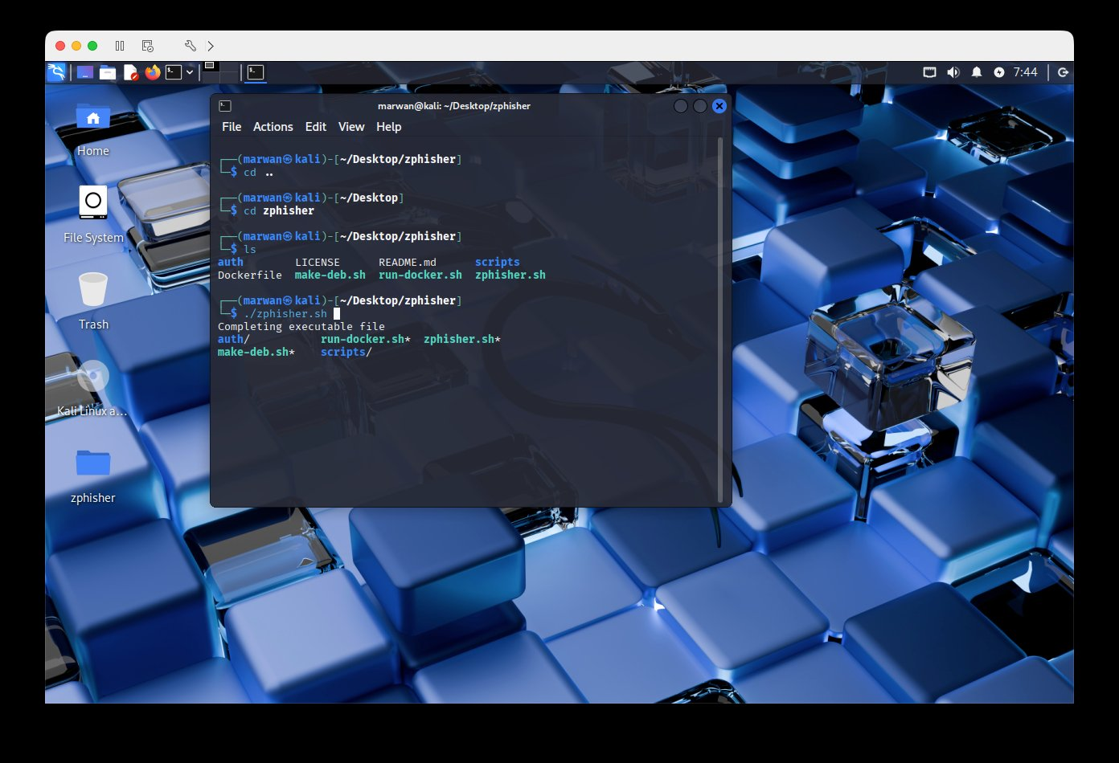
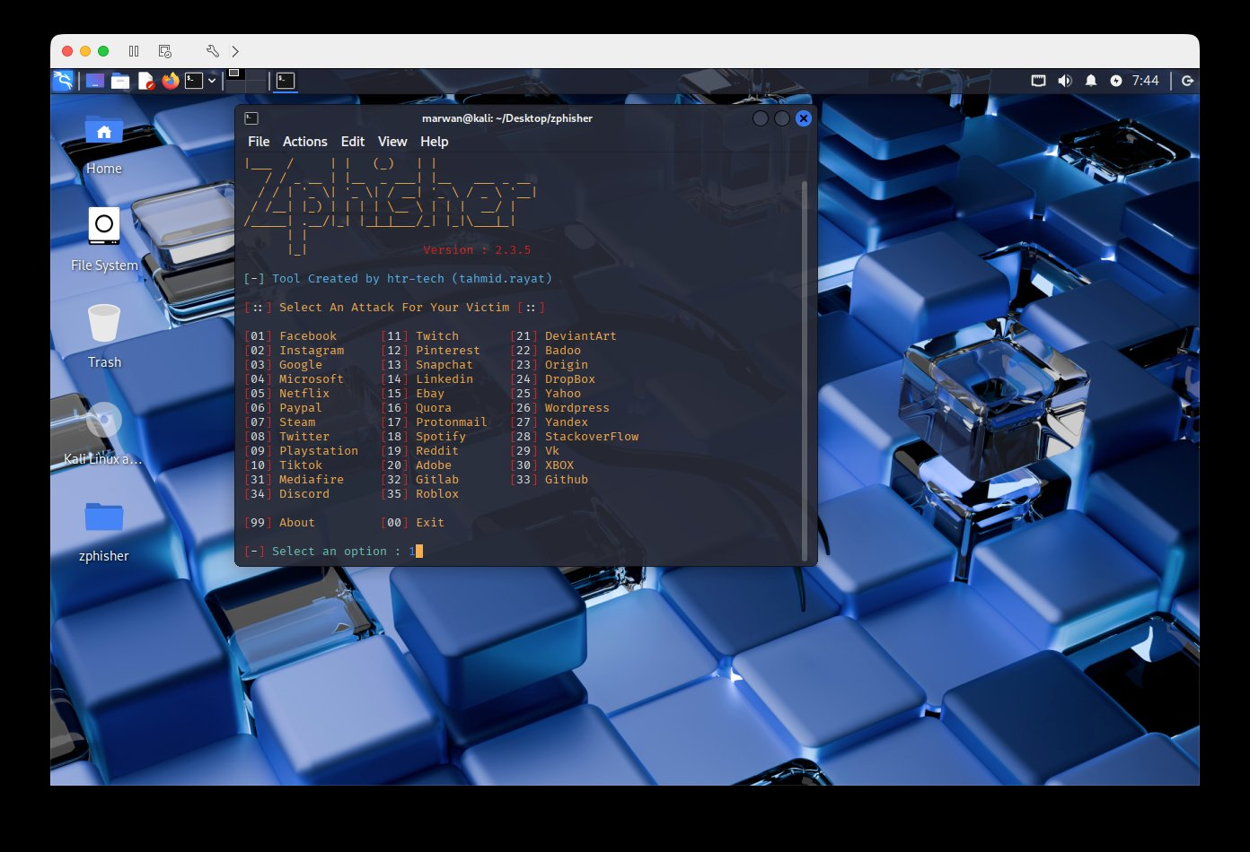
DEMO — STEP 1 & 2: LAUNCH & SELECT TARGET
① Run ./zphisher.sh — files & permissions
② Select target platform (e.g. [01] Facebook)
Step 1: cd zphisher && ./zphisher.sh
Step 2: Choose target site (35+ options)
Beta Team | COSC-3411

Slide 5
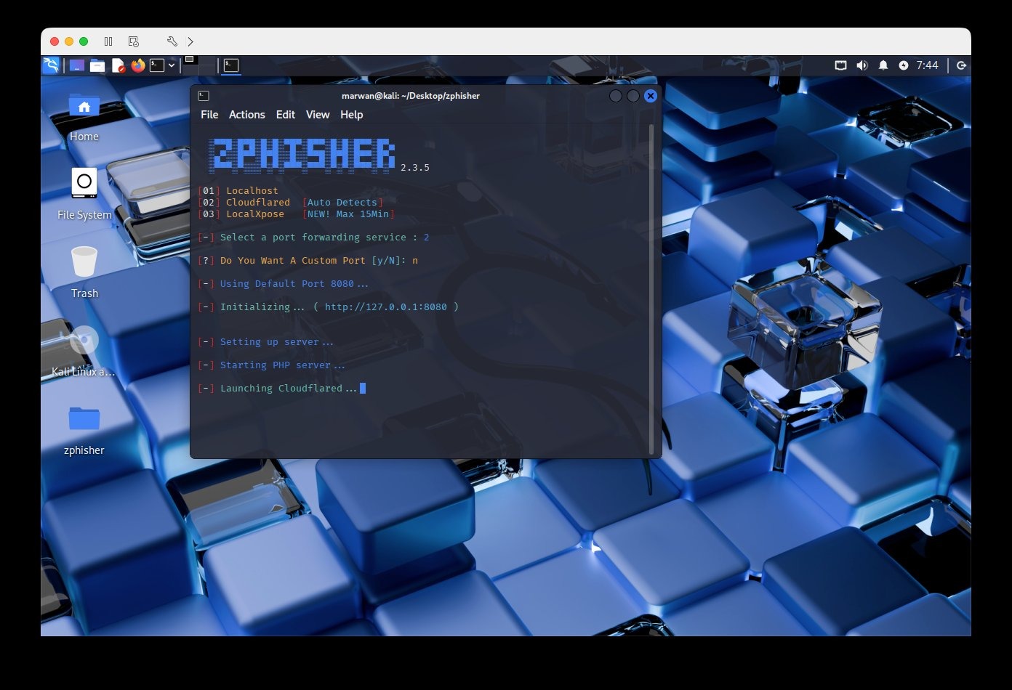
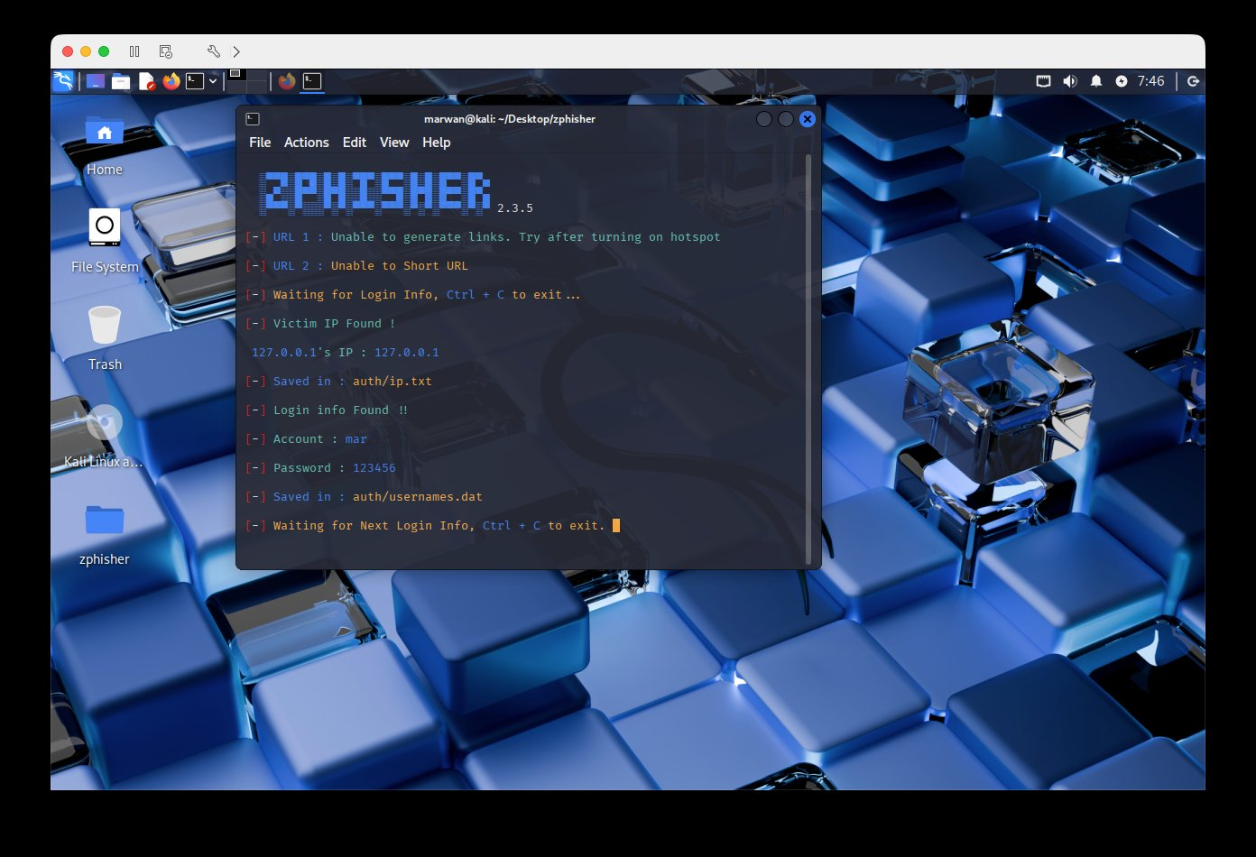
DEMO — STEP 3 & 4: TUNNELING & CREDENTIAL CAPTURE
③ Select Cloudflared — server starts on port 8080
④ Credentials captured: Account + Password + IP
Phishing link sent → victim visits → credentials saved automatically
Account : mar Password : 123456
Saved in: auth/usernames.dat | auth/ip.txt
Beta Team | COSC-3411

Slide 6
HOW IT WORKS — TECHNICAL BREAKDOWN
Phase 1: Setup
Phase 2: Delivery
Phase 3: Capture
Script selects PHP template for chosen platform
Attacker sends phishing URL to victim
PHP script intercepts POST request
PHP server starts on localhost:8080
Victim clicks link — sees a login page clone
Username & password extracted
Cloudflared creates public HTTPS tunnel
Page looks identical to legitimate site
Victim IP address logged
Public URL generated and displayed
Victim types their credentials
Data saved to auth/usernames.dat
$ cd zphisher && ./zphisher.sh → Select site → Select tunneling → Send link → Capture credentials
Beta Team | COSC-3411

Slide 7
DEFENSE — HOW TO DETECT & PREVENT
🔍 Detection Indicators
🛡 Prevention Measures
⚠
URL uses Cloudflare tunnel (trycloudflare.com)
✔
Enable MFA on all accounts
⚠
HTTP instead of official HTTPS domain
✔
Verify URLs before entering credentials
⚠
Domain doesn't match official brand
✔
Use a password manager (flags fake sites)
⚠
Page requests credentials via POST to PHP script
✔
Train users to recognize phishing attempts
⚠
SPF/DKIM/DMARC failures on delivery email
✔
Deploy email gateway with anti-phishing filters
⚠
Suspicious sender with urgency language
✔
Check SPF/DKIM/DMARC on suspicious emails
Key Lesson: Understanding how phishing attacks work is the first step to defending against them. The same techniques used by attackers inform the signatures used by defenders.
Beta Team | COSC-3411

Slide 8
CONCLUSION
01
Implemented
Working phishing simulation using zphisher v2.3.5 on Kali Linux
02
Demonstrated
Full attack flow: setup → link generation → credential capture
03
Analyzed
Technical breakdown of PHP server, tunneling, and credential harvesting
04
Countermeasures
Identified detection indicators and prevention techniques
github.com/ITAP/COSC-3411/Beta
Beta Team | COSC-3411 | For Educational Use Only

