Slide 1
Dealing with categorical variables
Mohamed Ahmed Aref

Slide 2
Quarto
Quarto enables you to weave together content and executable code into a finished presentation. To learn more about Quarto presentations see https://quarto.org/docs/presentations/.

Slide 3
Bullets
When you click the Render button a document will be generated that includes:
Content authored with markdown
Output from executable code

Slide 4
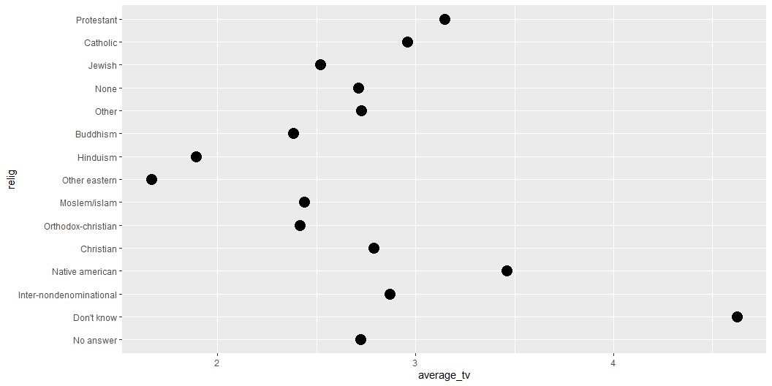
Code
When you click the Render button a presentation will be generated that includes both content and the output of embedded code. You can embed code like this:
Rows: 21,483 Columns: 9 $ year <int> 2000, 2000, 2000, 2000, 2000, 2000, 2000, 2000, 2000, 2000, 20… $ marital <fct> Never married, Divorced, Widowed, Never married, Divorced, Mar… $ age <int> 26, 48, 67, 39, 25, 25, 36, 44, 44, 47, 53, 52, 52, 51, 52, 40… $ race <fct> White, White, White, White, White, White, White, White, White,… $ rincome <fct> $8000 to 9999, $8000 to 9999, Not applicable, Not applicable, … $ partyid <fct> "Ind,near rep", "Not str republican", "Independent", "Ind,near… $ relig <fct> Protestant, Protestant, Protestant, Orthodox-christian, None, … $ denom <fct> "Southern baptist", "Baptist-dk which", "No denomination", "No… $ tvhours <int> 12, NA, 2, 4, 1, NA, 3, NA, 0, 3, 2, NA, 1, NA, 1, 7, NA, 3, 3…
[1] White Black Other Levels: Other Black White Not applicable
[1] White Black Other Levels: Other Black White Not applicable
# A tibble: 3 × 2 race n <fct> <int> 1 White 16395 2 Black 3129 3 Other 1959
# A tibble: 3 × 2 race n <fct> <int> 1 Other 1959 2 Black 3129 3 White 16395
[1] "Other" "Black" "White" "Not applicable"
race Other Black White Not applicable 1959 3129 16395 0
[1] "Other" "Black" "White"

Slide 5
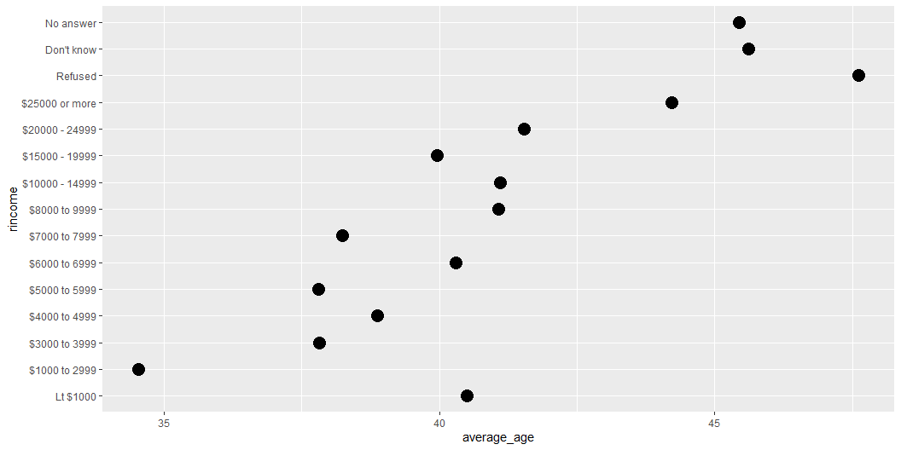

Slide 6
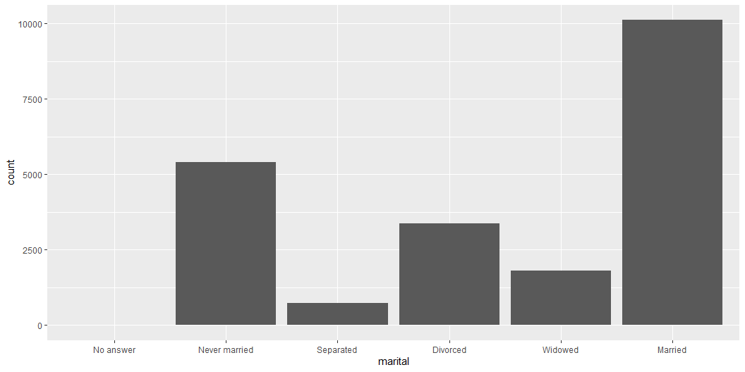

Slide 7
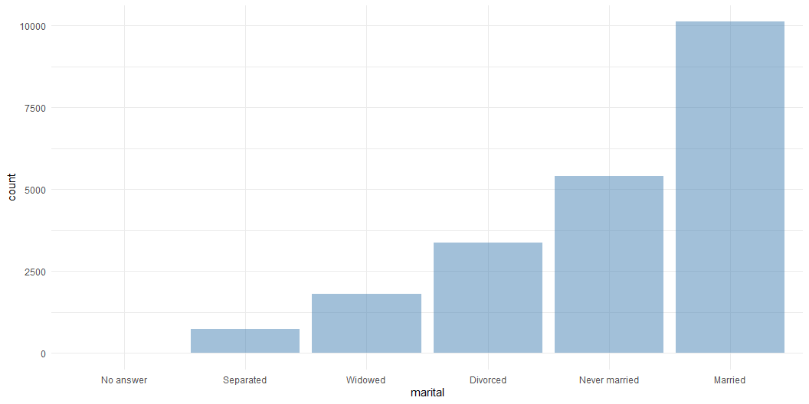

Slide 8
# A tibble: 8 × 2 partyid n <fct> <int> 1 Other 548 2 Republican, Strong 2314 3 Republican, Weak 3032 4 Independent, Near Rep 1791 5 Independent 4119 6 Independent, Near Dem 2499 7 Democrat, Weak 3690 8 Democrat, Strong 3490
# A tibble: 4 × 2 partyid n <fct> <int> 1 Other 548 2 Rep 7137 3 Ind 4119 4 Dem 9679
# A tibble: 15 × 2 relig n <fct> <int> 1 Protestant 10846 2 Catholic 5124 3 None 3523 4 Christian 689 5 Jewish 388 6 Other 224 7 Buddhism 147 8 Inter-nondenominational 109 9 Moslem/islam 104 10 Orthodox-christian 95 11 No answer 93 12 Hinduism 71 13 Other eastern 32 14 Native american 23 15 Don't know 15
# A tibble: 3 × 2 relig n <fct> <int> 1 Catholic 5124 2 Protestant 10846 3 Other 5513

