Slide 1
Introduction

Slide 2
Classification of Programming Languages
Machine languages
Strings of numbers giving machine specific instructions
Example:
+1300042774
+1400593419
+1200274027
Assembly languages
English-like abbreviations representing elementary computer operations (translated via assemblers)
Example:
LOAD BASEPAY
ADD OVERPAY
STORE GROSSPAY
High-level languages
Codes similar to everyday English
Use mathematical notations (translated via compilers)
Example:
grossPay = basePay + overTimePay

Slide 3
High Level Language Translators
One of the disadvantages of a high-level language is that it must be translated to machine language
High-level languages are translated using language translators
There are three types of translators:
Assemblers
Compilers
Interpreters

Slide 4
High Level Language Translators
Assemblers
An assembler is a program that translates an assembly language program, written in a particular assembly language, into a particular machine language
Compilers
A compiler is a program that translates a high-level language program, written in a particular high-level language, into a particular machine language
Interpreters
An interpreter is a program that translates a high-level language program, one instruction at a time, into machine language.
As each instruction is translated it is immediately executed
Interpreted programs are generally slower than compiled programs because compiled programs can be optimized to get faster execution
Some high-level languages are compiled while others are interpreted.
There are also languages, like Java, which are first complied and then interpreted

Slide 5
Compiling the Source Code
Edit
Preprocess
Compile
Link
Load
Execute
Editor
Disk
Program is created in the
editor and stored on disk.
Preprocessor
Disk
Preprocessor program
processes the code.
Compiler
Disk
Compiler creates object code and stores it on disk.
Linker
Disk
Linker links the object code with the libraries, creates an executable file and stores it on disk
Loader
Primary
Memory
  
  
  
  
  
Loader puts program in memory.
Disk
CPU
Primary
Memory
CPU takes each instruction and executes it, possibly
storing new data values as the program executes.
  
  
  
  
  

Slide 6
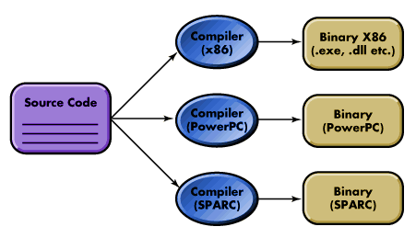
Compilation Process: Traditional Compilers
In the traditional compilation process, the compiler produces machine code for a specific family of processors
For example, given a source program, a compiler for the x86 family of processors will produce binary files for this family of processors
A disadvantage of this compilation method is that the code produced in each case is not portable
To make the resulting code portable, we need the concept of a virtual machine

Slide 7
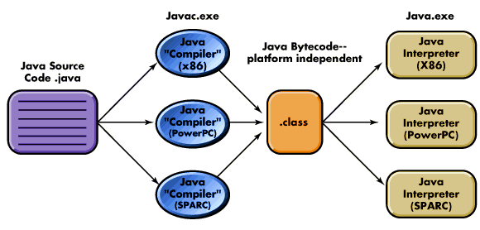
Compilation Processes: Java Compilers
Java Compiler translates program into bytecode
The Java Virtual Machine (JVM) is a bytecode interpreter that translates bytecode to machine code

Slide 8
Java Virtual Machine (JVM)
Instead of producing a processor-specific code, Java compilers produce an intermediate code called bytecode
The bytecode is also a binary code but is not specific to a particular CPU
A Java compiler will produce exactly the same bytecode no matter what computer system is used
The Java bytecode is then interpreted by the Java Virtual Machine (JVM) interpreter
Each type of computer system has its own Java interpreter that can run on that system
This is how Java achieves compatibility
It does not matter on what computer system a Java program is compiled, provided the target computer has a JVM

Slide 9
Characteristics of Java
Java Is Simple
Modeled on C++ bu greatly simplified and improved
Java Is Object-Oriented
Inherently object oriented from the start
Java Is Distributed
Designed to make distributed computing easy
Java Is Interpreted
Java – Bytecode – Interpreter (part of JVM)
Java Is Architecture-Neutral
Write once, run anywhere (OS independent)
Java Is Portable
Programs can run on any platform without being recompiled
Java Is Multithreaded
No need to call procedures specific to OS to enable multithreading
Java Is Dynamic
New code can be loaded on-the-fly without recompilation

Slide 10
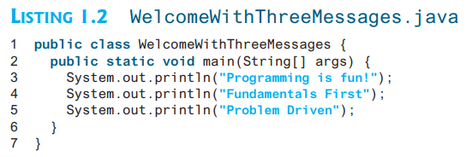

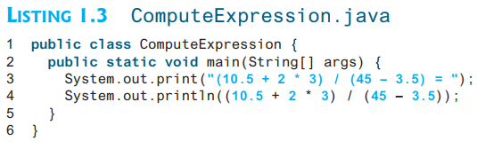

A Simple Java Program
Write Program to Display Three Messages
you can perform mathematical computations and display the result on the console

Slide 11

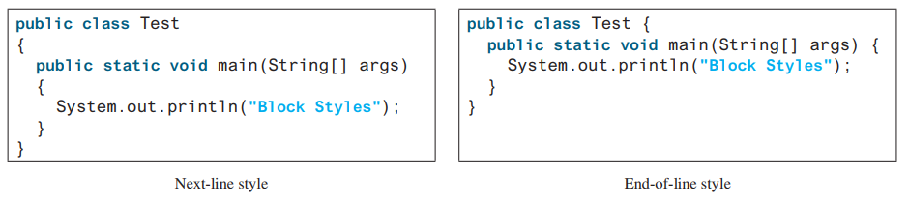
Programming Style and Documentation
Good programming style and proper documentation make a program easy to read and help programmers prevent errors.
Appropriate Comments and Comment Styles
Proper Indentation and Spacing
Block Styles

Slide 12
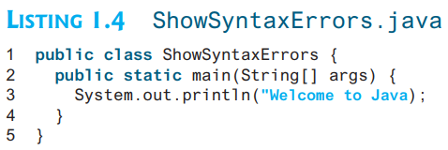
Programming Errors
Syntax Errors result from errors in code construction, such as mistyping a keyword, omitting some necessary punctuation, or using an opening brace without a corresponding closing brace

Slide 13
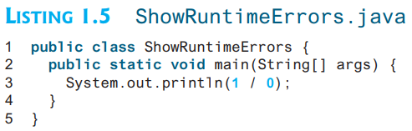
Programming Errors
Runtime errors are errors that cause a program to terminate abnormally.
They occur while a program is running if the environment detects an operation that is impossible to carry out.
Input mistakes typically cause runtime errors. An input error occurs when the program is waiting for the user to enter a value, but the user enters a value that the program cannot handle.
Another example of runtime errors is division by zero

Slide 14
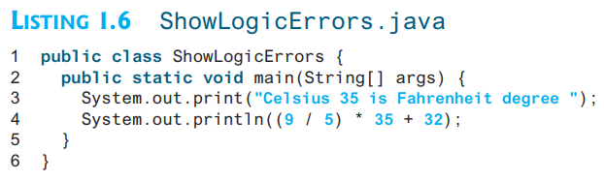
Programming Errors
Logic errors occur when a program does not perform the way it was intended to.
This can be due to wrong implementation of a formula or wrong calculations due to mixed data type operations
You will get Fahrenheit 67 degrees, which is wrong. It should be 95.0

Slide 15

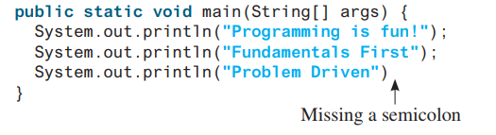

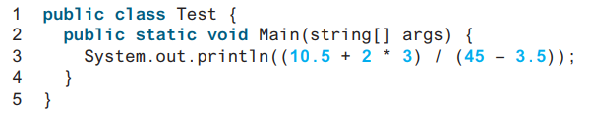
Common Errors
Missing Braces
Missing Semicolons
Missing Quotation Marks
Misspelling Names

Slide 16
Programming Paradigms

Slide 17
Programming Paradigms
A programming paradigm is a style of building the structure and elements of computer programs
A way of thinking about software construction
Does not refer to a specific language but rather to a way to program, a methodology
Some languages make it easier to write in some paradigms but not others
Examples
Unstructured Programming
Procedural Programming
Modular Programming
Object Oriented Programming

Slide 18
Unstructured Programming
A program that contains only one main program
Main program stands for a sequence of commands or statements which modify data which is global throughout the whole program
This programming technique provides tremendous disadvantages once the program gets sufficiently large
For example, if the same statement sequence is needed at different locations within the program, the sequence must be copied
This has lead to the idea of extracting these sequences, naming them and offering a technique to call and return from these procedures

Slide 19
Procedural Programming
Combine returning sequences of statements into one single place
A procedure call is used to invoke the procedure
After the sequence is processed, flow of control proceeds right after the position where the call was made
With the introduction of parameters as well as procedures of procedures (sub-procedures) programs can now be written more structured and error free
For example, if a procedure is correct, every time it is used it produces correct results

Slide 20
Procedural Programming
The main program is responsible to pass data to the individual calls,
the data is processed by the procedures and,
once the program has finished, the resulting data is presented
Now we have a single program which is divided into small pieces called procedures
To enable usage of general procedures or groups of procedures also in other programs, they must be separately available
For that reason, modular programming allows grouping of procedures into modules

Slide 21
Modular Programming
During the 1970s it became clear that even well-structured programs were not enough for mastering the complexity involved in developing a large program system
It was also recognized that it was necessary to support the division of the program into well-defined parts or modules, that could be developed and tested independently of one another, so that several people could work together within one large programming project
Modular programming is thus concerned with the subdivision of programs into manageable "chunks"

Slide 22
Modular Programming
Generate Payroll
Get Payroll Record
Calculate Net Pay
Print Check
Read Payroll Record
Validate Payroll Record
Calculate Gross Pay
Calculate Deductions
Update Employee Record
Calculate Tax withheld
Calculate SS witheld

Slide 23
Modular Programming
With modular programming procedures of a common functionality are grouped together into separate modules
A program therefore no longer consists of only one single part
It is now divided into several smaller parts which interact through procedure calls and which form the whole program
Each module can have its own data. This allows each module to manage an internal state which is modified by calls to procedures of this module
There is only one state per module and each module exists at most once in the whole program

Slide 24

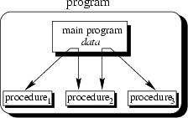
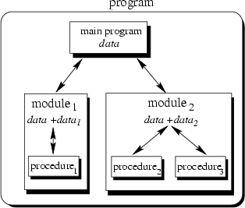
Programming Paradigms
Unstructured
The main program directly operates on global data
Procedural
The main program coordinates calls to procedures and hands over appropriate data as parameters
Modular
The main program coordinates calls to procedures in separate modules and hands over appropriate data as parameters

Slide 25
Problems of Procedural Approach
Data and code that operates on this data are not tightly coupled
Data is generally made globally accessible to all functions
Inadvertent changes to data may occur

Slide 26
Object Oriented Programming
In the OOP approach, data and the functions which are supposed to have the access to the data, are packed together into one box known as an object
Objects of the program interact by sending messages to each other
Objects made in a program can be reused by any other program
This increases the reusability of the programs once written
The programs written in an OOP can be easily updated by using the facilities of inheritance
program
object₁
data
object₄
data
object₃
data
object₂
data

Slide 27
OOP Features
Encapsulation
Inheritance and reuse
Creating new Data types
Polymorphism
Overloading

Slide 28
Encapsulation
Both the data, and the functionality that could affect or display that data are included under a unified name (the object name itself).
In the classic definition, the data elements (or properties of the object) are not available to the outside world directly.
Instead, methods would be created to give access to these values outside of the object
Now we have the ability to declare properties as being public or private

Slide 29
Inheritance and Reuse
This feature allows developers to define objects in a hierarchy much like a taxonomy chart
Each level of the hierarchy defines a more specific object than the parent level
Each level inherits all the properties and methods of it's parent object and at that point you define the more specific properties and methods need by the new level of object you created

Slide 30
Creating New Data Types
OOP provides the programmer a convenient way to construct new data types
Suppose you want to represent the location of something in the form of its x and y coordinates and want to add them like normal arithmetic operations
location1 = location2 + origin
Where each of these variables represents a pair of numerical quantities
This can be done with the help of objects and classes

Slide 31
Polymorphism
At any level of an object hierarchy each object could have a method of the same name and because of the level at which the method resides in, it could know which of the procedures or functions to call
Hence you could have a Shape object that has a Draw method
Then you could define a Circle, Square and Triangle object as Shape objects and override the Draw method to draw specifically a Circle, Square or Triangle method respectively
All 4 objects would then have a Draw method but only the right method for the right object would be called

Slide 32
Overloading
When an existing operator such as + or = is given the capability to operate on a new data type such as our location object in the previous example

Slide 33
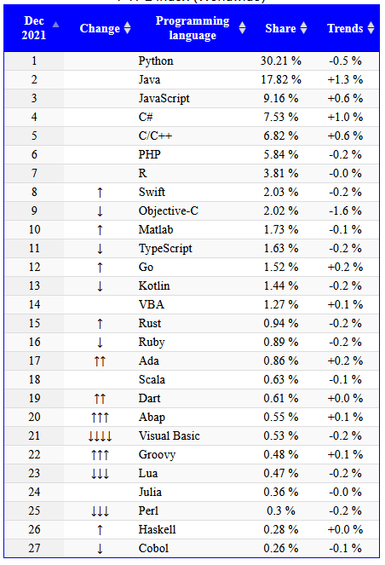
Programming Languages Popularity
Each Group to brief class about a language of its choice from the list (after OHT-II)
Select and submit the language name by OHT-I

