Slide 1
CS212-Object Oriented Programming
Lecture 07
Object Oriented Thinking

Slide 2
Class Abstraction & Encapsulation
Class abstraction is separation of class implementation from the use of a class.
The details of implementation are encapsulated and hidden from the user. This is known as class encapsulation.
In encapsulation, data members are made private and appropriate get and set methods are provided for modification.

Slide 3
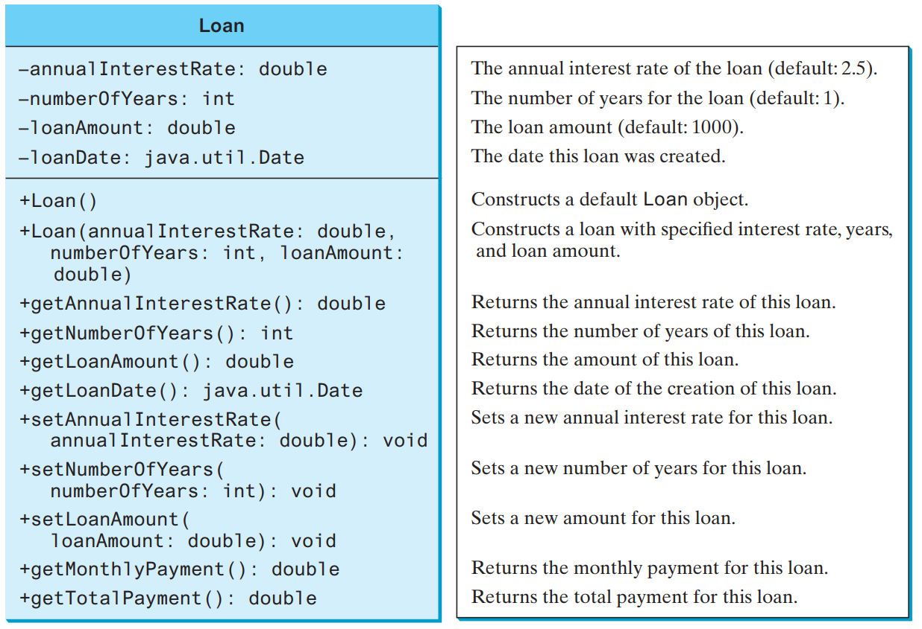
Loan Class
Implement the loan class

Slide 4
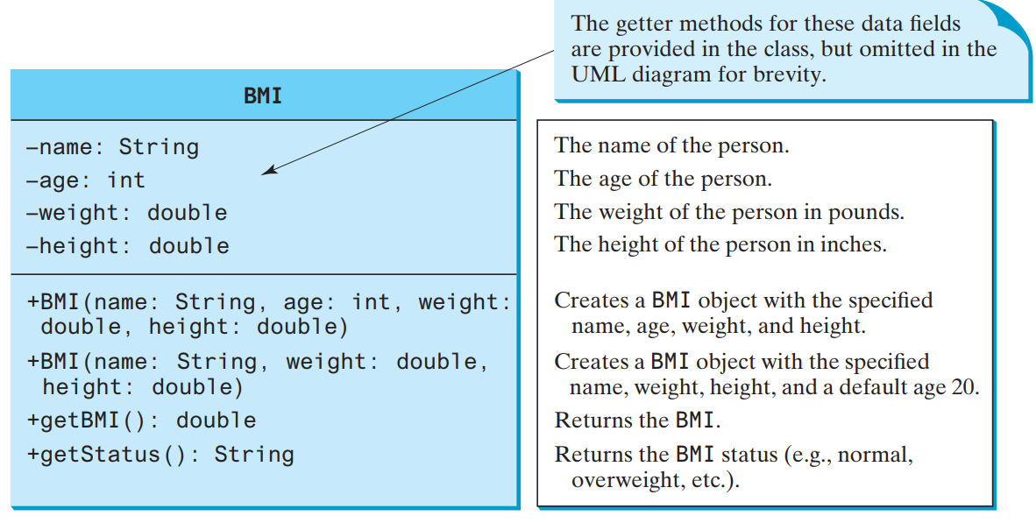
Thinking in Objects
Procedural paradigm focuses on designing methods. Object-oriented couples data & methods together into classes.
Implement BodyMassIndex(BMI) Class

Slide 5
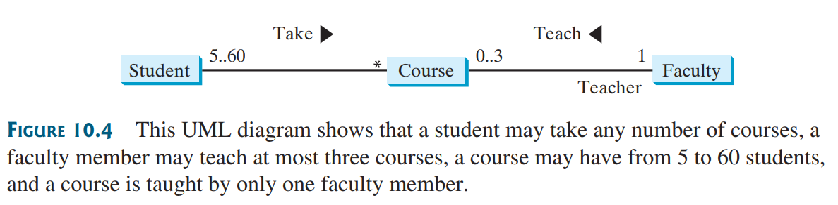
Class Relationships
Association describes an activity between two classes.
For example, a student taking a course is an association between the Student class and the Course class, and a faculty member teaching a course is an association between the Faculty class and the Course class.

Slide 6
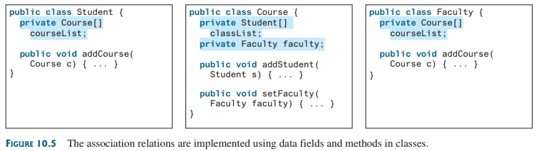
Class Relationships
Association Relation

Slide 7
Class Relationships
Aggregation is a special form of association that represents an ownership relationship between two objects.
Aggregation models has-a relationships.
The owner object is called an aggregating object, and the subject object is called an aggregated object.
If existence of the aggregated object is dependent on the aggregating object, its class composition
For example, “a student has a name” is a composition relationship between the Student class and the Name class because Name is dependent on Student
Whereas “a student has an address” is an aggregation relationship between the Student class and the Address class because an address can exist by itself

Slide 8
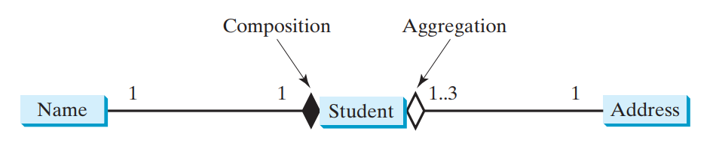
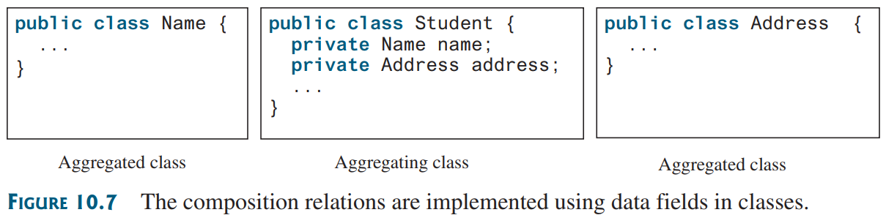
Class Relationships
Composition vs Aggregation

Slide 9
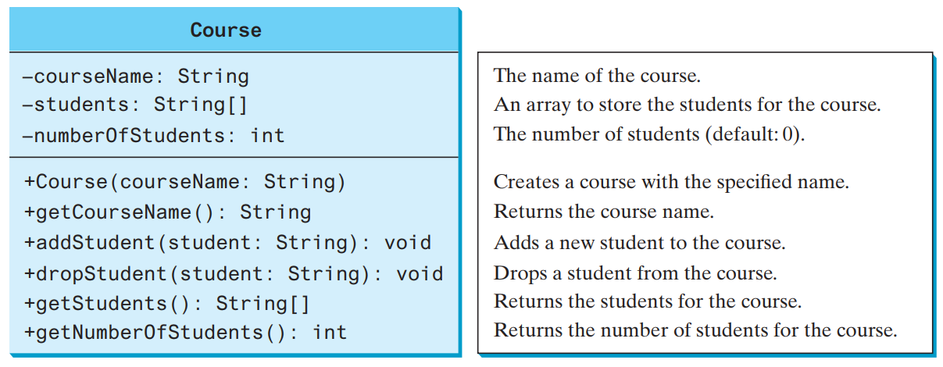
Case Study
Implement the Course Class

Slide 10
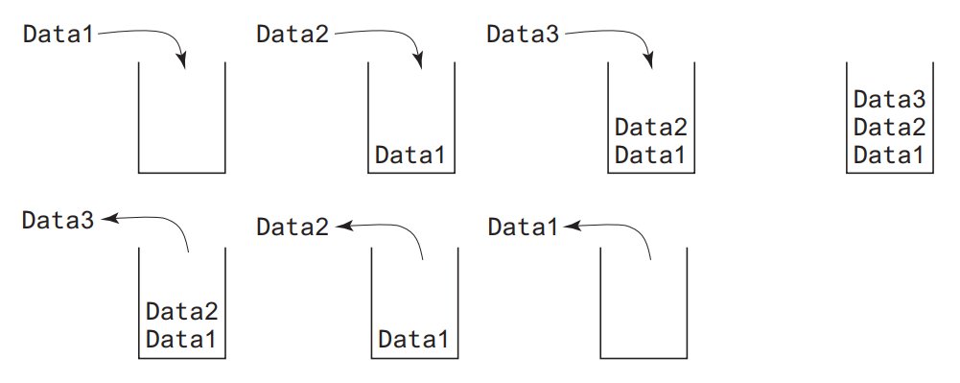
Case Study
Implement a Class for Integer Stacks
Stack is a data structure that holds data in a last-in, first-out fashion

Slide 11
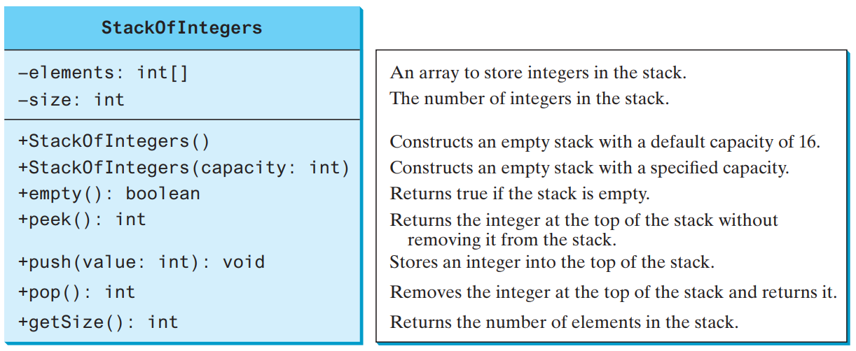
Case Study
Implement a Class for Integer Stacks
Stack is a data structure that holds data in a last-in, first-out fashion

Slide 12
Primitive Data Types as Objects
A primitive-type value is not an object, but it can be wrapped in an object using a wrapper class in Java API
Owing to performance considerations, primitive data type values are not objects in Java.
Because of the overhead of processing objects, the language’s performance would be adversely affected if primitive data type values were treated as objects.
However, many Java methods require the use of objects as arguments.
Java offers a convenient way to incorporate, or wrap, a primitive data type value into an object
e.g. wrapping an int into an Integer object, wrapping a double into a Double object, and wrapping a char into a Character object

Slide 13
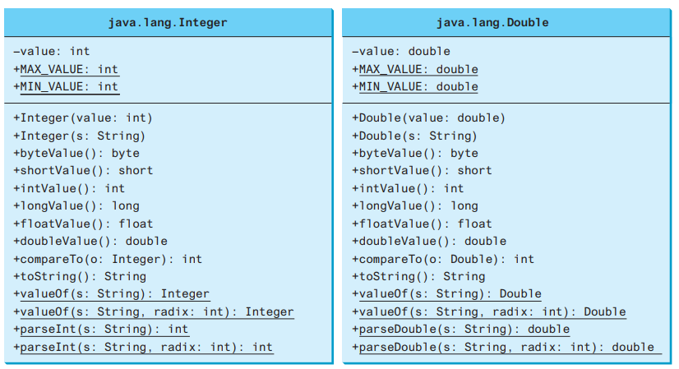
Primitive Data Types as Objects
Numeric wrapper classes are very similar to each other. Each contains the methods doubleValue(), floatValue(), intValue(), longValue(), shortValue(), and byteValue().

Slide 14
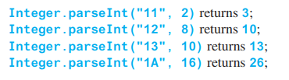
Primitive Data Types as Objects
You can construct a wrapper object either from a primitive data type value or from a string representing the numeric value—for example, new Double(5.0), new Double("5.0"), new Integer(5), and new Integer("5")
The wrapper classes do not have no-arg constructors.
The instances of all wrapper classes are immutable; this means that, once the objects are created, their internal values cannot be changed
Static method parse converts string to int, double etc
Integer.parseInt("12", 2) would raise a runtime error

Slide 15

BigInteger & BigDecimal Classes
The BigInteger and BigDecimal classes in java.math package can be used to represent integers or decimal numbers of any size and precision
You can use new BigInteger(String) and new BigDecimal(String) to create an instance of BigInteger and BigDecimal, use the add, subtract, multiply, divide, and remainder methods to perform arithmetic operations, and use the compareTo method to compare two big numbers.
The output is 18446744073709551614

Slide 16

BigInteger & BigDecimal Classes
There is no limit to the precision of a BigDecimal object.
The divide method may throw an ArithmeticException if the result cannot be terminated.
However, you can use the overloaded divide(BigDecimal d, int scale, int roundingMode) method to specify a scale and a rounding mode to avoid this exception, where scale is the maximum number of digits after the decimal point
The output is 0.33333333333333333334.

Slide 17
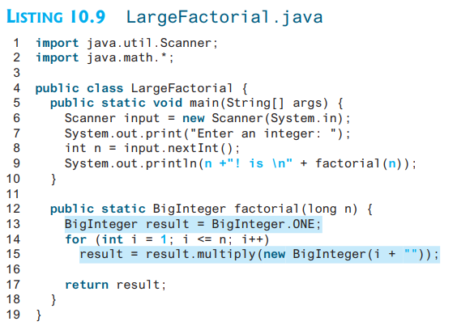

BigInteger & BigDecimal Classes

Slide 18

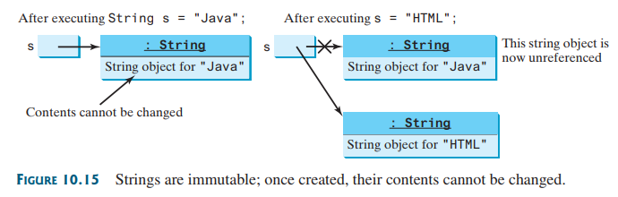
The String Class
A String object is immutable; its contents cannot be changed once the string is created

Slide 19
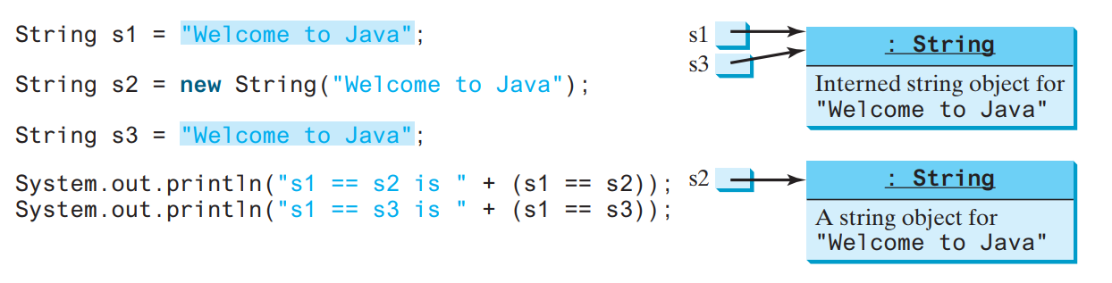
The String Class
s1 == s2 is false
s1 == s3 is true
Interned Strings: JVM uses a unique instance for string literals with the same character sequence in order to improve efficiency and save memory. Such an instance is called an interned string
Study String Class from Java documentation, chapter 4 and chapter 10

Slide 20
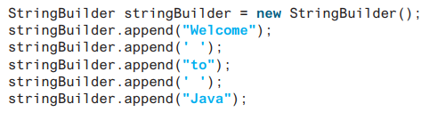
StringBuilder & StringBuffer Classes
The StringBuilder and StringBuffer classes are similar to the String class except that the String class is immutable and these are mutable.
You can add, insert, or append new contents into StringBuilder and StringBuffer objects, whereas the value of a String object is fixed once the string is created.
The StringBuilder class provides several overloaded methods to append boolean, char, char[], double, float, int, long, and String into a string builder.

Slide 21
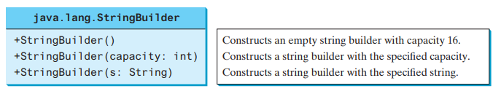
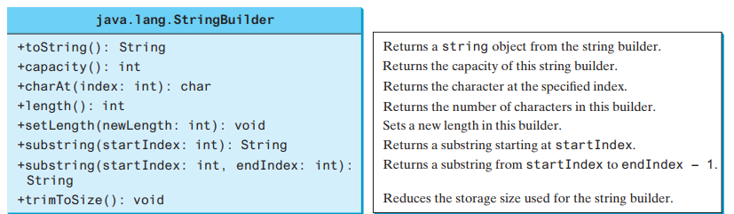
StringBuilder & StringBuffer Classes
The StringBuilder class is similar to StringBuffer except that the methods for modifying the buffer in StringBuffer are synchronized, which means that only one task is allowed to execute the methods

Slide 22
Exception Handling in Java
The exception handling in java is one of the powerful mechanism to handle the runtime errors so that normal flow of the application can be maintained
What is exception?
Dictionary Meaning: Exception is an abnormal condition.
In java, exception is an event that disrupts the normal flow of the program. It is an object which is thrown at runtime.
What is exception handling?
Exception Handling is a mechanism to handle runtime errors such as ClassNotFound, IO, SQL, Remote etc.

Slide 23
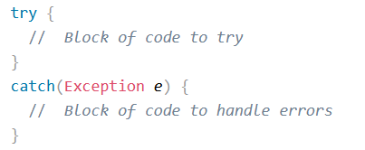
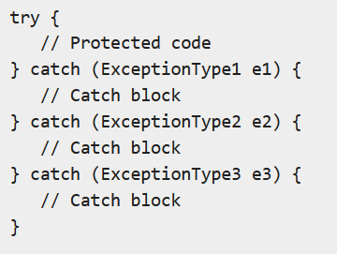
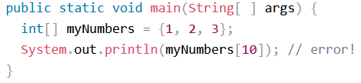
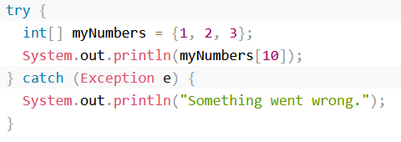

Exception Handling in Java

Slide 24
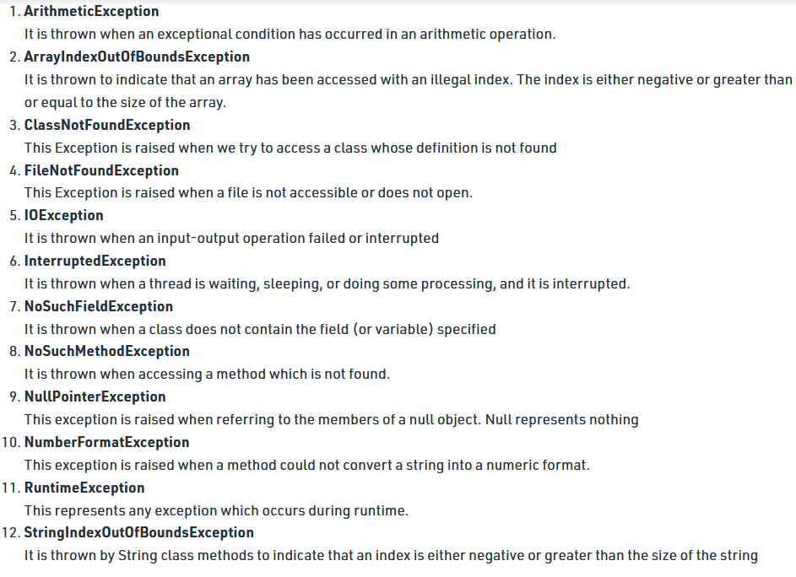
Exception Handling in Java

Slide 25
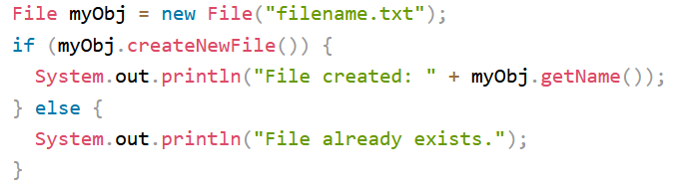
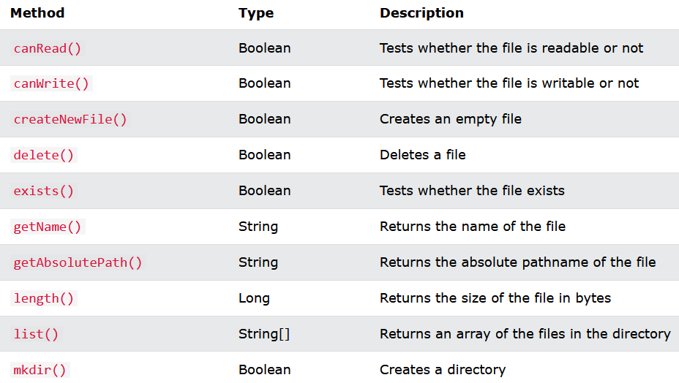
File Class

Slide 26
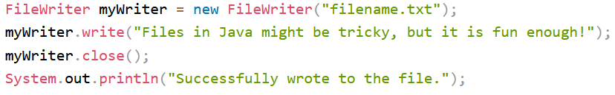
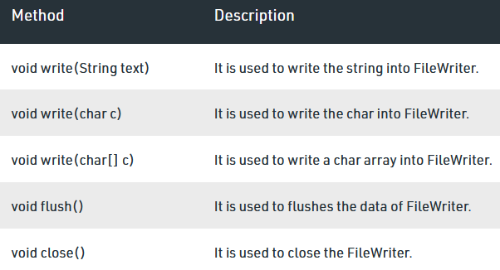
FileWriter Class

Slide 27
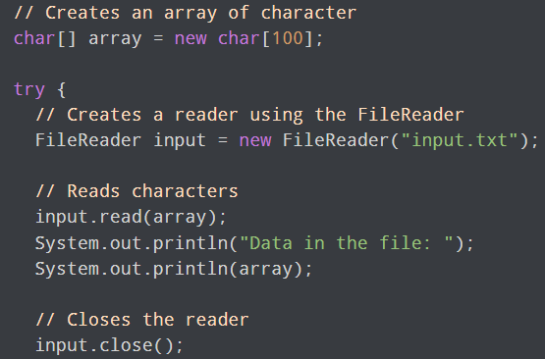
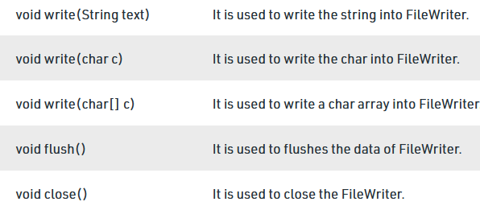
FileReader Class

Slide 28
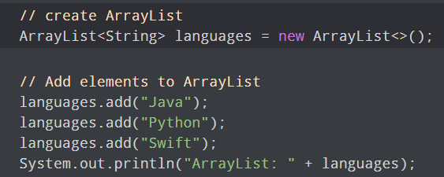

ArrayList Class
In Java, we need to declare the size of an array before we can use it. Once the size of an array is declared, it's hard to change it.
To handle this issue, we can use the ArrayList class. It allows us to create resizable arrays.
Unlike arrays, arraylists can automatically adjust its capacity when we add or remove elements from it. Hence, arraylists are also known as dynamic arrays.

Slide 29
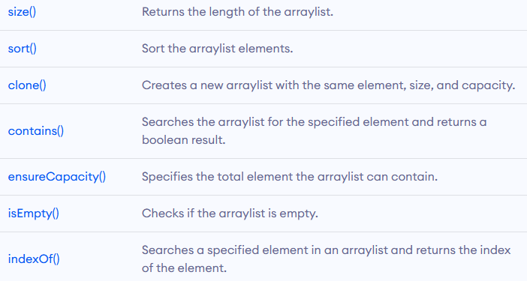
ArrayList Class
The ArrayList class provides various methods to perform different operations like
Add elements
Access elements
Change elements
Remove elements

Slide 30
Java.lang.System Class
static void arraycopy(Object src, int srcPos, Object dest, int destPos, int length) This method copies an array from the specified source array, beginning at the specified position, to the specified position of the destination array.
static long currentTimeMillis() This method returns the current time in milliseconds.
static void exit(int status) This method terminates the currently running Java Virtual Machine.
static void gc() runs the garbage collector. Calling this suggests that the Java Virtual Machine expend effort toward recycling unused objects in order to make the memory they currently occupy available for quick reuse.
static Properties getProperties() This method determines the current system properties like java version, installation directory, OS name etc

Slide 31
Java.lang.System Class
static void load(String filename) This method loads a code file with the specified filename from the local file system as a dynamic library.
static long nanoTime() This method returns the current value of the most precise available system timer, in nanoseconds.
There are many other functions implemented in this class, details of which can be found in language description.

Slide 32
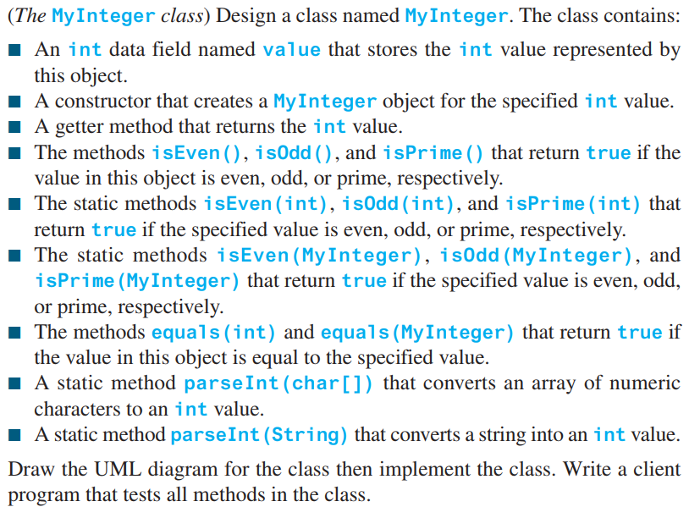
Practice

Slide 33
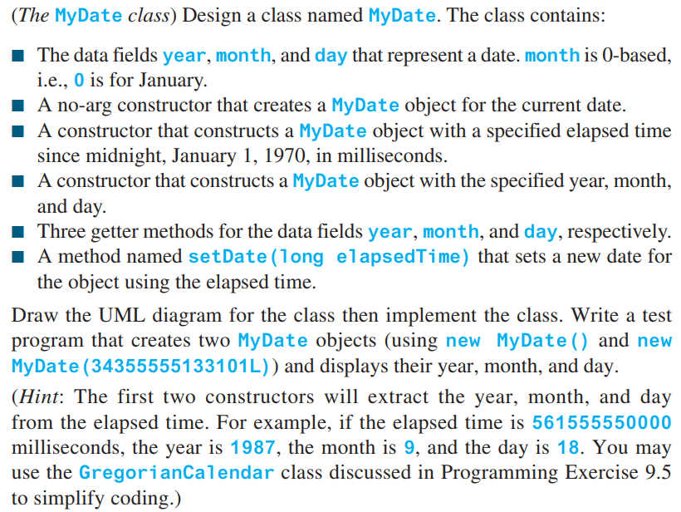
Practice

Slide 34
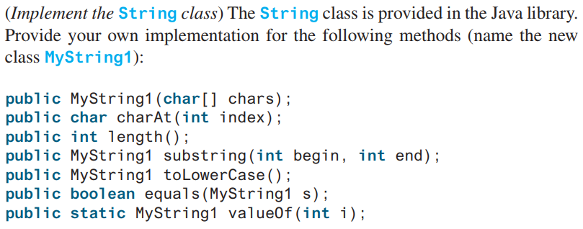
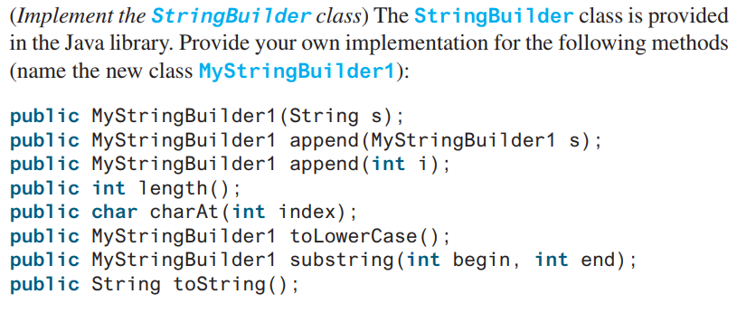
Practice

Slide 35
Practice
Write a program to compare performance of String, StringBuilder and StringBuffer Classes.
For example: Create large strings using String, StringBuilder and StringBuffer Classes by concatenation/ append method thousands of times and use StopWatch (you created in last lecture) to measure the execution time.

Slide 36
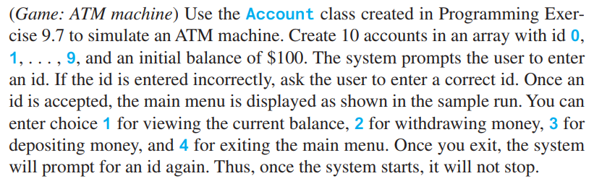
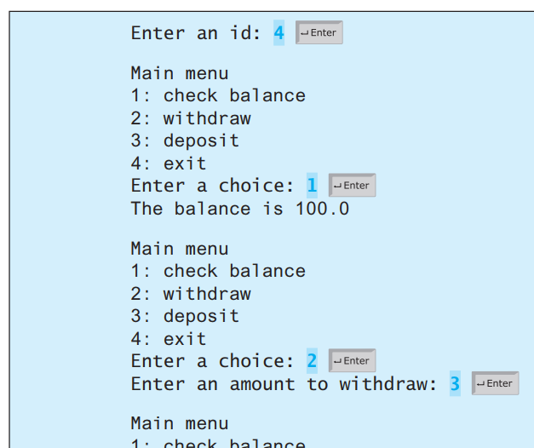
Practice

Slide 37
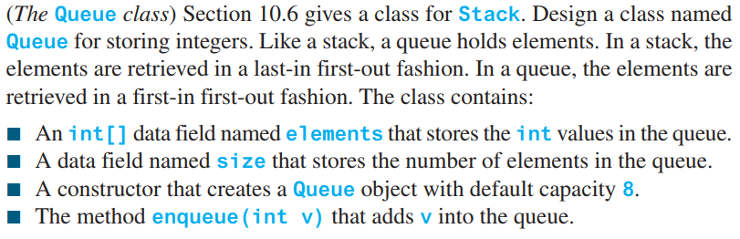
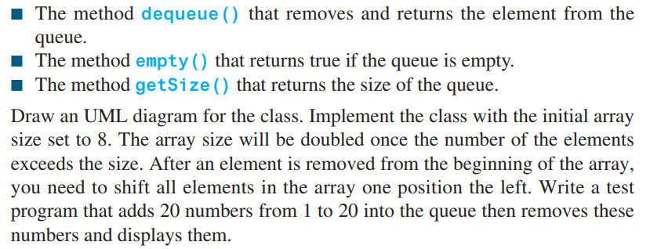
Practice

