Slide 1
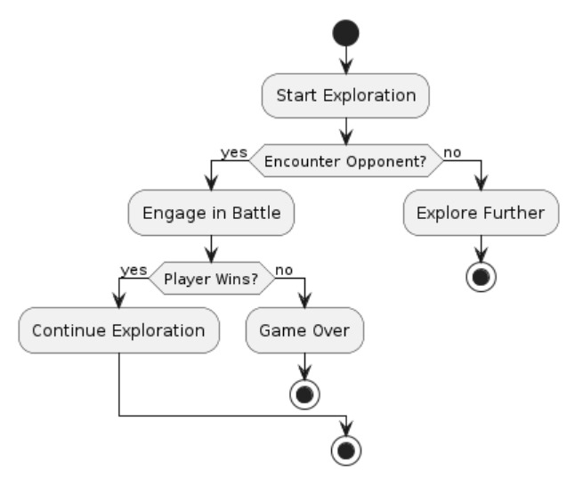
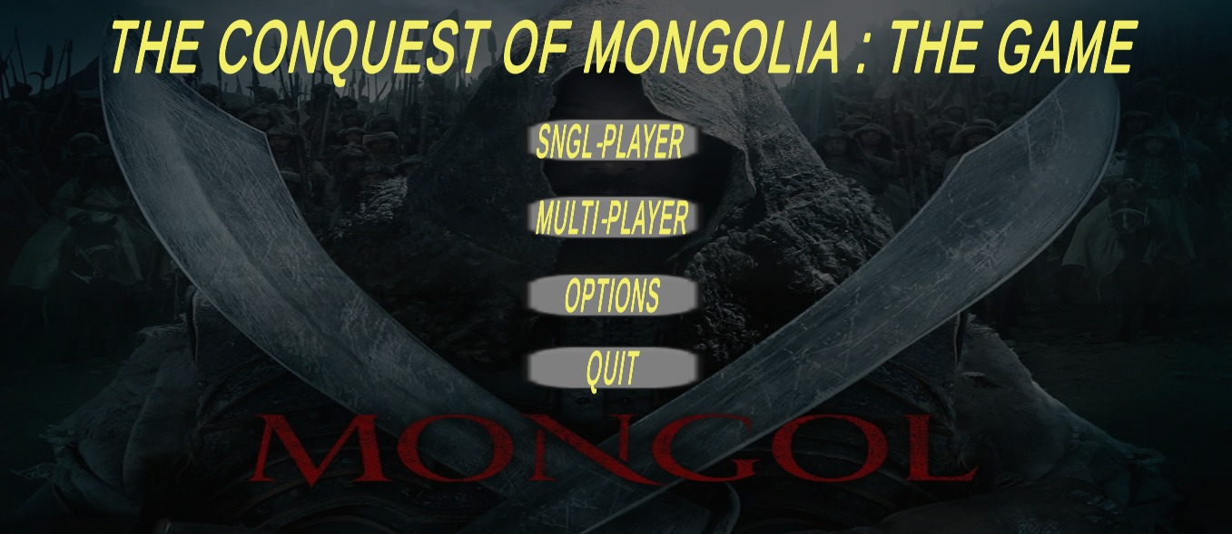
The Conquest Of Mongolia: THE GAME
INTRODUCTION
ARCHITECTURE
‘The Conquest Of Mongolia: THE GAME’, which offers a unique experience in the world of conquering Mongolia.
This game will give you the chance to lead your team through the challenges of uniting tribes, alliances and exploring the vast plains of Mongolia. While it may not boast stunning graphics or complex gameplay.
‘The Conquest of Mongolia’ aims to deliver a low-key and historically compelling gaming experience . As a player, you step into the shoes of a champion in the cloud fields of Mongolia, where your decisions will affect the course of your team
OBJECTIVES
CONCLUSION
Diverse Gameplay Modes: Develop a comprehensive online gaming system featuring both single-player and multiplayer modes, offering a variety of gameplay experiences to cater to different player preferences.
User-Friendly Interface: Design an intuitive and easy-to-use interface that allows players to navigate and interact with the game seamlessly, ensuring a positive and engaging user experience for all players.
Sophisticated Matchmaking Algorithms: Implement advanced matchmaking algorithms to match players based on their skill levels, ensuring balanced and fair gameplay in multiplayer mode.
Skill Development and Progression: Introduce AI-controlled opponents (BOTs) to provide players with opportunities to improve their skills and progress through the game at their own pace.
We are thrilled to announce the completion of "Conquest of Mongolia: THE GAME." It has been an exhilarating journey filled with challenges that we've overcome through hard work and creativity. Our goal was to deliver an immersive and engaging gaming experience, and we believe we've achieved just that.
At the heart of "Conquest of Mongolia" lies a captivating storyline, intriguing gameplay mechanics, and stunning visuals meticulously crafted to provide players with a seamless and enjoyable experience. From intricate level designs to dynamic combat systems, every detail has been carefully considered to immerse players in the world of Mongolian conquest.
Throughout development, we encountered various challenges such as optimization across platforms and balancing gameplay mechanics. However, through rigorous testing and iteration, we successfully addressed these challenges, ensuring a polished and enjoyable final product.
We eagerly anticipate feedback from players worldwide and are committed to providing continuous support and updates to ensure that "Conquest of Mongolia" remains a cherished title in the gaming industry. We extend our heartfelt thanks to all our supporters and invite players to embark on an unforgettable adventure with us in the vast plains of Mongolia. Good luck and happy conquering!
USER INTERFACE
FUTURE DIRECTIONS
Expanded Gameplay Elements: Introduce new gameplay mechanics and features to add depth and variety to the gaming experience.
Enhanced Visuals: Further improve the graphics and visual effects to create a more immersive and visually stunning world.
Additional Content: Continuously add new content such as quests, challenges, and characters to keep players engaged and excited.
Optimization: Further optimize the game for performance across different devices and platforms to ensure a smooth and seamless gaming experience for all players.

