Slide 1
A Machine Learning Approach Towards Plant Disease Prediction and Control Monitoring System
PIP4004 University Project
Review – 4
Batch Number: CSE_ISR_CAP_05
Name | Roll Number
M Abhishek | 20211ISR0048
K Sri Hari | 20211ISR0046
M D Sailesh | 20211ISR0044
Tushar Sagore | 20211ISR0024
Under the Supervision of,
Dr. Sasidhar Babu Suvanam
Professor,
School of Computer Science and Engineering,
Presidency University.
Name of the Program: ISR(AI & Robotics)
Name of the HoD: Dr. Zafar Ali Khan N
Name of the Program Project Coordinator: Dr. Afroz Pasha
Name of the School Project Coordinators: Dr. Sampath A K / Dr. Abdul Khadar A / Mr. Md Ziaur Rahman

Slide 2
Content
Introduction
Literature Review
Existing method Drawback
Proposed Method
Architecture
Hardware/software components
Timeline of the project
Conclusion
References

Slide 3
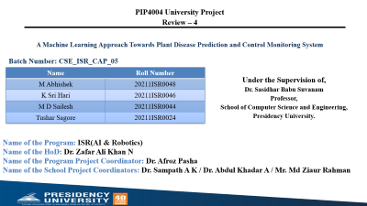
Introduction
The AI-Driven Crop Disease Prediction and Management System is designed to help farmers detect and manage crop diseases early using artificial intelligence. The system uses deep learning and computer vision to analyze images of crops and identify diseases in real time.
Key Features
1. Image Annotation and Dataset Preparation (Roboflow)
To ensure high accuracy, the system utilizes a well-annotated dataset of diseased and healthy crop images. Using Roboflow, the images are pre-processed, labeled, and augmented to improve model performance.
2. Deep Learning for Disease Recognition
The system employs Convolutional Neural Networks (CNNs) to learn disease patterns from images. By training models on diverse datasets, it achieves high accuracy in distinguishing between different plant diseases.

Slide 4
Introduction
3. Real-Time Disease Detection
For real-time identification, the system integrates:
Single Shot Detection (SSD) for fast object detection.
Classification models like EfficientNet or ResNet to accurately classify crop diseases. These models enable rapid identification, allowing farmers to take immediate action.
4. Live Image Processing with OpenCV
By incorporating OpenCV, the system can process live images from various sources such as:
Drones for large-scale field monitoring.
Smartphone cameras for instant disease detection. This functionality enhances accessibility and usability for farmers.
5. Data Storage and Monitoring
Detection results are stored in a cloud-based database like MongoDB or Firebase for:
Historical disease tracking.
Improving predictive capabilities for future crop health monitoring.

Slide 5
Literature Review
The integration of deep learning with real-time data processing has transformed the field of crop disease detection, improving the accuracy and efficiency of disease identification in agricultural settings. However, several studies highlight challenges that need to be addressed for effective real-time crop disease detection and management
Limitations of Traditional Disease Detection Methods
Traditional methods for identifying crop diseases rely on manual inspection and lab testing, which are time-consuming, labor-intensive, and often subjective. While IoT-based monitoring systems track environmental factors such as humidity and temperature, they fail to provide visual disease identification, making them insufficient for precise diagnosis., which limits their ability to generalize across different crops and environmental conditions.
Deep Learning-Based Crop Disease Detection
Modern deep learning models have significantly improved disease detection by leveraging Convolutional Neural Networks (CNNs) for image-based classification. Studies using PlantVillage and other agricultural datasets demonstrate that CNN-based models outperform traditional ML methods in disease classification accuracy.

Slide 6
Introduction
6. User-Friendly Application
The system is designed as a mobile or web application, providing farmers with:
Disease identification results.
Severity levels and confidence scores.
Recommended treatment options and best practices for disease management.
7. AI-Powered Chatbot for Farmer Support
To assist farmers in real time, the system includes an AI chatbot capable of:
Answering queries about crop diseases.
Suggesting appropriate pesticides and treatments.
Providing agricultural best practices for disease prevention.

Slide 7
Literature Review
Real-Time Object Detection in Agriculture
Real-time disease detection requires processing large amounts of image and video data efficiently. Computer vision techniques such as OpenCV are commonly used for image preprocessing, reducing noise, and enhancing detection accuracy. Research suggests that integrating Single Shot Detection (SSD) and You Only Look Once (YOLO) models can improve real-time detection performance, enabling early-stage identification of crop diseases before they spread. However, these models must be optimized for deployment on low-power devices like drones and smartphones for field applications.
Drone-Based Crop Surveillance
Drones equipped with high-resolution cameras are increasingly used for monitoring large farmlands. Studies highlight that drones can efficiently capture aerial images of diseased crops, reducing the need for manual field inspections. By integrating CNN-based classification models with drone imagery, researchers have developed automated crop monitoring systems that identify disease symptoms and suggest treatment strategies. However, challenges such as high operational costs and the need for stable internet connectivity remain barriers to widespread adoption.

Slide 8
Literature Review
Integration of AI Chatbots for Farmer Assistance
Recent advancements in Natural Language Processing (NLP) have enabled the development of AI-driven chatbots that assist farmers by providing real-time recommendations on disease prevention, pesticide use, and farming techniques. Studies show that these chatbots, when integrated with real-time disease detection systems, improve farmer engagement and decision-making by offering personalized disease management strategies based on detected symptoms
Optimization of Deep Learning Models for Agricultural Applications
Several studies emphasize the importance of optimizing deep learning models for real-time agricultural use. YOLOv5 and EfficientNet-based models have been explored for their ability to process live images quickly without compromising accuracy. By training these models on diverse, annotated datasets using platforms like Roboflow, researchers have improved their ability to detect diseases across various crop types and environmental conditions. The combination of lightweight models, cloud-based storage (e.g., MongoDB, Firebase), and real-time mobile interfaces has proven effective in ensuring that farmers receive timely disease alerts and treatment suggestions.

Slide 9
Existing method Drawback
Overfitting to Specific Conditions: Many models work well in controlled environments but fail in real-world settings due to variations in lighting, soil types, and weather conditions.
Inaccurate Disease Localization: Most models detect diseases but fail to pinpoint affected areas, leading to inefficient pesticide application and unnecessary resource wastage.
High False Positives: Models often misclassify nutrient deficiencies, insect damage, or water stress as diseases, causing unnecessary pesticide use and increased costs.
Delayed Real-Time Detection: Many models are computationally heavy, leading to slow disease identification and delayed response for farmers.
Lack of Robust Datasets: Existing datasets are limited in crop variety and environmental diversity, making models less effective for unseen diseases or new plant species.
Limited Integration with Farmer Decision-Making Tools:
No AI Chatbot Support: Farmers lack real-time AI assistance for disease management, pesticide recommendations, and prevention strategies.
No Nearby Pesticide Store Mapping: Models don’t integrate with GPS or maps to help farmers locate nearby agricultural stores for pesticides and medicines.
No Educational Support: Systems don’t provide integrated YouTube tutorials or expert videos to help farmers learn about disease prevention and treatment.
Resource Constraints: Deep learning models require GPUs or cloud processing, which is impractical for remote farms with poor connectivity.

Slide 10
Proposed Method
The proposed model for the AI-Driven Crop Disease Prediction and Management System is designed to detect and manage crop diseases in real-time using deep learning techniques and computer vision algorithms. The model incorporates the following key components and methodologies to ensure precise and timely detection of crop diseases and effective management strategies.
1. Image Annotation and Dataset Preparation (Roboflow)
The initial stage involves gathering and annotating images of various crop diseases. Using Roboflow, a large and diverse dataset of labeled images is prepared for training the model. These annotations include different disease symptoms on leaves, stems, and fruits, enabling the model to distinguish between healthy and diseased crops under different environmental conditions.
2. Convolutional Neural Networks (CNNs):
A CNN-based deep learning model is employed for feature extraction and disease classification. The CNN is trained to detect disease symptoms by processing the annotated images from the dataset. The CNN architecture allows the model to automatically learn spatial hierarchies of features through convolutional layers, which is particularly useful for detecting early-stage crop diseases.

Slide 11
Proposed Method
3. Crop Disease Detection
The model uses Single Shot Detection (SSD) for real-time detection of disease-affected plant regions. Additionally, it integrates classification models such as EfficientNet or ResNet to accurately identify the type of disease affecting the crop. This helps in assessing the severity of the infection and suggesting immediate management strategies.
4. Real-Time ImageProcessing (OpenCV)
Once deployed on a drone, the model processes live video feeds using OpenCV for real-time image analysis and object detection. OpenCV helps in preprocessing the video frames by removing noise and enhancing image quality, ensuring better performance of the detection algorithms in real-world conditions.
5. Data Storage and Retrieval
Detection results, including the locations of identified diseases, are stored in a database system such as MongoDB or Firebase. These results are essential for farmers and agricultural experts to track, assess, and monitor crop health over time. Additionally, storing images and detection results helps in post-analysis and improvement of disease management strategies.

Slide 12
Proposed Method
6. Output and Interface for Farmers and Agricultural Experts
The final detection results, including the locations and conditions of humans and fire, are displayed on a control system for emergency responders. This interface provides a real-time view of the situation, enabling quicker decision-making and more effective rescue operations. The system ensures that rescue teams can access vital information, such as the number of people trapped, their locations, and fire sources, all of which are crucial for reducing casualties in fire emergencies.
7. Integration with AI Chatbot for Recommendations
The system includes an AI-driven chatbot that provides real-time recommendations on disease treatment, pesticide use, and best farming practices. Using natural language processing (NLP), the chatbot interacts with farmers, answering queries regarding disease prevention and optimal crop management techniques.
In conclusion, the proposed AI-Driven Crop Disease Prediction and Management System effectively combines deep learning, computer vision, and real-time video analysis to deliver a robust solution for early disease detection and management in agriculture. By integrating advanced algorithms and mobile-based surveillance, the system can drastically improve crop yield and reduce losses caused by plant diseases.

Slide 13
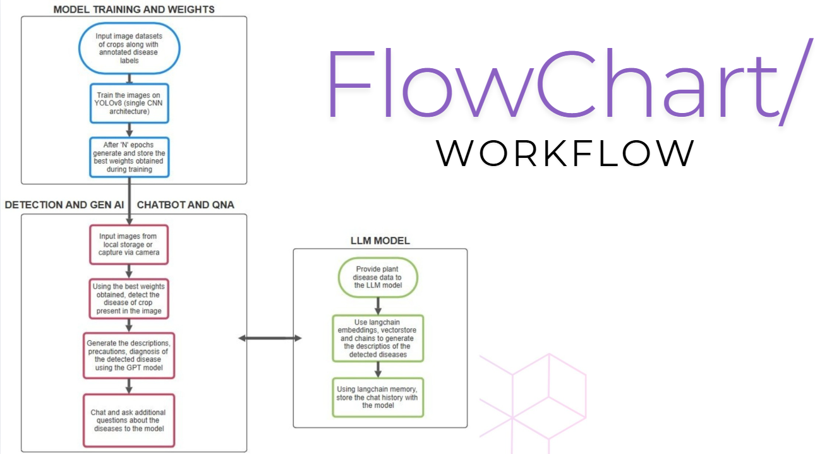
Architecture

Slide 14
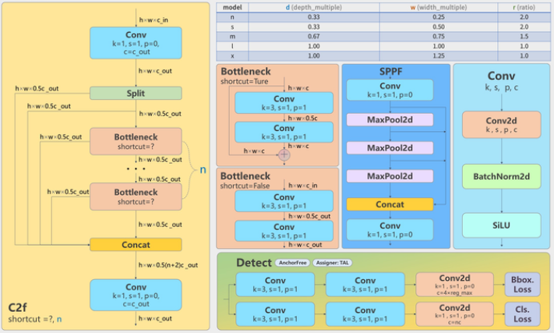
Architecture of YOLOv8

Slide 15
Hardware/software components
Software Requirements:
Operating System:Windows for development and deployment.
Programming Language: Python for deep learning, image processing
Software Tools
TensorFlow/PyTorch for training.
YOLOv8
OpenCV for image and video analysis.
Streamlit
Langchain, ChromaDB
Libraries
TensorFlow/PyTorch, OpenCV, SSD (face detection), OpenPose (for pose estimation), Numpy, SciPy.
Hardware Requirements:
GPU: NVIDIA GPU for real-time deep learning inference.
RGB Camera: A high-resolution camera for capturing images in normal lighting conditions.

Slide 16
Timeline of the Project
Phase | Tasks | Review
Project Initiation | Define the project scope, conduct a literature review on AI-based crop disease detection, and finalize the technology stack. Identify suitable datasets and model architectures (YOLO, CNNs). | Review 0: Initial Plan Review
Research & Design | Gather images of diseased and healthy crops, preprocess the dataset (resizing, augmentation), and store it in Google Drive. Ensure proper labeling and annotation in roboflow for training. | Review 1: Research & Design Review
Model Development & Integration | Train YOLO models for detecting crop diseases, fine-tune hyperparameters, and evaluate model performance using precision, recall, and F1-score. Create vector embeddings for disease-related text data. | Review 2: Model Development & Integration Review
Model Development & Integration | Develop a Streamlit-based web app for disease detection, integrate trained models, and connect LangChain & GPT-4 for chatbot-based recommendations. Optimize API calls for efficiency. | Review 3: Testing & Simulation Review
Model Development & Integration | Test the web app with real images, deploy it on a cloud platform (Streamlit Cloud, Hugging Face Spaces), gather user feedback, refine the UI, and compile the final project report and research paper. | Final Viva: Overall System Validation & Paper submission

Slide 17
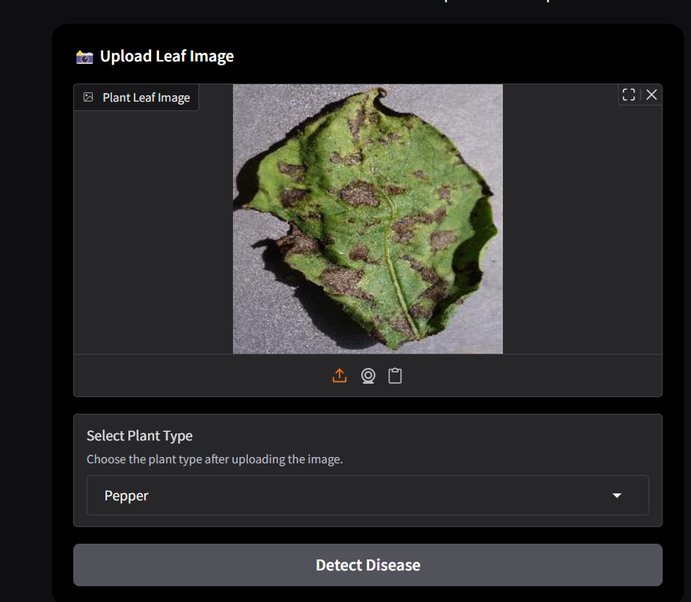
Experiment results

Slide 18
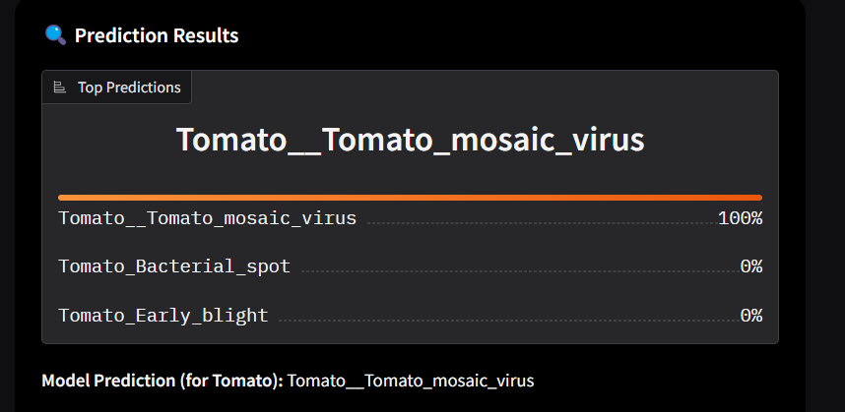
Experiment results

Slide 19
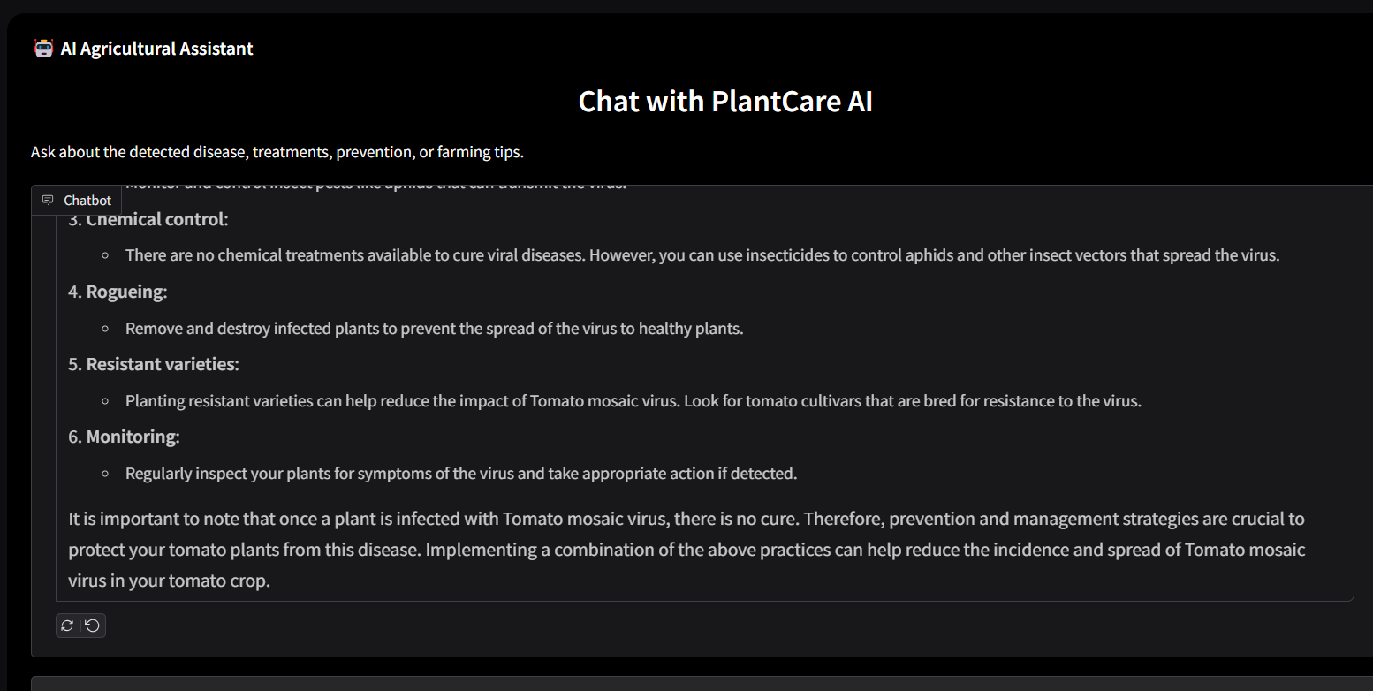
Experiment results

Slide 20
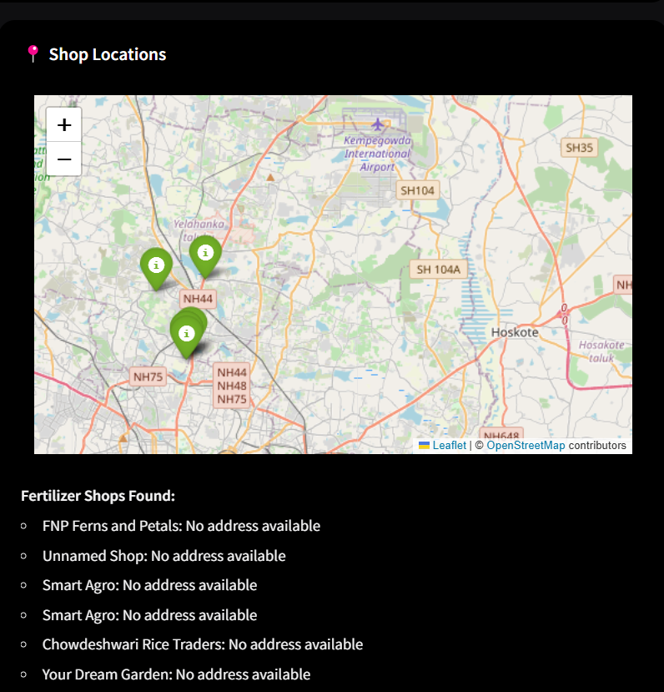
Experiment results

Slide 21
Conclusion
AI-Driven Crop Disease Prediction and Management System effectively combines deep learning, computer vision, and real-time video analysis to deliver a robust solution for early disease detection and management in agriculture. By integrating advanced algorithms and mobile-based surveillance, the system can drastically improve crop yield and reduce losses caused by plant diseases.

Slide 22
Github Link
https://github.com/M-Abhsihek/Crop-Disease-Prediction

Slide 23
References
[1] Shahi, T. B., Xu, C.-Y., Neupane, A., & Guo, W. (2023). Recent Advances in Crop Disease Detection Using UAV and Deep Learning Techniques. Remote Sensing, 15(9), 2450. https://doi.org/10.3390/rs15092450
[2] Singla, A., Nehra, A., Joshi, K., Kumar, A., Tuteja, N., Varshney, R.K., Gill, S.S., & Gill, R. (2024). Exploration of machine learning approaches for automated crop disease detection. Current Plant Biology.
[3] Ale, L., Sheta, A., Li, L., Wang, Y., & Zhang, N. (2019). Deep Learning Based Plant Disease Detection for Smart Agriculture. 2019 IEEE Globecom Workshops (GC Wkshps), 1-6.
[4] Edna Chebet Too, Li Yujian, Sam Njuki, and Liu Yingchun. 2019. A comparative study of fine-tuning deep learning models for plant disease identification. Comput. Electron. Agric. 161, C (Jun 2019), 272–279. https://doi.org/10.1016/j.compag.2018.03.032
[5] Chowdhury, M. E. H., Rahman, T., Khandakar, A., Ayari, M. A., Khan, A. U., Khan, M. S., Al-Emadi, N., Reaz, M. B. I., Islam, M. T., & Ali, S. H. M. (2021). Automatic and Reliable Leaf Disease Detection Using Deep Learning Techniques. AgriEngineering, 3(2), 294-312. https://doi.org/10.3390/agriengineering3020020
[6] J., A., Eunice, J., Popescu, D. E., Chowdary, M. K., & Hemanth, J. (2022). Deep Learning-Based Leaf Disease Detection in Crops Using Images for Agricultural Applications. Agronomy, 12(10), 2395. https://doi.org/10.3390/agronomy12102395
[7] Roy, A. M., & Bhaduri, J. (2021). A Deep Learning Enabled Multi-Class Plant Disease Detection Model Based on Computer Vision. AI, 2(3), 413-428. https://doi.org/10.3390/ai2030026

Slide 24


