Slide 1

Human Resources HR Analytics on Employee Attrition
Group 2
Mohamed AlaaElDin Awad
Valeriia Zalizniak
Salvatore Belzaino

Slide 2

The Goal
Defining the drivers of employee attrition basing on the IBM dataset
Looking at the factors contributing to attrition
Exploring the usefulness of various machine learning methods

Slide 3
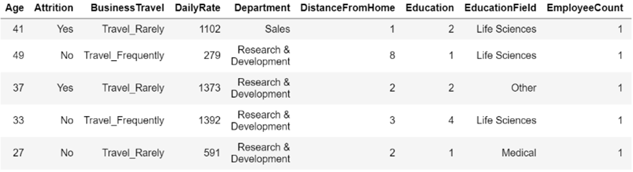
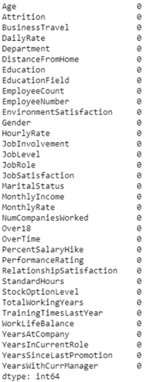
Data Exploration
After loading the dataset we had a check on the presence of missing values and the formatting needs. Luckily, no missing values were spotted, and as one can see in the upper figure, we also don’t need to format the data.

Slide 4
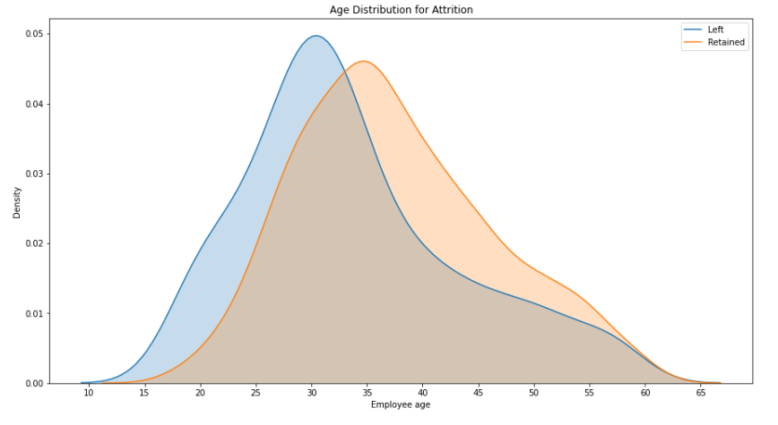
Looking at the Descriptives
Considering the descriptives one can see the variations basing on attrition
For instance, the picture to the right shows that the retained employees have the age distribution shifted to the right, as compared to non-retained

Slide 5
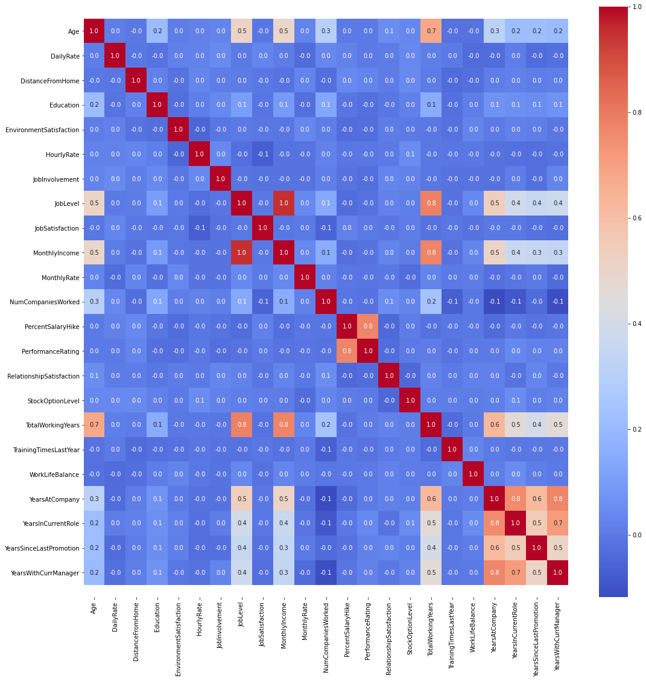
We created a seaborn heatmap in order to understand which variables were more correlated.
This provides an insight into which variables should be removed for further use in the models.
Some of the most correlated variables are: years at company, years in current role, and years with current manager.

Slide 6
Feature Engineering & Model Selection
We don’t want someone who is likely to leave to be classified as not leaving
Our strategy is to find the model that maximizes the recall value
Several supervised algorithms were utilized to find the best performing model
GridSearchCV with Cross Validation of 5 folds was employed to search for the best parameters in each model and avoid overfitting.
Performance of Random forest classifier was used as a baseline
Exploring the classes of the target variable was necessary to check for Class Balance.

Slide 7
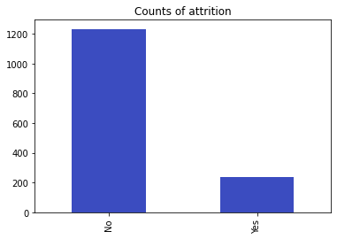
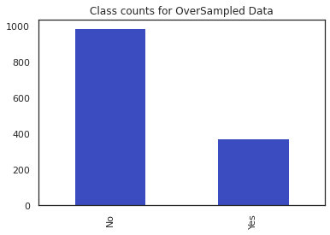
There is a clear class imbalance in the training dataset
Number of exhausted employees (“Yes” in attrition) : only 16% of the classes.
In such case, increasing the number of values in the underrepresented class is suggested to improve the accuracy of the model.
SMOTE oversampling was implemented to account for the class imbalance
The number of “Yes” class values was doubled
Worth to note: more than doubling the positive class made the accuracy of all the models drop considerably

Slide 8
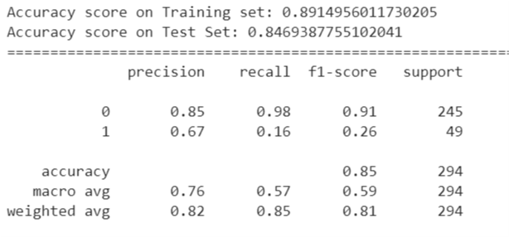
Model 1: Random Forest Classifier
A Random Forest Classifier has yielded a small recall value of 0.16
Despite trying various hyper-parameters using GridSearchCV, the recall value did not go beyond 0.16

Slide 9
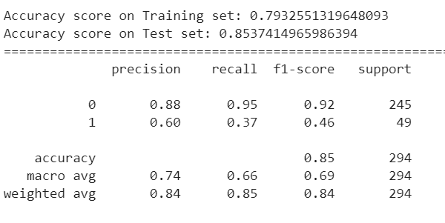
Model 2: Feature Selection using Extra Tree Classifier
The important features obtained from Extra Tree Classifier are fed into the Select_from_model () function
The important features are further selected based on the mean of the coefficients.
Features greater than or equal to the mean of the coefficients are used to train a linear SVC
Number of features selected using Extra Tree Classifier: 12 out of 40
Recall Value: 0.37

Slide 10
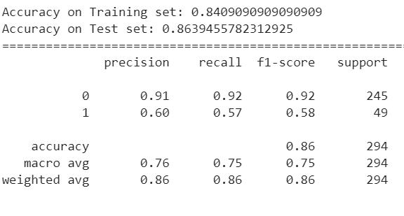
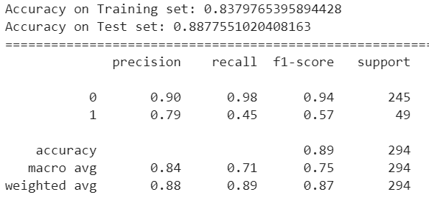
Model 3 - Linear SVC:
Model 4 – Nonlinear SVC
The best parameters obtained from GridSearchCV: {‘C’:1}
The best parameters obtained from GridSearchCV: {‘gamma’:0.01}
Recall Value : 0.57
Recall Value : 0.45

Slide 11
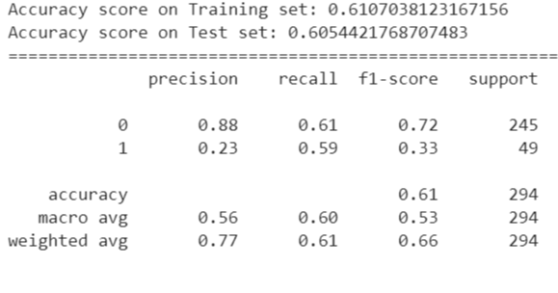
Model 5 - Gradient Boosting Model
The Gradient Boosting Model was able to yield the best result among all parameters
The best hyper-parameters chosen by GridSearchCV: {n_estimators': 500,
'max_features': 0.9, 'learning_rate' : 1.68, 'max_depth': 4}
Recall Value : 0.59

Slide 12
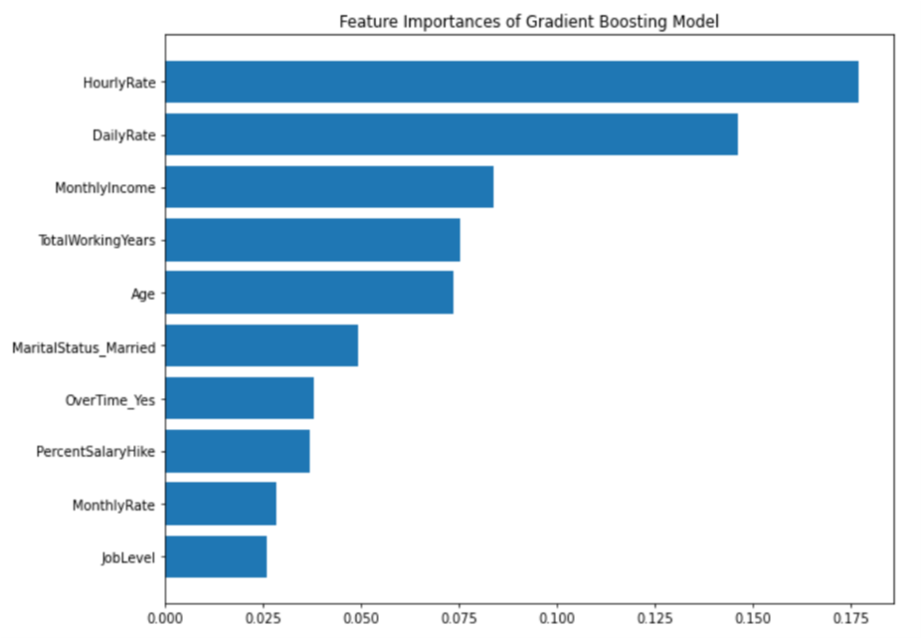
The 10 most important features that makes an employee decide to leave or stay are:
HourlyRate
Daily Rate
Monthly Income
TotalWorkingYears
Age
MaritalStatus_Married
OverTime_Yes
PercentSalaryHike
MonthlyRate
JobLevel

Slide 13
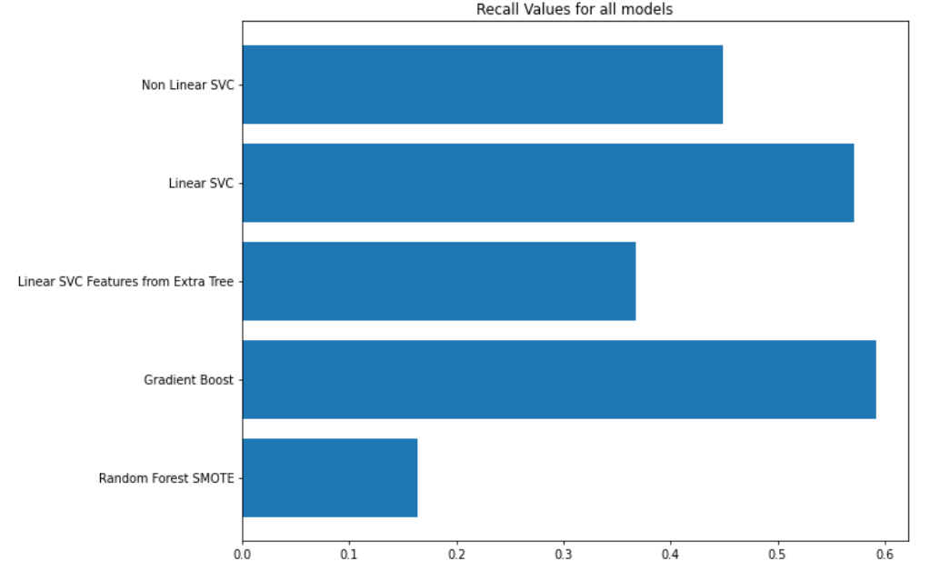
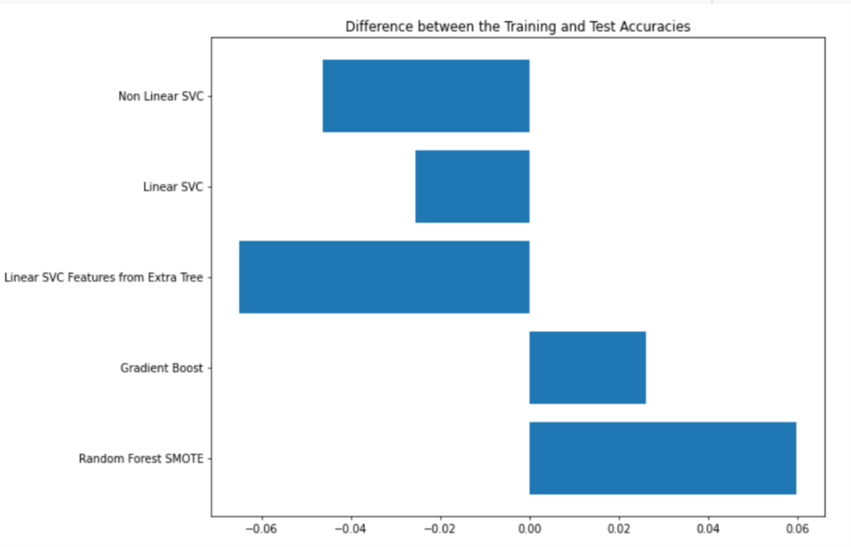
Gradient Boosting Model has yielded the highest Recall value
0.57
0.59
The smaller the difference in accuracies, the better the model

Slide 14
Conclusion
In the current research project the analysis of the HR employee attrition dataset was conducted, in order to define the factors most contributing to the attrition of employees in companies, and find the models that are most suitable for identifying the attrition intentions. One additional consideration was to take into account the imbalance in classes present in the distribution of the target variable. As it was shown in the report, the gradient boosting model is best in terms of both recall and the difference between the training and testing accuracies. It is closely followed by the linear SVC in each of these two indicators. Gradient boosting model highlights the monthly and hourly rates, as well as the monthly income as the top three indicators contributing to the variation in attrition. At the same time, the linear SVC rates the presence of overtimes, frequent business travel and the dummy variable for being a sales representative as the features of highest contribution to different attrition rates. However, the outcomes of the analysis should be taken with caution in applying to real world problems, as the dataset is fictitious and also doesn't take into account the external drivers of attrition and the temporal component.
Thank you for your attention

