Slide 1
Pakistan skincare - what the category is actually posting
A brand-by-brand communications scan
84 posts · 7 brands · collected 2026-08-27
Category scan, August 2026 - no client named

Slide 2
What we looked at
The most recent posts from each brand's public account.
Every artwork was downloaded and coded from the image, not from the caption.
Codes left `unclear` where the message could not be read. None were guessed.
Brands with no account are recorded as absences, not gaps.
A limit worth stating first
Every brand contributed the same number of posts - a collection artefact, not a fact about the category. Share of voice cannot be measured here, and no share-of-voice number appears in this deck.
Everything shown is organic owned content. No paid creative, no spend, no reach.

Slide 3
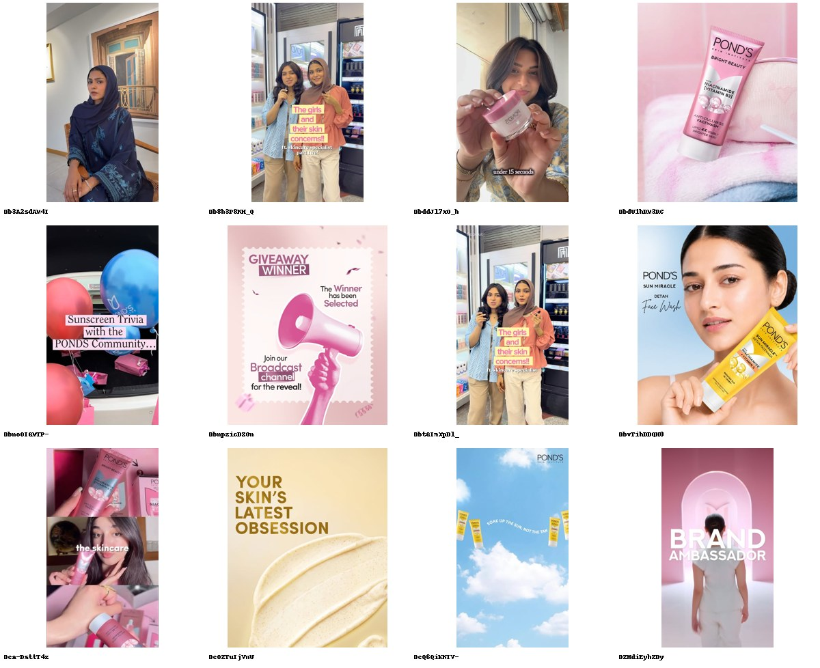
POND'S Pakistan
@pondspk · DIRECT COMPETITOR · 112K followers · 12 ads coded
Two campaigns and a party, running at once.
· The one real idea: 'SOAK UP THE SUN, NOT THE TAN' - Sun Miracle tubes pegged on a washing line against sky.
· Then Bright Beauty niacinamide, '4X', on a towel - the only measured number the brand publishes.
· Then a giveaway: 'GIVEAWAY WINNER... Join our Broadcast channel for the reveal!' - the only post in 84 that pushes to an owned platform.
· Two of twelve are the same in-store reel: 'The girls and their skin concerns!! ft. skincare specialist'.
Biggest verified account in the set at 112K, and the widest spread of intent: de-tan, brightening, community, ambassador. 4/12 brand-building is the highest of the multinationals - but no line recurs, so nothing compounds.
8/12 no proof device · 4/12 address the core objection · 4/12 brand-building

Slide 4
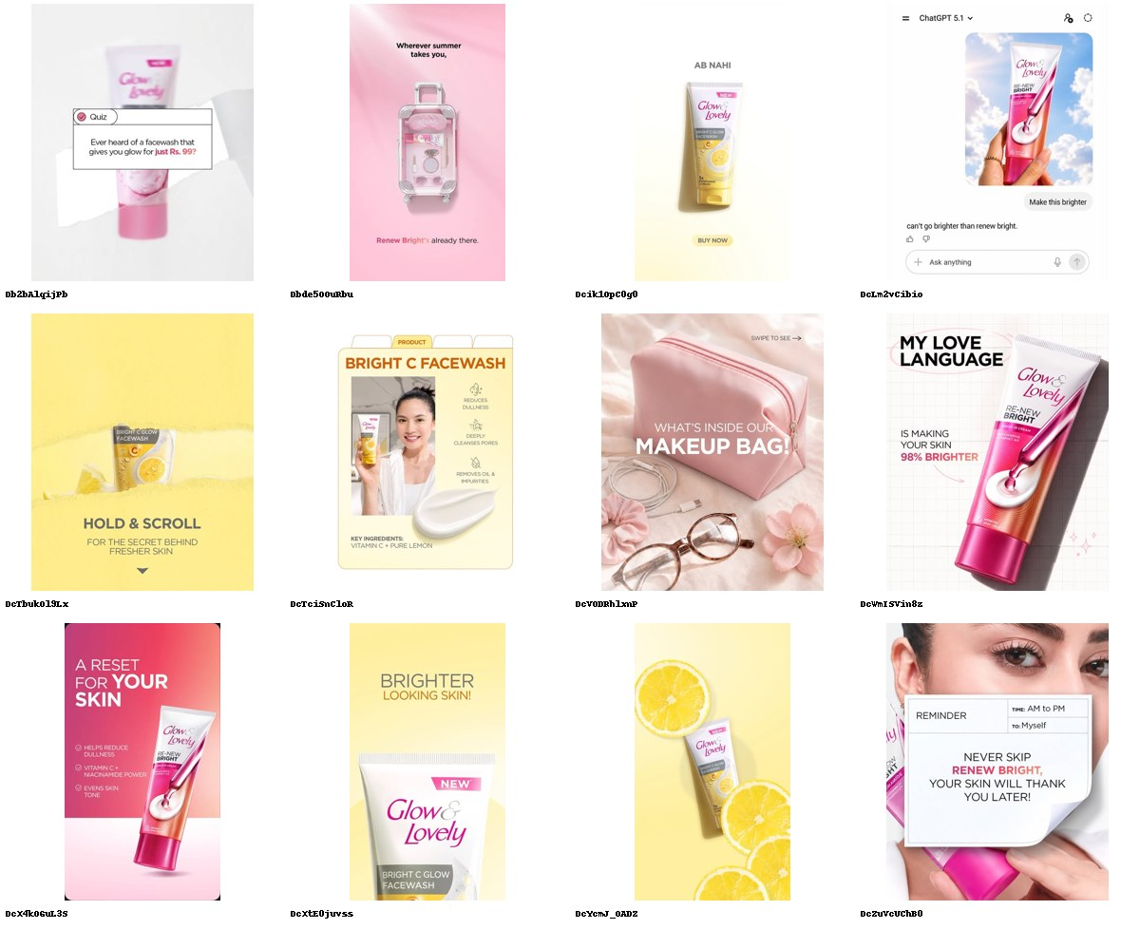
Glow & Lovely Pakistan
@glowandlovely.pk · DIRECT COMPETITOR · 13.1K followers · 12 ads coded
Brightening, restated eleven different ways.
· 'MY LOVE LANGUAGE IS MAKING YOUR SKIN 98% BRIGHTER' - the only stat in the feed.
· 'Ever heard of a facewash that gives you glow for just Rs. 99?' - the category's only price-led post.
· A mocked-up ChatGPT screenshot: 'Make this brighter' / 'can't go brighter than renew bright'.
· 'AB NAHI' with a BUY NOW button - the only Urdu-led headline in 84 posts.
Eleven of twelve posts lead on brightening or the facewash that delivers it. Seven are in-house template graphics. Renew Bright recurs five times, so there is a platform - it just has nothing to say beyond brighter.
11/12 no proof device · 3/12 address the core objection · 3/12 brand-building

Slide 5
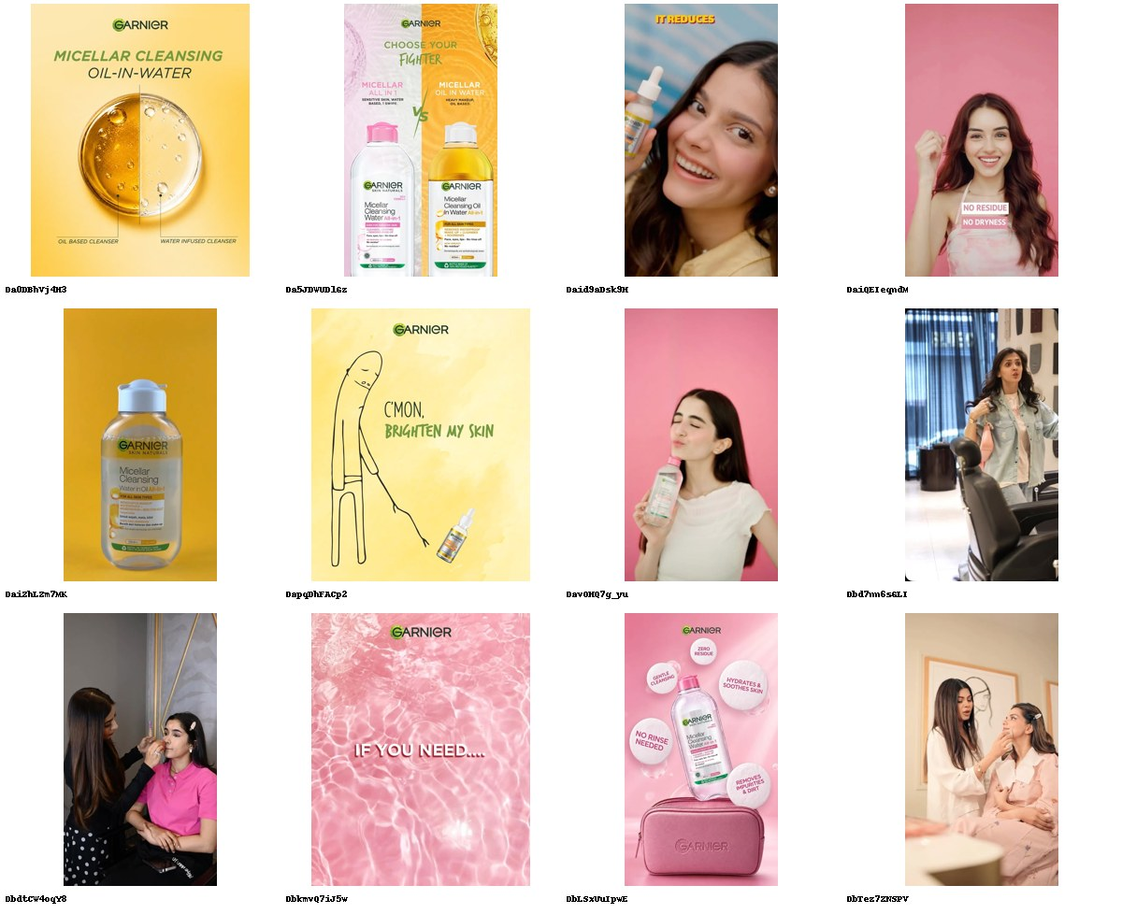
Garnier Pakistan
@garnierpakistan · DIRECT COMPETITOR · 131K followers · 12 ads coded
Half the feed is somebody else's footage.
· Six of twelve are creator reposts - @Merub Ali, @SARA ALI, @B O B B Y Official and three more.
· The brand's own work is packshots: 'ZERO RESIDUE / HYDRATES & SOOTHES SKIN / NO RINSE NEEDED'.
· One genuinely art-directed idea: a line drawing of a figure dragging a serum bottle - 'C'MON, BRIGHTEN MY SKIN'.
· 'CHOOSE YOUR FIGHTER - Micellar All in 1 VS Micellar Oil in Water' is the only recurring device, used once.
131K followers, the largest account here, and nine of twelve posts are one SKU - Micellar Cleansing Oil-in-Water. Last post 24 days before collection. The creator reposts carry the only testimonials; the brand itself proves nothing.
6/12 no proof device · 5/12 address the core objection · 2/12 brand-building

Slide 6
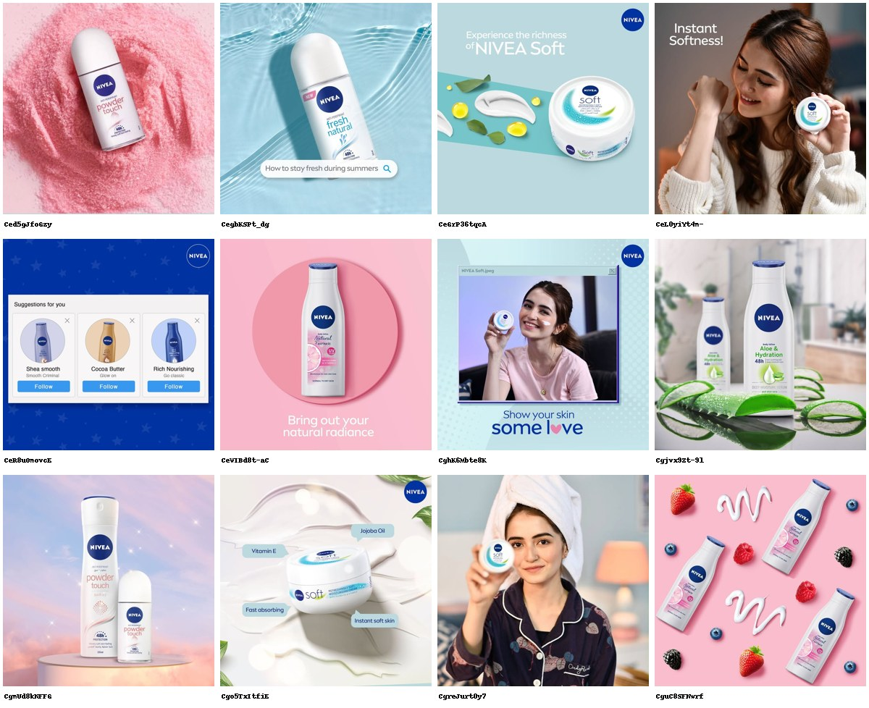
Nivea Pakistan
@niveapakistan · DIRECT COMPETITOR · 23.7K followers · 12 ads coded
The account stopped in August 2022.
· The twelve most recent posts are dated 28 May to 1 August 2022. Nothing since - 1,487 days.
· Four of them are deodorant, not skincare: Powder Touch, Fresh Natural.
· The sharpest thing in the grid is four years old: a mock 'Suggestions for you' panel offering Shea Smooth, Cocoa Butter and Rich Nourishing, each with a Follow button.
· 'Bring out your natural radiance' - Natural Fairness body lotion, 2022.
23.7K followers, unverified, dormant. Read this as a finding about the category's face-care contest, not a hole in the sample: the world's largest skin-care brand is not competing on this platform in this market at all.
11/12 no proof device · 1/12 address the core objection · 2/12 brand-building

Slide 7
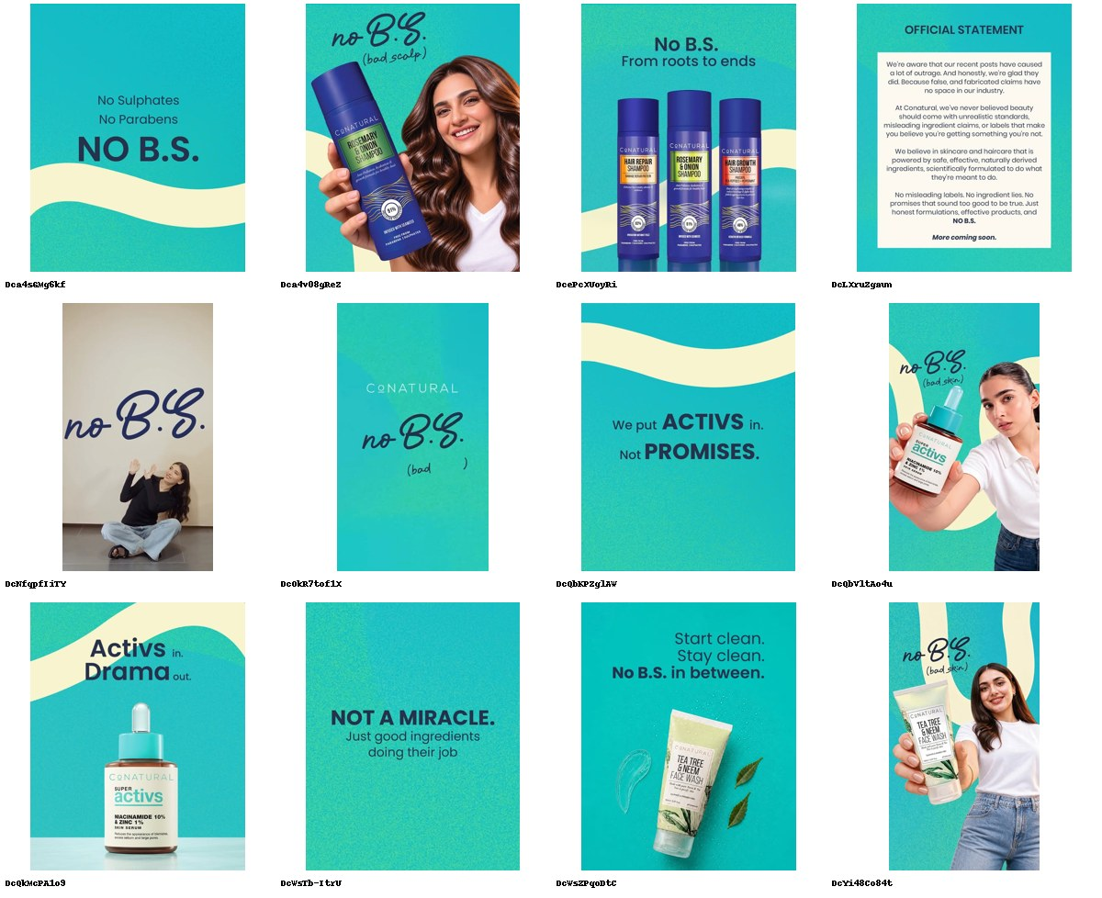
Conatural
@conatural · DIRECT COMPETITOR · 339K followers · 12 ads coded
The only brand arguing with the category instead of joining it.
· 'We put ACTIVS in. Not PROMISES.'
· 'NOT A MIRACLE. Just good ingredients doing their job.'
· And an OFFICIAL STATEMENT post: 'We are aware that our recent posts have caused a lot of outrage. And honestly, we are glad they did. Because false, and fabricated claims have no space in our industry... No misleading labels. No ingredient lies.'
· NO B.S. appears on all twelve posts - the only platform in the set with total coverage.
339K followers, verified, 12 posts in a week, 58% brand-building - the highest in the scan on every one of those measures. It has taken the honesty territory by naming the category's dishonesty. It still proves nothing: zero proof devices in twelve posts. The position is claimed, not evidenced.
12/12 no proof device · 5/12 address the core objection · 7/12 brand-building

Slide 8
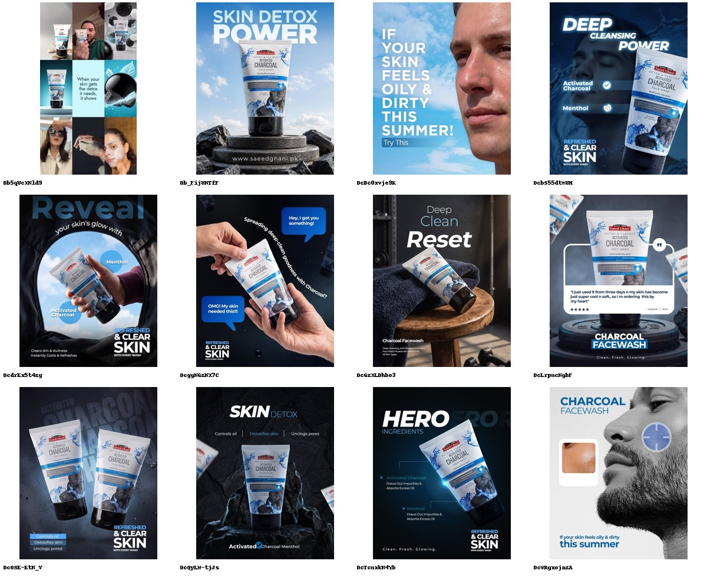
Saeed Ghani
@saeedghani1888 · ADJACENT · 560K followers · 12 ads coded
One SKU, twelve times, and the only male face in the category.
· All twelve posts are the Detox & Cleanse Activated Charcoal Face Wash. Not the range - the tube.
· 'IF YOUR SKIN FEELS OILY & DIRTY THIS SUMMER!' over a man's face against sky.
· The only published customer review in the scan, verbatim: 'I just used it from three days my skin has become just super cool so i m ordering this by my heart'.
· 'REFRESHED & CLEAR SKIN with every wash' recurs on five of twelve.
560K followers, the largest account in the set, and a 138-year-old herbal house running one product like a performance ad. Male casting and oil control are both uncontested here. Only 1 of 12 is brand-building - the heritage that is the whole asset is never once used.
10/12 no proof device · 9/12 address the core objection · 1/12 brand-building

Slide 9
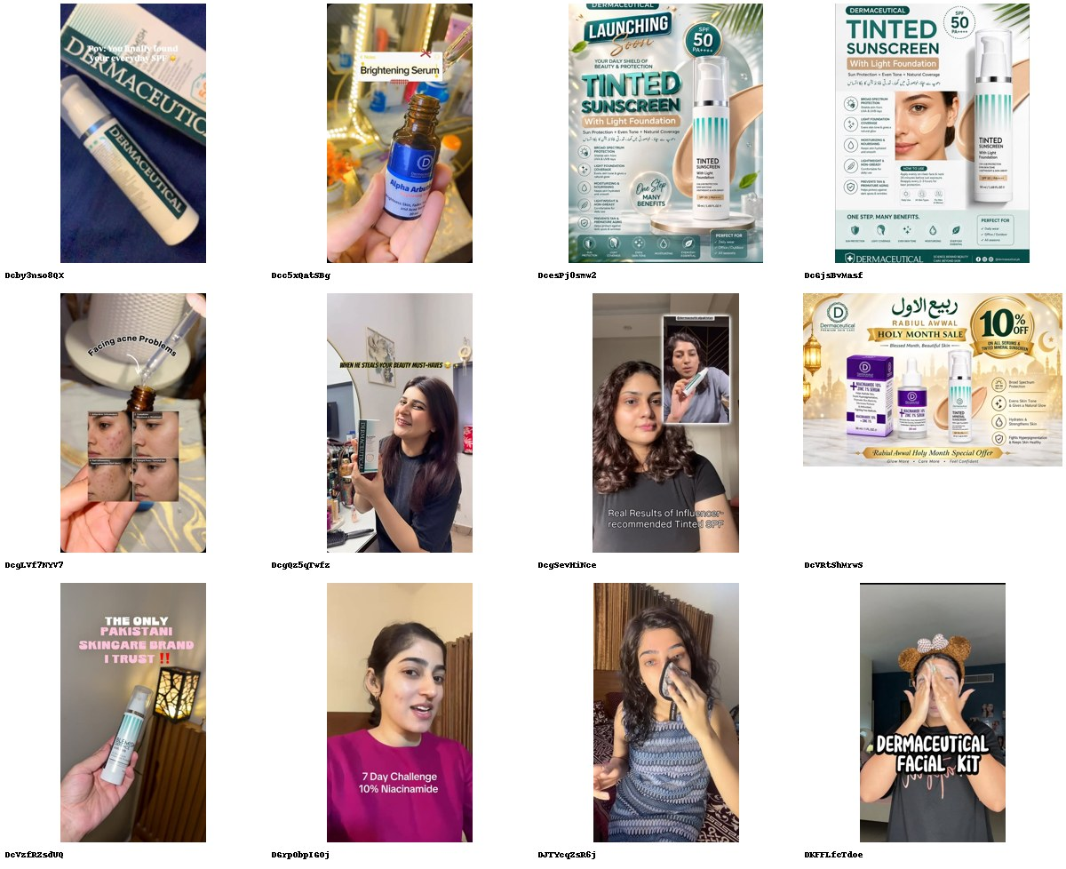
Dermaceutical Pakistan
@dermaceuticalpakistan · ADJACENT · 12.9K followers · 12 ads coded
Zero brand-building. The influencers are the brand.
· Seven of twelve posts are creator reposts - @Doc.Rapunzel, @Paro, @Rija Rafique and four more.
· 'THE ONLY PAKISTANI SKINCARE BRAND I TRUST!!' - said by a creator, not by the brand.
· The only before/after face grid in 84 posts is a repost: 'Facing acne Problems'.
· The brand's own posts are a spec sheet ('TINTED SUNSCREEN... ONE STEP. MANY BENEFITS') and a sale ('RABI-UL-AWWAL HOLY MONTH SALE - 10% OFF').
12.9K followers, verified, dermo-science positioning - and 0% brand-building. It has the most proof in the category (7 testimonials, an expert voice, a before/after) and none of it belongs to it. Rent the credibility, never bank it.
4/12 no proof device · 6/12 address the core objection · 0/12 brand-building

Slide 10
Nobody in this category is over forty.
Across 84 posts and seven brands, not one is cast, styled or written for GenX or older. Zero. And `anti_ageing` - the single largest value pool in global skincare - is claimed by nobody: 0 of 84 posts.
The two brands that would naturally own it have no Pakistan account at all. Olay and Cetaphil are absences, not competitors.
The occupied centre is brightening (13 posts, 9 of them aspirational) and cleansing (11). 74% of the category's output offers no proof of anything - no statistic, no test, no before/after, no expert. Three posts in 84 carry a number.
So the vacant territory is a proven claim made to an adult: efficacy, evidenced, cast for someone with a skin history rather than a skin trend. Conatural has already taken the honesty position rhetorically - 'NOT A MIRACLE. Just good ingredients doing their job' - and has published no evidence behind it. That gap is open for exactly as long as it takes someone to publish one.

