Slide 1
Pakistani retail banking on Instagram - what the category is publishing
A brand-by-brand communications scan
84 posts · 7 brands · collected 2026-08-27
Retail bank pitch

Slide 2
What we looked at
The most recent posts from each brand's public account.
Every artwork was downloaded and coded from the image, not from the caption.
Codes left `unclear` where the message could not be read. None were guessed.
Brands with no account are recorded as absences, not gaps.
A limit worth stating first
Every brand contributed the same number of posts - a collection artefact, not a fact about the category. Share of voice cannot be measured here, and no share-of-voice number appears in this deck.
Everything shown is organic owned content. No paid creative, no spend, no reach.

Slide 3
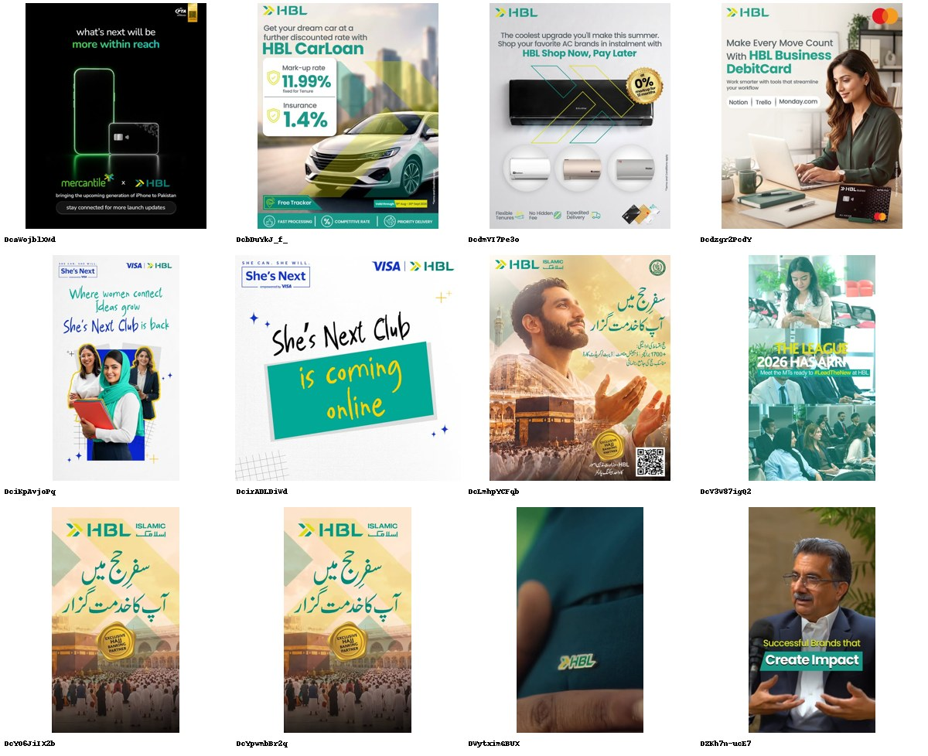
HBL
@hblpak · DIRECT COMPETITOR · 137K followers · 12 ads coded
The only bank still trying to mean something - in three unrelated directions.
· Hajj: 'safar-e-Hajj mein aap ka khidmatguzar', badged EXCLUSIVE HAJJ BANKING PARTNER (Ministry of Religious Affairs). Urdu-first. Run three times in the window.
· She's Next with Visa: 'Where women connect, ideas grow - She's Next Club is back.'
· HBL CarLoan puts the actual number on the artwork: 'Mark-up rate 11.99% fixed for Tenure / Insurance 1.4% / Free Tracker'.
· And then a brand film that is a macro shot of the logo on teal fabric, and a CEO talking head titled 'Successful Brands that Create Impact'.
Six of twelve posts are brand-building - the highest ratio of any bank here. But three platforms (faith, women, careers) run side by side with no connective idea, so the volume buys reach rather than a position.
7/12 no proof device · 0/12 address the core objection · 6/12 brand-building

Slide 4
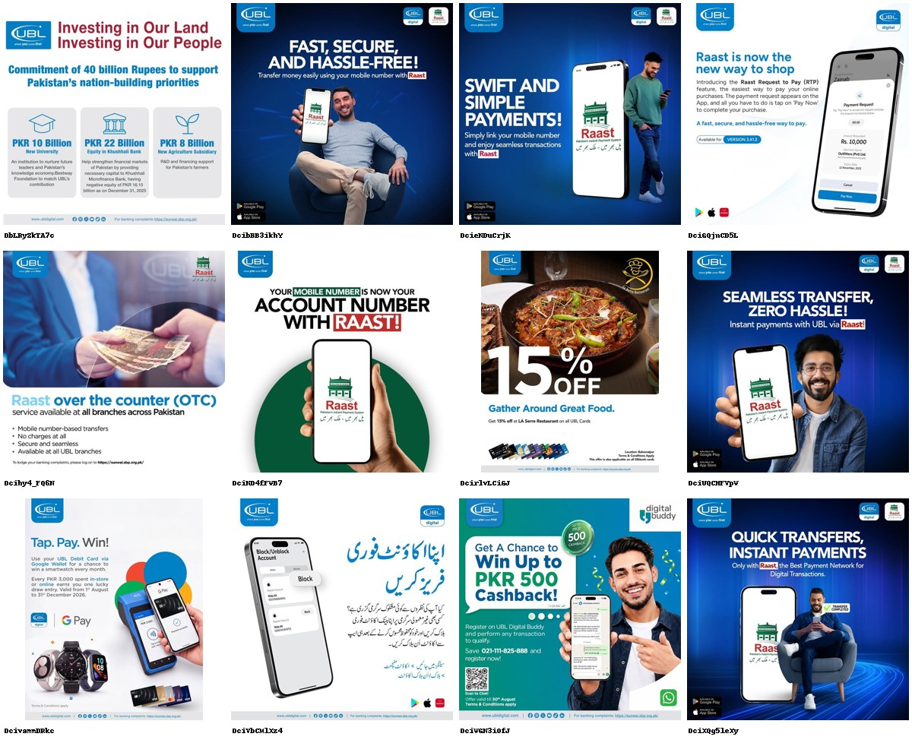
UBL
@ubldigital · DIRECT COMPETITOR · 196K followers · 12 ads coded
Has handed its brand to Raast.
· Seven of twelve posts carry the Raast lockup: 'QUICK TRANSFERS, INSTANT PAYMENTS - Only with Raast, the Best Payment Network for Digital Transactions'.
· 'YOUR MOBILE NUMBER IS NOW YOUR ACCOUNT NUMBER WITH RAAST!'
· Nine of twelve posts drive to an app - the highest ecosystem push in the scan (75%).
· The one exception is the largest number in the whole category: 'Commitment of 40 billion Rupees' - PKR 10bn new university, 22bn Khushhali Bank equity, 8bn agriculture subsidy.
Zero brand-building posts in twelve. UBL is advertising a State Bank rail that every competitor also offers, with the state's logo bigger than its own. The 40bn nation-building post proves it can stand for something and then does not repeat it.
11/12 no proof device · 2/12 address the core objection · 0/12 brand-building

Slide 5
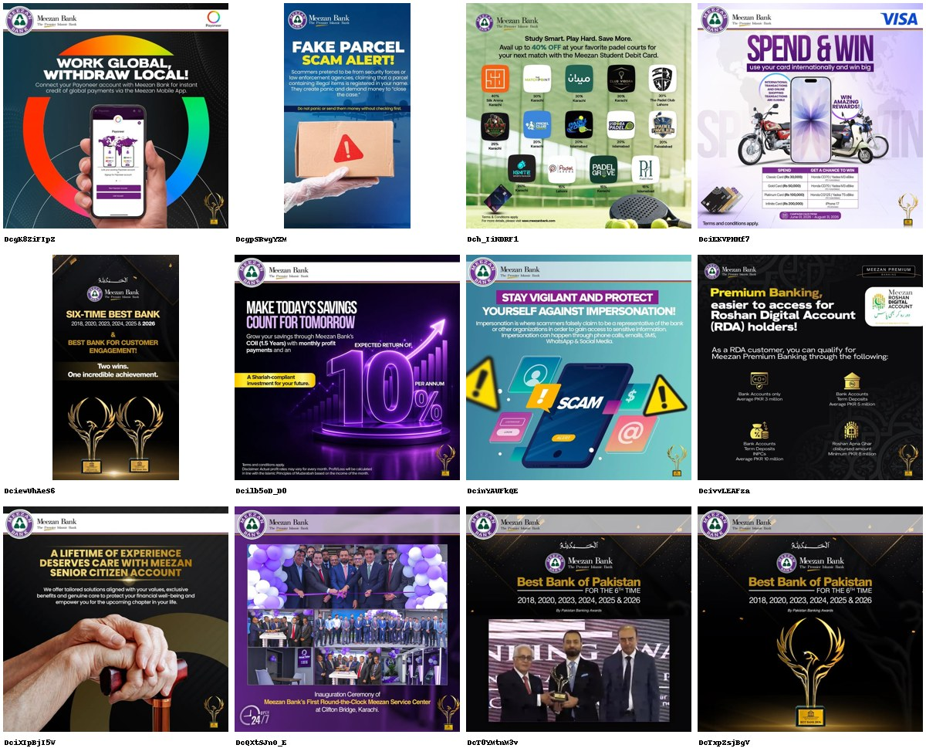
Meezan Bank
@meezanbanklimited · DIRECT COMPETITOR · 163K followers · 12 ads coded
Publishing its own trophy cabinet.
· 'SIX-TIME BEST BANK 2018, 2020, 2023, 2024, 2025 & 2026 - Two wins. One incredible achievement.' Run three separate times.
· Ribbon-cutting: 'Inauguration Ceremony of Meezan Bank's First Round-the-Clock Meezan Service Center at Clifton Bridge, Karachi' - executives in frame.
· The genuinely useful posts get one slot each: 10% p.a. on COII, and 'A LIFETIME OF EXPERIENCE DESERVES CARE' for the Senior Citizen Account.
Zero brand-building posts; four of twelve are corporate PR, three of those are the same award. The largest Islamic bank in the country published faith-based value exactly once in twelve posts. Its own strongest territory is standing empty.
7/12 no proof device · 2/12 address the core objection · 0/12 brand-building

Slide 6
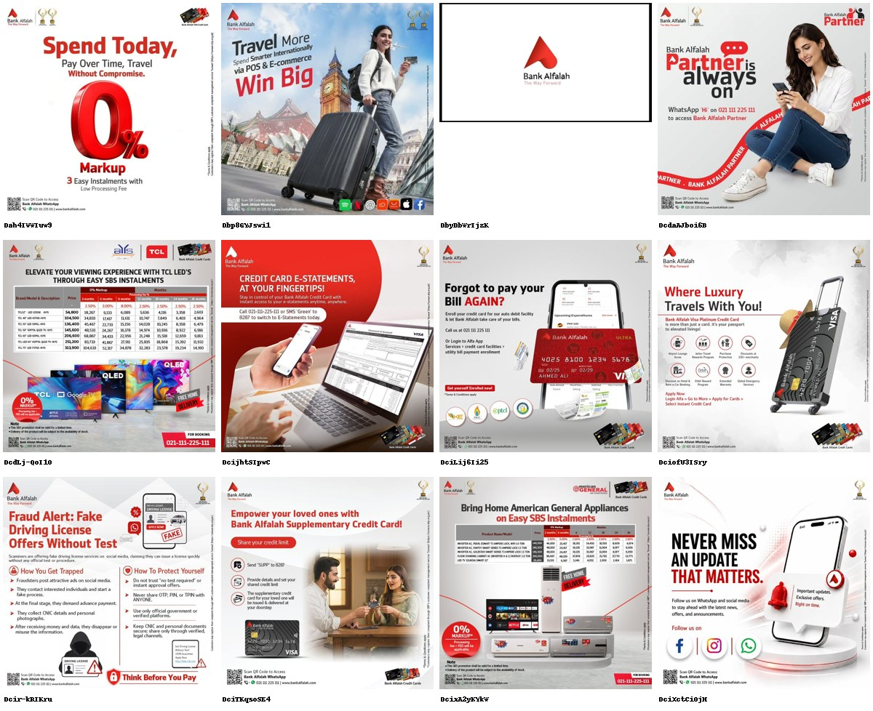
Bank Alfalah
@bank_alfalah · DIRECT COMPETITOR · 106K followers · 12 ads coded
A credit-card offer sheet with a bank's logo on it.
· 'Spend Today, Pay Over Time, Travel Without Compromise - 0% Markup, 3 Easy Instalments.'
· Two separate posts are eight-column instalment price tables (TCL LEDs, American General appliances), 3-24 months, unreadable at feed size.
· One post is a video whose entire frame is the logo lockup on white. No proposition, no product, no person.
· Best line in the set is buried in a service post: 'Forgot to pay your Bill AGAIN?'
One brand-building post in twelve (8%), nine of twelve cast for GenY, and the territory is entirely price and instalments. Alfalah has trained its audience to wait for the next discount.
10/12 no proof device · 3/12 address the core objection · 1/12 brand-building

Slide 7
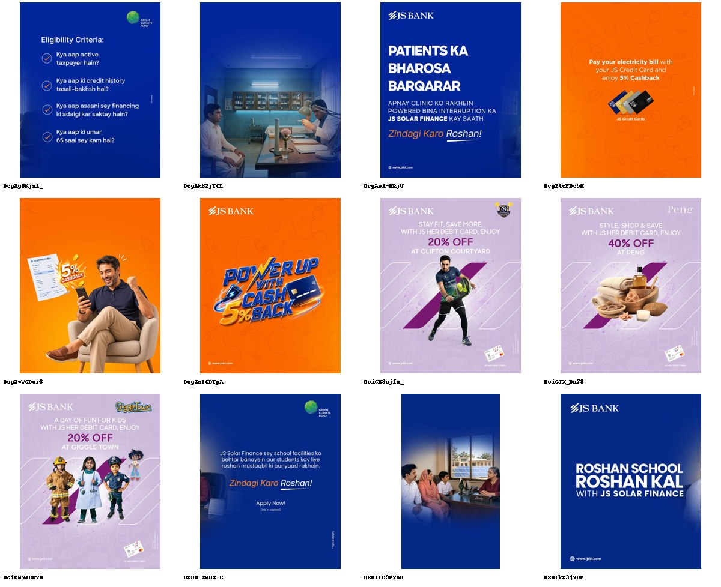
JS Bank
@jsbankltd · ADJACENT · 35.9K followers · 12 ads coded
The smallest bank here is the only one running a campaign.
· 'Zindagi Karo Roshan' carries six of twelve posts - JS Solar Finance for clinics, schools and homes.
· 'PATIENTS KA BHAROSA BARQARAR - apnay clinic ko rakhein powered bina interruption ka JS Solar Finance kay saath.'
· Roman Urdu eligibility criteria published openly: 'Kya aap active taxpayer hain? / credit history tasalli-bakhsh hai? / umar 65 saal sey kam hai?'
· The night-lit clinic and the family in a lit room are the only commissioned documentary photography in 84 posts.
At 35.9K followers, a tenth of HBL's, JS Bank has the only recurring line, the only real-world problem, and the only work that would still mean something in six months. Its JS Her card is undercut by casting a male athlete on a women's product.
12/12 no proof device · 1/12 address the core objection · 4/12 brand-building

Slide 8
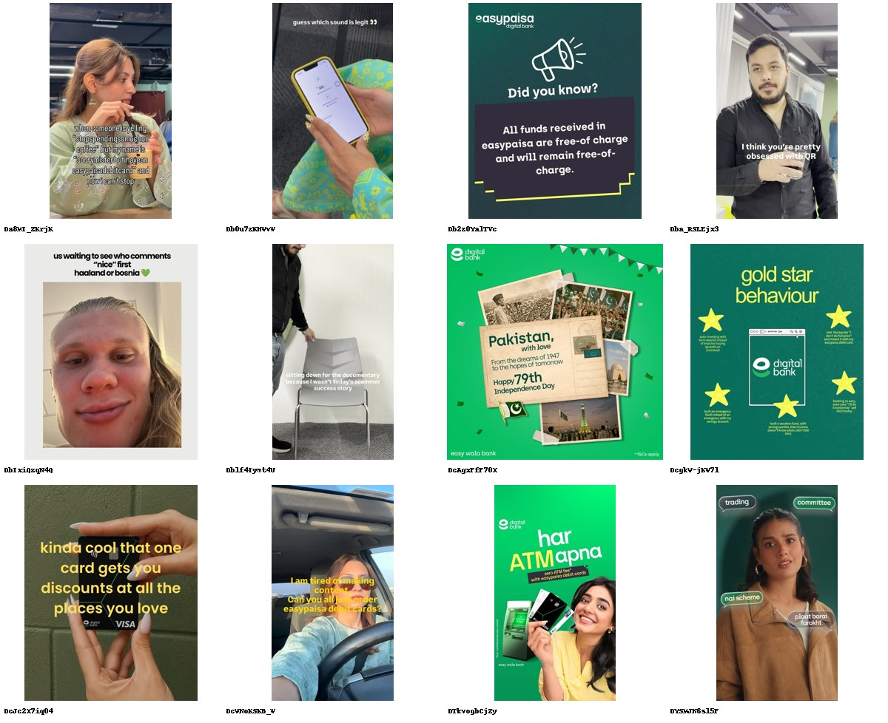
Easypaisa
@easypaisa · SUBSTITUTE · 155K followers · 12 ads coded
Talks like a person; nine of twelve posts are cast for GenZ.
· 'when someone is yelling stop spending so much on coffee but my name is easypaisa debit card and now I can't stop.'
· 'gold star behaviour: auto-investing with term deposit instead of impulse-buying' - the only savings product in the category sold in meme language.
· 'All funds received in easypaisa are free-of-charge and will remain free-of-charge.'
· 'har ATM apna - zero ATM fee with easypaisa debit cards.'
Ten of twelve posts are phone-native or template; almost none are stock. It removes named costs (ATM fee, receiving fee) that no bank in the set will mention. The cost is drift: one post is a borrowed Haaland meme with no product in it at all.
12/12 no proof device · 5/12 address the core objection · 5/12 brand-building

Slide 9
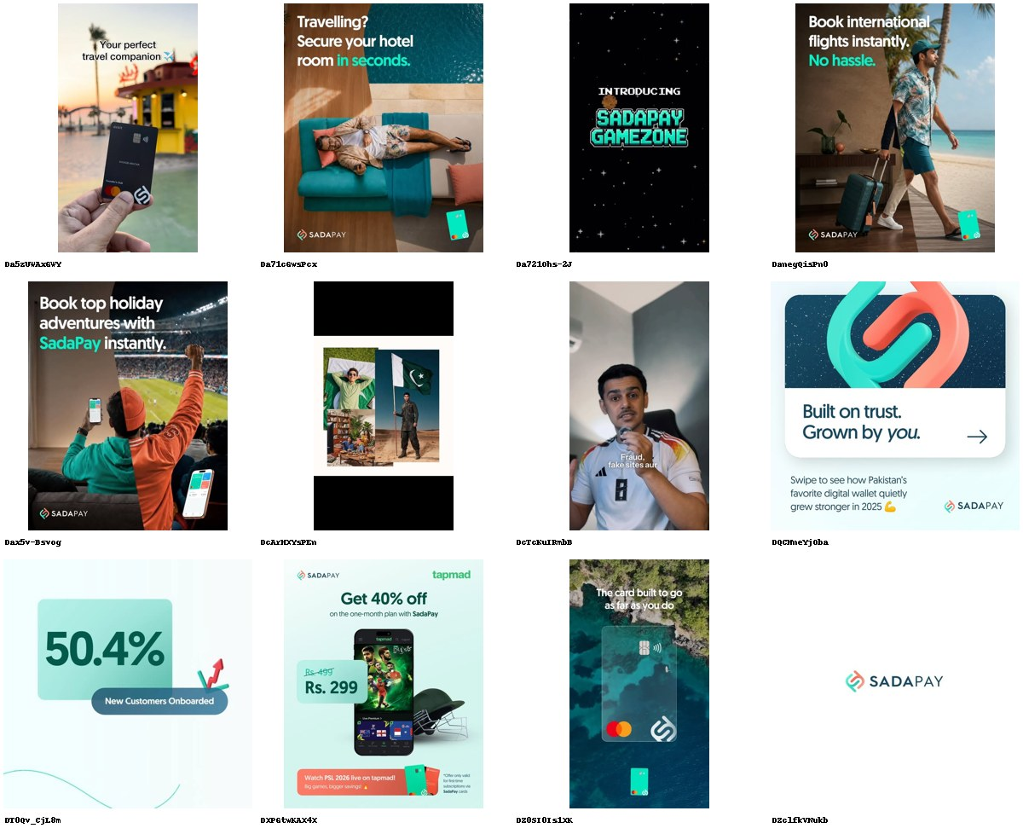
SadaPay
@sadapay · SUBSTITUTE · 48.7K followers · 12 ads coded
The only brand in the category publishing its own numbers.
· 'Built on trust. Grown by you. Swipe to see how Pakistan's favorite digital wallet quietly grew stronger in 2025.'
· '50.4% New Customers Onboarded' - a single performance figure as the entire creative.
· Travel is its whole product story: 'Book international flights instantly. No hassle.' / 'Travelling? Secure your hotel room in seconds.'
· Cadence is roughly one post a week - the slowest in the scan, and the only unverified account of the seven.
SadaPay is doing what every bank here says it stands for and never demonstrates: showing a number about itself. It is also the least frequent poster, so the territory is claimed, not held.
9/12 no proof device · 1/12 address the core objection · 4/12 brand-building

Slide 10
The vacant territory is proof - and the customer nobody is speaking to is over 44.
81% of category posts (68 of 84) carry no proof device at all. Only 8 cite a performance number, and 3 of the 8 are a bank quoting an award it won.
60% of posts have no person in them. Where there is a person, 33 of 51 codeable posts are cast for under-43s; exactly one post in 84 is aimed at over-60s (Meezan Senior Citizen Account) and none at all address the mass-market saver in Urdu.
Fear is used three times in 84 posts, all of them scam alerts. Nobody in this category converts the fraud epidemic into a reason to bank with them.
Every bank is fighting on discount tiles at 10-30 posts a week; the two fintechs post 1-2 a week and own the tone. Volume is not the battleground - a publishable, repeatable number is.

