Slide 1
Pakistani mutual funds: what the category is publishing
A brand-by-brand communications scan
168 posts · 14 brands · collected 2026-08-27

Slide 2
What we looked at
The most recent posts from each brand's public account.
Every artwork was downloaded and coded from the image, not from the caption.
Codes left `unclear` where the message could not be read. None were guessed.
Brands with no account are recorded as absences, not gaps.
A limit worth stating first
Every brand contributed the same number of posts - a collection artefact, not a fact about the category. Share of voice cannot be measured here, and no share-of-voice number appears in this deck.
Everything shown is organic owned content. No paid creative, no spend, no reach.

Slide 3
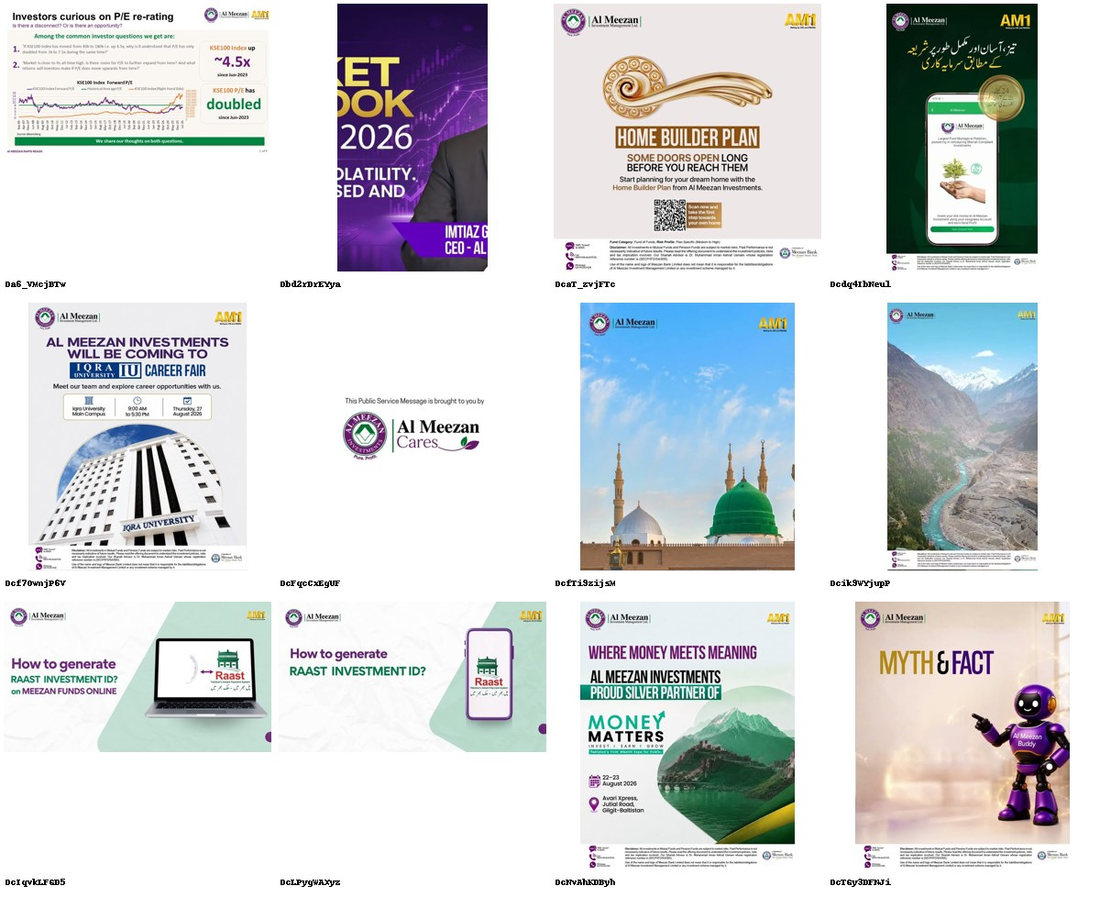
Al Meezan Investments
@almeezangroup · DIRECT COMPETITOR · 81.8K followers · 12 ads coded
The category's biggest account, publishing like a house organ.
· 'HOME BUILDER PLAN - SOME DOORS OPEN LONG BEFORE YOU REACH THEM.' The one genuine life-goal idea in twelve posts.
· Two near-identical 'How to generate RAAST INVESTMENT ID?' posts, desktop and mobile.
· CEO-fronted 'MARKET OUTLOOK 2026' video, an Iqra University career fair, a Money Matters silver-sponsor plaque and an unreadable Al Meezan Cares placeholder.
81.8K followers, the largest in the direct set, and three of twelve posts are brand-building. The rest is admin: how-to, plaque, career fair, calendar.
10/12 no proof device · 3/12 address the core objection · 3/12 brand-building

Slide 4
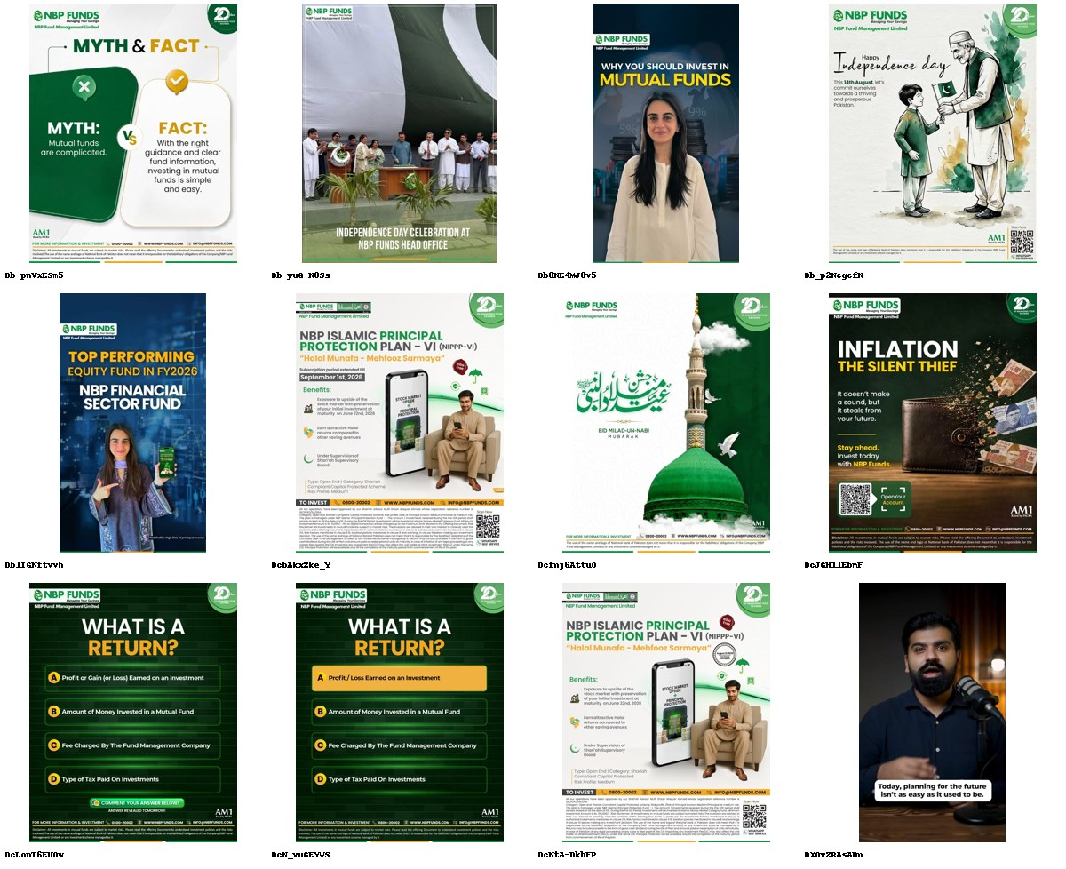
NBP Funds
@nbpfunds · DIRECT COMPETITOR · 26.1K followers · 12 ads coded
The only large AMC arguing that mutual funds are simple - and the only one using fear.
· 'MYTH: Mutual funds are complicated. FACT: With the right guidance and clear fund information, investing in mutual funds is simple and easy.'
· 'WHAT IS A RETURN?' run twice as a quiz with an answer reveal - comment-bait education.
· 'INFLATION THE SILENT THIEF - It doesn't make a sound, but it steals from your future.'
50% brand-building, the highest of any large AMC, and the single fear-register ad in the direct ring. It is the closest thing the category has to an argument for the product itself rather than a product.
11/12 no proof device · 8/12 address the core objection · 6/12 brand-building

Slide 5
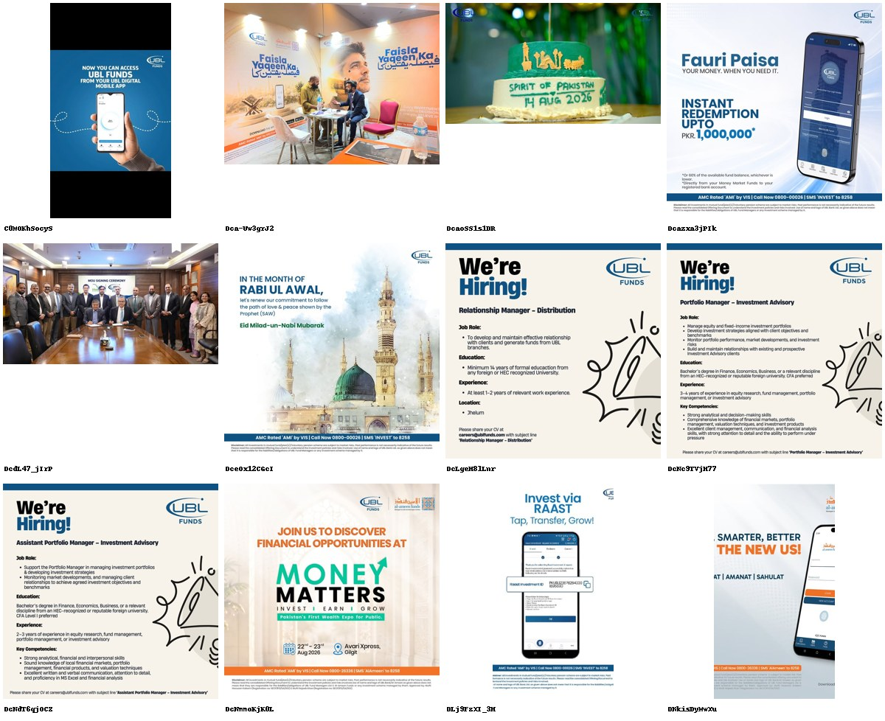
UBL Fund Managers
@ublfunds · DIRECT COMPETITOR · 21.6K followers · 12 ads coded
Zero brand-building. Three of twelve posts are job adverts.
· Three 'We're Hiring!' posts carrying full job descriptions as artwork - Relationship Manager, Portfolio Manager, Assistant Portfolio Manager.
· 'Fauri Paisa - YOUR MONEY, WHEN YOU NEED IT. INSTANT REDEMPTION UPTO PKR 1,000,000.'
· An MOU signing photo, an office cake, an expo stand.
Fauri Paisa is the only ad in 168 that answers the liquidity objection - the reason most Pakistani savers stay in a bank account. It is buried between recruitment posts. Nothing in the window is brand-building.
12/12 no proof device · 1/12 address the core objection · 0/12 brand-building

Slide 6
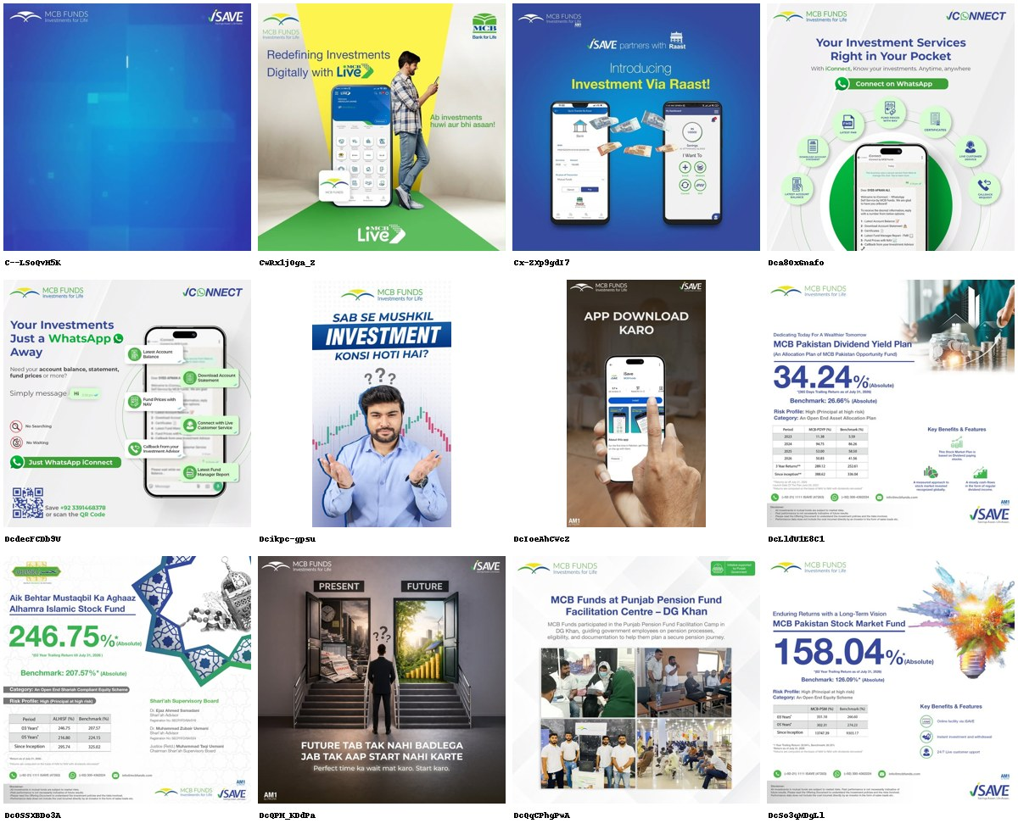
MCB Investments
@isave.mcbfunds · DIRECT COMPETITOR · 17K followers · 12 ads coded
No longer an asset manager on Instagram. It is an app.
· Six of twelve posts drive to iSave, iConnect, MCB Live or WhatsApp - the highest ecosystem push in the scan.
· 'Your Investments Just a WhatsApp Away - No Searching, No Waiting. Just WhatsApp iConnect.'
· 'FUTURE TAB TAK NAHI BADLEGA JAB TAK AAP START NAHI KARTE. Perfect time ka wait mat karo.'
50% of output exists to move people into an owned platform. The one strong brand idea in the set - the present/future staircase - is outnumbered five to one by app plumbing.
9/12 no proof device · 4/12 address the core objection · 2/12 brand-building

Slide 7
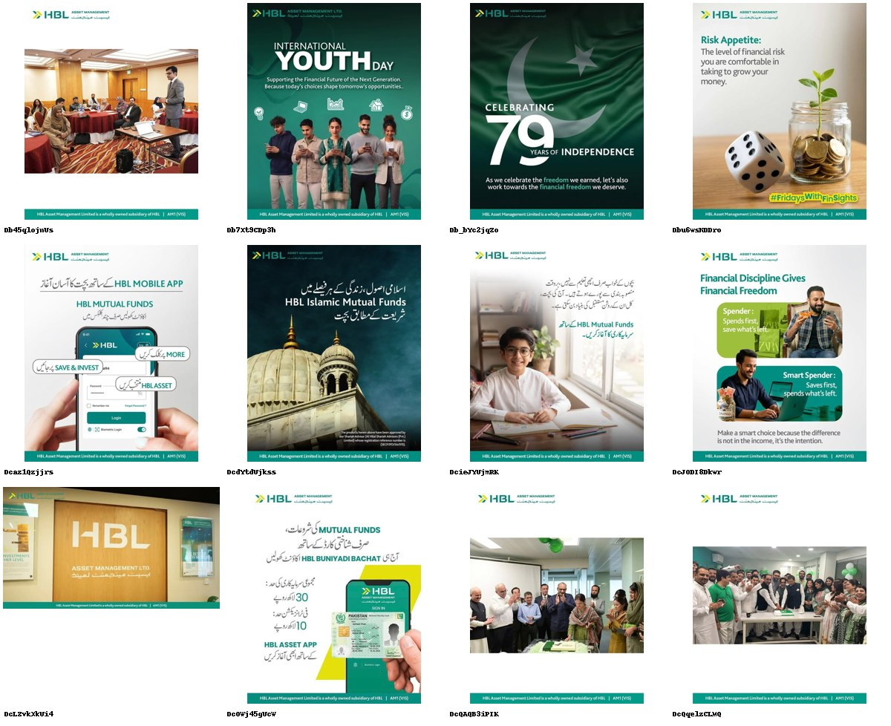
HBL Asset Management
@hbl_amc · DIRECT COMPETITOR · 15.1K followers · 12 ads coded
Owns the low-ticket entry claim and does not repeat it.
· Urdu: open HBL Buniyadi Bachat with just a CNIC - minimum investment Rs 30, transactions from Rs 10.
· 'Financial Discipline Gives Financial Freedom - Spender: spends first, saves what's left. Smart Spender: saves first, spends what's left.'
· Four of twelve posts are corporate: office signage, cake-cutting, balloons, a seminar room.
Rs 30 is the lowest entry ticket in the entire scan - Atlas asks Rs 5,000, KTrade Rs 5,000. It appears once, in Urdu, and is never built on.
11/12 no proof device · 4/12 address the core objection · 3/12 brand-building

Slide 8
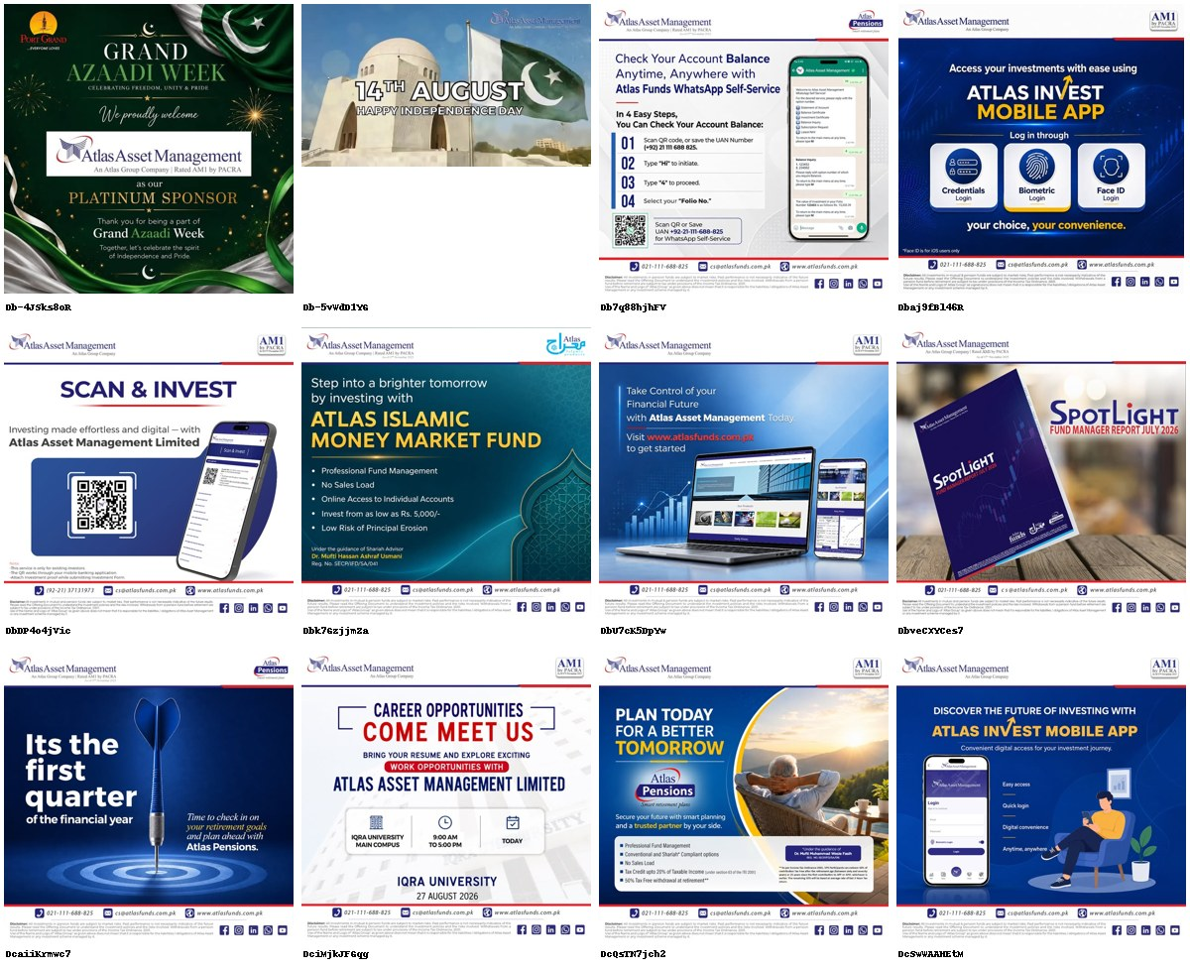
Atlas Asset Management
@atlasfunds · DIRECT COMPETITOR · 3,443 followers · 12 ads coded
Eight of twelve posts are product mechanics. 8% brand-building.
· 'Check Your Account Balance Anytime, Anywhere with Atlas Funds WhatsApp Self-Service' - four numbered steps.
· 'ATLAS INVEST MOBILE APP - Credentials / Biometric / Face ID login.' Plus a separate 'SCAN & INVEST' QR post and a third app post.
· 'PLAN TODAY FOR A BETTER TOMORROW... Tax Credit upto 20% of Taxable Income, 50% Tax Free withdrawal at retirement.'
The Atlas Pensions ad is the only boomer-plus casting in 168 posts. The rest of the feed is login methods and QR codes.
10/12 no proof device · 3/12 address the core objection · 1/12 brand-building

Slide 9
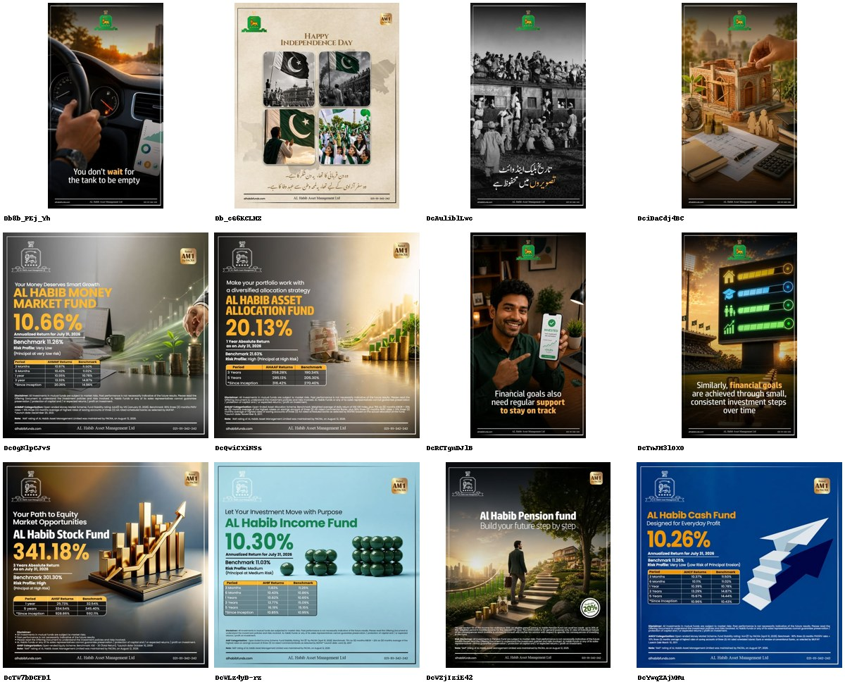
AL Habib Asset Management
@alhabibfunds · DIRECT COMPETITOR · 1,794 followers · 12 ads coded
The best-written brand line in the scan, wrapped in AI renders and return tables.
· 'You don't wait for the tank to be empty' - a hand on a fuel gauge. No product, no number.
· 'Similarly, financial goals are achieved through small, consistent investment steps over time.'
· Five posts are single-fund return cards: Money Market 10.66% vs benchmark 11.28%, Stock Fund 341.18% vs 301.30%, Cash Fund 10.26% vs 11.28%.
1,794 followers and the most distinctive writing in the direct ring. Seven of twelve posts are AI-generated imagery with visible render tells, and three of the return cards show the fund trailing its own benchmark.
7/12 no proof device · 3/12 address the core objection · 4/12 brand-building

Slide 10
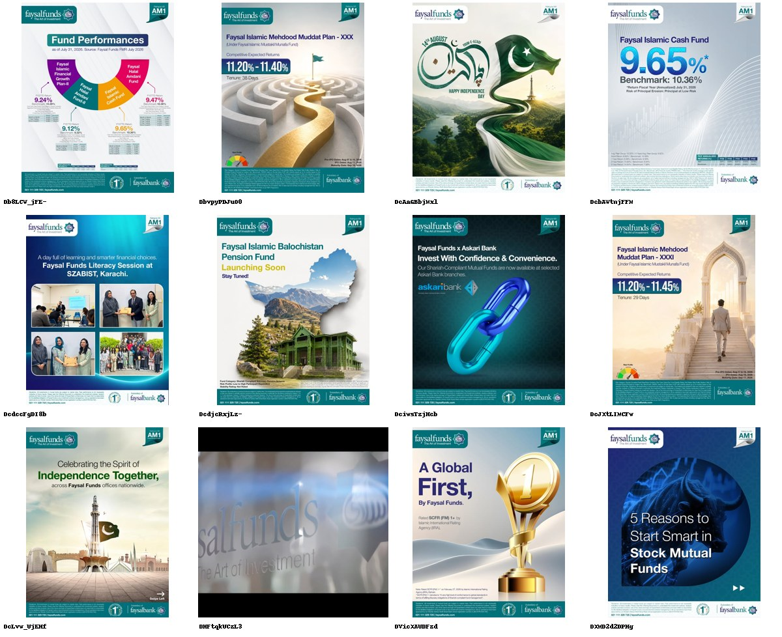
Faysal Funds
@faysal_funds · DIRECT COMPETITOR · 4,990 followers · 12 ads coded
Fixed-tenure Islamic yield, posted like a rate board.
· 'Faysal Islamic Mehdood Muddat Plan - XXX. Competitive Expected Returns 11.20%-11.40%. Tenure: 38 Days.' Then XXXI, 29 days, 11.20%-11.45%.
· 'A Global First, By Faysal Funds - Rated SCFR (FM) 1+ by Islamic International Rating Agency.'
· 'Faysal Islamic Balochistan Pension Fund - Launching Soon.'
The Mehdood Muddat plans are numbered in Roman numerals past thirty and sold on an expected rate with a tenure - a term-deposit sold by an asset manager. The Balochistan pension fund is the only provincial mandate in the scan.
7/12 no proof device · 2/12 address the core objection · 2/12 brand-building

Slide 11
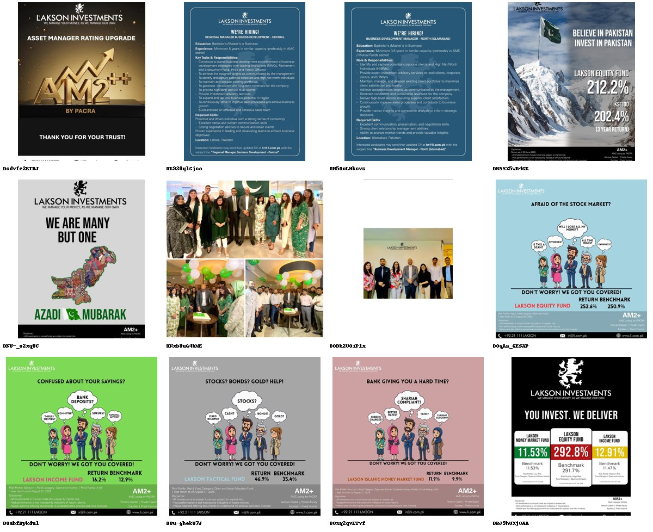
Lakson Investments
@laksoninvestments · DIRECT COMPETITOR · 428 followers · 12 ads coded
428 followers, and the only campaign in the category built on what savers actually object to.
· 'CONFUSED ABOUT YOUR SAVINGS? Bank deposits? T-bills? Committee? Sukuks? National Savings? DON'T WORRY! WE GOT YOU COVERED!'
· 'BANK GIVING YOU A HARD TIME? Hidden charges? Better rates? Taxes? Shariah compliant? Current account?'
· 'AFRAID OF THE STOCK MARKET? Will I lose all my money? Is this a scam? All time high?'
Four cartoon posts that name the substitutes - committee, National Savings, bank deposits - out loud, and answer each with a fund and a benchmarked number. Nobody with a hundred times the following is doing this.
5/12 no proof device · 4/12 address the core objection · 4/12 brand-building

Slide 12
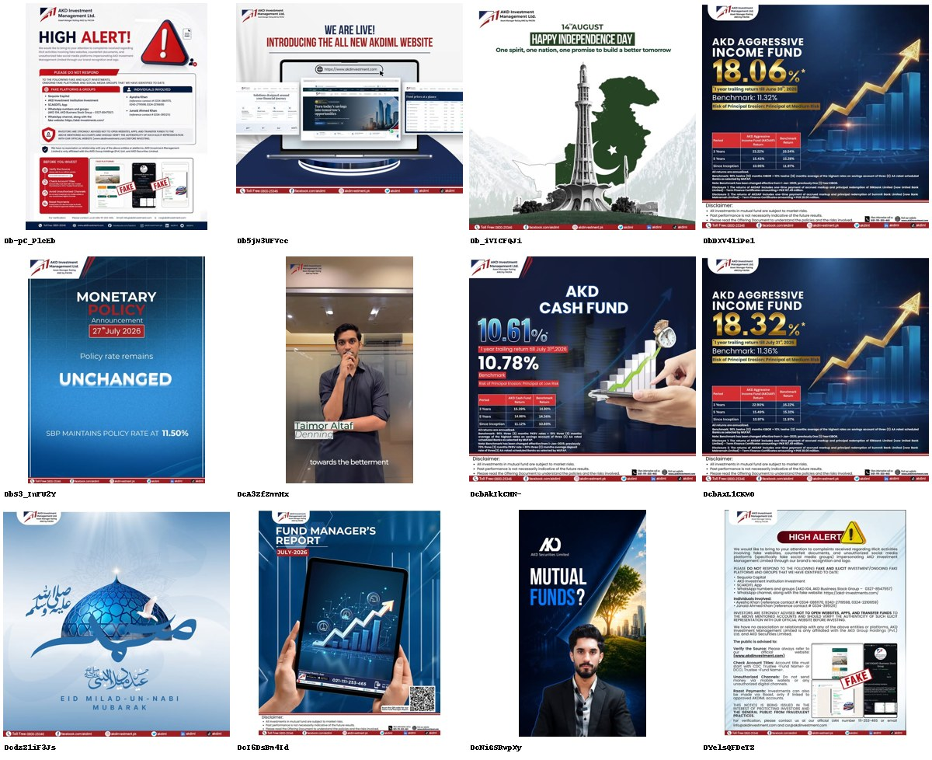
AKD Investment Management
@akdinvestment.pk · DIRECT COMPETITOR · 547 followers · 12 ads coded
Spends two of twelve posts warning the public about people impersonating it.
· 'HIGH ALERT! ... fake platforms and social media groups impersonating AKD Investment Management' - fake accounts and phone numbers listed by name.
· A second, longer 'HIGH ALERT' notice on fake investment accounts and CDC Trustee fund names.
· Fund cards: AKD Aggressive Income 18.06%, then 18.32% a month later; AKD Cash Fund 10.61% vs benchmark 10.78%.
Fraud is the category's real trust problem and AKD is one of only two accounts in 168 posts that says so. It reads as damage control rather than a position.
8/12 no proof device · 3/12 address the core objection · 3/12 brand-building

Slide 13
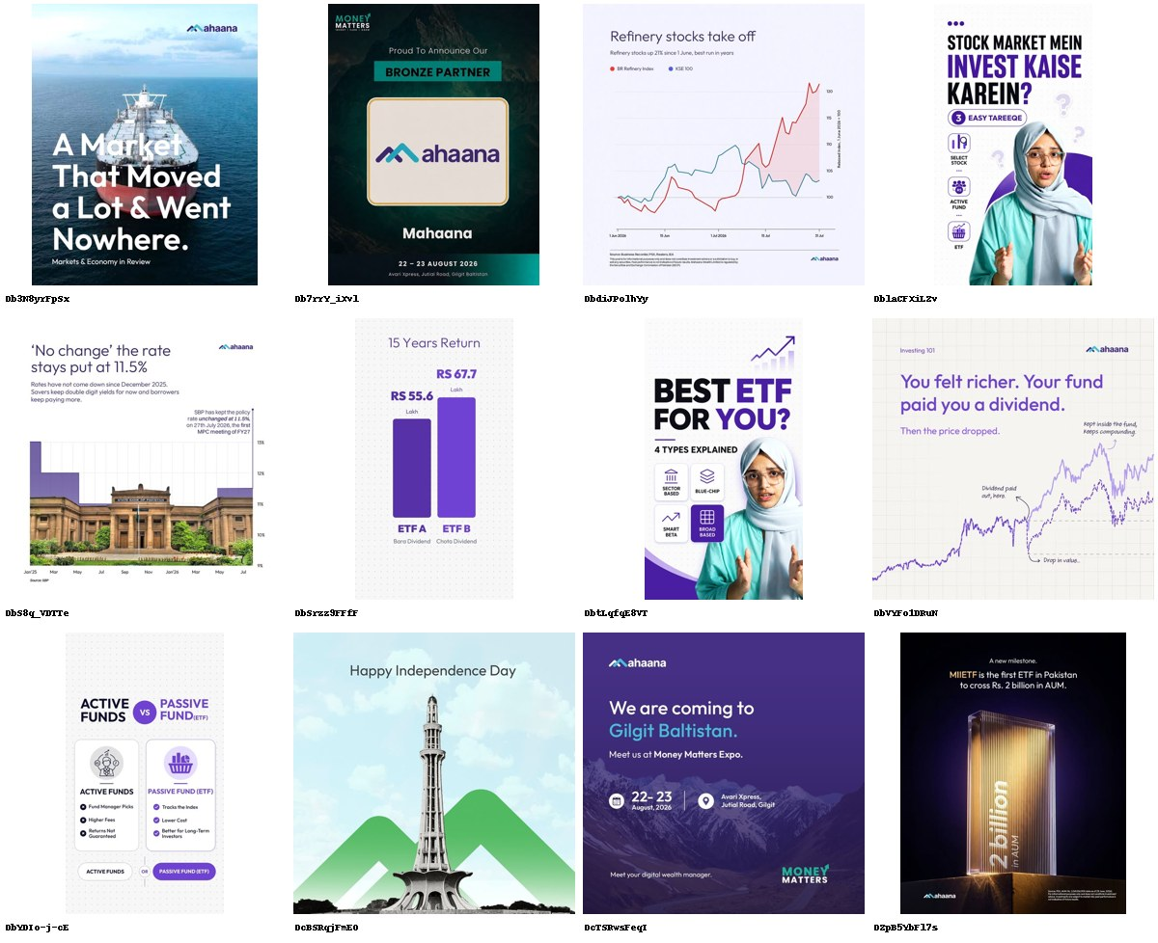
Mahaana Wealth
@mahaanawealth · ADJACENT · 932 followers · 12 ads coded
932 followers. 67% brand-building - by far the highest in the scan.
· 'You felt richer. Your fund paid you a dividend. Then the price dropped.'
· '15 Years Return - RS 55.6 Lakh vs RS 67.7 Lakh' comparing a high-dividend ETF against a low-dividend one.
· 'ACTIVE FUNDS vs PASSIVE FUND (ETF)' - Lower Cost, Tracks the Index, Better for Long-Term Investors.
The only brand attacking the category's own economics, in the category's own language, with charts sourced to PSX and SBP. It has fewer followers than a mid-sized restaurant.
6/12 no proof device · 7/12 address the core objection · 8/12 brand-building

Slide 14
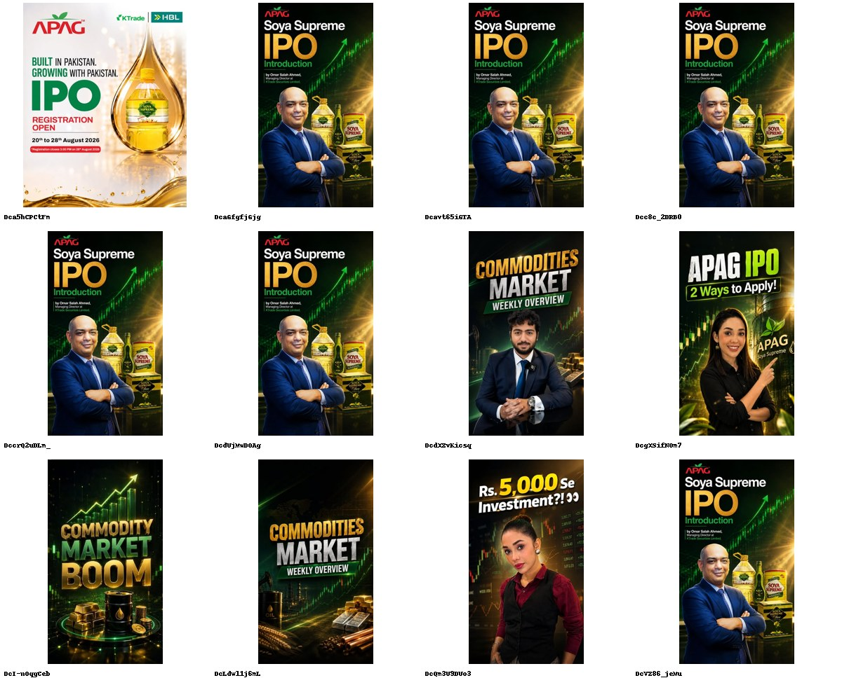
KTrade Securities
@ktrade.securities · ADJACENT · 69.9K followers · 12 ads coded
69.9K followers and a feed that is one IPO.
· Seven of twelve posts are the same Soya Supreme IPO key art fronted by the MD, Omar Salah Ahmed.
· 'APAG - BUILT IN PAKISTAN. GROWING WITH PAKISTAN. IPO REGISTRATION OPEN 20th to 28th August 2026.'
· 'Rs. 5,000 Se Investment?!'
The adjacent ring reaches more people than most AMCs and spends it on a single transaction. The MD's face appears on six of twelve posts - the heaviest executive presence in the scan.
6/12 no proof device · 2/12 address the core objection · 4/12 brand-building

Slide 15
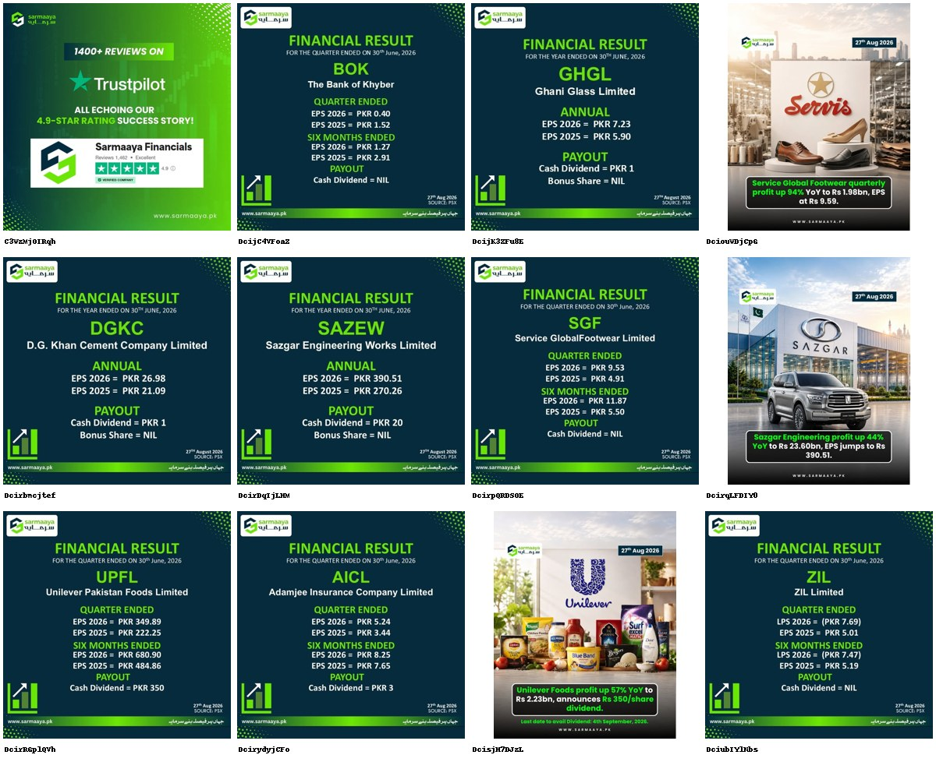
Sarmaaya
@sarmaayapk · ADJACENT · 38.5K followers · 12 ads coded
38.5K followers, zero brand-building, and the most useful feed in the category.
· Eleven of twelve posts are PSX results cards: 'FINANCIAL RESULT - SAZEW Sazgar Engineering. Annual EPS 2026 PKR 390.51 vs 270.26. Cash Dividend PKR 20.'
· Losses are posted as readily as profits: 'ZIL Limited. Quarter LPS 2026 (PKR 7.69).'
· '1400+ REVIEWS ON Trustpilot ALL ECHOING OUR 4.9-STAR RATING SUCCESS STORY!'
A utility, not a brand - and it has more reach than eleven of the twelve AMCs. It proves the category's audience wants numbers, not reassurance.
0/12 no proof device · 0/12 address the core objection · 0/12 brand-building

Slide 16
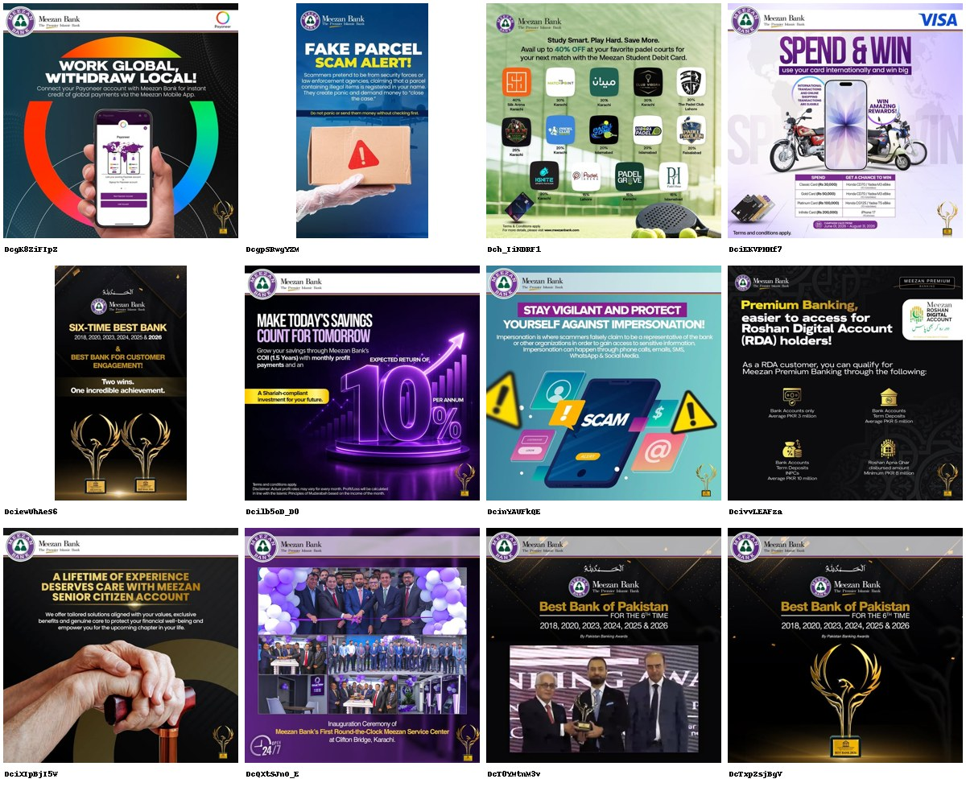
Meezan Bank
@meezanbanklimited · SUBSTITUTE · 163K followers · 12 ads coded
The substitute. Zero brand-building, and it does not need any.
· 'Grow your savings through Meezan's COII (1.5 Years) with monthly profit payments and an EXPECTED RETURN OF 10% PER ANNUM. A Shariah-compliant investment for your future.'
· 'Best Bank of Pakistan FOR THE 6TH TIME 2018, 2020, 2023, 2024, 2025 & 2026' - run three times in twelve posts.
· 'A LIFETIME OF EXPERIENCE DESERVES CARE WITH MEEZAN SENIOR CITIZEN ACCOUNT.'
163K followers, the only verified account in the set, and a deposit product advertising 10% expected annual return with monthly payouts - competing head-on with every Islamic money market fund in this scan, from a position of trust none of them can match.
8/12 no proof device · 2/12 address the core objection · 0/12 brand-building

Slide 17
The vacant territory is the switch.
Nobody in the direct ring argues against where the money currently sits.
Only Lakson Investments (428 followers) names bank deposits, committees and National Savings as the thing to leave. Meezan Bank, the substitute, advertises a 10%-per-annum Shariah-compliant deposit to 163K followers with a six-time Best Bank badge.
65% of the category's posts prove nothing at all. Where a number does appear it is a fund's own trailing return - and three AL Habib cards and one AKD card show the fund behind its benchmark.
74% of posts contain no people. 23 posts in 168 show a customer.
The category advertises returns to people who already believe in mutual funds. It does not advertise to the far larger group whose money is in a bank.

