Slide 1
Pakistan fixed broadband - category creative scan
A brand-by-brand communications scan
336 posts · 14 brands · collected 2026-09-11
PTCL

Slide 2
How the category talks
68%
20%
6%
0
of ads prove nothing
is brand-building
drives to an owned app
ads cast for over-60s
229 of 336. No statistic, rating, testimonial or guarantee.
67 of 336. The rest is promotion, PR, calendar and recruitment.
21 of 336 exist to move people into an ecosystem.
Of 336, in a category selling retirement and legacy.
336 posts, 24 per brand, collected logged-out on 11 September 2026. Equal N by construction, so share of voice is not measurable and is not presented anywhere here.
Everything in this deck is ORGANIC, owned-channel output. It says nothing about media spend, reach or weight. Only the Meta Ad Library shows paid creative.
Three brands in scope have no Instagram at all: PTCL Business, Cybernet and Fiberlink. Those absences are findings and are recorded, not dropped.

Slide 3
What a message map cannot see
Converging on an app
Brand-building share
Talking to customers, not itself
output driving to an owned ecosystem
everything else is promotion, PR, calendar, recruitment
ads with a customer in frame
Zong
12/24 · 50%
PTCL
14/24 · 58%
Optix
16/24 · 67%
Nayatel
6/24 · 25%
Transworld Home
9/24 · 38%
Transworld Home
13/24 · 54%
Optix
2/24 · 8%
Nayatel
8/24 · 33%
Zong
12/24 · 50%
Transworld Home
1/24 · 4%
Jazz
8/24 · 33%
StormFiber
8/24 · 33%
PTCL
0/24 · 0%
Ufone
8/24 · 33%
Worldcall
6/24 · 25%
StormFiber
0/24 · 0%
Tapmad
5/24 · 21%
Ufone
6/24 · 25%
Wateen
0/24 · 0%
StormFiber
4/24 · 17%
PTCL
5/24 · 21%
68% of the category's creative carries no proof device of any kind.
Only 19% of posts answer a customer objection. PTCL's figure is zero of 24.
Not one post in 336 uses an independent speed or performance result as proof.

Slide 4
Why the category advertises streets instead of brands
Fixed broadband in Pakistan is a footprint business. Whether a household can buy you at all is decided by your street, not your brand - so the category's creative is a distribution announcement with a logo on it.
Fixed is 2.5% of broadband
Of Pakistan's 150 million broadband subscriptions, 97.5% are mobile. Fixed broadband is 2.5%. The category everyone in this deck competes in is a rounding error against the mobile networks two of them also own.
Two million FTTH users, nationally
Fibre-to-the-home reached 2 million users in June 2025. Against roughly 35 million households, availability - not preference - is the binding constraint on growth.
So coverage is the message
Nine of StormFiber's 24 posts name a neighbourhood. Worldcall and Optix do the same. These are not brand campaigns; they are announcements that a street is now sellable.
And meaning goes unbuilt
With the message space filled by availability and price, only 8 posts in 336 claim reliability and 4 claim the connected home. The layer above the network is empty because nobody in a footprint business has needed it yet.
PTCL is the one brand here that does not have a footprint problem - which means the category's dominant creative behaviour solves a problem PTCL largely does not have.
Source: PTA Annual Report 2025 (published November 2025), figures as of June 2025 - broadband subscriptions, fixed/mobile split, FTTH users. Household estimate is ours.

Slide 5
Who the work is cast for
11%
25%
0%
0%
64%
Gen Z
Millennial
Gen X
60+
Multi-generational
under ~28 · 36 of 336
~28-43 · 85 of 336
~44-59 · 0 of 336
retirement, legacy · 0 of 336
cast across ages · 215 of 336
Half the category's creative is cast 'mixed' - no one in particular. Tapmad is the only brand with a clearly chosen audience, and it is the only one whose feed reads as a destination rather than a noticeboard.
Not a single post in 336 is cast for over-60s, in a category whose most loyal customers have been with PTCL for decades.
Generation is inferred from casting, styling and setting. It is a read of who the work addresses, never a claim about who actually buys.

Slide 6
The customer pulse: what people say when the brand is not listening
976 YouTube comments on Pakistani broadband, analysed separately. When commenters criticise other brands they say the service is slow. When they criticise PTCL they use the language of dishonesty.
“These people are frauds. First they install it cheap, then every third month they keep increasing the bill. If you ask, they say rates have gone up.”
“Whenever a problem arises you have to fall at their feet, and they become Pharaoh - you are caught in our clutches now, look out for yourself.”
Urdu, translated. The word used is fraud, not expensive.
The most articulate comment in the corpus. Register: captivity, not service.
“If you want to disconnect, you have to pay the whole of the following month too. Where in the world does this happen, except PTCL?”
“Their internet is very good, I get 107 Mbps and it rarely breaks. I would give their service 10/10.”
Leaving is penalised - and cited as proof of bad faith.
Same commenter: his bill went from Rs 4,000 to Rs 7,250. Even advocates are repriced.
“For all the people saying PTCL is bad, it's usually because of their location - my internet in Bahria Town Lahore is probably the best you can get.”
“STORM FIBER REPLIES ON FACEBOOK, CAN YOU IMAGINE, AND AT 3AM.”
Every defence is about a postcode. Nobody defends the company.
The single most admired competitor behaviour in the corpus is answering.
Nobody in 976 comments says PTCL is fair, modern, or on their side. The brand has no equity independent of whether the individual line happens to work.
Source: COMMENTS.xlsx, 976 comments analysed, all 92 PTCL mentions read. Self-selected corpus - not a satisfaction measure. Full analysis in the consumer conversation document.

Slide 7
Where the audience actually is
Follower and subscriber counts, collected logged-out on 11 September 2026. This scan read Instagram - which every brand here is an order of magnitude smaller on.
Brand
Instagram
Facebook
YouTube
TikTok
PTCL
91K
1.3M
43K
none
Jazz
295K
5.5M
n/v
n/v
Ufone
279K
3.2M
n/v
n/v
Nayatel
19K
1.1M
1.5K
n/v
Transworld Home
13K
381K
1.8K
n/v
StormFiber
31K
233K
n/v
none
Zong
181K
n/v
n/v
n/v
Tapmad
264K
n/v
n/v
n/v
Worldcall
2.3K
98K
n/v
n/v
Wateen
1.2K
93K
627
n/v
Fiberlink
none
23K
n/v
n/v
Shoq
2.6K
n/v
n/v
n/v
Optix
356
n/v
n/v
n/v
Multinet
601
n/v
n/v
n/v
PTCL has 14x more people on Facebook than on Instagram; Nayatel has 57x. Fiberlink has no Instagram at all and 23K on Facebook - a brand this scan would otherwise have called absent.
n/v = not verified: the candidate page could not be confirmed, so the cell is left open rather than reported as zero. TikTok "none" = the account does not exist (PTCL and StormFiber both return "Couldn't find this account"); no official TikTok surfaced for any brand in this category. Facebook renders logged-out for header data only - it is not a viable platform for a systematic creative read, which is why Instagram was scanned.

Slide 8
Levels of branding: where the category is, and where PTCL is talking
Placement computed from the 336 coded posts - each brand's dominant claim mapped to a level, not asserted.
6. Mission / philosophy
Nobody in this category.
"I change things you would like to"
5. Human values / way of life
PTCL (4.1) - 14 of 24 posts claim heritage or nation, in the pride register
WHERE PTCL IS TALKING
"I think like you do"
4. Psychological territory
Transworld (3.8), Ufone (3.9) - household truths, nostalgia, relatability
THE DIFFERENTIATION GAP
"I am like you; you are like me"
3. Product benefits
Tapmad (3.0), Multinet (3.2), Jazz Business (3.3) - problem-led, what it does for you
WHERE PTCL MUST EARN
"Here is what I can do for you"
2. Product attributes
StormFiber (2.6), Zong (2.8), Optix (2.9), Jazz (2.9) - speed, price, coverage tiles
WHERE THE CATEGORY SITS
"Reason to buy me"
1. Name only
Nobody. Every brand in this category has moved past recognition.
"I am here"
PTCL is communicating roughly two levels above where it is delivering - and the ladder does not let a brand skip.
Framework: Levels of Branding. Placement is each brand's mean level across its coded posts; a claim map, not a quality judgement.

Slide 9
Three things the sheet says that the category does not know about itself
PTCL's territory is the most crowded one
Nobody proves anything
The customer's problem goes unanswered
59
68%
19%
posts claim heritage or nation - the largest territory on the map, 49 of them in the pride register. 13 of 14 brands are standing in it.
of posts carry no proof device at all. Not one post in 336 cites an independent speed test or performance result.
of posts answer a customer objection, and they cluster in two brands. PTCL answers none of the 24.
PTCL
14/24
no proof device
229
Multinet
16/24
Nayatel
10/24
partner brand
37
Optix
14/24
Transworld Home
8/24
celebrity
24
StormFiber
11/24
Ufone
7/24
network scale
16
Transworld Home
7/24
Wateen
4/24
heritage scale
12
Wateen
6/24
Worldcall
4/24
speed / perf. result
0
PTCL
0/24
PTCL is loudest in the most crowded territory, and silent in the two that are empty. Reliability - the attribute the brief says it is losing - is claimed in 8 posts out of 336.

Slide 10
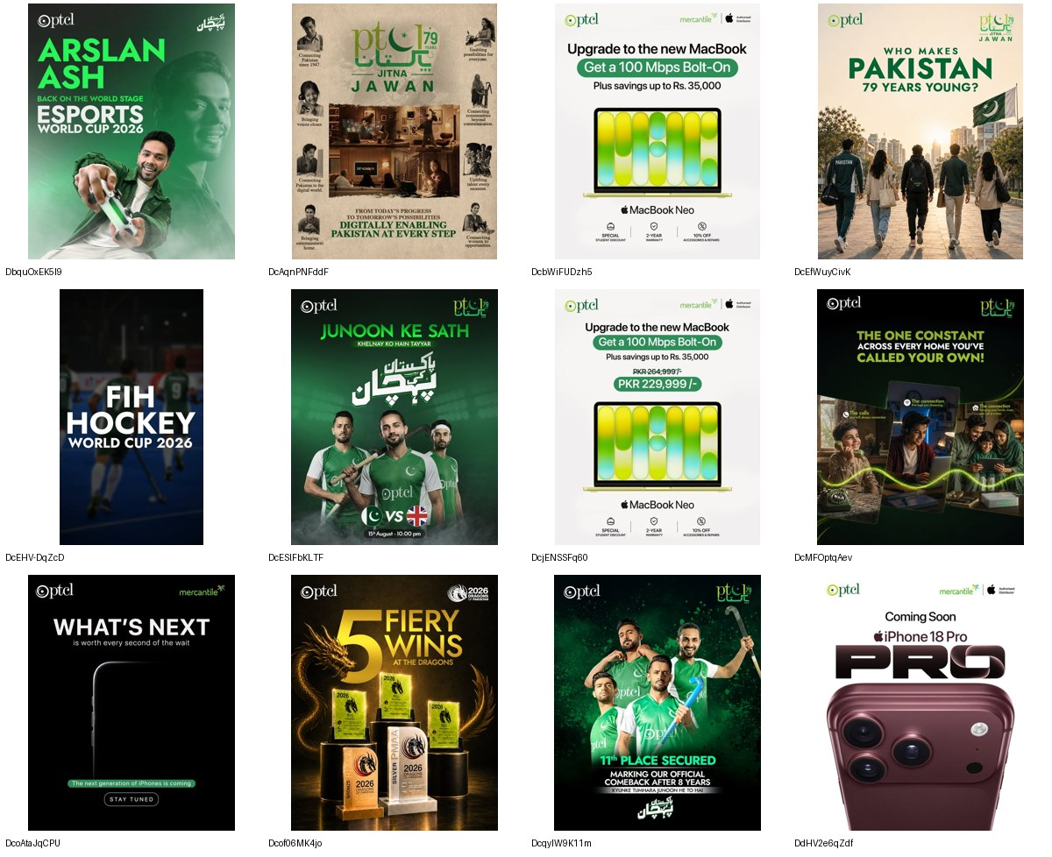
PTCL
@ptclofficial · CLIENT · 91K followers · 24 ads coded
Spends its whole voice on being Pakistani, and none of it on being good.
· 14 of 24 posts claim heritage or nation - 'Celebrating 79 years', 'Who makes Pakistan 79 years young?', Defence Day, Jitna Jawan.
· One post in 24 mentions speed. Zero mention reliability. Zero mention service.
· Four posts sell other people's hardware: 'iPhone 18 Pro, coming soon' and 'MacBook Neo PKR 229,999' with Mercantile.
· Proof devices used: heritage_scale (7) and celebrity (6). Performance proof: none.
The most-loved brand in the category is advertising like a sponsor, not a service. Hockey, esports, Independence Day and device retail fill the grid; the product the brief says it is losing ground on - reliability, speed, product-benefit clarity - is absent from its own channel.
6/24 no proof device · 0/24 address the core objection · 14/24 brand-building
WHY: A brand that never mentions performance cannot correct a performance perception, however much affinity it spends.

Slide 11
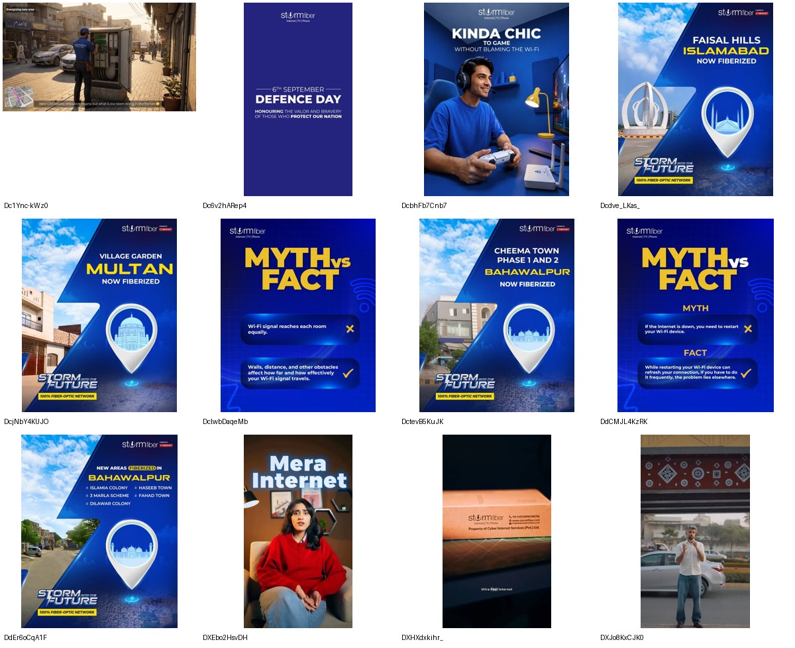
StormFiber
@stormfiber_official · DIRECT COMPETITOR · 30.9K followers · 24 ads coded
The only brand in the category that treats the customer's problem as the subject.
· Eleven of 24 posts answer an objection - the highest of any consumer brand in the set.
· 'MYTH vs FACT: More Wi-Fi bars = faster internet' ... 'Bandwidth allocation is first come, first serve.'
· 'Experiencing Wi-Fi issues? Try these steps.' 'Connection not found.'
· Nine posts are coverage announcements: 'Cheema Town Phase 1 and 2 Bahawalpur NOW FIBERIZED'.
The brand the brief names as leading awareness-to-consideration conversion is also the brand that explains the product. It builds competence rather than affection, and converts because it answers the question a switcher actually has.
12/24 no proof device · 11/24 address the core objection · 4/24 brand-building
WHY: Wi-Fi literacy is a conversion tool - every myth it corrects removes a reason to blame the provider.

Slide 12
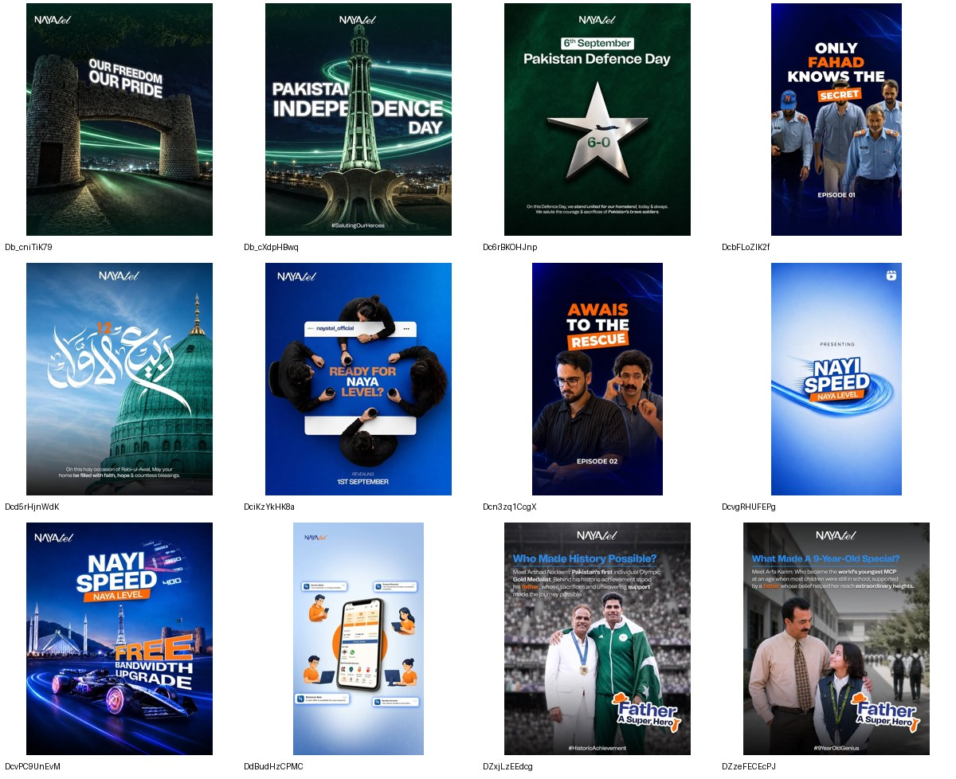
Nayatel
@nayatel_official · DIRECT COMPETITOR · 19.2K followers · 24 ads coded
Runs its staff as the story, and the national calendar as the filler.
· Ten of 24 posts are calendar: Iqbal, Jinnah, Fatima Jinnah, Independence, Defence Day, Rabi-ul-Awwal.
· 'Episode 01 - Only Fahad Knows The Secret'; 'Episode 02 - Awais to the Rescue' - service staff cast as characters.
· Six posts drive the My Nayatel App: 'Play the Quiz, win Rs. 500 off'.
The staff-as-heroes device is the most human thing in the category and nobody else is doing it. It sits beside ten posts of national wallpaper that any brand could run.
22/24 no proof device · 3/24 address the core objection · 8/24 brand-building

Slide 13
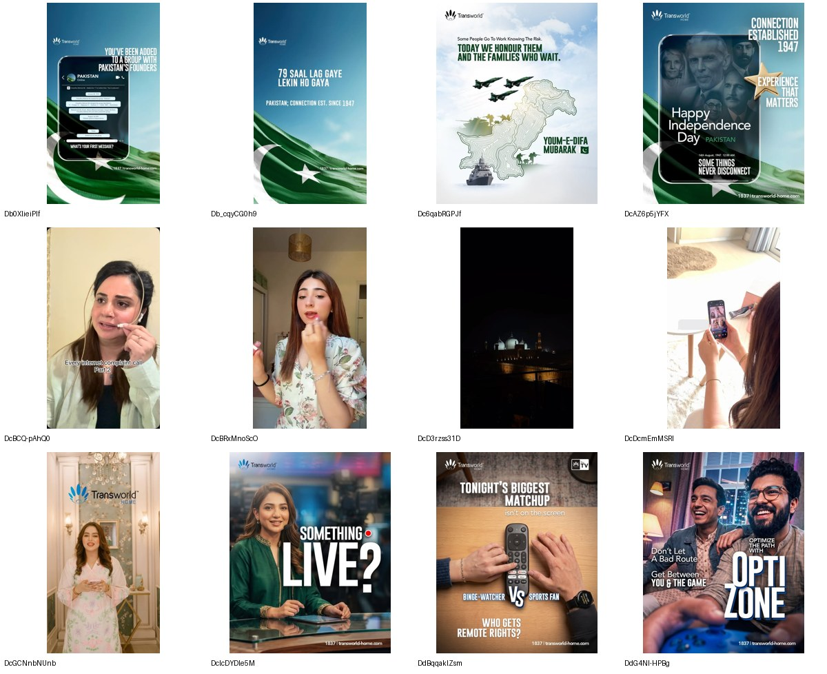
Transworld Home
@transworldhome · DIRECT COMPETITOR · 12.6K followers · 24 ads coded
Already running PTCL's heritage claim, and running it better.
· 'CONNECTION ESTABLISHED 1947 - EXPERIENCE THAT MATTERS', over the faces of the founders.
· '79 saal lag gaye lekin ho gaya. PAKISTAN; CONNECTION EST. SINCE 1947.'
· Seven of 24 posts are creator videos: 'Burey internet se jaan churaayein.'
· 'The fight for the remote starts at 8PM.' 'More MBPS isn't always the answer.'
The sharpest consumer work in the category comes from the fourth-largest brand in it. It pairs household truths with creators, and it has planted a flag on 1947 - the single asset PTCL assumes is its own.
15/24 no proof device · 7/24 address the core objection · 9/24 brand-building
WHY: A heritage claim nobody else could make is worth building on; one a competitor is already making is a race PTCL would be entering second.

Slide 14
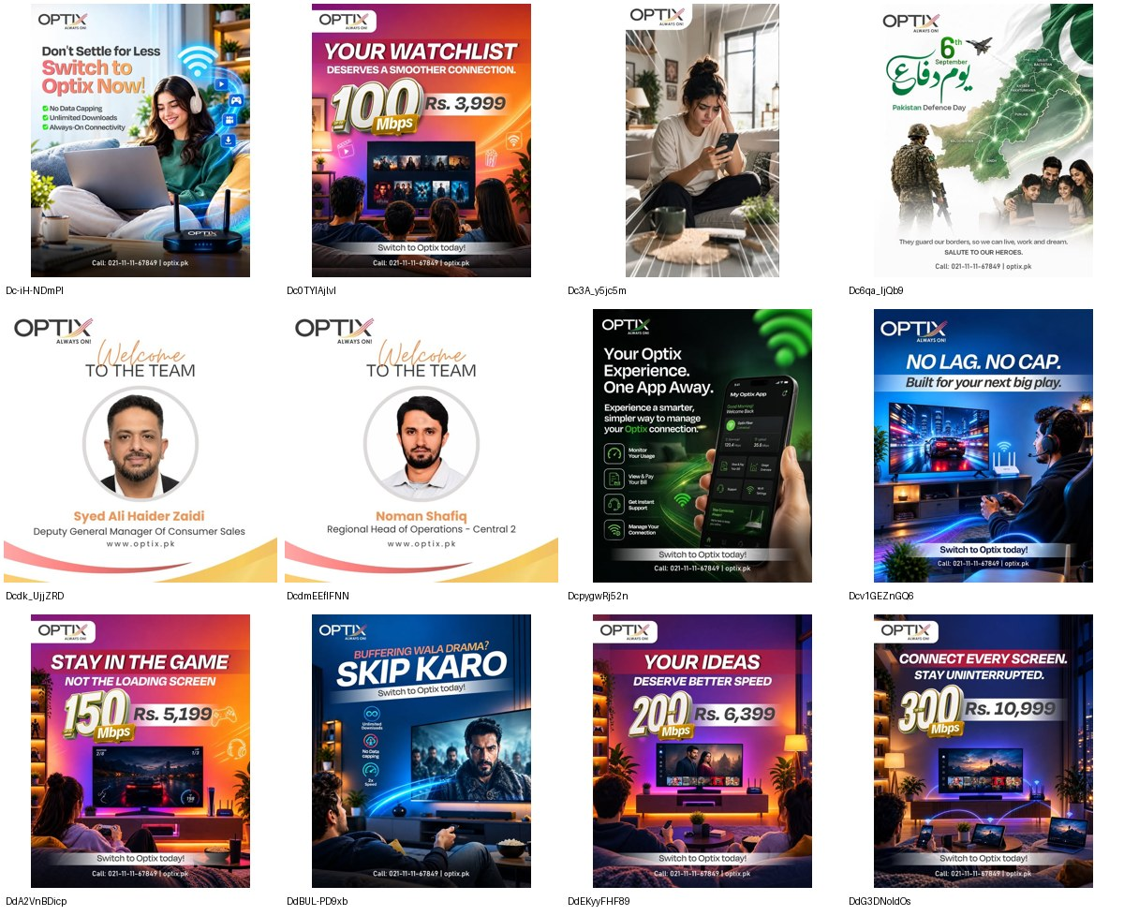
Optix
@optixpkofficial · DIRECT COMPETITOR · 356 followers · 24 ads coded
A price list with a flag on it, published by a brand with 356 followers.
· Sixteen of 24 posts are tactical price tiles: '300 Mbps for Rs. 10,999', '150 Mbps Rs. 5,199'.
· Five of 24 are HR announcements - 'Welcome to the team' - in a 24-post window.
· 'Hidden charges se Azadi', 'Slow internet se Azadi', 'Streaming ki asli Azadi'.
· Almost the entire grid is AI-generated imagery.
An ISP with roughly 50,000 customers has 356 Instagram followers and gives a fifth of its feed to recruitment. Credit where due: its copy names the customer's problem - hidden charges, buffering, data caps - more directly than PTCL's does.
24/24 no proof device · 14/24 address the core objection · 0/24 brand-building

Slide 15
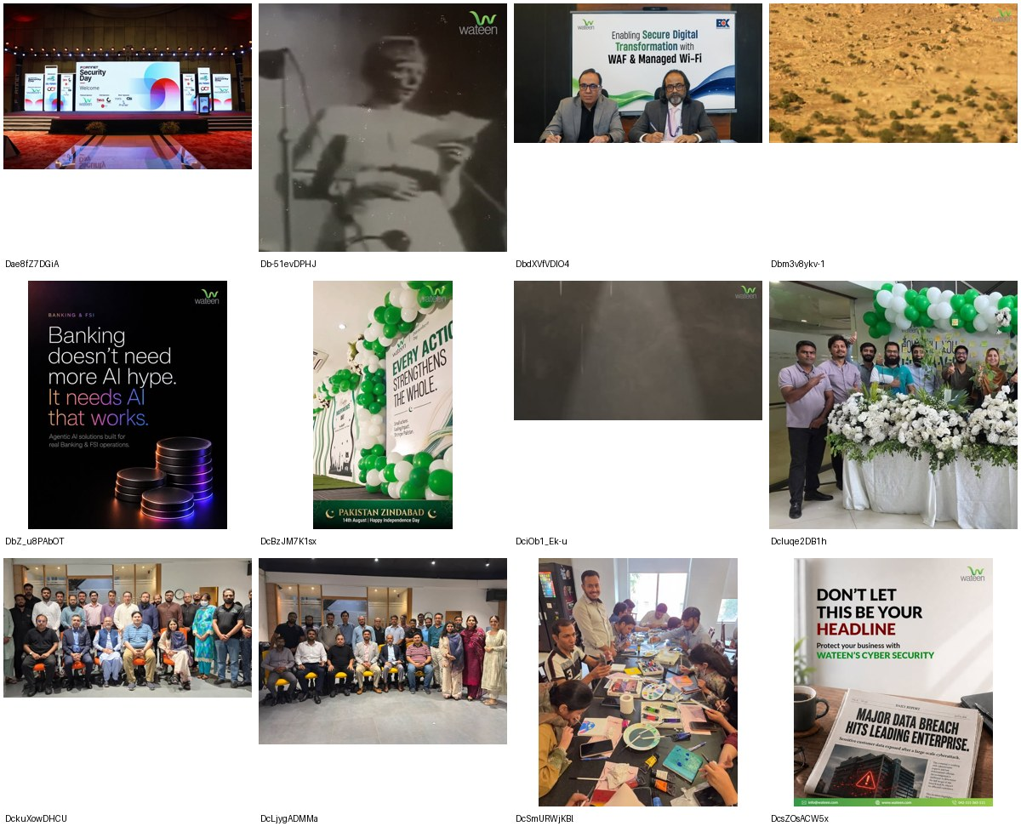
Wateen
@wateentelecomlimited · DIRECT COMPETITOR · 1,221 followers · 24 ads coded
A B2B brand whose public channel is mostly its own staff.
· Eight of 24 posts are corporate PR: townhalls, group photos, balloons, a team painting session.
· The enterprise work is sharp where it appears: 'Banking doesn't need more AI hype. It needs AI that works.'
· Twenty-one days since the last post.
Ten posts feature executives or staff against two featuring a customer. The proposition is good and the channel is being used as an internal newsletter.
21/24 no proof device · 6/24 address the core objection · 3/24 brand-building

Slide 16
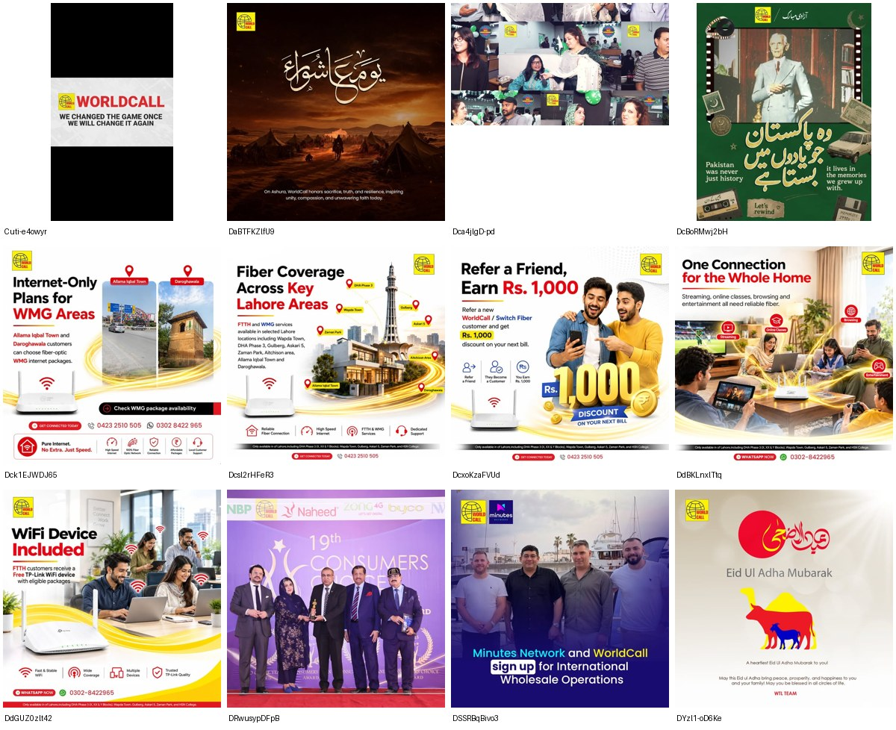
Worldcall
@worldcalltel · DIRECT COMPETITOR · 2,266 followers · 24 ads coded
Publishes offers into a channel it has effectively abandoned.
· 0.4 posts per week - the slowest in the set; the 24-post window reaches back to July 2023.
· Six of 24 posts are religious or seasonal greetings.
· 'We changed the game once, we will change it again' - posted in 2023.
A legacy operator whose channel is a noticeboard. The offers are competitive; nobody is there to read them.
19/24 no proof device · 2/24 address the core objection · 1/24 brand-building

Slide 17
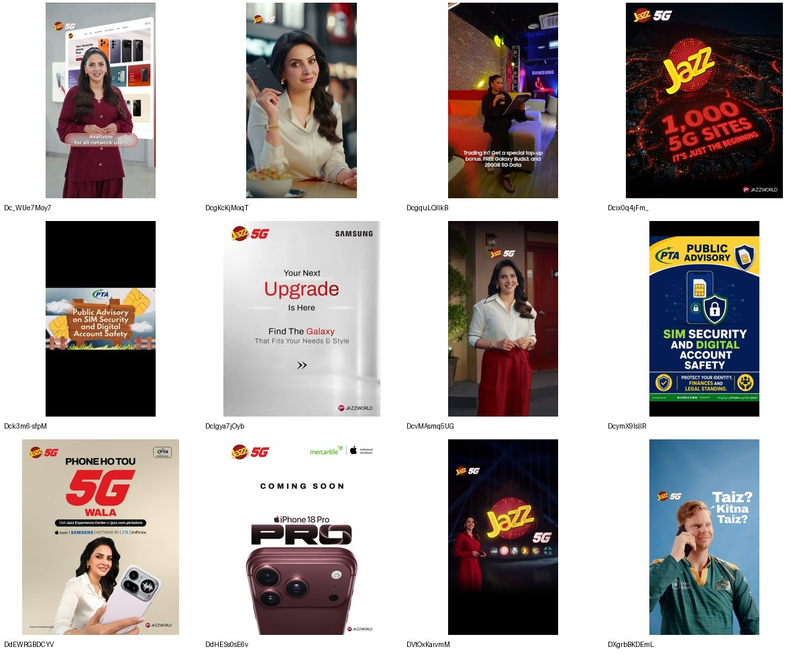
Jazz
@jazzdigital · ADJACENT · 295K followers · 24 ads coded
Buys the future tense with a number nobody else can match.
· '1,000 5G SITES. IT'S JUST THE BEGINNING' - network scale used as proof, four times.
· Celebrity-fronted device retail throughout: 'Phone ho tou 5G wala'.
· Ran the identical 'iPhone 18 Pro, coming soon / Mercantile' creative as PTCL and Zong, in the same week.
The only brand in the set that consistently proves a claim with a countable fact about its own network. That is the proof behaviour PTCL's brief asks for, executed by a competitor.
7/24 no proof device · 1/24 address the core objection · 8/24 brand-building

Slide 18
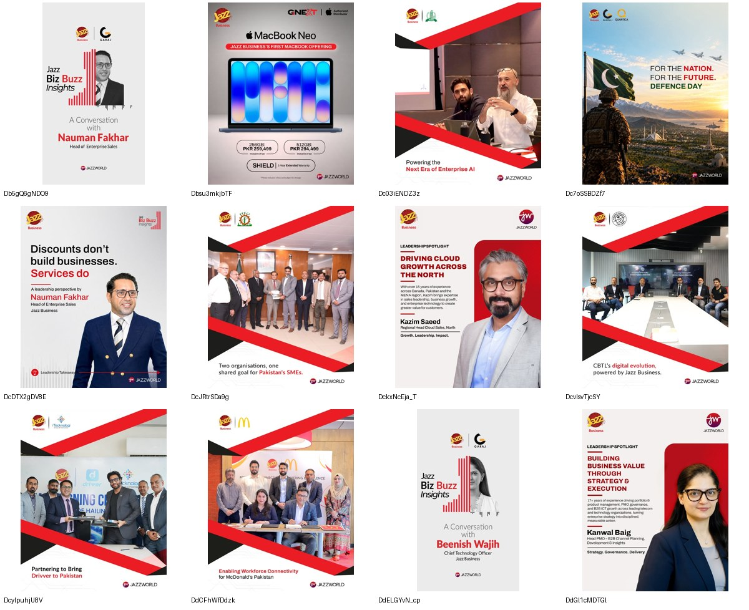
Jazz Business
@jazzbusinesspk · ADJACENT · 4,109 followers · 24 ads coded
The enterprise category advertises to itself.
· Fifteen of 24 posts are corporate PR: MoU handshakes, leadership spotlights, partner logos.
· Seventeen posts feature an executive. Zero feature a customer.
· 'Building business value through technology' - a leadership portrait, repeated as a format.
This is the only B2B comparator in the set with an active Instagram, and it spends it on portraits of its own management. The enterprise audience is being addressed as an audience of peers, not of customers with problems.
15/24 no proof device · 2/24 address the core objection · 3/24 brand-building

Slide 19
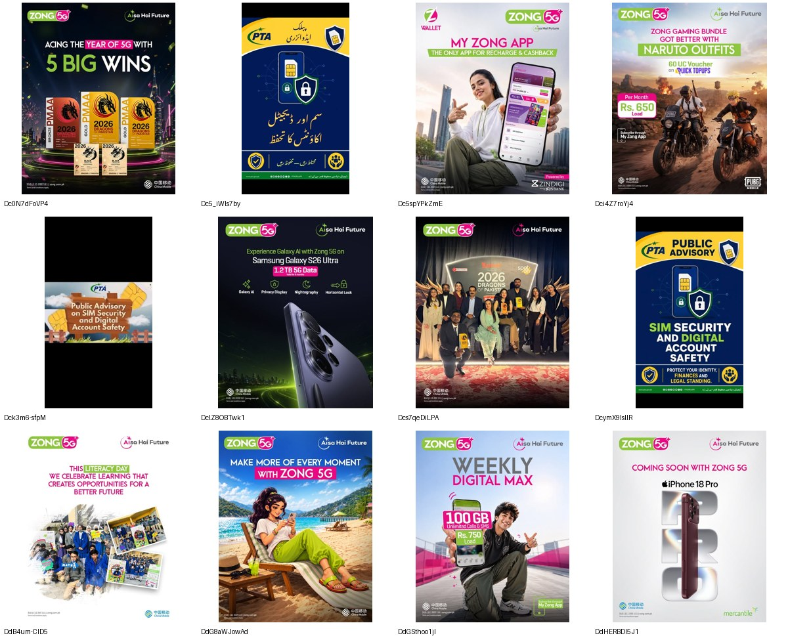
Zong
@zong.official · ADJACENT · 181K followers · 24 ads coded
Every road leads to the app.
· Twelve of 24 posts drive My Zong App or Z Wallet - 50%, the highest in the set.
· 'Bachat Bazaar', 'Double Advance Loan', 'Wallet, gaming and recharge - all in one app'.
· Also ran the same iPhone 18 Pro / Mercantile creative.
Zong is not selling connectivity, it is recruiting into a wallet. The claims differ from Jazz's; the destination is identical.
16/24 no proof device · 2/24 address the core objection · 2/24 brand-building

Slide 20
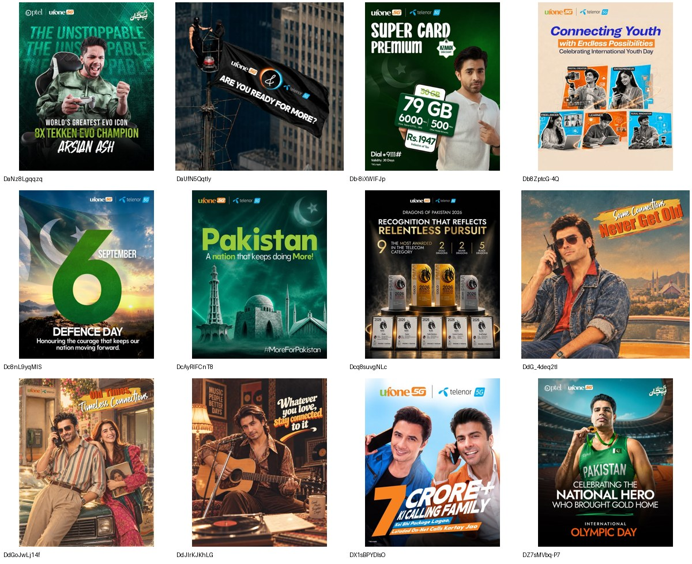
Ufone
@ufone_official · ADJACENT · 279K followers · 24 ads coded
PTCL's own sibling is already occupying the emotional territory.
· 'Some Connections Never Get Old' and 'Oh Times, Timeless Connections' - 80s nostalgia, shot properly.
· Carries a co-branded 'PTCL | ufone 5G' lockup on its own posts.
· Runs the same properties as PTCL: Arslan Ash esports, the Dragons of Pakistan awards.
· Four of 24 posts are Father's Day executions on the emotional-connection theme.
Telenor Pakistan ceased to exist in July 2026 and the merged business now posts as Ufone 5G. The architecture question in Section 9 of the brief is not theoretical: two brands in one group are currently running one territory and one set of sponsorships.
17/24 no proof device · 0/24 address the core objection · 8/24 brand-building
WHY: The human-connection space the brief calls unclaimed is occupied - by a brand inside PTCL's own group, spending PTCL's own equity.

Slide 21
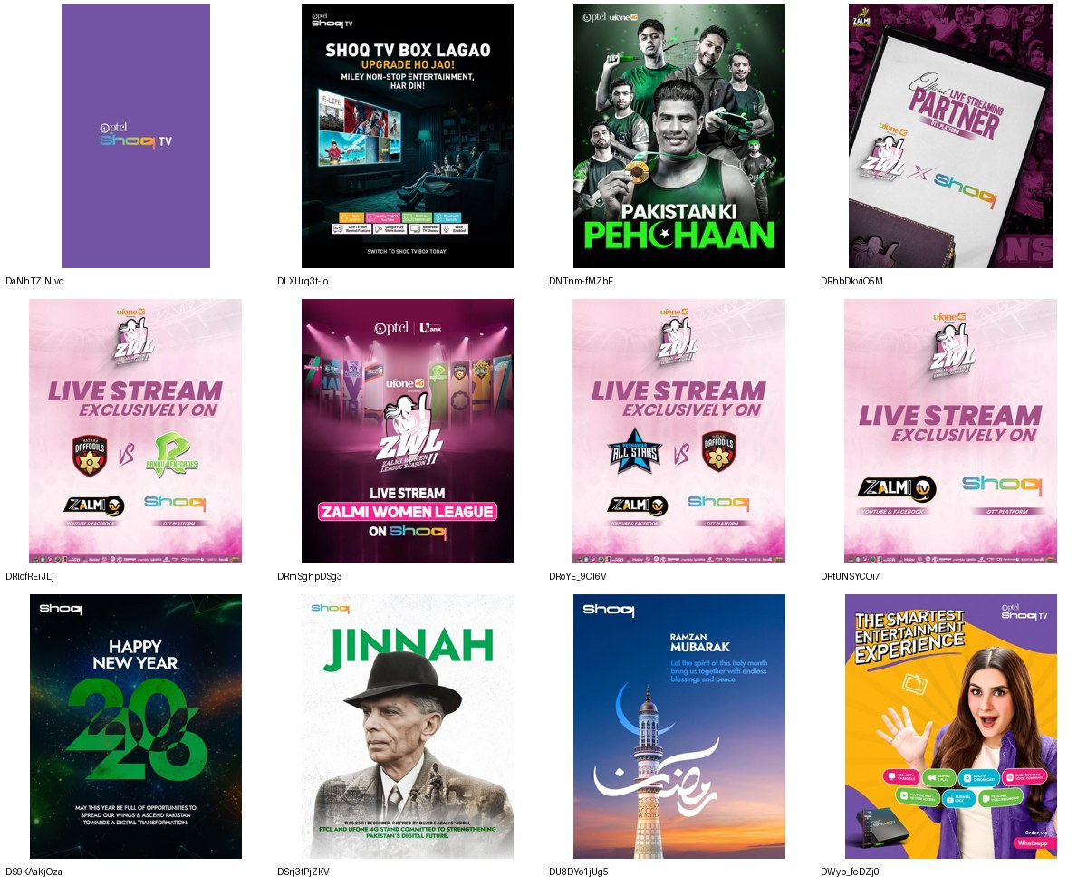
Shoq
@shoqofficial · SUBSTITUTE · 2,558 followers · 24 ads coded
PTCL's entertainment layer has been dark for eight months.
· 253 days since the last post. The only DORMANT brand in the scan.
· Ten of 24 posts are religious or calendar greetings.
· Its liveliest work is borrowed: five Zalmi Women League streaming posts.
Smart TV and OTT is one of the five brand territories the brief names. On its own channel that territory has not been advertised since December 2025.
17/24 no proof device · 0/24 address the core objection · 1/24 brand-building

Slide 22
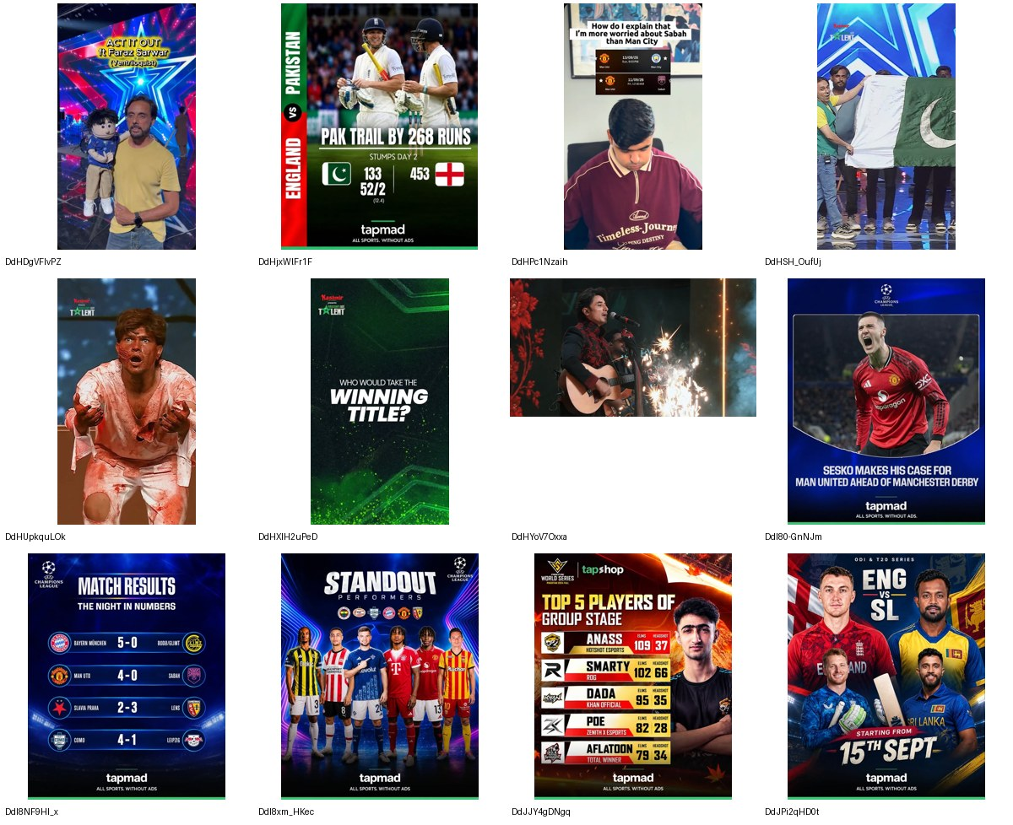
Tapmad
@tapmad.entertainment · SUBSTITUTE · 264K followers · 24 ads coded
What an entertainment brand looks like when it is actually alive.
· 21 posts a week - the fastest cadence in the set.
· Fixtures, live scores, results, esports leaderboards, Coke Studio Nu.WAV, Pakistan's Got Talent.
· 'ALL SPORTS. WITHOUT ADS.' carried as a permanent strap.
A free OTT platform out-publishes PTCL's own paid entertainment product by a factor of thirty-five, on the same audience, in the same week.
15/24 no proof device · 0/24 address the core objection · 5/24 brand-building

Slide 23
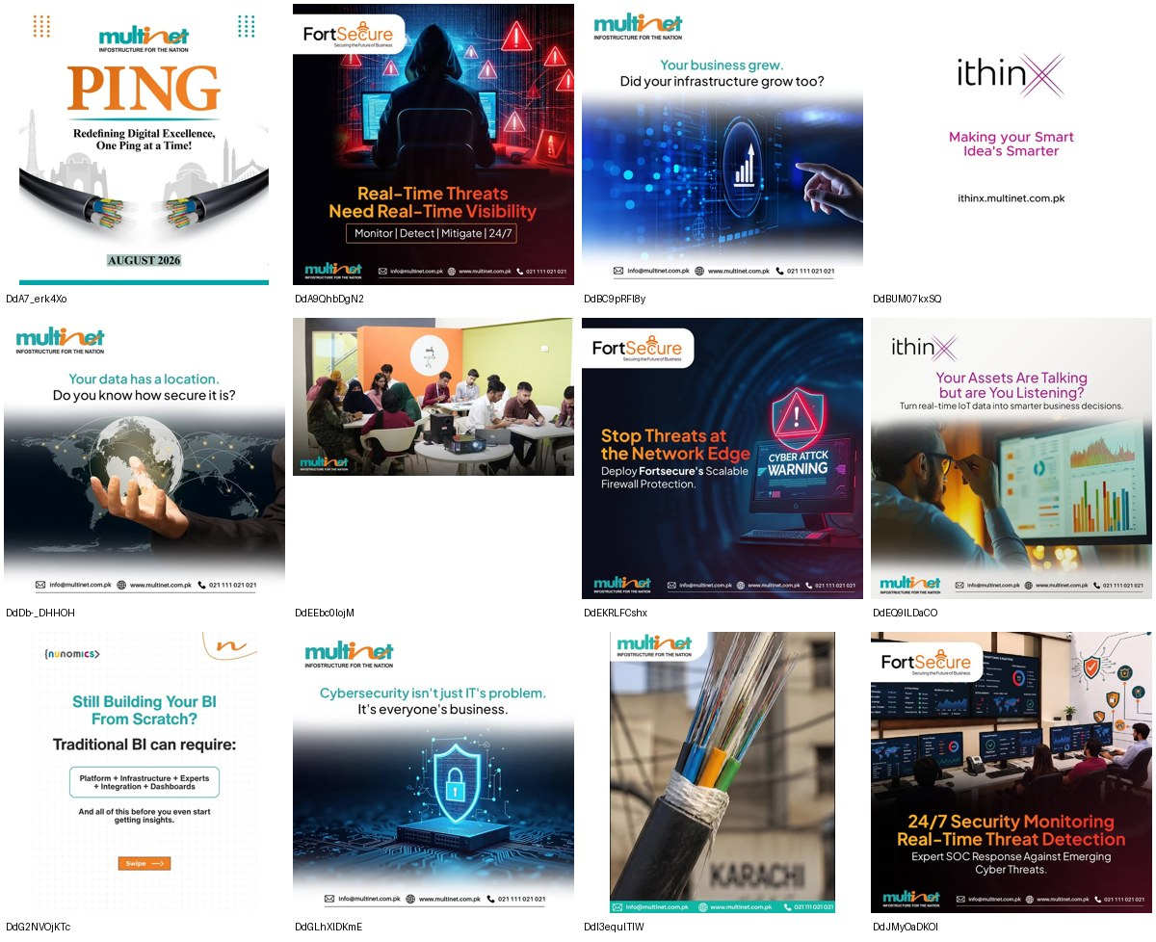
Multinet
@multinetpakistan · SUBSTITUTE · 601 followers · 24 ads coded
The one B2B brand leading with the customer's problem.
· Sixteen of 24 posts answer an objection - the highest count in the whole scan.
· 'Your business grew. Did your infrastructure grow too?' 'One password can't protect a business.'
· A house of sub-brands does the work: FortSecure, MyCloud, Nunomics, ithinX, Tezz.
Question-led, problem-first, and entirely built on stock imagery. It proves the enterprise story can be told through the customer rather than the org chart.
23/24 no proof device · 16/24 address the core objection · 1/24 brand-building

Slide 24
PTCL is advertising at level 5 and delivering at level 2.
The category sits on product attributes - speed, price, coverage. PTCL sits on national identity: 14 of its 24 posts claim heritage or nation, only one mentions speed, none mentions reliability or service.
Its customers are not in that conversation. They are describing a bill that changes without notice, a fault that takes days of pleading, and an exit that is penalised - in the language of fraud, tyranny and captivity.
A brand cannot occupy "I think like you do" while its customers are saying "you are Pharaoh". The higher the claim, the wider the credibility gap it opens.
This is why the awareness does not convert. Not a media weight problem. A permission problem.

Slide 25
The strategy: earn the rung below, then own the one above the category
Fairness is the one territory that works on every rung and answers the customer pulse directly. As a benefit it is predictable billing and a fault fixed without pleading. As a psychological territory it is a brand that treats you like an adult. As a value it is straight dealing - but only once the first two are true. It is also completely unclaimed: no brand in 336 posts promises anything about price stability or being answerable, and the most admired competitor behaviour in the corpus is simply replying.
L3 to L4
The category is stuck at level 2 - attributes. The framework's own rule is to differentiate one level above where the category sits, which makes 3 and 4 the contested ground and 5 a claim nobody has earned.
PTCL does not need a bigger idea. It needs a smaller, harder one it can prove.
The sequence - each rung earns the next
1. Fix the terms (level 3)
2. Become answerable (level 3-4)
3. Then claim the value (level 5)
Predictable pricing with notice, a published fault-response time, and an exit without a penalty month. These are commercial decisions, not campaigns - and they are the only things that will make any claim credible.
Show up where the decision is made. PTCL appears nowhere in 976 comments while StormFiber is praised for replying at 3am. Presence converts a utility into a relationship.
Only when the first two are demonstrable does national scale become meaning rather than advertising. The legacy story is the reward for fixing the relationship, not a substitute for it.
Heritage is the most crowded territory in the category - 13 of 14 brands are in it, and Transworld already owns 1947. Fairness is empty.

