Slide 1

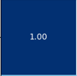
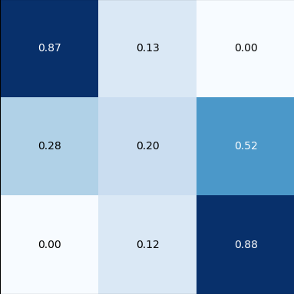

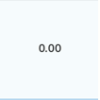
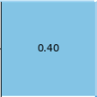
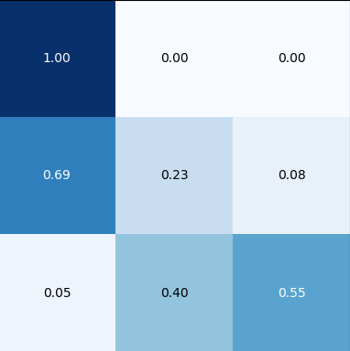
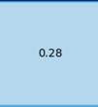
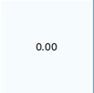
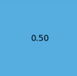
C(Moh,Mich,Lisa)
C(0,0,0) = 48 = 0.8727
C(0,1,0) = 7 = 0.1273
C(0,0,1) = 5 = 0.2083
C(1,0,1) = 2 = 0.0833
Lisa
0
1
2
Michael
0
Mohamed
0
1
1
2
2

Slide 2
Lisa
C(Moh, Mich, Lisa)
C(1,2,1) = 6 = 0.25
C(2,2,1) = 7 = 0.2917
0
1
2
Michael
0
Mohamed
0
1
1
2
2

Slide 3
Lisa
C(Moh, Mich, Lisa)
C(1,1,2) = 1 = 0.125 C(1,2,2) = 3 = 0.375
C(2,2,2) = 4 = 0.5
0
1
2
Michael
0
Mohamed
0
1
1
2
2

