Slide 1
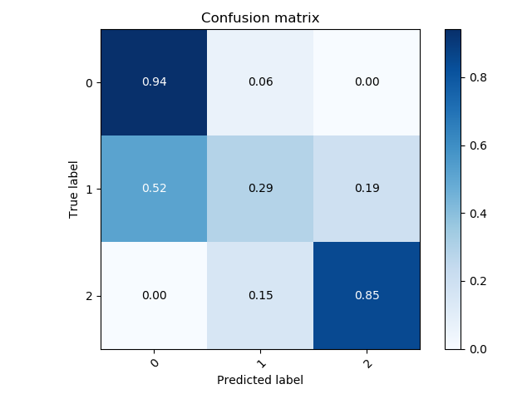
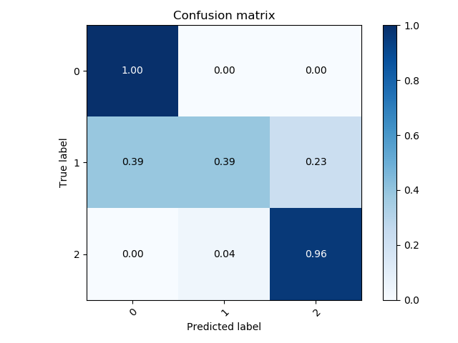
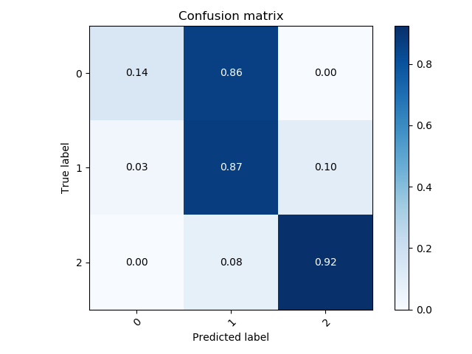
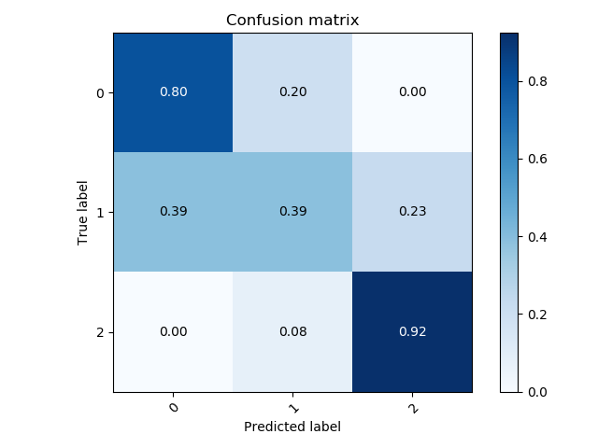
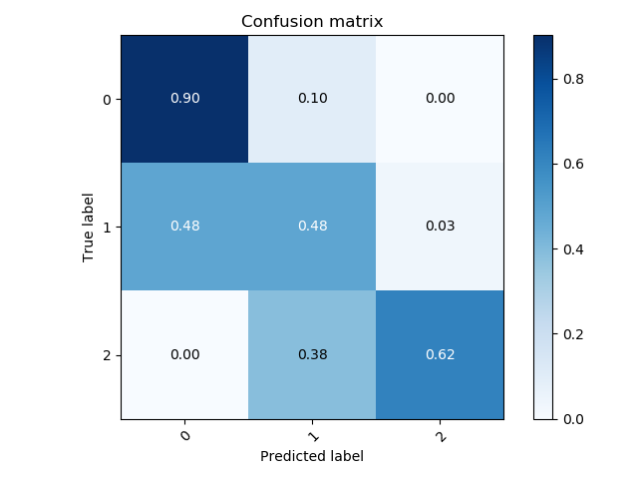
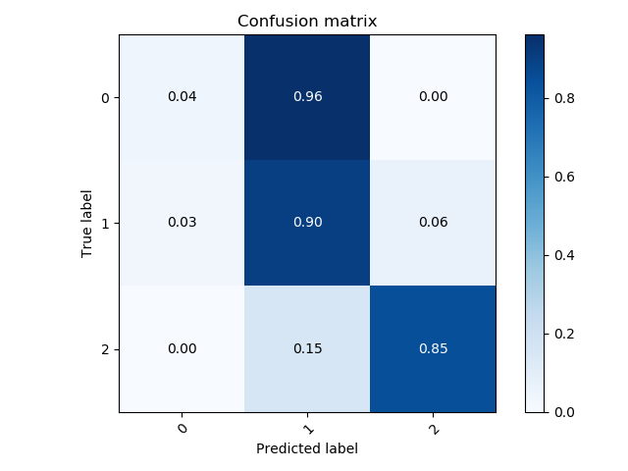
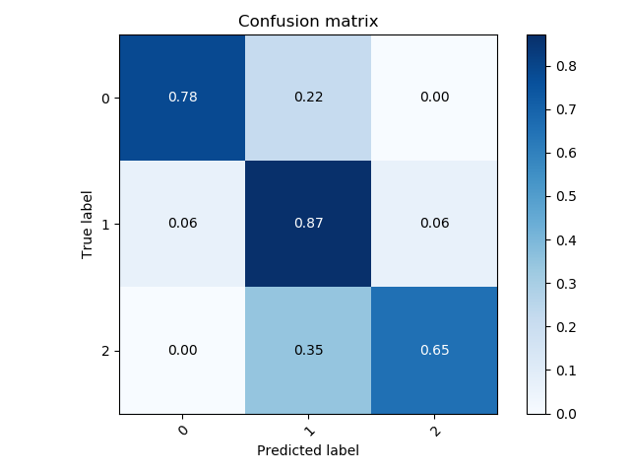
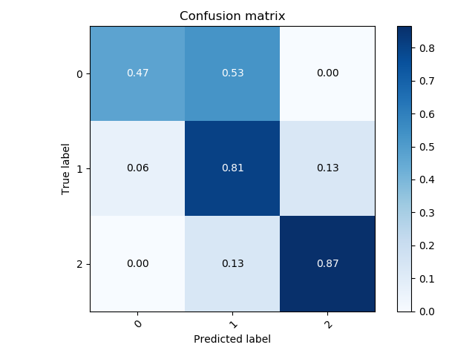
Note: Tested on a date-set labelled by Mohamed
Depth (No. of conv blocks *)
 | 1 | 2 | 3
64, 128
32, 64
16, 32
Width (Filter size of conv_1, conv_2
* Maximum of 2 conv layers per block

Slide 2
Note: Tested on a date-set labelled by Mohamed
Depth (No. of conv blocks *)
Best Yet!
 | 1 | 2 | 3
64, 128
32, 64
16, 32
Width (Filter size of conv_1, conv_2
* Maximum of 2 conv layers per block

Slide 3
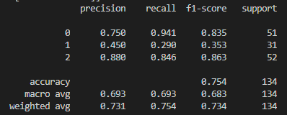
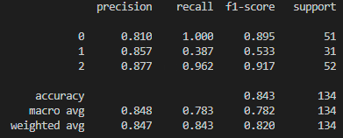
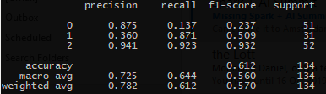
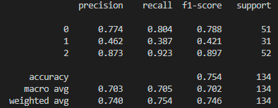
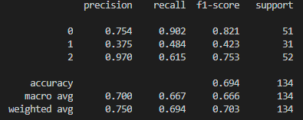
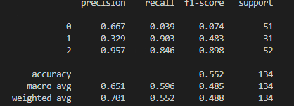

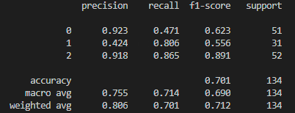
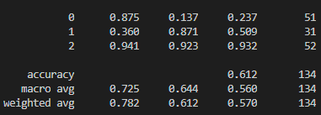
Depth (No. of conv blocks *)
 | 1 | 2 | 3
64, 128
32, 64
16, 32
Width (Filter size of conv_1, conv_2
* Maximum of 2 conv layers per block

Slide 4
Depth (No. of conv blocks *)
Best Yet!
 | 1 | 2 | 3
64, 128
32, 64
16, 32
Width (Filter size of conv_1, conv_2
* Maximum of 2 conv layers per block

Slide 5
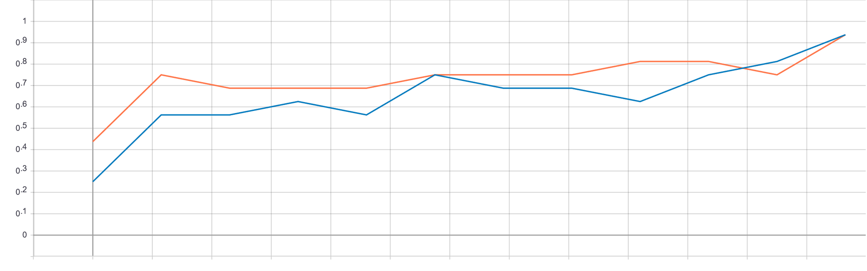
Best-Model Validation Accuracy
1
2
3
4
5
6
7
8
9
10
11
12
13
Epoch # (n)

Slide 6
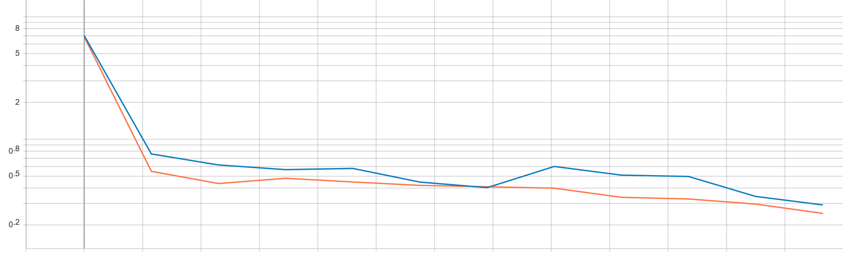
Best-Model Validation Loss (Cross Entropy)
1
2
3
4
5
6
7
8
9
10
11
12
13
Epoch # (n)

Slide 7
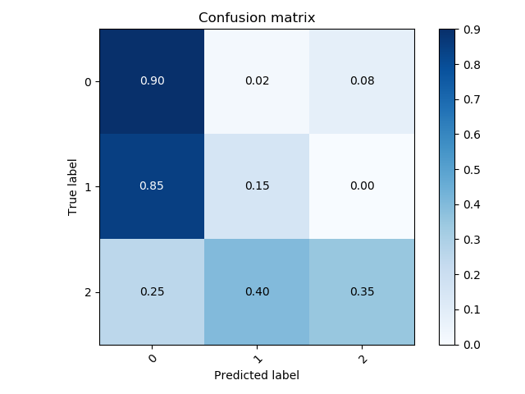
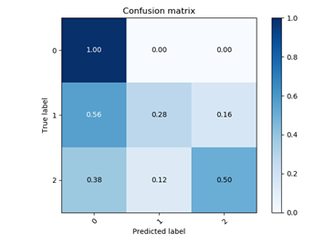
Results
Model vs Michael
Model vs Lisa
Michael’s
Lisa’s
Model’s
Model’s

Slide 8
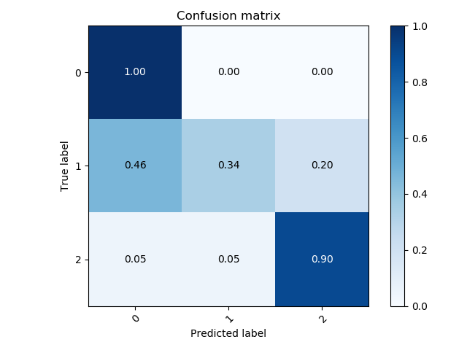
Results
Model vs Mohamed
Mohamed’s
Model’s

Slide 9
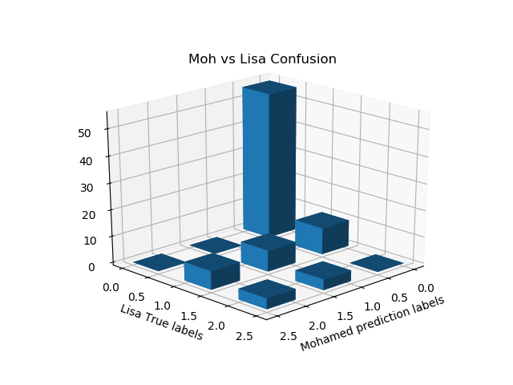
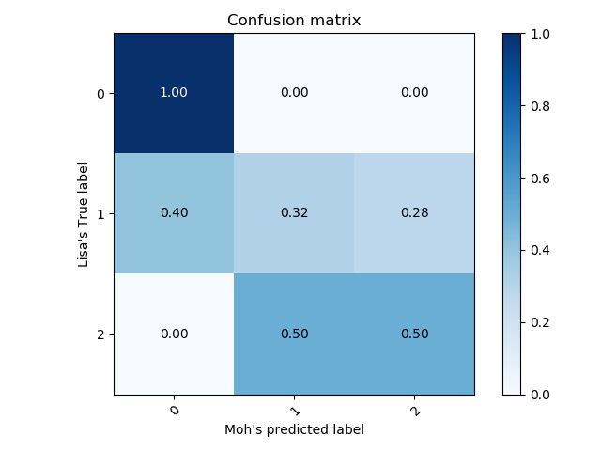

Slide 10
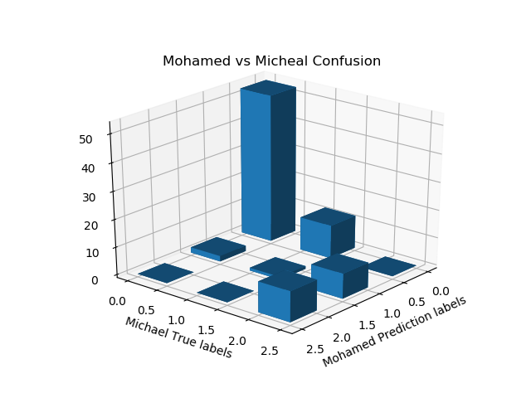
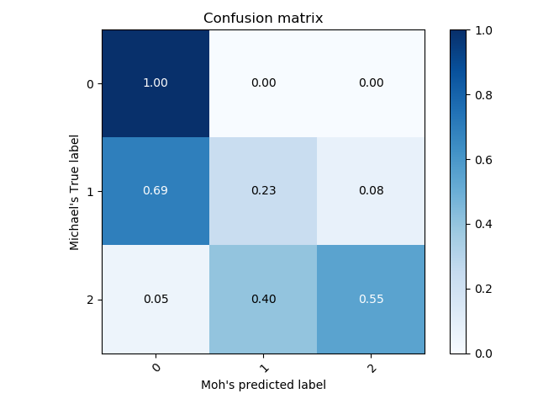

Slide 11
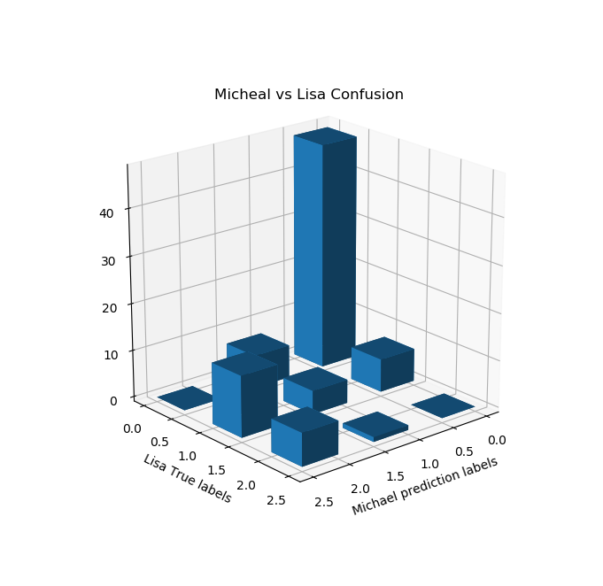
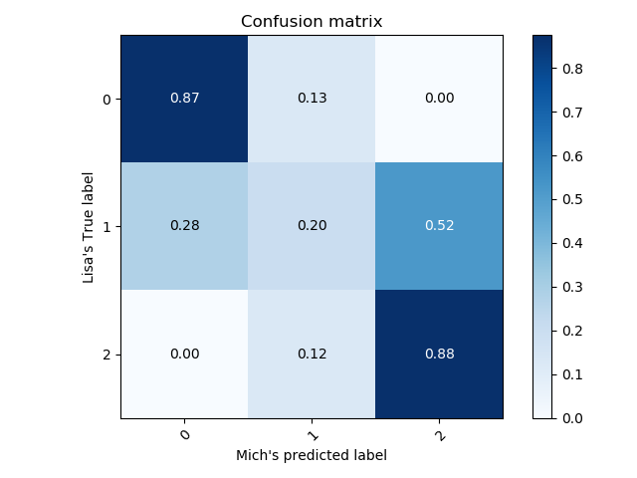

Slide 12

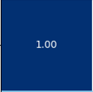
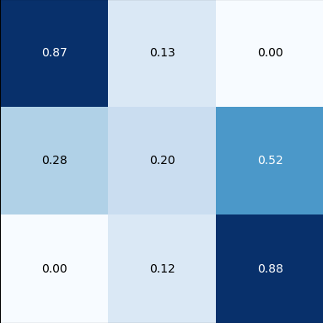

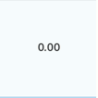
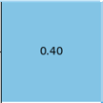
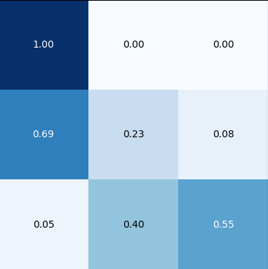
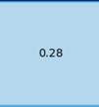
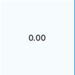
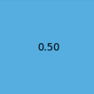
C(Moh,Mich,Lisa)
C(0,0,0) = 48 = 0.8727
C(0,1,0) = 7 = 0.1273
C(0,0,1) = 5 = 0.2083
C(1,0,1) = 2 = 0.0833
Lisa
0
1
2
Michael
0
Mohamed
0
1
1
2
2

Slide 13
Lisa
C(Moh, Mich, Lisa)
C(1,2,1) = 6 = 0.25
C(2,2,1) = 7 = 0.2917
0
1
2
Michael
0
Mohamed
0
1
1
2
2

Slide 14
Lisa
C(Moh, Mich, Lisa)
C(1,1,2) = 1 = 0.125 C(1,2,2) = 3 = 0.375
C(2,2,2) = 4 = 0.5
0
1
2
Michael
0
Mohamed
0
1
1
2
2

