Slide 1
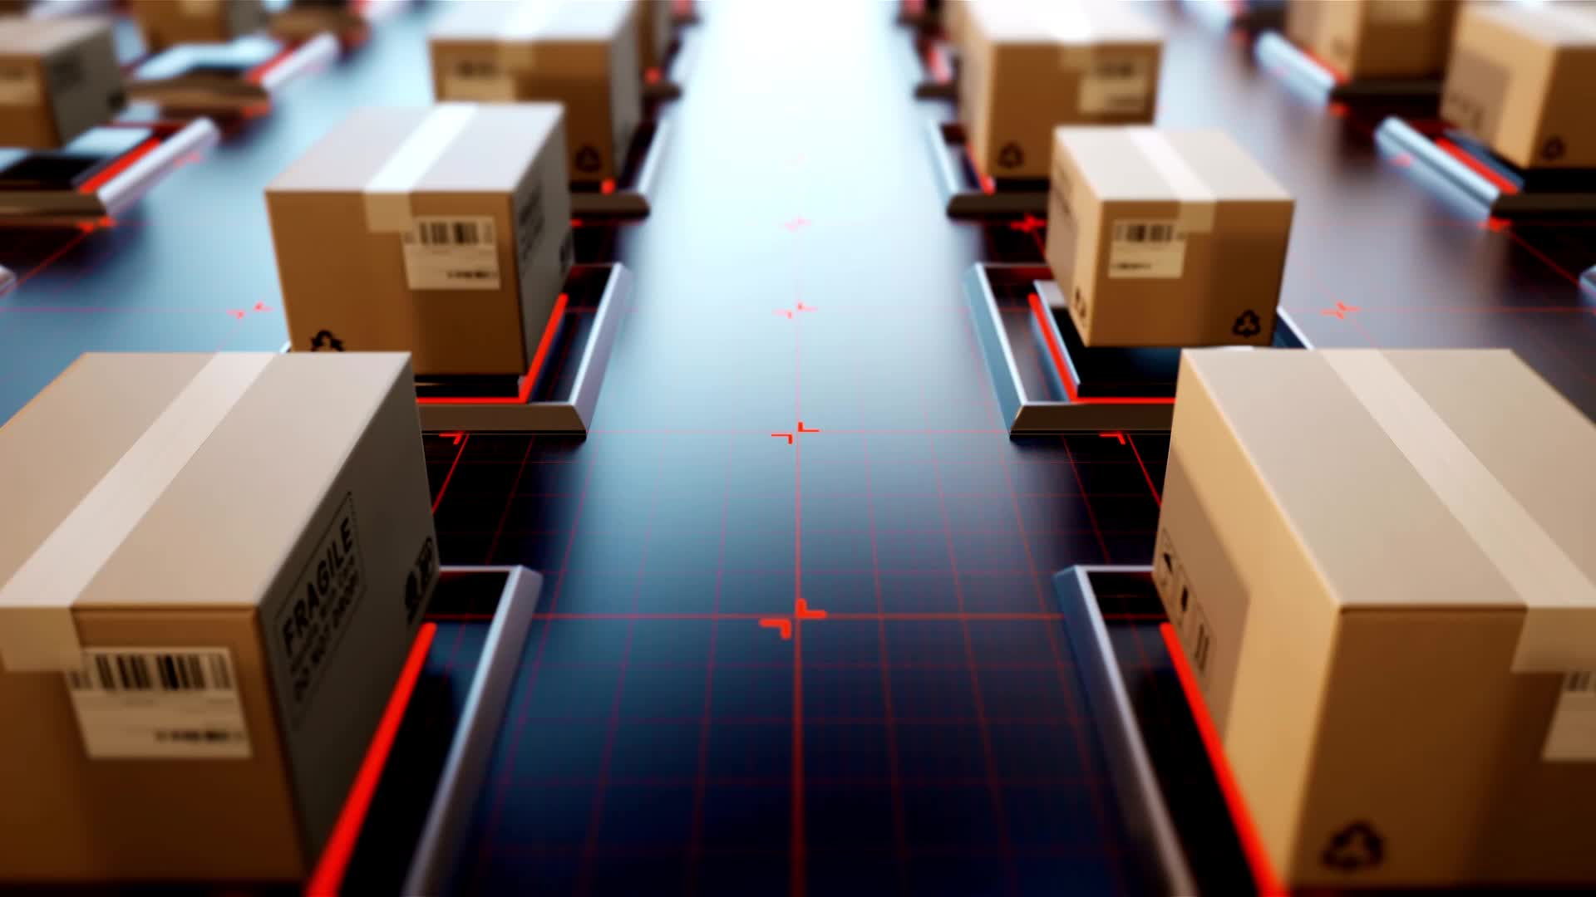
PointFusion: Deep Sensor Fusion for 3D Bounding Box Estimation
Authors
Chenfeng Xu, Tianyang Shi, Bingbing Zhuang, Cewu Lu
Presented
by
M.Amrit

Slide 2

Introduction
Objective
Enhance 3D object detection accuracy by combining RGB images and point cloud data using deep learning.
Motivation
Traditional methods using only RGB or point cloud data have limitations in accuracy and robustness.

Slide 3

PointFusion Model
Inputs: RGB images and point cloud data.
Process
Extracts features from both RGB images and point clouds.
Uses a fusion network to combine these features.
Outputs 3D bounding boxes around detected objects.

Slide 4
Data Fusion Technique Steps
Feature Extraction: Use separate networks to extract features from RGB images and point clouds.
Fusion Layer: Combine features using a neural network.
Bounding Box Estimation: Predict 3D bounding boxes from the fused features.

Slide 5
Network Architecture Components
Feature Extractors: Separate networks for RGB and point cloud features.
Fusion Network: Combines the extracted features.
Bounding Box Predictor: Estimates the dimensions and positions of 3D bounding boxes.

Slide 6

Results and Conclusion
Performance
KITTI Dataset: PointFusion outperforms state-of-the-art methods in 3D object detection accuracy.
SUN-RGBD Dataset: Robust performance across various indoor scenarios.
Conclusion
PointFusion effectively combines RGB and point cloud data, significantly improving 3D object detection accuracy.
Future Work
Explore real-time applications and refine fusion techniques.

Slide 7
Thank you

