Slide 1


Forage Data Science Virtual Internship Program
Task-1 :
Web Scraping to gain company insights
Scrape and analyze costumer review data to uncover findings for British Airways
Amulya Muthoju

Slide 2
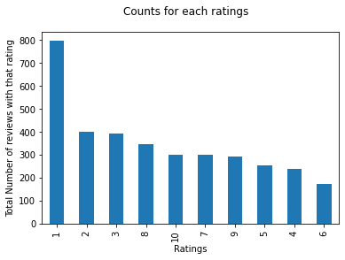
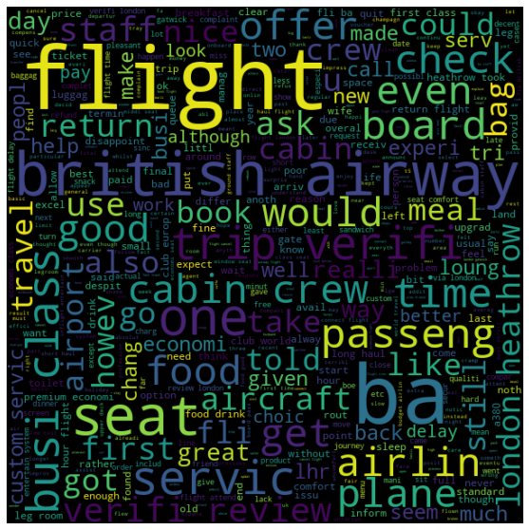
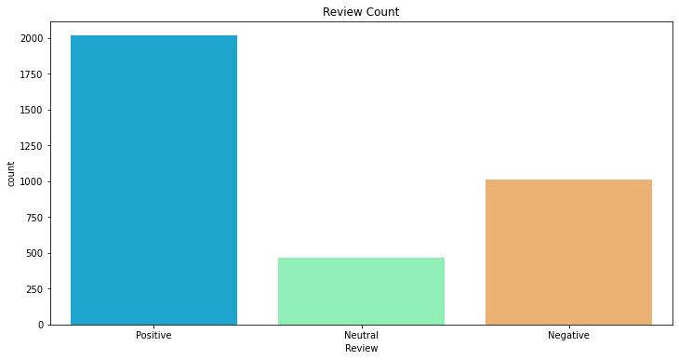
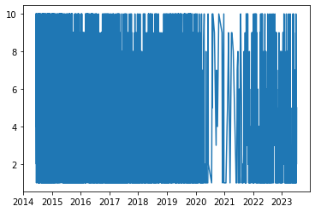
Key Metrics
Average Overall Rating
4.84 /10
3495 Total reviews collected
→ Most of customers have given 1 rating
→ Costumers has given
2016 Positive Reviews 1010 Negative 469 Neutral
→ It can be seen that from 2020 to 2021 there has been a decline in reviews due to covid.

