Slide 1


Forage Data Science Virtual Internship Program
Task-2 :
Predicting customer buying behaviour.
Build a predictive model to understand factors that influence buying behaviour.
Amulya Muthoju

Slide 2
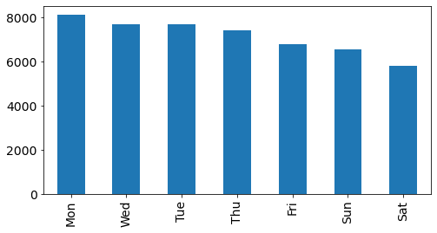
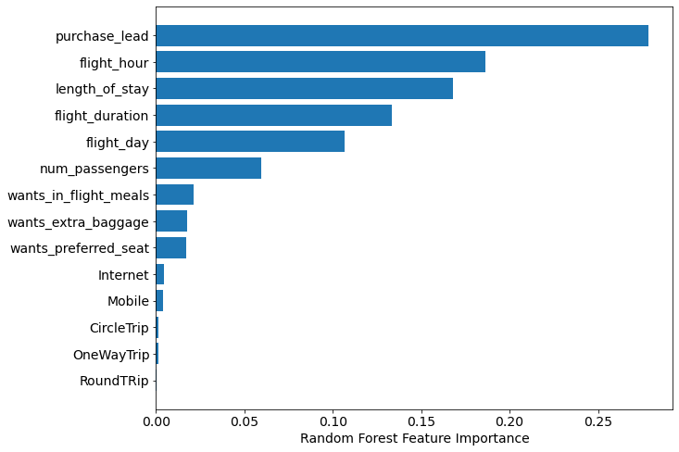
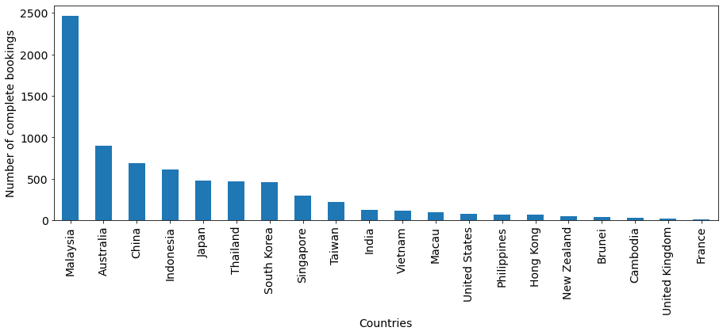
Predictive Model Results
Accuracy
85%
Recall Rate
60%
Precision
55%
-> Top 5 features that can drive successful flight bookings are purchase_lead, flight_hour, length_of_stay, flight_duration, flight_day.
-> Most of the customers want to travel on Monday and choose Saturday as least preferred day as flight day.
-> Travelers from Malaysia had high booking complete.

