Slide 1
Group 1
Spice up your life

Slide 2

The purpose of our product
Katherine Hughes 01-E
Scrum master for sprint 2 and 4

Slide 3
Our sites main purposes
To sell spices
To ensure the user has a good time
To encourage returning customers

Slide 4
Muhammad Anas Afzal Syed 01-A
Scrum master for Sprint 3

Slide 5
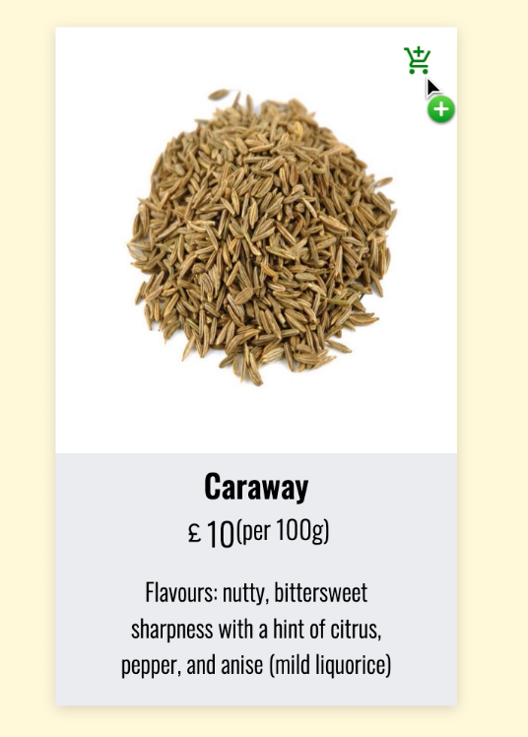
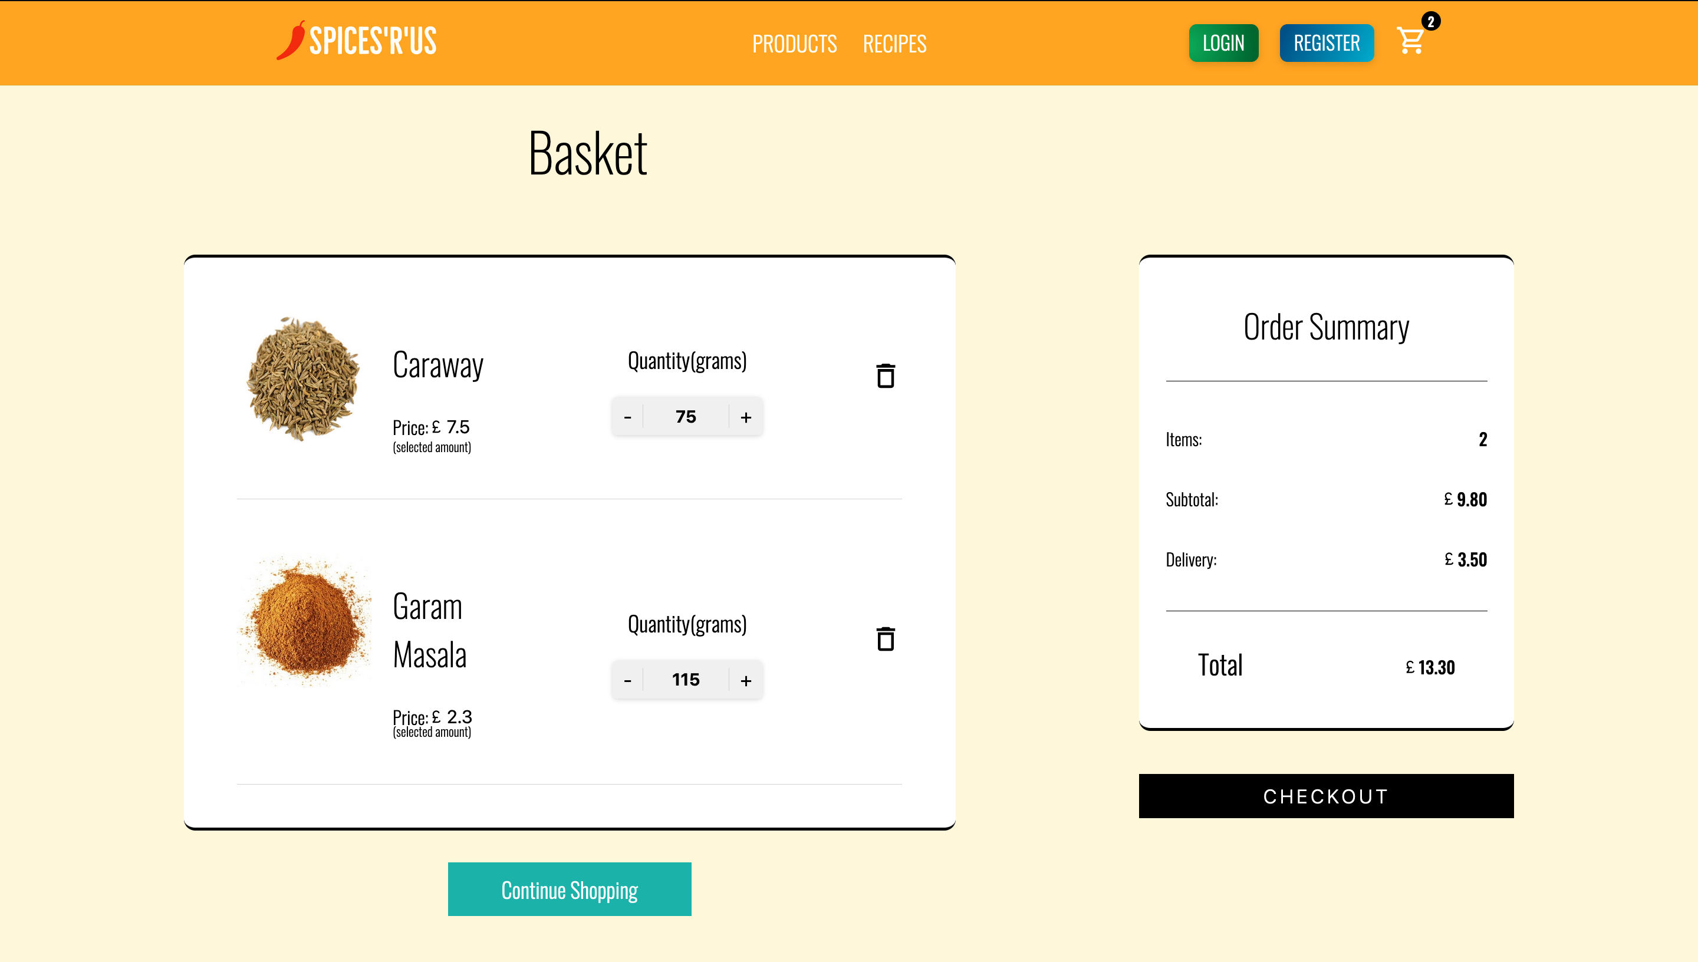
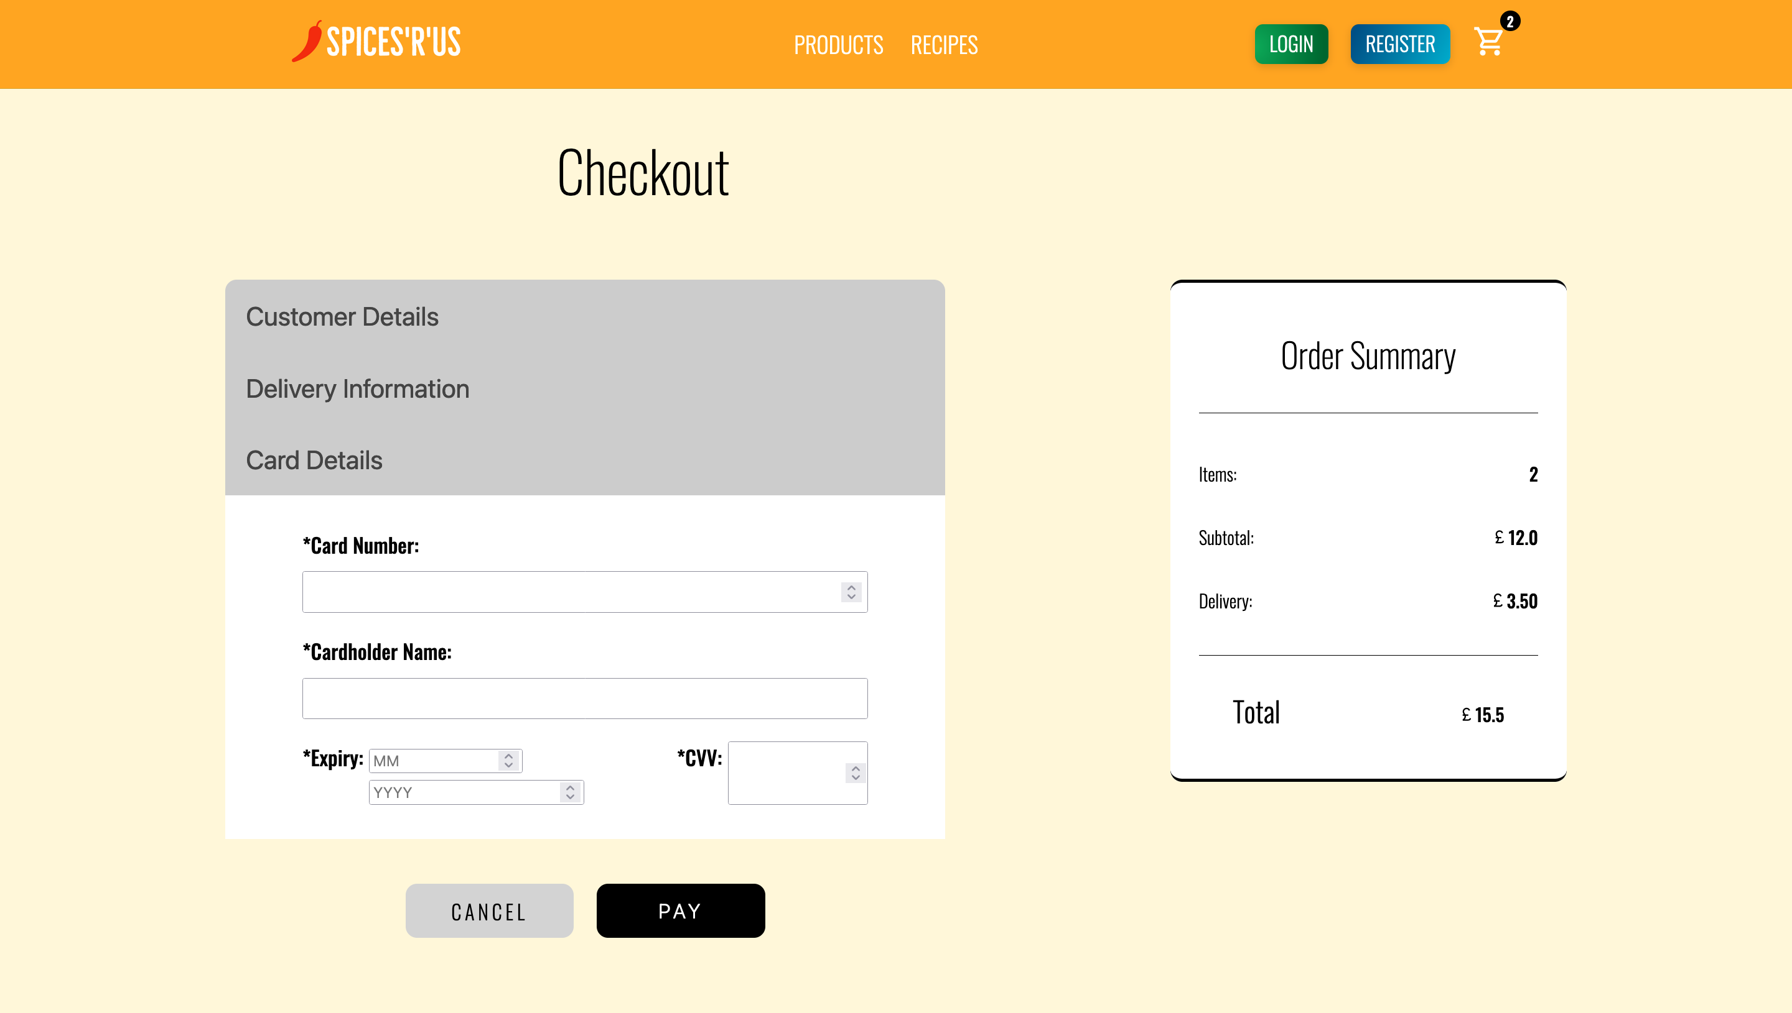
Key Features
Quick Buy
Basket
Checkout

Slide 6
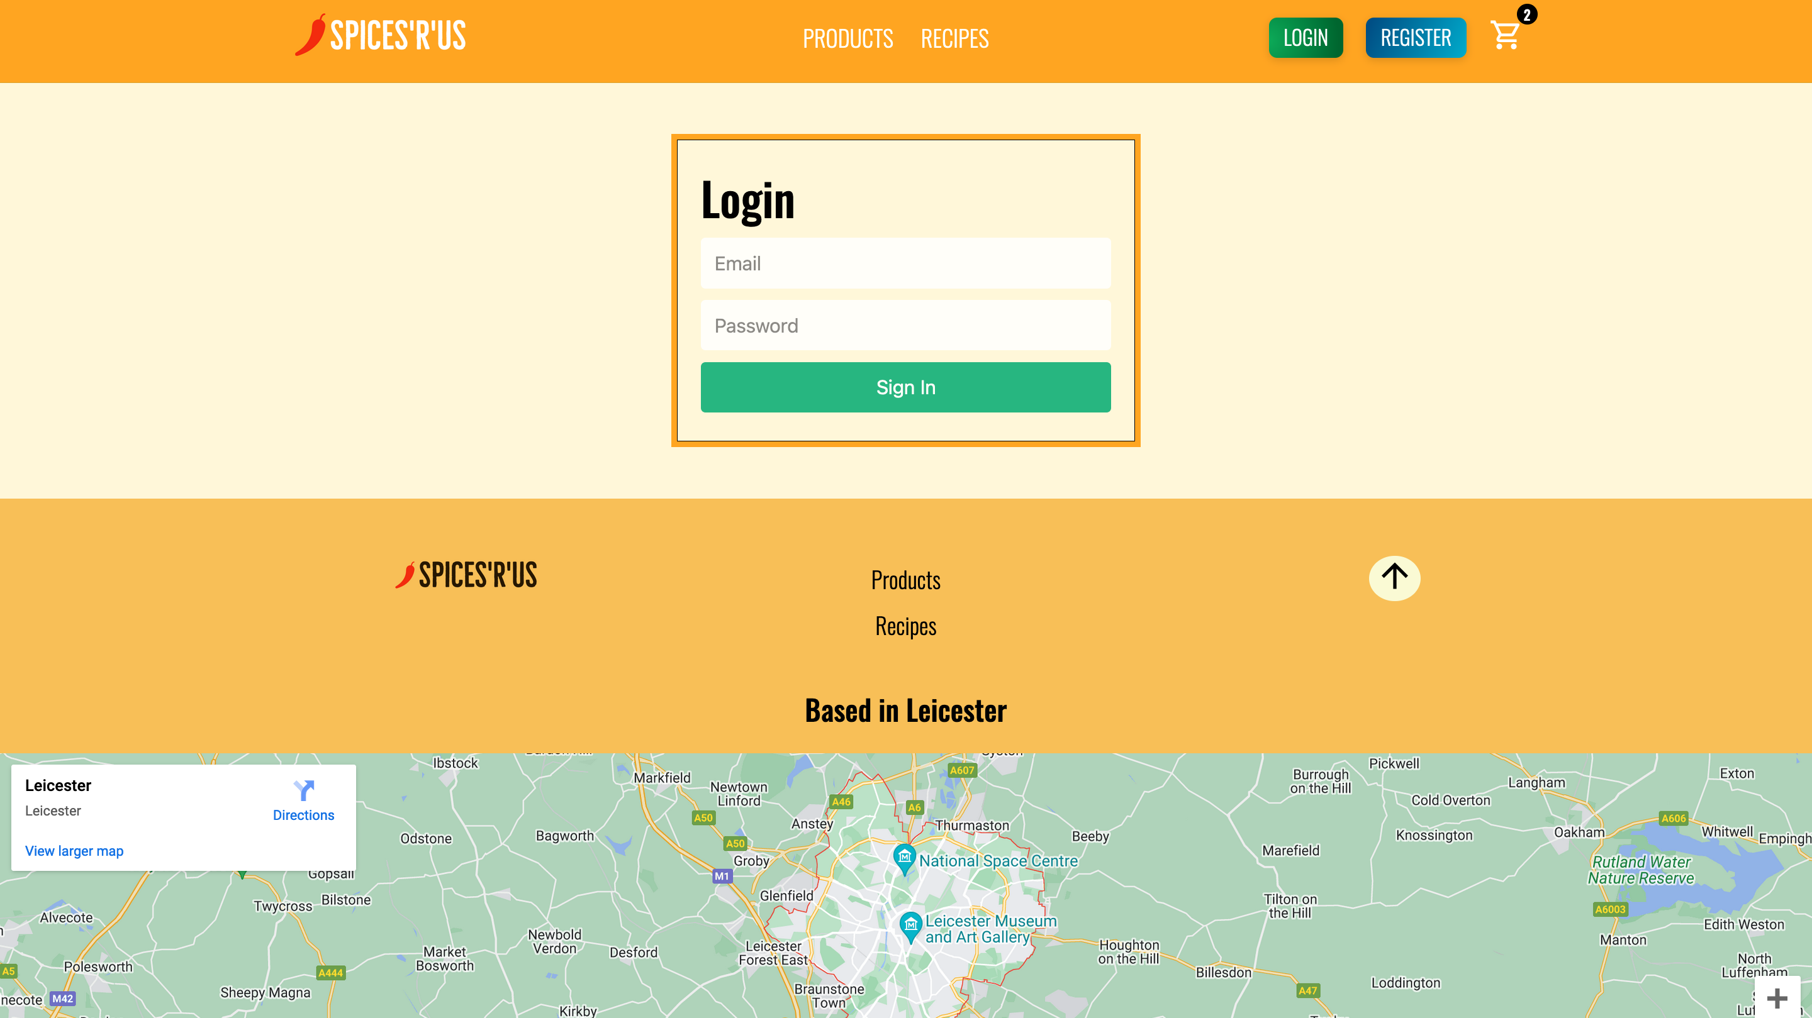
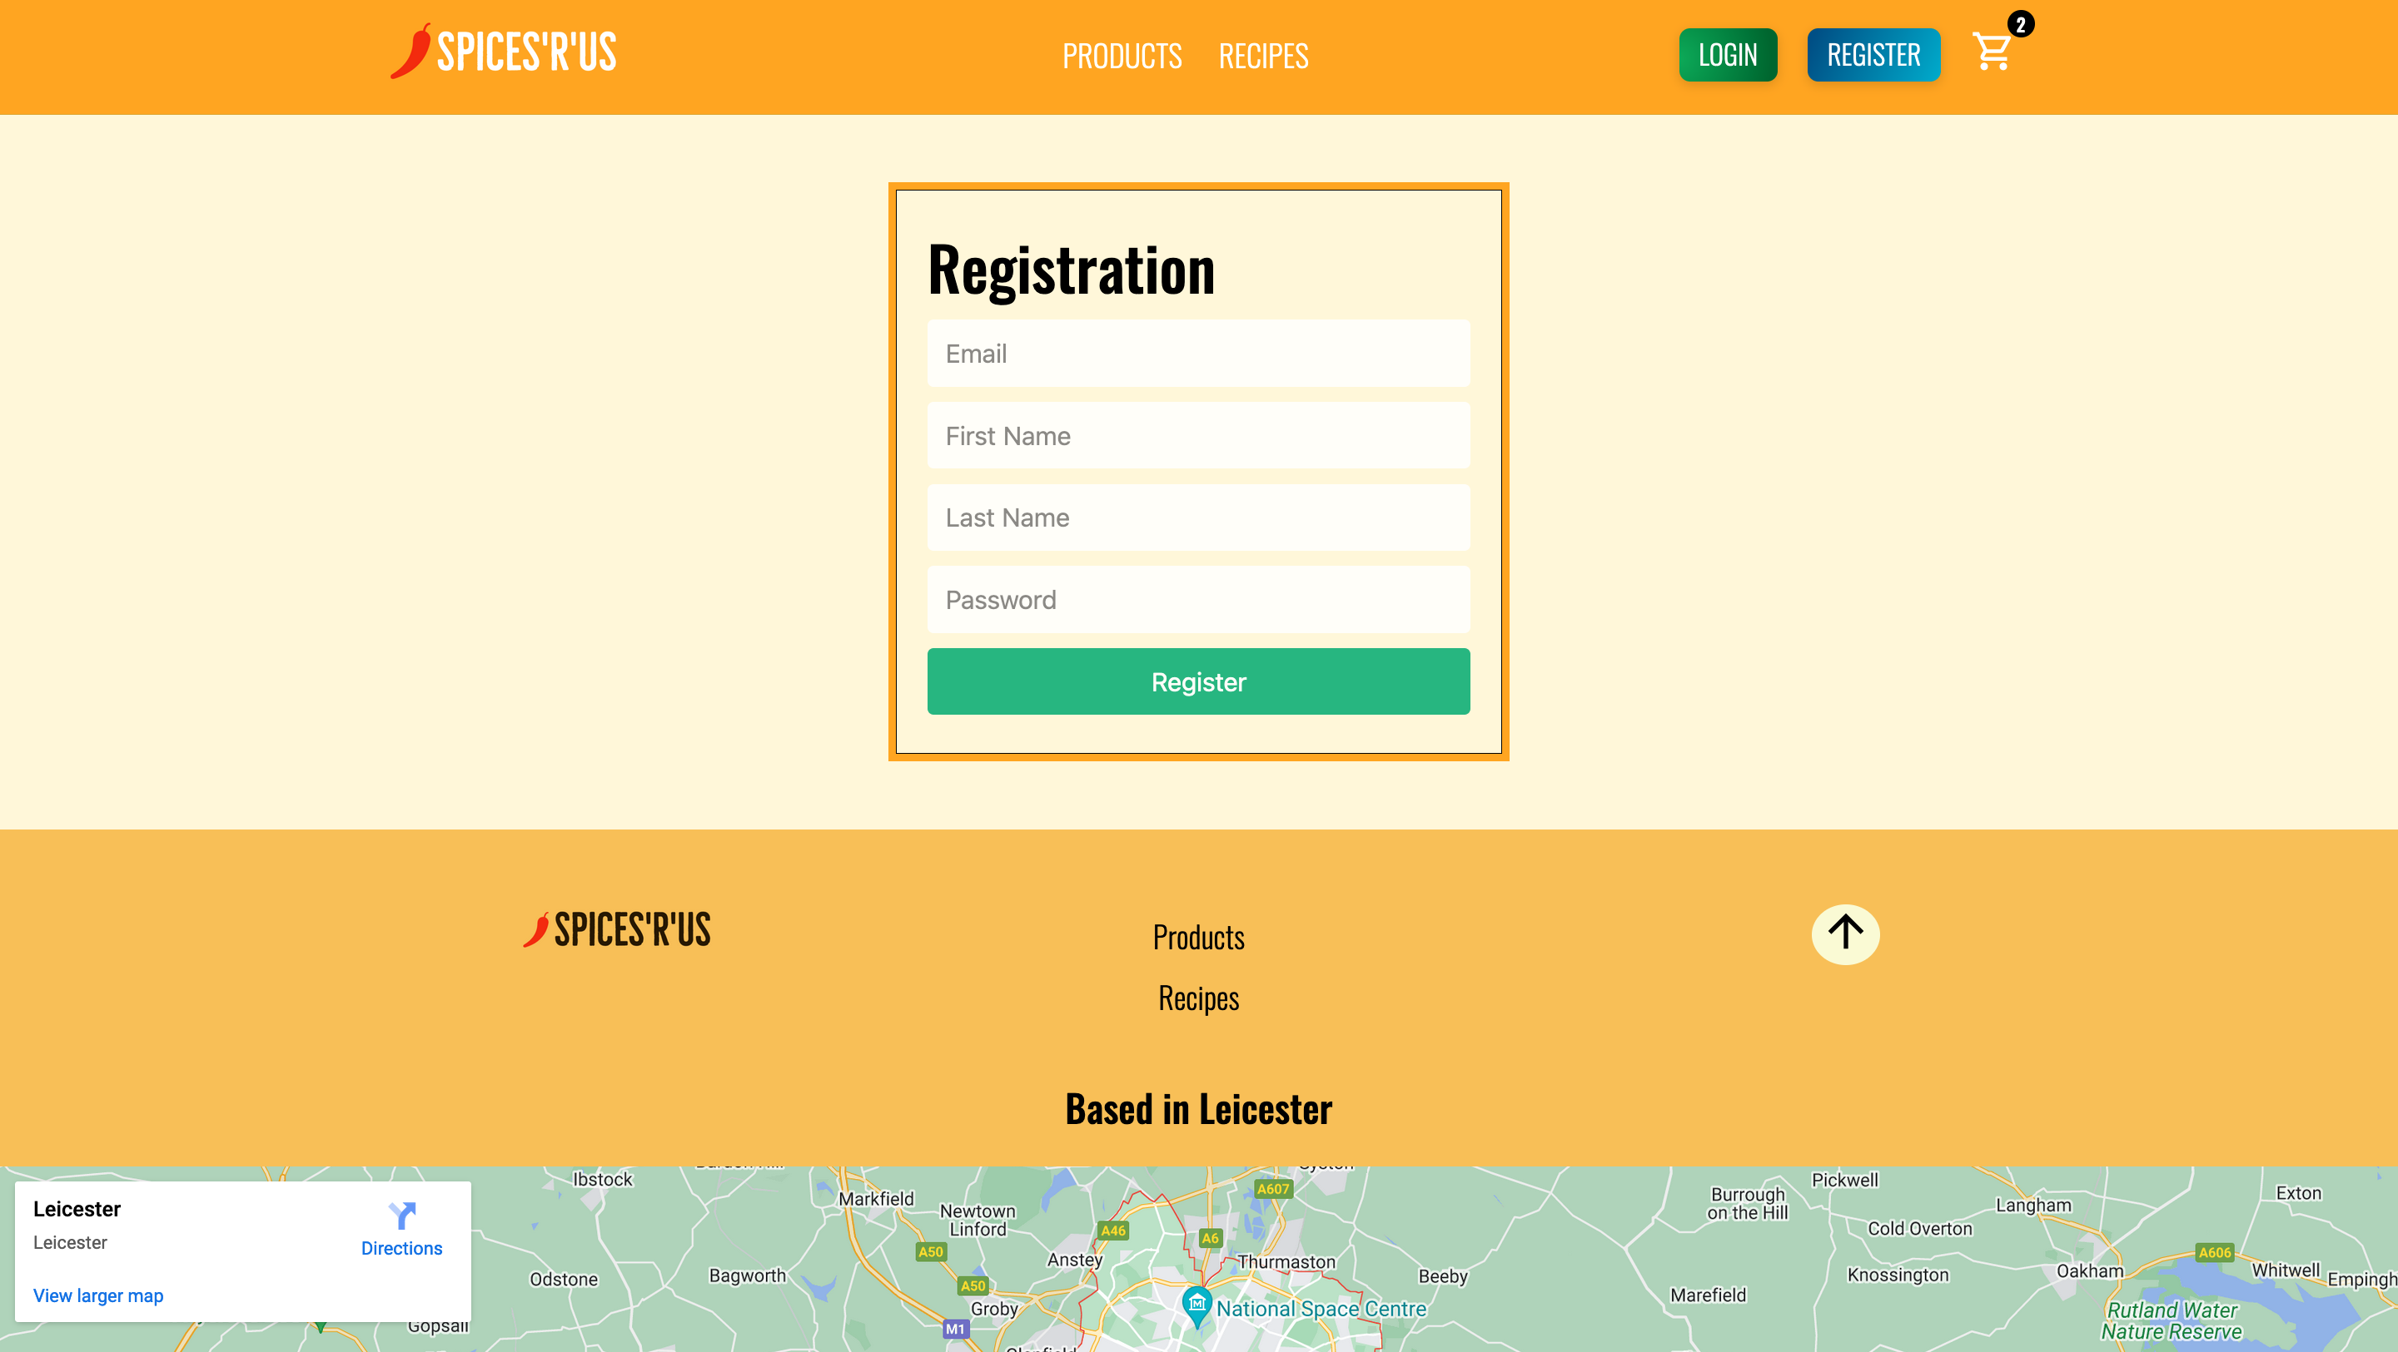
Key Features
Accounting
Login/Registration

Slide 7

Something non-technical that I learned during the project
Binbin Lin 01-F
Scrum master for sprint 1

Slide 8
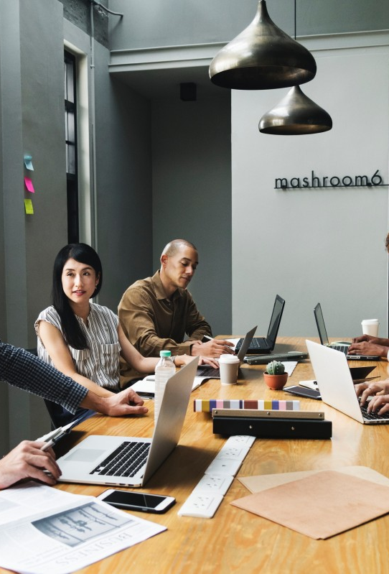
1、Teamwork is important
2、To ensure the communication
3、Seek common points while reserving difference

Slide 9
Non-Technical Skills learned throughout the project
Hubert J Dybcio 01-B

Slide 10
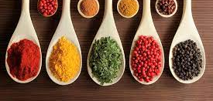

Non-Technical Skills learned throughout the project
Communication Skills
Leadership Skills
Team-work Skills
Decision-making Skills
Situation-awareness Skills

Slide 11
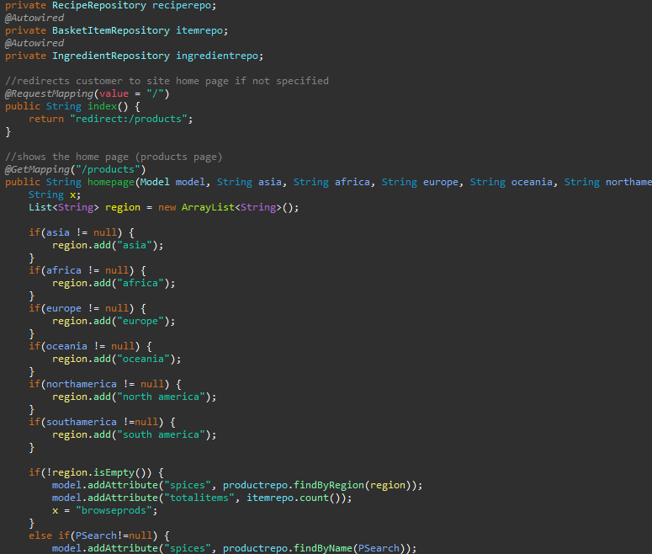
Skills Explained
Team-work
Exchanging information (Discord, WhatsApp, Snapchat…)
Supporting others
Activity coordination
Confirming and assigning roles and responsibilities
Looking over each others work
Decision-making
Identifying options
Different ideas from the members of the group
Reviewing outcomes
Was this really the most suitable option?
Situation-awareness
Gathering information
Research on the different spices
Anticipating

Slide 12
How the group communicated and whether it worked well or not
Shania Fernandes 01-D

Slide 13

How the group communicated and whether it worked well or not
The way in which the group communicated
Meetings
Stand ups
Group chats
Benefits of group communication
Encourages members to make decision's as a team
Progress as a team is more easily tracked
Work together to archive end goal
The pressure is divided within the team
Drawbacks of group communication
Not all members are available
Set times and venues
Not all work is done in time
Distractions

