Slide 1
CAR ACCIDENT DETECTION AND ALARM SYSTEM USING YOLOv5

Slide 2
Agenda
Introduction
Purpose
Working Model
Evaluation metrics and accuracy
Results
Summary

Slide 3
Introduction
Leveraging AI and computer vision technologies.
Detection and alarm system for car accidents.
Cameras and video streams as data sources.
Distinguishes between varying accident severities.
Efficient data processing and alarm activation.

Slide 4
PURPOSE
What's the need ?

Slide 5
PURPOSE:
Addressing a critical need for safer driving environments.
Early detection for timely alerts and interventions.
Enabling swift emergency services deployment.
Overcoming limitations of manual monitoring.

Slide 6
PURPOSE:
Facilitating smoother traffic flow around incidents.
Gathering essential accident data for analysis.
Providing reliable evidence for claims and investigations.
Equipping drivers with real-time hazard awareness.

Slide 7
WORKING MODEL
Accident Detection Workflow

Slide 8
WORKFLOW:
Data Collection
Data Annotation
Model Training
Model Validation
Real-time Detection
Accident Classification
Alert Generation

Slide 9
TRAINING OF MODEL USING YOLOV5:
YOLOv5 excels in real-time object detection, outperforming traditional multi-stage approaches.
YOLOv5 adapts to varying input image sizes, accommodating different scenarios.
YOLOv5 simplifies training and deployment of object detection models.

Slide 10
TRAINING OF MODEL USING YOLOV5:
YOLOv5 achieves high detection speed while maintaining accuracy, surpassing many other models.
YOLOv5 efficiently detects small and densely packed objects, a challenge for some models.
YOLOv5 strikes a balance between fast detection and reliable accuracy.

Slide 11
Evaluation metrics
Model precision, recall & MAP

Slide 12
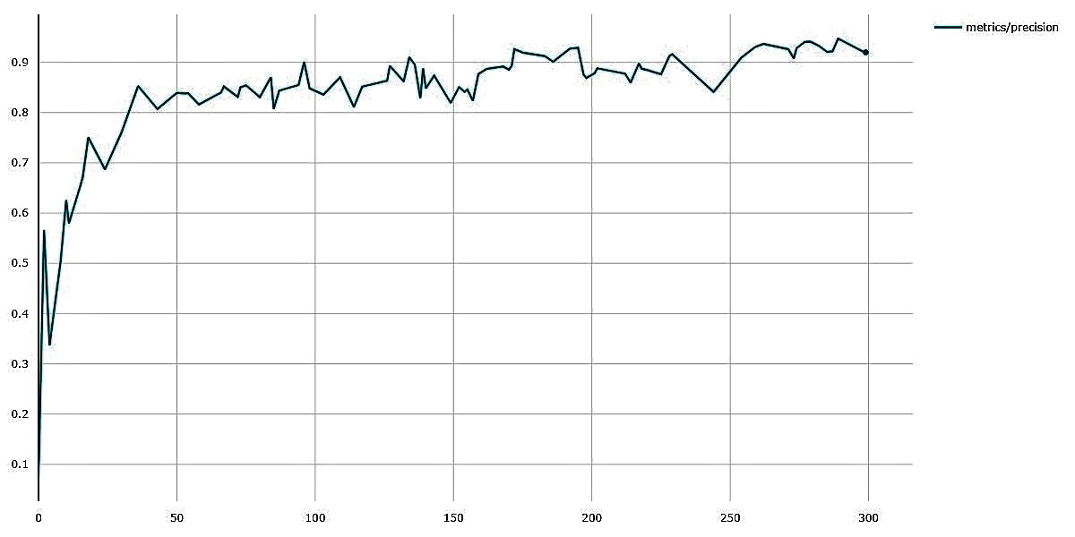
PRECISION/EPOCH

Slide 13
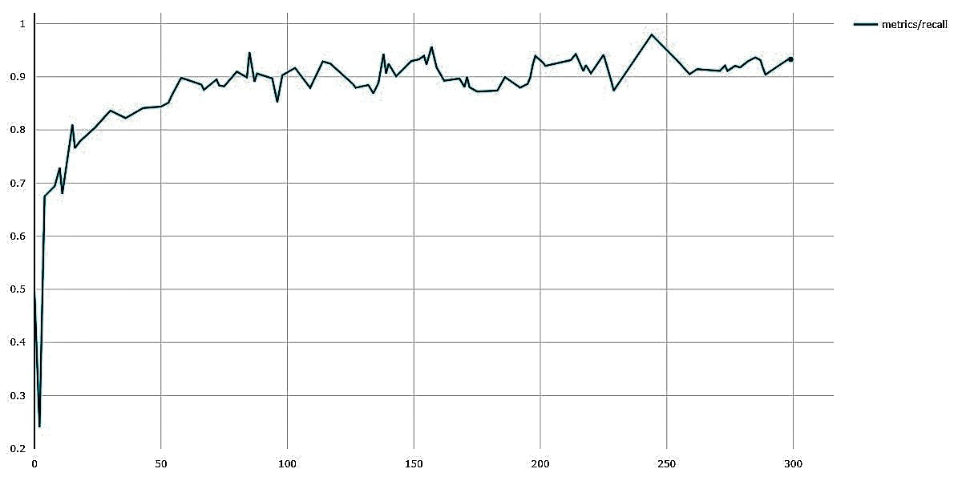
RECALL/EPOCH

Slide 14
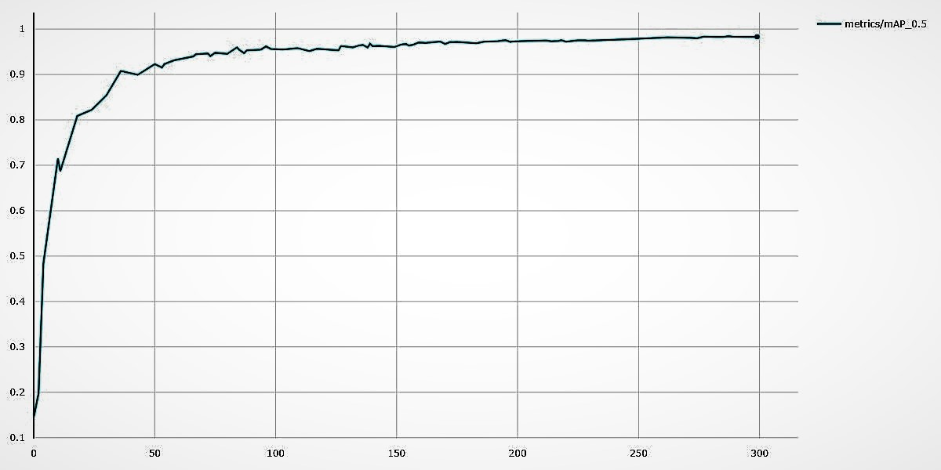
MEAN AVG. PRECISION/EPOCH

Slide 15
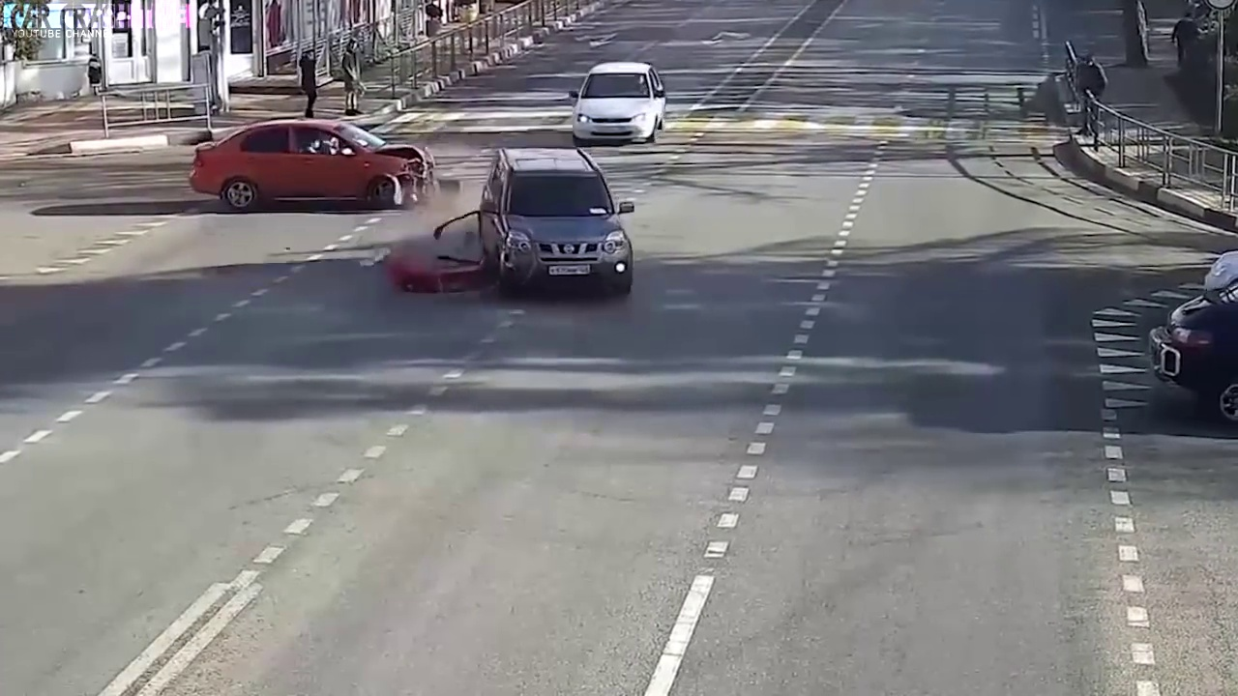
RESULTS:

Slide 16
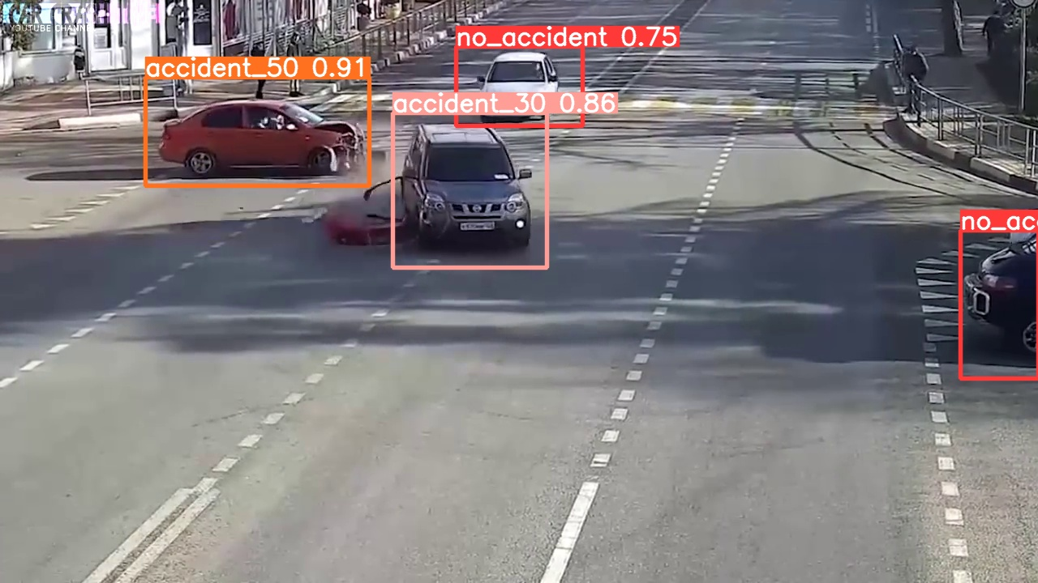
RESULTS:

Slide 17
SUMMARY
Summing up

Slide 18
Summary
YOLOv5-powered system enhances road safety through real-time accident detection.
Real-time processing ensures swift and accurate detection of car accidents.
Alerts are triggered upon accident identification for prompt emergency response.
The system achieves the 'summum bonum' of road safety by blending technology and real-time detection.

Slide 19





Our team
M. Arslan Arshad
Hassaan Ahmed
Abdul Saboor
Muhammad Ansar
Muazzam Rasool

Slide 20
Thank you

