Slide 1
Cyclistic
Behavioral Differences Between Casual Users and Members
May 2020

Slide 2
Business Task
Recognizing the differences in needs between both types of customer so, the marketing team can develop a strategy that would be alluring for the casual riders to convert to annual membership

Slide 3
Data Preparation
Raw Quarterly Data Obtained from the Company Cloud.
Data Storing and Organizing.
Data Cleaning.

Slide 4
Data Analysis
Organizing and Formatting Data.
Keeping Integrity.
Conducting Descriptive Analysis.

Slide 5
Findings
The casual user tend to use bikes longer than members
The members tend to use the bikes for more number rides during the working days.

Slide 6
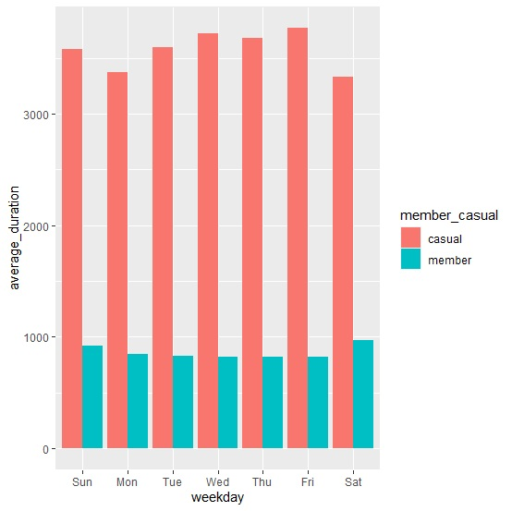

Slide 7
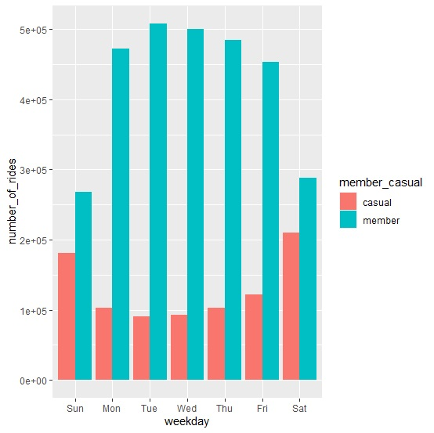

Slide 8
Recommendations
Target casual users who have higher number of rides to convert them to a suitable membership plan.
Target casual users who use bikes on working days more often.
Target casual users with low average duration of rides and higher average number of rides would be interested in a membership.

