Slide 1

BlindSpot-C2
DoH + DGA malware vs. a defensive TLS VPN architecture

Slide 2
Two Tunneling techniques, defensive and offensive approaches:
PROJECT
1
Real-World Malware offensive attack mapped to MITRE ATT&CK focused on Command and Control (C2).
DEMONSTRATION
2
Network isolation defensive solution, using a VPN implementation to isolate the victim machine and eliminate public internet exposure

Slide 3
MITRE ATT&CK: three malware techniques
T1568.002
T1071.004
T1572
Dynamic Resolution: DGA
Application Layer: DNS
Protocol Tunneling: DoH
Generates changing C2 domains to hide the real domain
DNS used as the C2 application protocol for data exfiltration
DNS carried inside encrypted HTTPS request
KEY INSIGHT
applecloud.com ✘
bluestorm.net ✘
evil-c2.io ✔
greenlight.org ✘
IJWGS3TEKNYG65BNIMZA.example.com
Cloudflare DoH Resolver
03

Slide 4
SCENARIO • BEFORE
Exposed Architecture
NO PERIMETER DEFENSE
Direct connection
DoH request
Encrypted HTTPS
ATTACKER
TARGET SERVER
DoH RESOLVER
C2 Server
Victim talks straight to the open Internet. every open port, unpatched service, misconfiguration can be exploited.
04

Slide 5


SCENARIO • AFTER
Isolated Behind a Defensive VPN Gateway
ZERO-TRUST PERIMETER
⛉
VPN GATEWAY TLS Tunnel Server
>_
EXTERNAL ATTACKER No route in
BLOCKED
ⓧ
TARGET SERVER Isolated
Encrypted TLS Tunnel
INTERNAL NETWORK
ⓧ
Outbound Exfil Blocked
AUTHORIZED CLIENT
Only the authenticated VPN client can reach the target server, and the server has no path to the outside world at all.
05

Slide 6
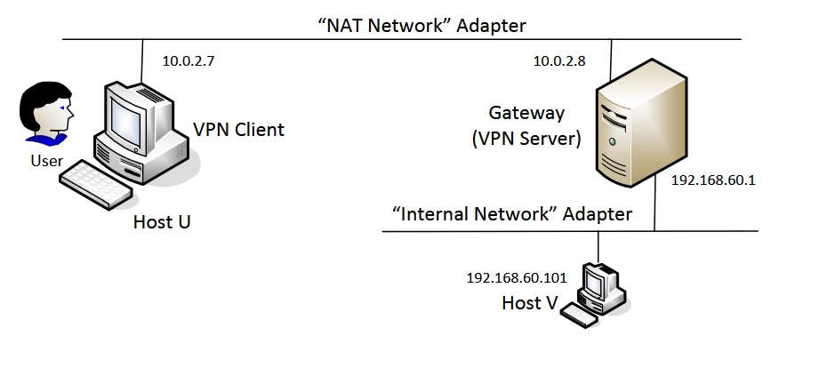
The structure: Three Virtual Machines
06

Slide 7
How the VPN works:
creates a virtual interface, authenticates, establishes TLS, then forwards IP packets.
01
CREATE
02
AUTH
03
TUNNEL
04
FORWARD
TUN interface
TLS + certificates
Encrypt packets
Route through Gateway
CLIENT
TLS
ENCRYPTED FRAMES
GATEWAY FORWARD
Internal Host
TUN interface
The client requires a CA, creates tun0, connects to the server, and wraps the socket in TLS.
07

Slide 8
What changes for the attacker?
The same malware behavior now hits a network boundary instead of an exposed host.
BEFORE
AFTER
Discover host
No public target
cannot directly reach internal Host must first defeat the VPN gateway
ATTACK SURFACE ↓
Connect directly
Gateway is the only door
Resolve DoH
No internal host egress
Exfiltrate
C2 path collapses
09

Slide 9
Why this is worth deploying
01
REDUCE EXPOSURE Remove public reachability to sensitive hosts.
02
MALWARE IS POWERLESS Malware can execute, but it cannot communicate.
03
KEEP ACCESS Authorized users still reach the private host.
04
CENTRALIZE CONTROL Manage access and traffic from a single gateway.
DON’T CHASE THE DOMAINS. CUT OFF THE ROUTE.
10

