Slide 1
EV Charging Demand Prediction and Optimization
23CSE452 BUSINESS ANALYTICS
Team number: 8​
Members:
1.ADITHYARAMAN R -[CB.SC.U4CSE23601]​
2.MUPPIDI CHANDANA-[CB.SC.U4CSE23228]​
3.D BHUVANESHWARI-[CB.SC.U4CSE23612]​
4.KHANDAVILLI V V S D GNANESH-[CB.SC.U4CSE23662]​
Faculty:Rohini S [19-10-2026]
01
Notes:
Suggested time: 20 seconds. Replace bracketed prompts with your project evidence. Present actual results only. Target 15 minutes including the live demonstration. Cover the whole project. Review 2 assessment primarily focuses on two Unit 3 methods.

Slide 2
Business problem and objectives
Business problem:
Workplace EV charging demand is uneven across time, chargers, weekdays, and operating regimes. Long-stay vehicles occupy chargers for several hours, while demand also changes after pricing, access, and COVID-related operational changes. This makes it difficult to plan charger capacity, staffing, charger allocation, and charging policies.
Objectives:
1.Understand charging demand patterns by time of day, weekday/weekend, station, charging duration, energy delivered, and operating regime.
2. Forecast future charging demand and estimate the capacity buffer required to serve most days without unnecessary charger expansion.
3. Identify recurring charging-behaviour patterns (arrival, stay, energy, idle time) to guide charger allocation and idle-time policies.
02
Notes:
Suggested time: 40 seconds. Replace bracketed prompts with your project evidence. Present actual results only.

Slide 3
Business decision:
The analysis supports decisions about:
Number of chargers required during weekday and weekend peaks
Charger allocation and maintenance scheduling
Staffing and operational planning
Pricing, access rules, idle-time policies, and user notifications
Expected output:
An interactive Streamlit dashboard containing:
Historical demand and energy KPIs
Station and space utilisation summaries
Demand pattern visualisations
Next-day and multi-week forecasts
Forecast accuracy metrics
Charging-behaviour association rules
Capacity-planning and operational recommendations

Slide 4
Research gap and comparative study
Existing methods (comparative study):
EV charging studies analyze charging demand and user behaviour.
Other studies focus on workplace charging-station planning and capacity optimization.
Demand forecasting and infrastructure planning are often studied as separate analytical problems.
Research gap: There is scope for an integrated analytics approach that combines future charging-demand prediction with recurring charging-pattern analysis for workplace EV charging.
Proposed approach: ACN-Data API → Data Preparation → EDA → Predictive Modelling → Time-Series Forecasting → Association Rule Mining → Business Recommendations

Slide 5
Complete project workflow
Stage | Your implementation
Unit 1 | Collected ACN workplace charging data; validated timestamps, duplicates, missing values, energy values, duration, power, and overlapping sessions; converted timestamps to local time; performed EDA on demand, energy, duration, station usage, weekday/hour patterns, and policy regimes.
Unit 2 | Built and evaluated predictive models for daily charging-session demand using time-aware validation. Compared Ridge, Lasso, ElasticNet, Poisson, Random Forest, Gradient Boosting, HistGradientBoosting, and adaptive baselines.
Unit 3 | SARIMAX time-series forecasting for multi-week demand planning and Apriori association-rule mining for charging-behaviour patterns.
Final application | Developed an interactive Streamlit dashboard with date, station, and space filters; KPIs; demand trends; forecast comparison; station summaries; behaviour analysis; and association-rule results.
100% of the planned analytical workflow is implemented and integrated, including data preparation, EDA, modelling, forecasting, association analysis, saved outputs, and the interactive dashboard.
03
Notes:
Suggested time: 30 seconds. Replace bracketed prompts with your project evidence. Present actual results only.

Slide 6
Overall dataset description
Source and collection / generation method:
The project uses the ACN-Data workplace EV charging dataset collected through the ACN Data Caltech API. The raw data contains individual EV charging-session records, including connection and disconnection timestamps, charging energy, station and space identifiers, user information, and optional user-input fields.
Final dataset size:
Raw dataset:31,424 charging sessions and 13 source fields
Validated dataset: 31,387 retained sessions
Removed records: 37 sessions exceeding the 72-hour connected-duration limit
Feature-engineered dataset: 31,387 sessions and 59 analytical variables
Association-rule transactions: 31,387 sessions
Final association rules:295 rules : 165 driver-behaviour + 130 policy-driven
04
Notes:
Suggested time: 45 seconds. Replace bracketed prompts with your project evidence. Present actual results only. Document original collection or generation. Pre-built datasets from Kaggle, UCI, GitHub or similar repositories are not permitted under the project requirements.

Slide 7
Coverage:
Date range:25 April 2018 to 13 September 2021
Total calendar coverage:1,238 days
Data available across:155 weeks
Important data gap: No sessions were recorded from 4 August 2020 to 17 November 2020, representing 106 empty days
Domain: Workplace/campus EV charging demand
Unit mapping:
Unit 1: Raw session fields, cleaned timestamps, energy, duration, power, station, space, weekday, hour, and regime variables
Unit 2:Daily session counts, lagged demand, rolling averages, calendar indicators, model predictions, and forecast evaluation data
Unit 3: Behaviour categories such as arrival period, stay length, energy band, charging share, power band, user status, station group, and operating regime
Final application:Cleaned session data, forecast holdout data, model comparison outputs, and association-rule results

Slide 8
Sample dataset and key variables
Session ID | Station / Space | Energy delivered | Connection and duration
2_39_78_362_2018-04-25 | Station `2-39-78-362` / Space `CA-496` | 7.93 kWh | 2.20 connected hours
2_39_95_27_2018-04-25 | Station `2-39-95-27` / Space `CA-319` | 10.01 kWh | 11.19 connected hours
2_39_79_380_2018-04-25 | Station `2-39-79-380` / Space `CA-489` | 5.26 kWh | 9.32 connected hours
05
Notes:
Suggested time: 35 seconds. Replace bracketed prompts with your project evidence. Present actual results only.

Slide 9
Key variables:
`sessionID`: unique charging-session identifier
`stationID` charging station identifier
`spaceID` individual charging-space identifier
`connectionTime` / `disconnectTime` session start and end timestamps
`kWhDelivered`energy delivered during the session
`connected_h`total time the vehicle remained connected
`charging_h` estimated time spent actively charging
`avg_power_kW` average charging power
`hour`, `dayofweek`, `date` time-based demand features
`regime` operating period such as free charging, paid charging, or COVID/recovery
`is_weekend`, `is_morning_arrival`, `is_long_stay` engineered behaviour indicators

Slide 10
Target / outcome
The main forecasting target is daily charging-session demand, measured as the number of charging sessions per day. Additional outcomes include total daily energy demand, station-level session volume, charging duration, and charger occupancy/capacity requirements.
Linked datasets and method-specific subsets
Clean and feature-engineered session datasets support Units 1 and 2.
Daily and hourly time-series datasets support SARIMAX forecasting.
One-hot association baskets support Apriori rule mining.
Forecast holdout and model-comparison files support model evaluation.
No synthetic data was used; the analysis is based on observed ACN charging sessions.

Slide 11
Dataset validation and preparation
Check | Finding | Correction / evidence
Missing values and duplicates | No duplicates found. `doneChargingTime` was missing for 2,055 sessions. | Sessions were retained and flagged as `done_time_missing`; excluded only where completion time was required.
Types, ranges and consistency | 28 invalid charging-end times; 37 sessions exceeded 72 hours; 39 had power above 10 kW. | Invalid end times were set to missing. Extreme-duration sessions were removed and logged. Implausible power values were set to missing and flagged.
Suitability across all units | Required fields were available. A 106-day recording gap was identified. | Timestamps were converted to local time. Gap days were excluded from demand and forecasting analysis.
Synthetic data, if applicable | No synthetic records were used. | Analysis used observed ACN charging sessions; user-input fields were transformed where available.
31,387 records retained in `acn_clean_sessions.csv` and `feature_engineered_sessions.csv`; 37 invalid long-duration records flagged in `acn_flagged_sessions.csv’
06
Notes:
Suggested time: 45 seconds. Replace bracketed prompts with your project evidence. Present actual results only.

Slide 12
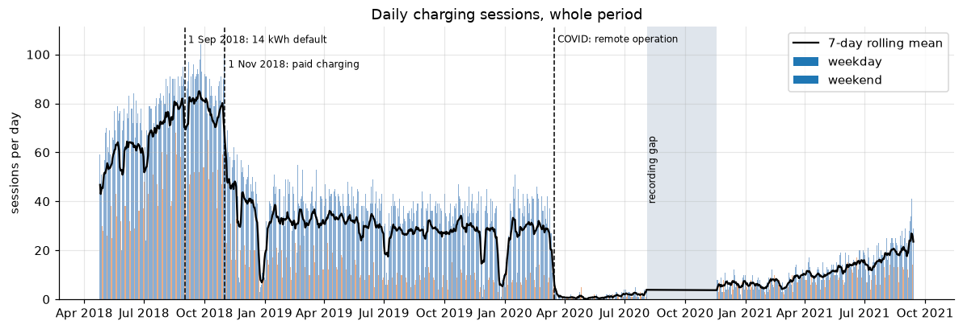
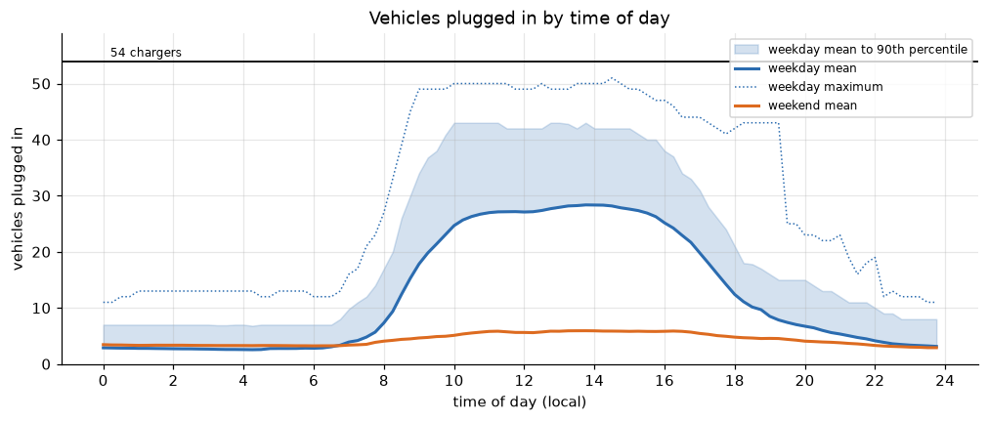
Exploratory analysis and preprocessing
UNIT 1
Tracks demand shifts across 1132 calendar days with data.
Shows distinct operational stages: Free R1 (74.0 sessions/day)
Free R2 (88.5 sessions/day)
Paid R3 (36.8 sessions/day)
and COVID period R4 dropping to 8.7 sessions/day.
Visualizes the 5-hour lag between arrival and occupancy peaks.
Arrivals peak at 08:00 ,
while charging bay occupancy peaks at 13:00–14:00 with an average of 28.1 vehicles and a maximum of 51 out of 55 stations occupied (92% bay utilization)
07
Notes:
Suggested time: 55 seconds. Replace bracketed prompts with your project evidence. Present actual results only. Replace the chart prompt with actual charts. Explain what changed after preprocessing and connect findings to the business objective.

Slide 13
Major preprocessing done
Step | What We Did | Numbers / Details
Cleaning (Notebook: EV_Charging_Demand_Analysis_i9.ipynb) | Removed bad records and extreme stays | Kept 31,387 out of 31,424 sessions (99.9%). Removed 37 sessions parked over 72 hours, and excluded a 106-day recording gap.
Feature Engineering (Notebook: EV_Charging_Demand_Analysis_i12.ipynb) | Adjusted timezones and calculated session metrics | Calculated total stay, charging time, idle time, and average power in kW.
Daily Aggregation (Notebook: EV_Charging_Demand_Analysis_i12.ipynb) | Grouped data by day and created modeling features | Created 1,104 daily records (holding out the first 28 days to build lag features). Created 17 features: day of week, past demand lags (1, 7, 14 days), rolling averages, and pricing rules.

Slide 14
Predictive modelling and final evaluation
UNIT 2
Model | Error (WAPE %) | Average Error (MAE) | Large Error (RMSE) | Notes
Baseline (4-Week Same Day Average) | 31.1% | 7.9 sessions | 11.5 sessions | Simple average of past 4 matching weekdays
Baseline (Last Week Same Day) | 32.8% | 8.3 sessions | 12.5 sessions | Uses same day from previous week
Random Forest | 23.8% | 6.1 sessions | 8.8 sessions | Standard tree ensemble
Histogram Gradient Boosting (Champion) | 21.2% | 5.4 sessions | 7.9 sessions | Best model; beats baseline by 10%
ElasticNet Regression | 18.5% | 4.7 sessions | 6.4 sessions | Linear model comparison
What We Predict: Total number of charging sessions for the next day across all 55 chargers.
Features Used: 17 features including day of the week, campus holidays, past demand (yesterday, last week, 2 weeks ago), rolling averages, and pricing policies.
Data Split: Tested in real time order across 1,104 days: Free period (31 test days), Paid period (91 test days), and COVID recovery (105 test days).
08

Slide 15
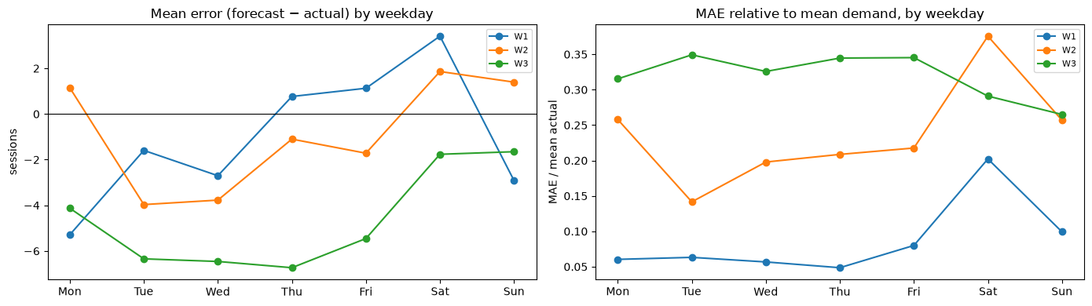
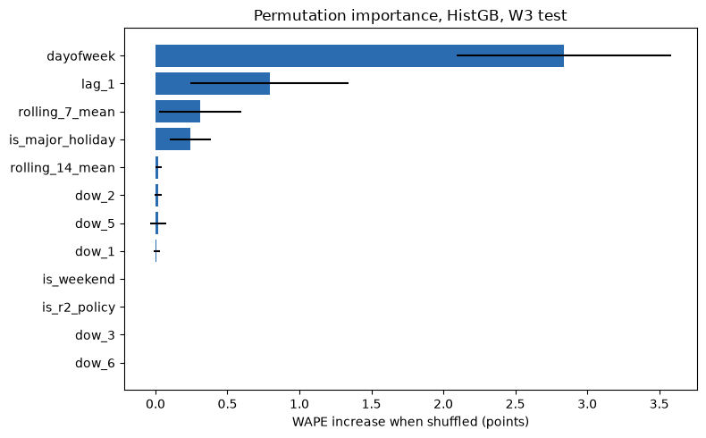
Target: Predict next-day total charging sessions across all 55 campus stations.
Inputs: 17 daily features including day of the week, campus holidays, recent demand (1, 7, and 14 days ago), weekly rolling averages, and pricing policy flags.
Split & Test Record Count: Tested in strict chronological order across 1,104 usable daily records (holding out the first 28 days for lag warm-up) across three test periods: Free (31 days), Paid (91 days), and Recovery (105 days).
Choice: Histogram Gradient Boosting (HistGB), selected for having the lowest 5-fold cross-validation error (35.6% WAPE).
Evidence: Outperformed baseline models on main operational data, achieving a 21.2% error (off by only ~5.4 sessions) during paid charging - beating simple historical averages by nearly 10 percentage points (-0.88 sessions).
Limitations: Struggles during sudden external shocks (such as unexpected COVID shutdowns) and requires regular retraining as return-to-office demand grows.
Business Outcome: Delivers an accurate next-day demand forecast that allows operations teams to plan grid loads, schedule maintenance during quiet periods, and manage driver parking capacity without spending money on unneeded new chargers.

Slide 16
UNIT 3
Selected advanced analytics methods
Selected method | Business question | Data used
Method 1: SARIMAX | How many charging sessions should we expect each day over the next 8 weeks, and when are the peaks, so we can plan charger capacity? | time_series_daily.csv
Method 2: APRIORI | Which charging behaviours occur together (arrival time, stay length, energy, idle time), to guide charger allocation and idle-time policies? | association_onehot.csv
09
Notes:
Suggested time: 30 seconds. Replace bracketed prompts with your project evidence. Present actual results only.

Slide 17
UNIT 3
Method 1 implementation
Selected method: Time-Series Analysis using SARIMAX, to forecast daily EV charging sessions
Input and preparation: Daily session counts from time_series_daily.csv.Data split into 4 demand regimes, with the final model trained on the recovery regime only.
Implementation: SARIMA with a campus-closure input and a drift (growth) term, in Python using pandas and statsmodels
Output: 8-week daily forecast with 80% and 95% ranges: about 24.7 sessions/day; busiest day Fri 5 Nov; peak window 10:30–15:45; expected peak 21 vehicles against 33 chargers in use. Held-out error (MAE) 3.9 sessions/day
10
Notes:
Suggested time: 45 seconds. Replace bracketed prompts with your project evidence. Present actual results only. For time series, explain frequency and time split. For text, explain cleaning and representation. For association rules, explain transactions and thresholds.

Slide 18
UNIT 3
Method 1 evaluation and comparison
Approach / configuration | MAE | RMSE | WAPE
A: 8-week weekday mean (baseline) | 3.86 | 4.93 | 25.0%
B: SARIMAX + closures + drift (selected) | 3.18 | 4.08 | 20.6%
Evaluation (Nov 2020 – Sep 2021): Tested via a leak-free rolling-origin backtest of 28-day-ahead forecasts across 16 weekly cutoffs (448 total forecast days).
Results: SARIMAX (with closures + drift) outperformed all baselines, reducing MAE by 18% and achieving 3.9 MAE / 19% WAPE on the final holdout (Aug–Sep 2021).
Takeaway: Forecasts are accurate to ±4 sessions/day, supporting 1–4 week charger capacity planning. Because the 80% prediction interval only achieved 61% coverage, use the 95% interval for operational buffers.
11
Notes:
Suggested time: 65 seconds. Replace bracketed prompts with your project evidence. Present actual results only. Compare alternatives within the same task using consistent data and conditions. Forecasting: MAE / RMSE on future held-out periods. Text classification: precision, recall, F1 and confusion matrix on test messages. Association rules: support, confidence and lift on final transaction data. Explain any threshold comparison. Do not compare unrelated tasks directly.

Slide 19
UNIT 3
Method 2 implementation
Selected method: Association Rule Mining (Apriori). Finds charging behaviours that occur together, to guide charger allocation and idle-time policy.
Input and preparation: 31,387 sessions, each one transaction (association_onehot.csv). 36 items from 11 attributes: arrival period, day type, stay length, energy band, charging share, power, app user, request outcome, overnight, station group, regime. Bins come from the data, e.g. the 6 h short/long split and the 13–14 kWh default allowance. Unreliable values produce no item.
Implementation: Apriori in Python (pandas/numpy). Mining floor 1% support, itemsets up to 4. Thresholds: support ≥ 2% (628 sessions), confidence ≥ 60%, lift ≥ 1.2, and a longer rule must gain at least 5 points of confidence over every shorter version.
Output: 9,725 frequent itemsets → 35,149 candidate rules → 165 driver-behaviour rules (+130 policy-driven, reported separately).
Example: morning arrival + mostly idle → 68% stay 6–10 h (lift 2.1).
Example: evening + mostly charging → 64% stay under 2 h (lift 2.4).
12
Notes:
Suggested time: 45 seconds. Replace bracketed prompts with your project evidence. Present actual results only. For time series, explain frequency and time split. For text, explain cleaning and representation. For association rules, explain transactions and thresholds.

Slide 20
UNIT 3
Method 2 evaluation and comparison
Approach / configuration | Rules | Kept for interpretation | Stable across regimes
A: All candidate rules (support ≥ 1%) | 35,149 | - | -
B: Thresholds only (s ≥ 2%, c ≥ 60%, lift ≥ 1.2) | 3,540 | Includes trivial and redundant rules | -
C: Thresholds + remove trivial/redundant (selected) | 295 | 165 behaviour | 79 of 98
D: Mined separately per regime | 71 / 80 / 77 / 44 | 202 not found when pooled | -
Evaluation data: All 31,387 validated sessions. Each final rule was re-measured inside each regime (lift ≥ 1.1 counts as stable).
Interpretation: C is selected. Filtering removed 524 rules true by construction (request → app user), 595 arithmetic ones (e.g. evening + 10 h → overnight) and 1,351 redundant ones.
Limitation: association is not causation, and 130 rules reflect operator policy, not driver choice.
13
Notes:
Suggested time: 65 seconds. Replace bracketed prompts with your project evidence. Present actual results only. Compare alternatives within the same task using consistent data and conditions. Forecasting: MAE / RMSE on future held-out periods. Text classification: precision, recall, F1 and confusion matrix on test messages. Association rules: support, confidence and lift on final transaction data. Explain any threshold comparison. Do not compare unrelated tasks directly.

Slide 21
Combined insights and recommendations
Evidence from the project | Recommended action | Expected benefit / limitation
Unit 2 + Unit 3: the ML model is good in stable periods (21% vs 31%) but fails in the recovery (33%). SARIMAX refitted on the recovery beats the baseline by 18%. | Use SARIMAX, refitted weekly, for capacity planning. Use the same-weekday rule for the day ahead after any change. | Reliable 1–4 week plan. Intervals too narrow while growing, so add a buffer.
Both Unit 3 methods: peak occupancy 10:00–16:00 (forecast). Commuters are 28% of sessions but 45% of charger-hours and 50% of idle hours. 61% of plugged-in time is idle. | Idle fee after a grace period, or move-your-car notifications, in 10:00–16:00 | Frees chargers without new hardware. Effect size of a fee is unknown.
Forecast + EDA: busiest weekday needs about 26 chargers (90% buffer); 36 in use, 55 installed; about 37 if pre-COVID demand returns | No new chargers. Re-activate idle chargers. Maintenance on weekends, closure days, and before 08:00 / after 21:00. | Avoids capital spend. Assumes one site and current growth.
Business objective addressed: We can forecast demand 1–4 weeks ahead, size charger capacity with a buffer, and target the real constraint, idle parked cars, with policy rather than hardware.
14
Notes:
Suggested time: 55 seconds. Replace bracketed prompts with your project evidence. Present actual results only.

Slide 22
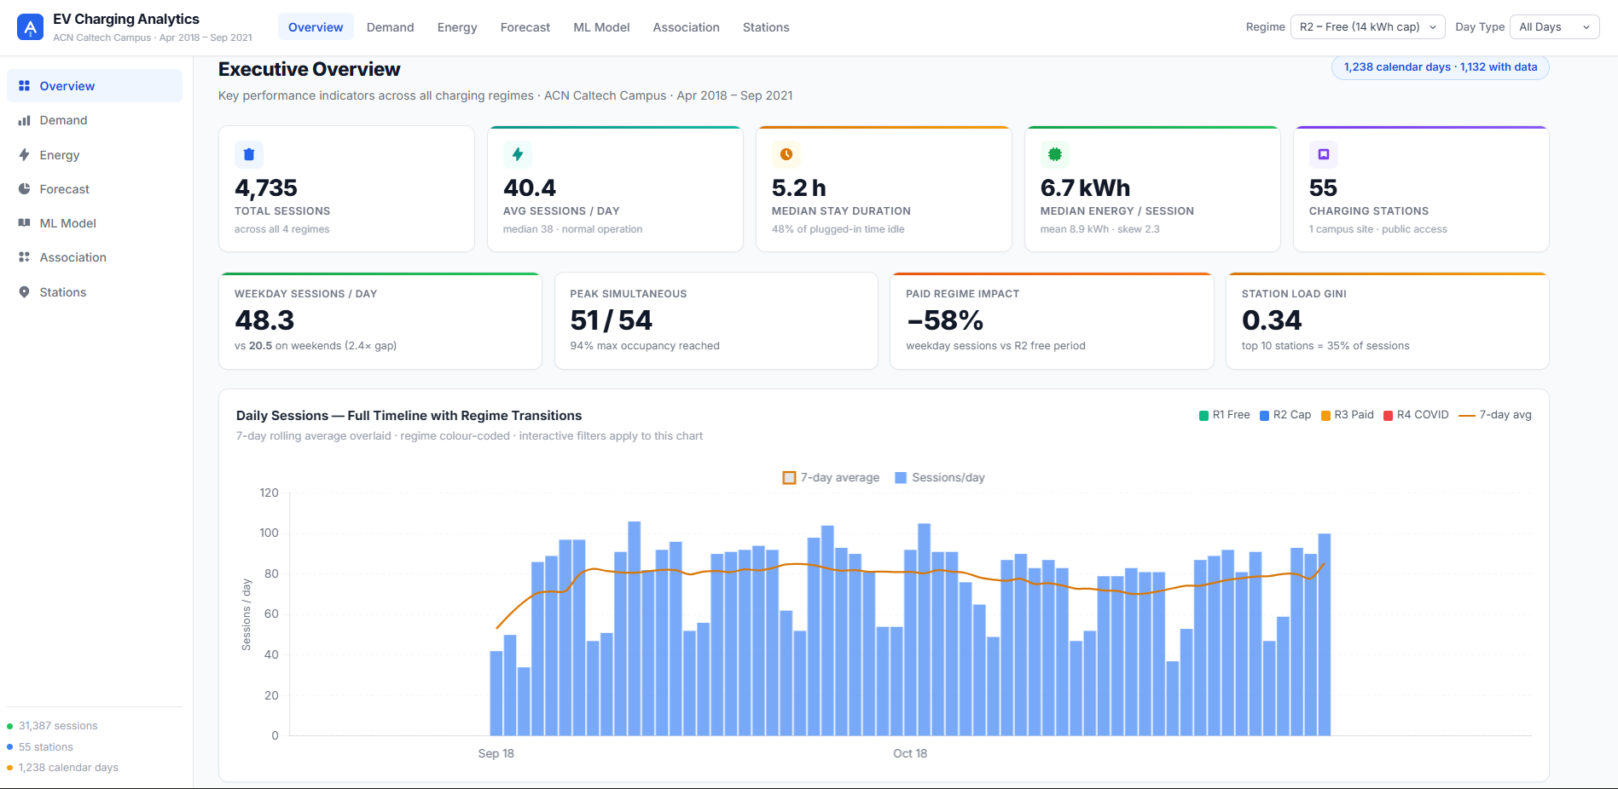
MANDATORY LIVE DEMONSTRATION
Interactive dashboard or website
Application: EV Charging Analytics, an interactive web dashboard built with HTML and Chart.js.
Live: https://evcharging-alpha.vercel.app/
Business scenario: "Now that charging is paid and demand is recovering, do we need more chargers?" Weekday demand fell 58% after pricing. The Forecast tab predicts 24.7 sessions/day (28.3 on weekdays) for the next 8 weeks, with a peak of about 21 vehicles at once, against 33 chargers in use and 55 installed. Answer: no new chargers are needed. Reactivate idle chargers as demand grows, and manage the 10:30–15:45 peak with idle-time rules.
15
Notes:
Suggested time: 120 seconds. Replace bracketed prompts with your project evidence. Present actual results only. Switch to the working application. Demonstrate meaningful interaction using the final project data and results. Show relevant findings from the complete project. A screenshot supports the presentation but does not replace the live demonstration. Test the application before the panel.

Slide 23
100% PROJECT IMPLEMENTATION
Completion and individual contribution
Team member | Completed responsibility | Evidence / project-board task
CB.SC.U4CSE23601 | Perform time-series charging-demand analysis and forecasting | https://github.com/M-Chandana/EV-Charging-Demand-Analytics/issues/16
CB.SC.U4CSE23228 | Evaluate and interpret time-series forecasts | https://github.com/M-Chandana/EV-Charging-Demand-Analytics/issues/17
CB.SC.U4CSE23612 | Build interactive EV charging analytics dashboard | https://github.com/M-Chandana/EV-Charging-Demand-Analytics/tree/main/.github
CB.SC.U4CSE23662 | Implement association rule mining for charging behavior | https://github.com/M-Chandana/EV-Charging-Demand-Analytics/issues/6
Repository / deliverables: https://github.com/M-Chandana/EV-Charging-Demand-Analytics
16
Notes:
Suggested time: 45 seconds. Replace bracketed prompts with your project evidence. Present actual results only. Delete the fifth member row for a four-member team. Confirm all Units 1–3 components, final evaluation and interactive application are complete. Use activity history and task evidence to support individual contribution.

Slide 24
FINAL PROJECT OUTCOME
Conclusion and limitations
Main outcome: End-to-end analysis of 31,387 sessions, with ML and SARIMAX forecasts, 295 behaviour rules, and a live dashboard.
Business value: No new chargers needed; manage the 10:30–15:45 peak with idle-time rules; pricing is the strongest demand lever.
Limitations: Single site, a 106-day data gap, narrow forecast ranges during growth, daily totals only.
Future scope: Live data refresh, hourly and per-station forecasts, weather and calendar inputs, a controlled idle-fee trial.
17
Notes:
Suggested time: 40 seconds. Replace bracketed prompts with your project evidence. Present actual results only. Core implementation must be complete. Future scope should describe extensions, not unfinished mandatory components. Keep detailed references, additional charts and code explanations in optional backup slides. Reserve panel questions for after the presentation.

Slide 25
Comparative Analysis
Limitation at last review | How it was fixed
Only 46% of the data, no full year | Complete collection (31,424 sessions, 2018–2021)
Test period crossed the switch to paid charging, which no feature could explain | Regime flags added; the series is split into regimes; the switch is now a separate stress test
Holidays caused large errors | Campus-closure calendar derived from the data, used by both ML and SARIMAX
Lags meant "k rows back", not "k days back" | Complete daily calendar; checks confirm lag_1 is the previous day
Possible leakage (same-day averages, whole-data station stats) | Every column labelled predictor / target / same_day_outcome; only predictors enter models
Weak baselines (global and weekday mean only) | Smarter baselines added: same weekday last week, and the 4-week same-weekday mean
Only next-day forecasts, no uncertainty | SARIMAX 8-week forecast with prediction intervals
106-day recording gap not handled | Gap marked as missing, not zero, and excluded from training

