Slide 1
EXECUTIVE PERSPECTIVE
Bootstrapping Benchmarks: Agent-Assisted Discovery of Implicit Ground Truth
01
Context
Keep knowledge persistent
02
Decision
Pressure-test the change
Executive Overview Deck
03
Execution
Commit to next actions

Slide 2
SECTION 01 - EXECUTIVE SUMMARY
01
Current benchmarks need harnesses that discover operational truth
Executive Summary: Problem vs. Solution
Signal
Implication
Benchmarks are foundational to
Benchmarks are foundational to model development
This white paper proposes
This white paper proposes a framework for
Rather than asking how
Rather than asking "how do we get humans to label
The framework introduces two
The framework introduces two core abstractions:
The Model Contract declaratively
The Model Contract declaratively specifies
Source: Bootstrapping Benchmarks > Executive Summary
2/16

Slide 3

SECTION 02 - DIAGNOSIS
02
Use source-grounded harnesses instead of synthetic benchmark shortcuts
Important context
Recommendations look
Teams cannot reproduce
Symptom: Important context disappears between handoffs. Better move: Persist context in a shared record.
Symptom: Recommendations look plausible before evidence is checked. Better move: Verify claims against the source.
Symptom: Teams cannot reproduce the reasoning behind decisions. Better move: Record decisions beside the workflow.
Source: Bootstrapping Benchmarks > Introduction; Bootstrapping Benchmarks > Why Not Simply Generate Synthetic Benchmarks?
3/16

Slide 4
SECTION 03 - REFERENCE SYSTEM
03
Harness-centric design turns existing workflows into evaluation evidence
OPERATING RULES
REFERENCE ARTIFACT
operating-rules.md
1
Artifact | Purpose | Update trigger.
# operating-rules.md
- Artifact | Purpose | Update trigger.
- Instead of looking | Instead of looking at using
- Connect the harness-centric | Connect the
- Make the harness-centric | Make the harness-centric
2
Instead of looking | Instead of looking at using models to try to create direct... | When conditions change.
3
Connect the harness-centric | Connect the harness-centric view to an explicit review gate. | When conditions
ARTIFACT
REVIEW GATE
UPDATE TRIGGER
OPERATING TEST
operating-rules.md
Evidence check
Material change
Make the harness-centric | Make the harness-centric view visible before execution
Source: Bootstrapping Benchmarks > The Harness-Centric View
4/16

Slide 5
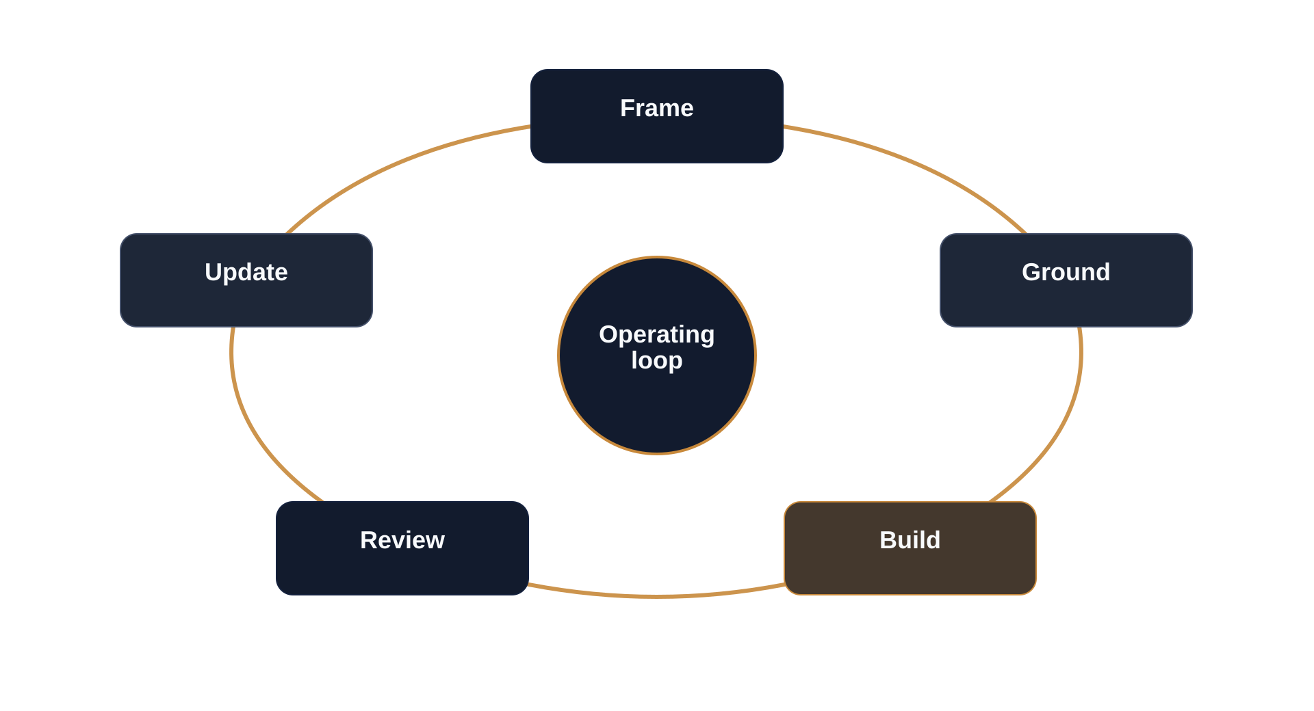
SECTION 03 / OPERATING MODEL
05
Direct synthetic benchmarks fail because they lack grounding in reality
Risks of Unvalidated Synthetic Data
Source: Bootstrapping Benchmarks > Why Not Simply Generate Synthetic Benchmarks?
5/16

Slide 6
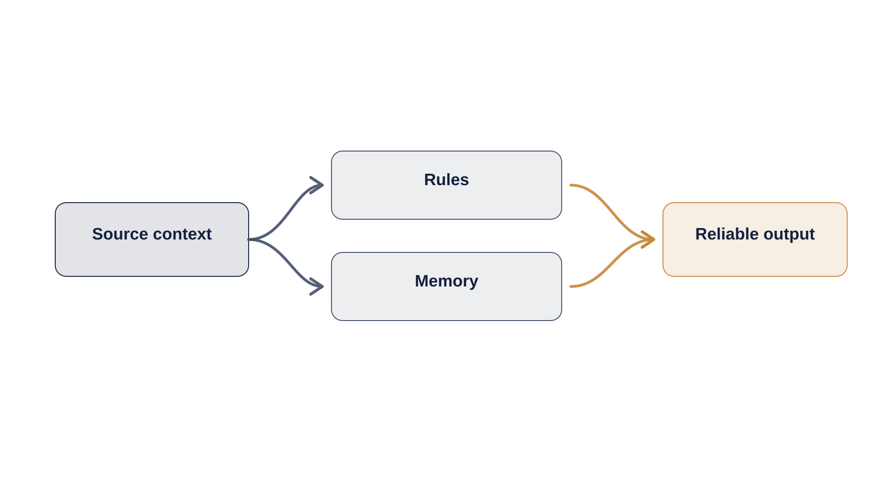
SECTION 04 - EVIDENCE
04
Implicit ground truth discovery turns existing evidence into benchmarks
Source: Bootstrapping Benchmarks > The Case for Implicit Ground Truth Discovery
6/16

Slide 7
SECTION 05 - OPERATING MODEL
05
Five harness layers connect contracts, data, execution, and review
Framework Architecture Overview
CURRENT STATE
TARGET STATE
COMPARISON LENS
The framework consists of
The framework consists of five primary layers
Convert the framework consists of five primary layers that work into an
4 shifts
Make the target model concrete by pairing each current behavior with the operating change.
Orchestration Layer
Orchestration Layer: Top-level agent that
Convert orchestration Layer: Top-level agent that reasons about which
Model Contract Registry A
Model Contract Registry: A repository of
Convert model Contract Registry: A repository of model contracts that
Unknown models have
Unknown models have contracts inferred by the
Convert unknown models have contracts inferred by the agent into an
Read left to right: what changes, what improves, and where the target model tightens control.
TARGET TEST
Every row should make the behavior change explicit enough to inspect or assign.
Source: Bootstrapping Benchmarks > Architecture Overview
7/16

Slide 8
SECTION 06 - EVIDENCE
06
Bootstrapping strategies leverage extractive generation from documents to create provably answerable test pairs
1
Name the decision and success criteria (Sponsor / Now)
THE NEXT MOVE
2
Assign evidence and review owners (Lead / Next)
Bootstrapping Strategy: Extractive Ground Truth.
3
Pilot the operating loop on one workflow (Team / Pilot)
4
Codify lessons before scaling (Owner / Scale)
Name the decision and success criteria.
Source: Bootstrapping Benchmarks > Bootstrapping Strategies
8/16

Slide 9
SECTION 07 - IMPLEMENTATION
07
Model contracts make evaluation expectations explicit
Model Contract Specification Checklist
Model Contract Specification Checklist
Source: Bootstrapping Benchmarks > The Model Contract; Bootstrapping Benchmarks > The Questions the Model Contract Must Answer
9/16

Slide 10

SECTION 08 - DECISION
08
Six contract questions keep every benchmark operational
Strategic Focus: Semantic Definition of Success
A model contract addresses six basic questions.
These questions apply regardless of whether the model predicts protein binding, classifies documents
What goes in?
The contract specifies not just the technical format of inputs but their semantic meaning
Source: Bootstrapping Benchmarks > The Questions the Model Contract Must Answer
10/16

Slide 11
SECTION 08 - DECISION
08
Harness interfaces standardize benchmark execution across domains
Contract vs. Harness: Declarative vs. Operational
Impact
High impact / high readiness
High impact / low readiness
While the Model Contract declares what should be evaluated and how success is
It's the operational counterpart to the Contract's declarative specification
Low impact / high readiness
Low impact / low readiness
The Harness Interface standardizes the benchmark lifecycle, ensuring that
As such the Harness Interface exists in a defined lifecycle with the
Readiness
Source: Bootstrapping Benchmarks > The Harness Interface
11/16

Slide 12

SECTION 09 - REFERENCE SYSTEM
09
Implicit ground truth discovery makes benchmark creation scalable
Operating Rules for Agent-Assisted Discovery
Frame the request with an explicit outcome.
Prime the agent with memory and constraints.
Generate bounded changes from the spec.
Review output before updating memory.
Source: Bootstrapping Benchmarks > Conclusion and Future Directions
12/16

Slide 13
SECTION 10 - EVIDENCE
10
Enterprise data catalogs make benchmark discovery scalable
Critical Future Work Areas for Scalability
Implication
Evidence
• Several areas warrant further development
• Data Catalog Integration.
• Production deployment requires robust interfaces to diverse enterprise data sources.
• Future work should address automated schema discovery, metadata extraction, and integration
Source: Bootstrapping Benchmarks > Future Directions
13/16

Slide 14
SECTION 11 - IMPLEMENTATION
11
Organizations must focus human judgment on defining success rather than manual data labeling
1
The proliferation of AI models across enterprise applications has outpaced the development of (Owner / Next)
THE NEXT MOVE
2
Organizations deploying models for consequential decisions need benchmarks that reflect their (Owner / Next)
Resource Allocation: Human vs. Agent Roles.
3
By shifting from manual benchmark creation to systematic discovery of implicit ground truth (Owner / Next)
4
The framework presented here provides conceptual foundations and architectural patterns for (Owner / Next)
5
Realizing its full potential will require continued development, organizational adoption, and (Owner / Next)
The proliferation of AI models across enterprise applications has outpaced the development of.
Source: Bootstrapping Benchmarks > Closing Remarks
14/16

Slide 15
SECTION 12 - EVIDENCE
12
Use real use-case benchmarks instead of generic public evaluations
Comparison: Generic Public Benchmarks vs. Proprietary Grounded Benchmarks
The proliferation of AI models across enterprise applications has outpaced the development of evaluation
Organizations deploying models for consequential decisions need benchmarks that reflect their actual use
By shifting from manual benchmark creation to systematic discovery of implicit ground truth
Source: Bootstrapping Benchmarks > Closing Remarks
15/16

Slide 16
SECTION 13 / FINAL DECISION
16
Shift leaders from manual labeling to systematic discovery
Closing Recommendation and Next Steps
RECOMMENDATION
1
Confirm the decision owner.
Adopt the operating model through a named pilot and review gate.
2
Run the first governed workflow.
3
Update the shared reference after each milestone.
DECISION ASK
Confirm ownership and timing.
Source: Bootstrapping Benchmarks > Closing Remarks
16/16

