Slide 1
ECT (Easy Consensus Tree)
Mateusz Chojnacki, Krzysztof Łukasz, Younginn Park and Daniel Zalewski
Architecture of large projects in bioinformatics 24L

Slide 2
Overview
Easy Consensus Tree allows the user to easily construct a whole-proteome consensus tree based on a specified list of species names.
It automates the workflow from downloading proteomes and clustering sequences to building individual cluster trees and generating a final consensus tree, ensuring a streamlined and efficient process.
The user-friendly setup makes it accessible even for those with minimal bioinformatics experience.

Slide 3
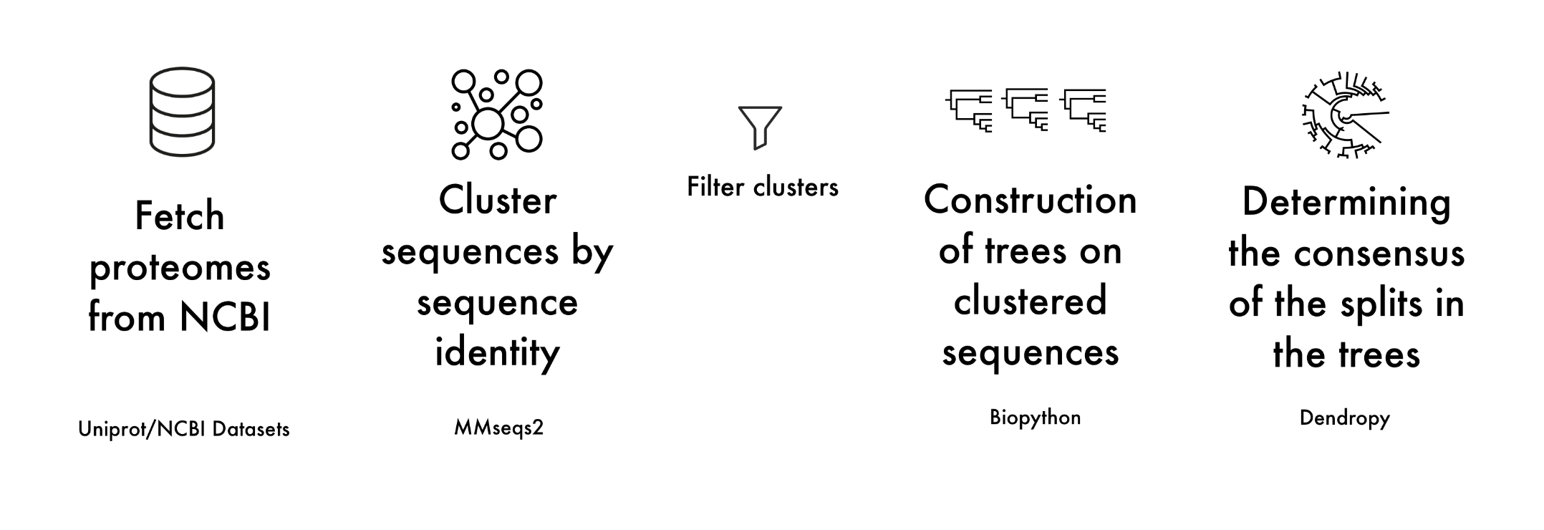
Workflow

Slide 4

Phylogenetic trees

Slide 5
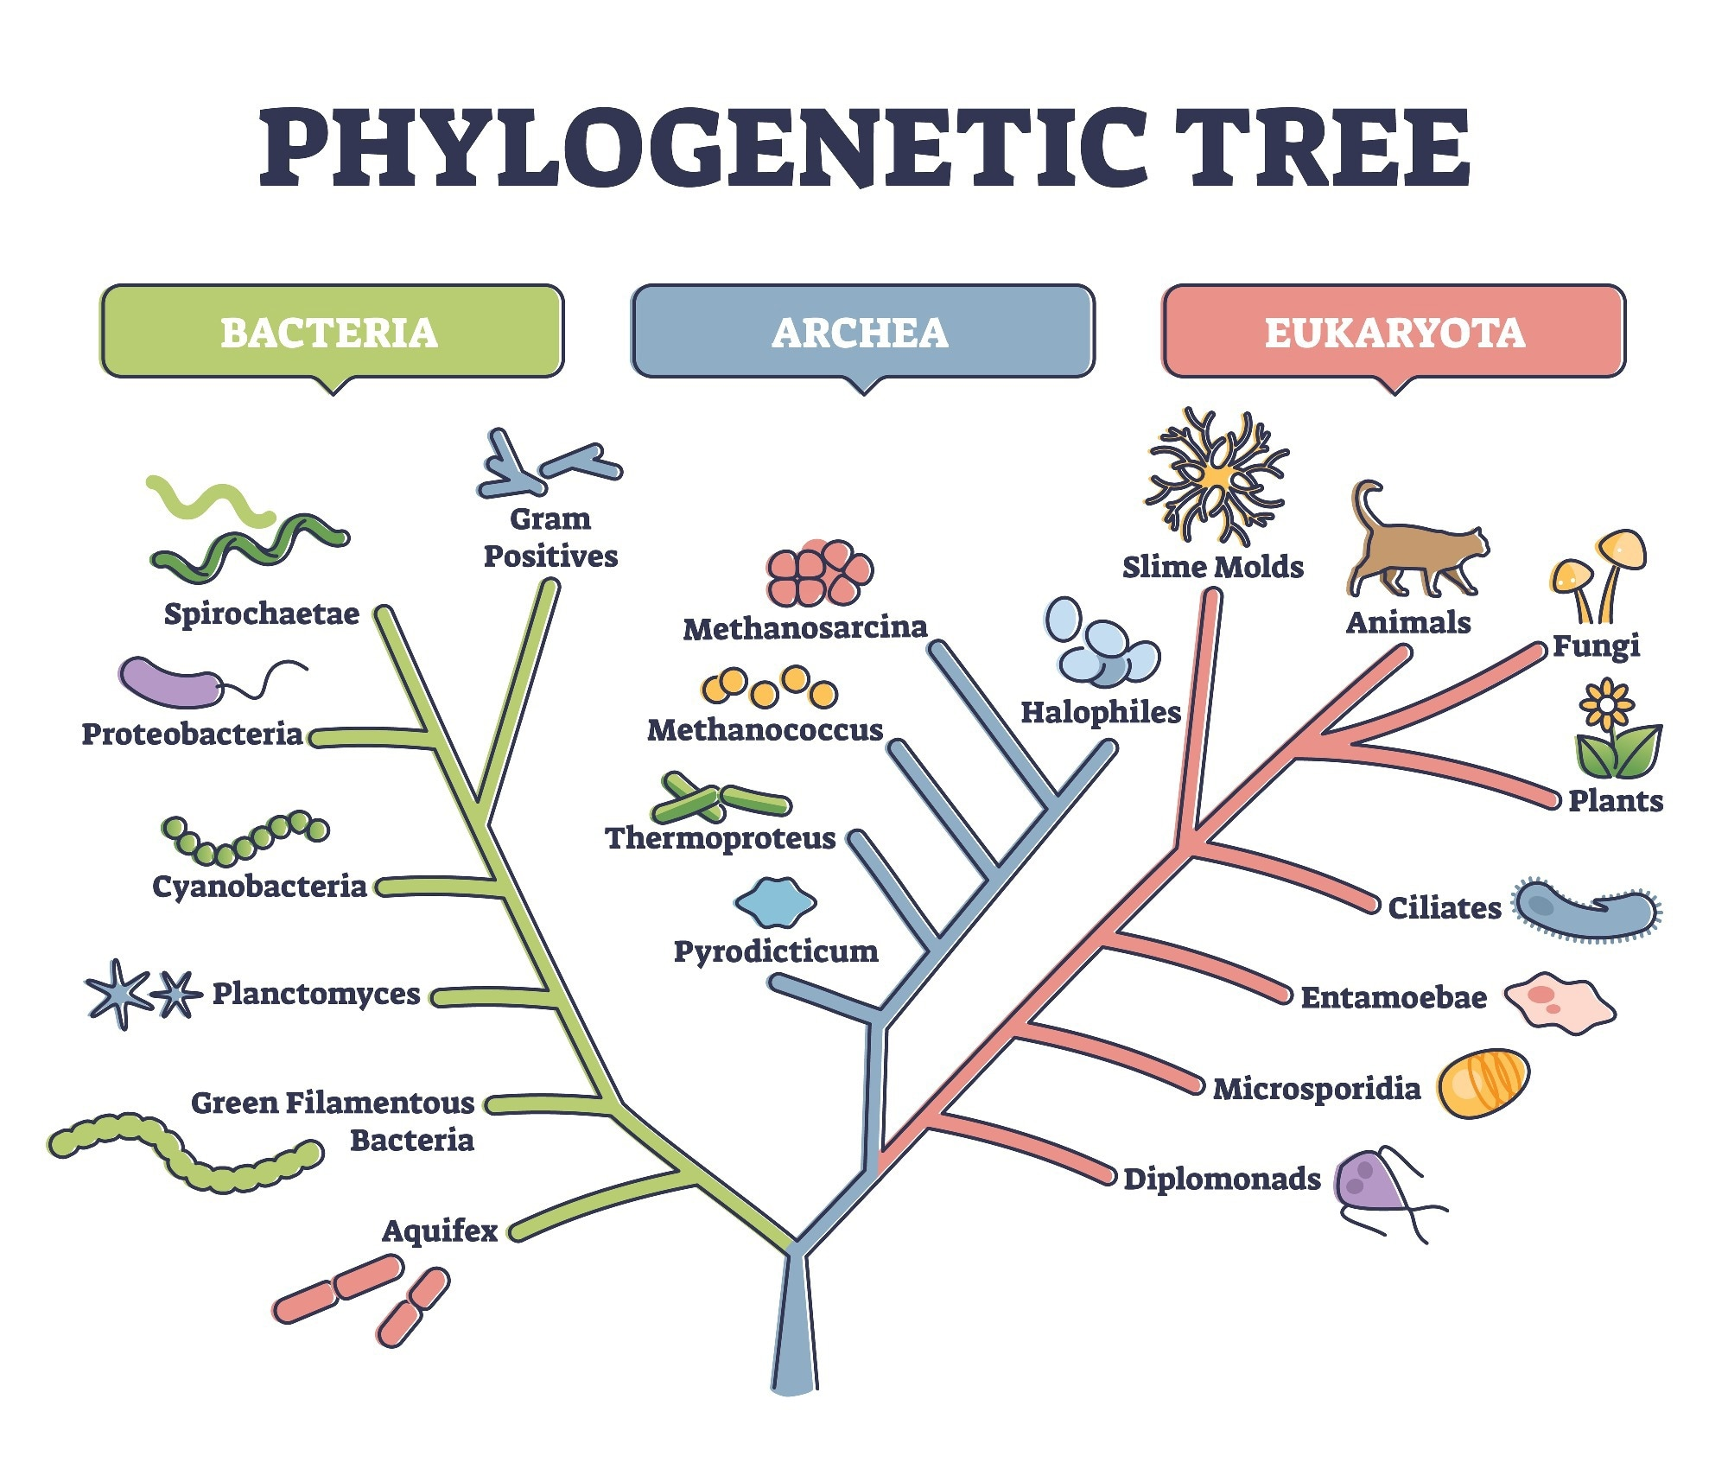
Constructing phylo trees: choosing a marker
16S rRNA
component of the small subunit of the ribosome in prokaryotes
both highly conserved regions and variable regions
Specific Genes (Single-Copy or Multi-Copy)
recA (DNA repair), gyrB (DNA gyrase), rpoB (RNA polymerase), or others
Multilocus Sequence Typing (MLST)
WHOLE PROTEOMES – our method

Slide 6
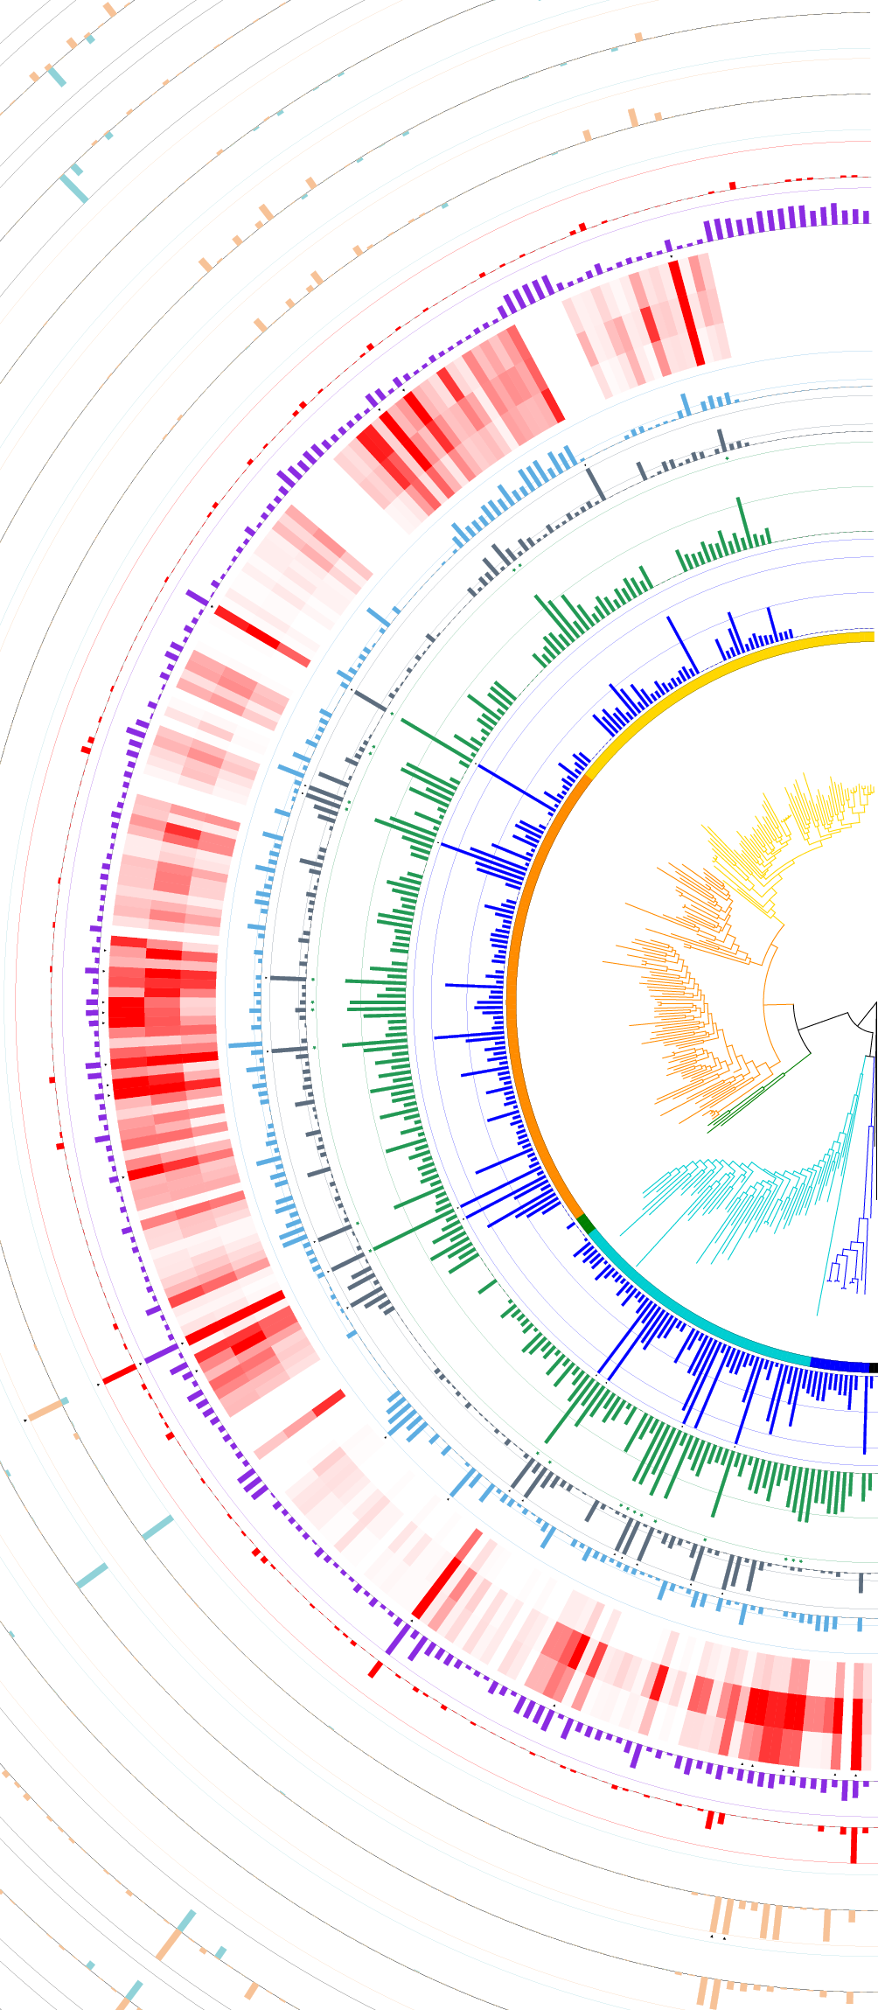
Constructing phylo trees: methods
Distance-based – lightweight and fast
Unweighted Pair Group Method with Arithmetic Mean (UPGMA)
Neighbor-Joining (NJ)
Character-Based – more reliable
Maximum parsimony (MP)
Maximum likelihood (ML)
Bayesian Inference

Slide 7
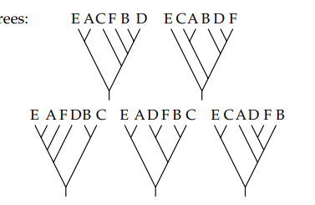
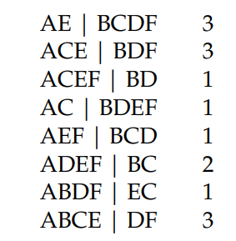
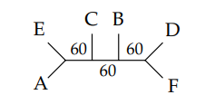
Consensus tree
Method of gathering information from multiple trees
The same set of taxa in every tree
Essentially, information from a set of multiple tree on one tree
Example:
proteomes -> set of many trees -> consensus

Slide 8

What we did
* panda unrelated

Slide 9
ECT integrates the following steps:
DOWNLOADING proteomes from Uniprot or NCBI
MERGING proteomes
CLUSTERING proteins using MMseq2 - easy-cluser
MULTIPLE SEQUENCE ALIGNMENT, using ClustalW, Muscle or Mafft
constructing NJ TREES using Biopython
constructing CONSENSUS TREE using DendroPy
simple VISUALIATION of the tree

Slide 10

Parameters
So many options
short flag | long flag | description
-i | --input | Text file with species names or taxonomy id in lines (default: species.txt)
-p | --minCons | Minimum support consensus for consensus tree construction; (default: 0.5)
-s | --msi | MMseq2 option: list matches above this sequence identity (range 0.0-1.0); (default: 0.3)
-l | --clusterMode | MMseq2 option: select clustering mode
-v | --covMode | MMseq2 option: sevuence coverage mode
-c | --cov | MMseq2 option: list matches above this fraction of aligned (covered) residues; (default: 0.800)
-m | --msa | Algorithm used to MSA (default: ClustalW)
-d | --description | Show help information of not-skipped subscripts
-r | --remove | Text file with species names or taxonomy id in lines to remove from local database and describing it taxon_library.csv file
-e | --step | Select step, from which you want to start script:

Slide 11
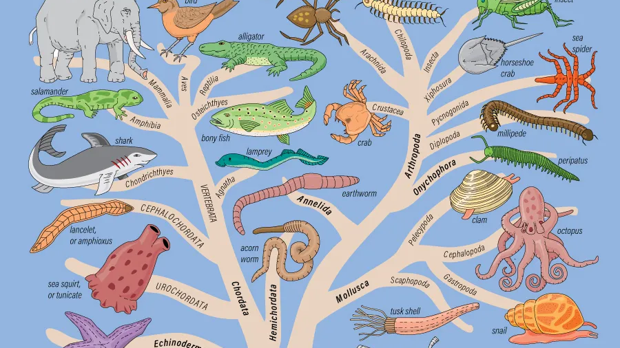
Examples

Slide 12

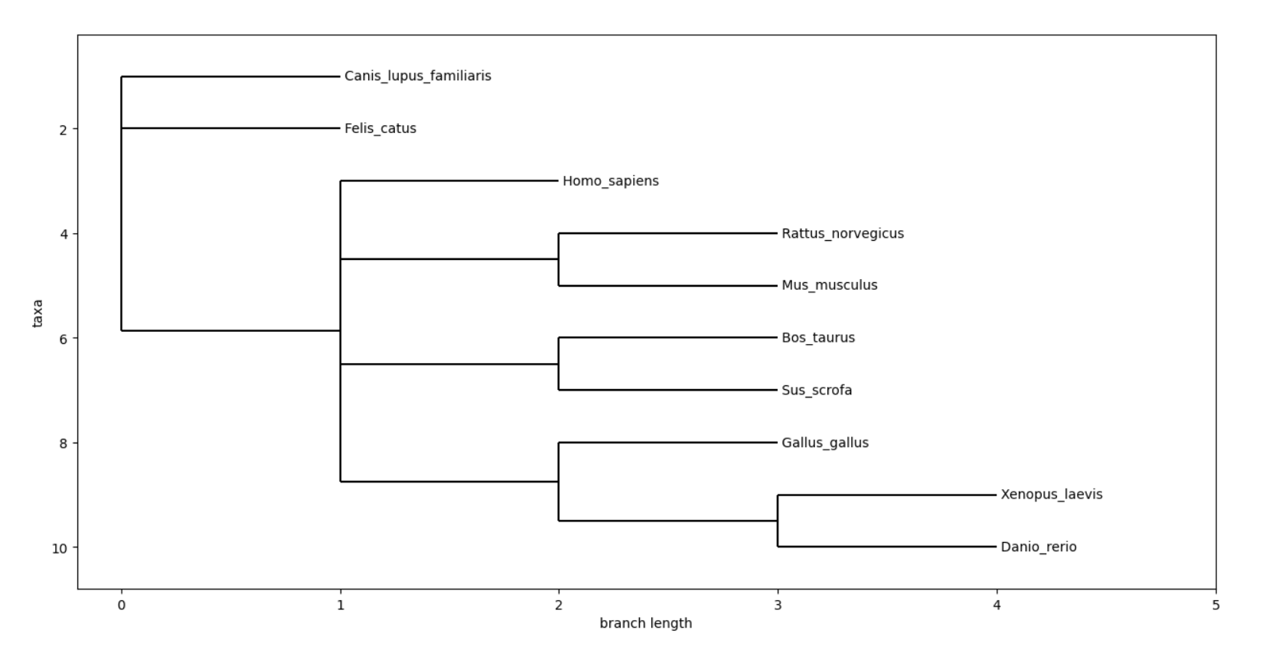

Simple test
INPUT
OUTPUT
Canis lupus
Felis catus
Xenopus laevis
Danio rerio
Bos taurus
Sus scrofa
Mus musculus
Rattus norvegicus

Slide 13
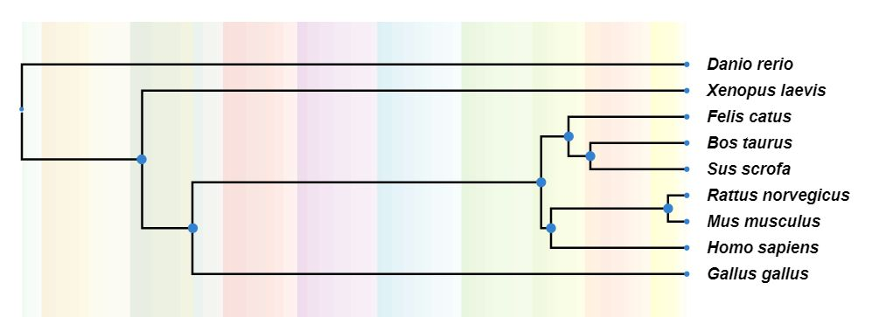
Robinson-Foulds : 2
Timetree.org
ECT ©

Slide 14
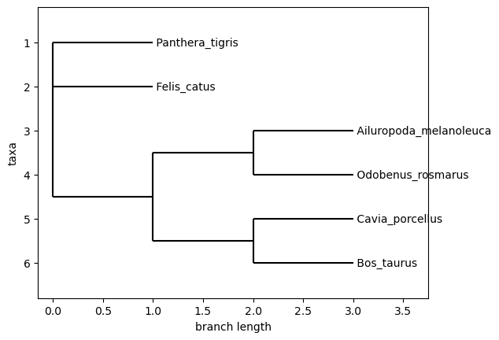
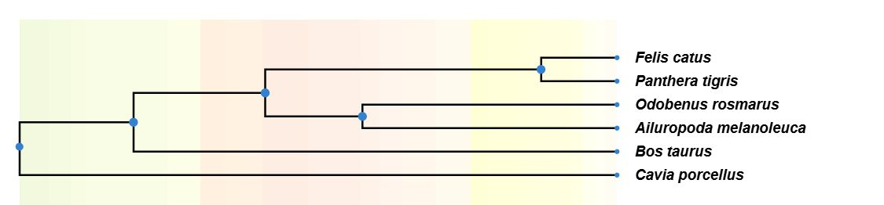
Robinson-Foulds : 0
Timetree.org
ECT ©

Slide 15
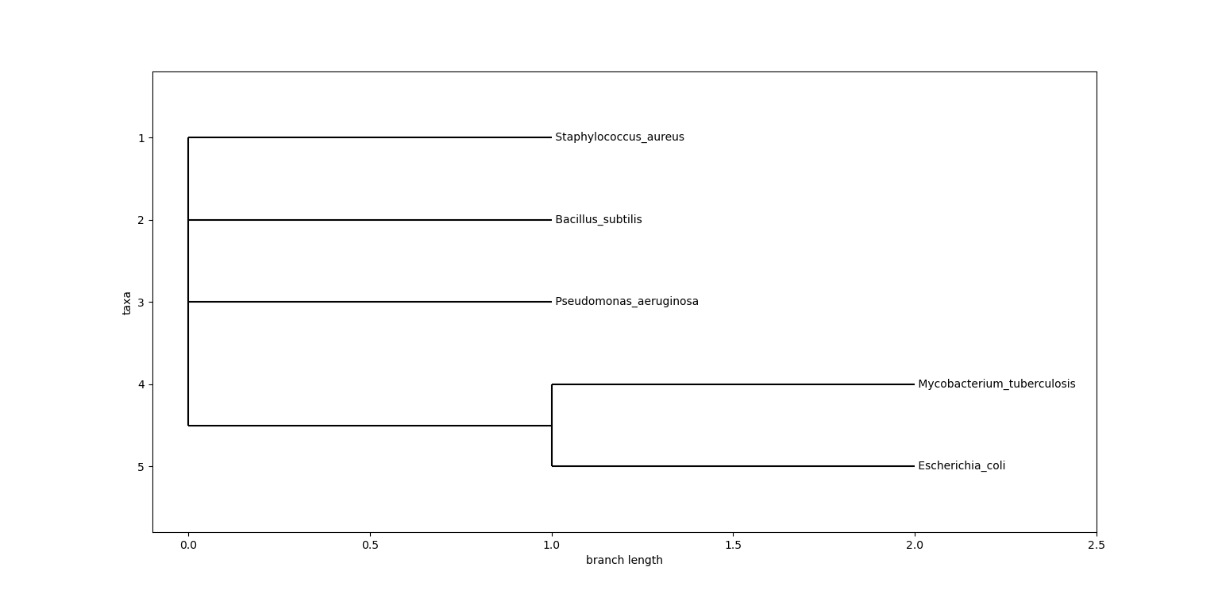
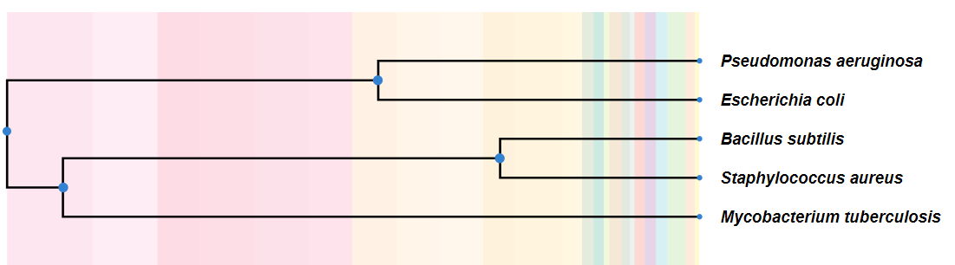
5 Bacteria names input
ECT ©
Timetree.org

Slide 16
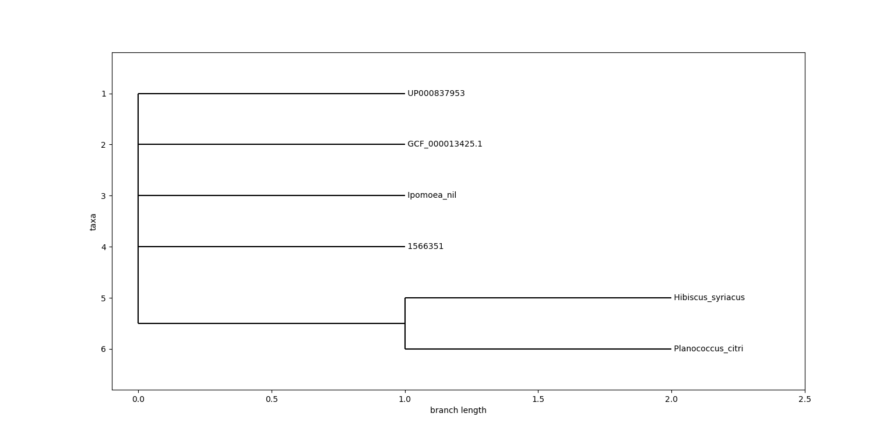
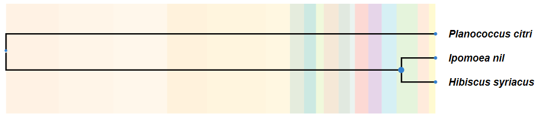
Names and IDs input
Timetree.org
ECT ©

Slide 17
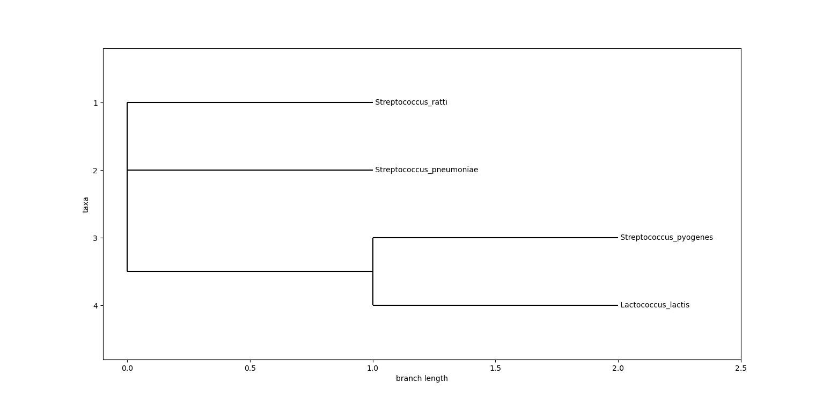
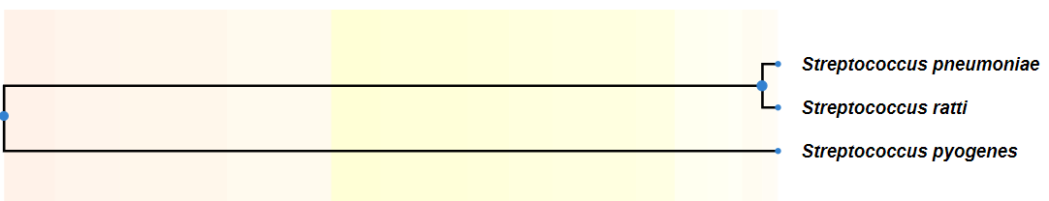
Streptococcus Family input
Timetree.org
ECT ©

Slide 18
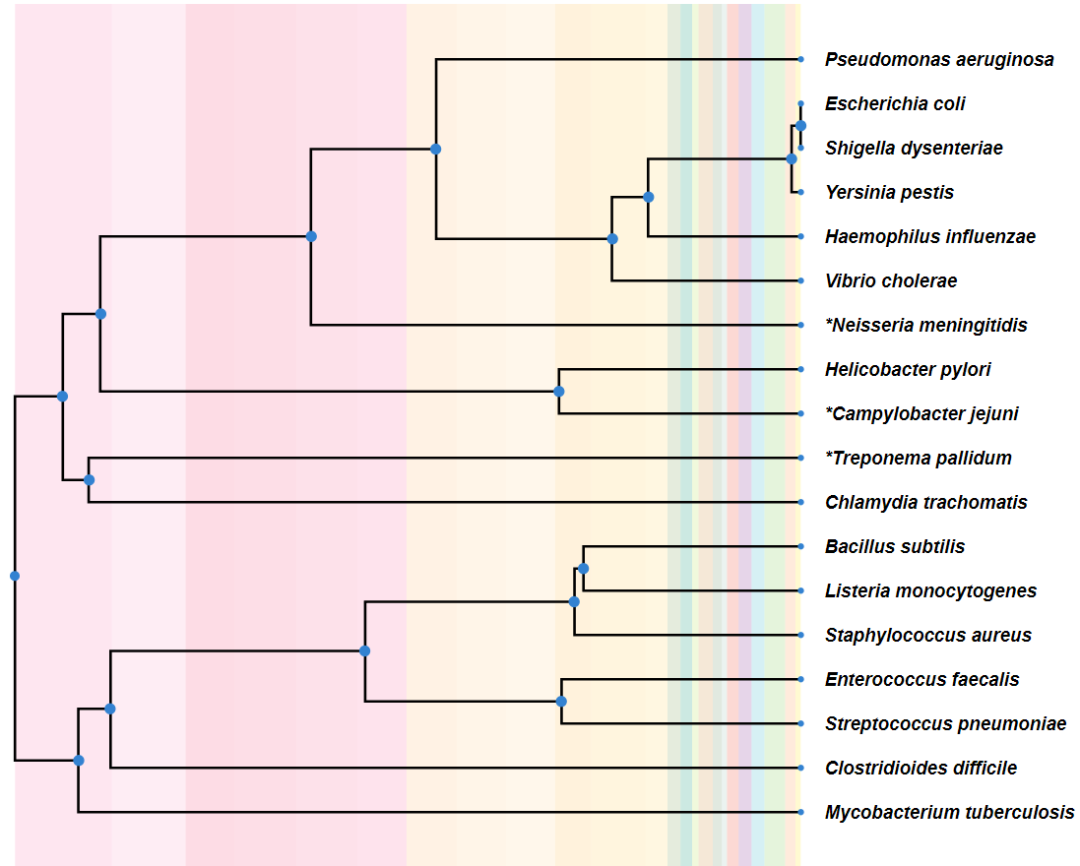
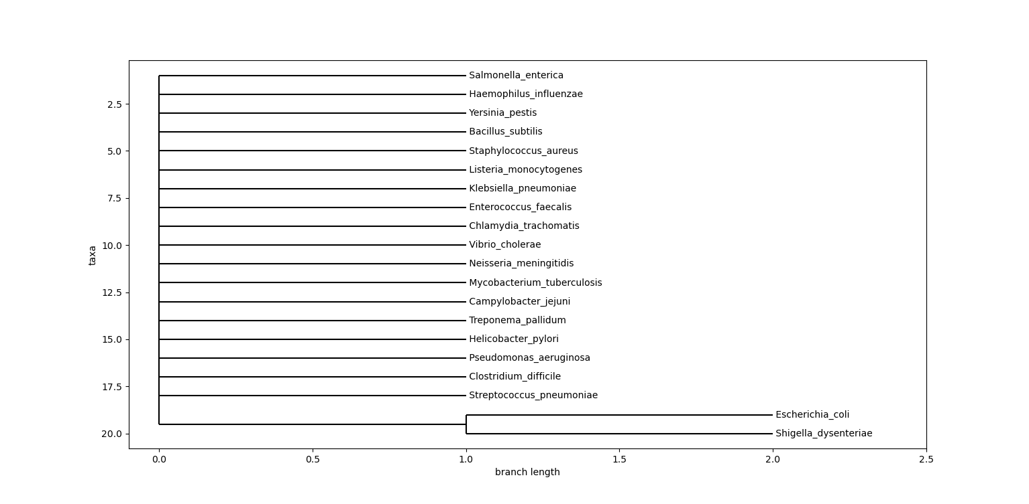
20 Bacteria input (deafult options)
Timetree.org
ECT ©

Slide 19
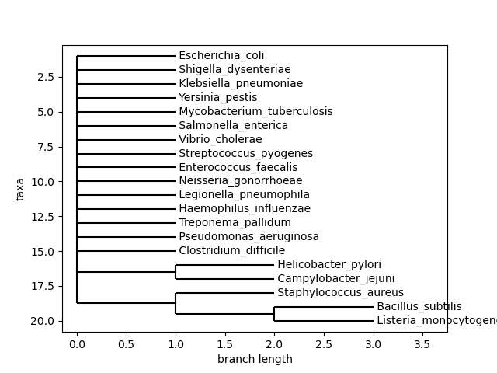
20 Bacteria input (-p 0.1)
Timetree.org
ECT ©

Slide 20
Speed tests
Input | Time (min)
Names of 5 Bacteria | ~5
Mixed IDs and names of 6 Bacteria | ~5
Names of 4 Streptococcus | ~5
Names of 20 Bacteria | ~27
Ńames of 10 Vertebrates | ~205

Slide 21
References
The UniProt Consortium, UniProt: the Universal Protein Knowledgebase in 2023, Nucleic Acids Research, Volume 51, Issue D1, 6 January 2023, Pages D523–D531, https://doi.org/10.1093/nar/gkac1052
NCBI Datasets, https://github.com/ncbi/datasets
Steinegger, M., Söding, J. Clustering huge protein sequence sets in linear time. Nat Commun 9, 2542 (2018). https://doi.org/10.1038/s41467-018-04964-5
Cock PJ, Antao T, Chang JT, Chapman BA, Cox CJ, Dalke A, et al. Biopython: freely available Python tools for computational molecular biology and bioinformatics. Bioinformatics. 2009;25(11):1422–3.
Moreno, M. A., Sukumaran, J., and M. T. Holder. 2024. DendroPy 5: a mature Python library for phylogenetic computing. arXiv preprint arXiv:2405.14120. https://doi.org/10.48550/arXiv.2405.14120
M.A. Larkin, G. Blackshields, N.P. Brown, R. Chenna, P.A. McGettigan, H. McWilliam, F. Valentin, I.M. Wallace, A. Wilm, R. Lopez, J.D. Thompson, T.J. Gibson, D.G. Higgins, Clustal W and Clustal X version 2.0, Bioinformatics, Volume 23, Issue 21, November 2007, Pages 2947–2948, https://doi.org/10.1093/bioinformatics/btm404
Kazutaka Katoh, Daron M. Standley, MAFFT Multiple Sequence Alignment Software Version 7: Improvements in Performance and Usability, Molecular Biology and Evolution, Volume 30, Issue 4, April 2013, Pages 772–780, https://doi.org/10.1093/molbev/mst010
Edgar, Robert C. (2004), MUSCLE: multiple sequence alignment with high accuracy and high throughput, Nucleic Acids Research 32(5), 1792-97.
Kumar S, Suleski M, Craig JM, Kasprowicz AE, Sanderford M, Li M, Stecher G, Hedges SB (2022) TimeTree 5: An Expanded Resource for Species Divergence Times. Mol Biol Evol doi.org/10.1093/molbev/msac174

Slide 22
Thank you
DISCLAIMER: We cannot guarantee that the resulting trees will accurately reflect the true relationships between species, especially if the provided species are distantly related. ☺

