Slide 1
Hungry li'l Lith
An HTML-5 Canvas Game!
By Marcus Elliott

Slide 2
Why Hungry li'l Lith?
Philosophized about time travel
Made 'Castle of the Python' in Pygame
Avid lifetime VG player
Have great VG ideas, now gaining skill to implement

Slide 3
What is a
'Monolith Logic'
Mechanism?
a hypothetical method
to create a galactic star map!

Slide 4
'Monolith Logic' steps:
Build interstellar Biomechanical device
Device travels to nearest moon or planet
Device sends celestial data back to central node.
Device makes thousands of copies of itself
Copies repeat from step 2

Slide 5
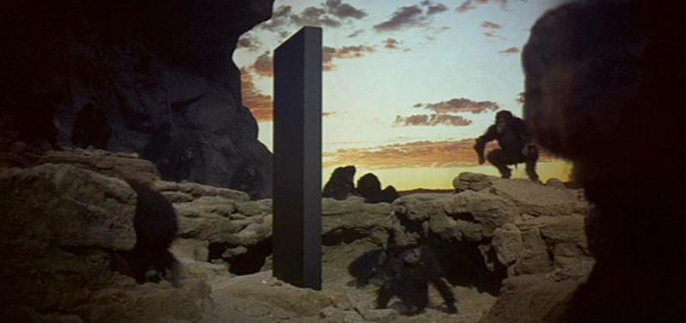
Benevolent ?
Benign? Only Stanley Kubrick knows!

Slide 6
What does a malignant 'Monolith Logic' Mechanism
look like?

Slide 7



Slide 8
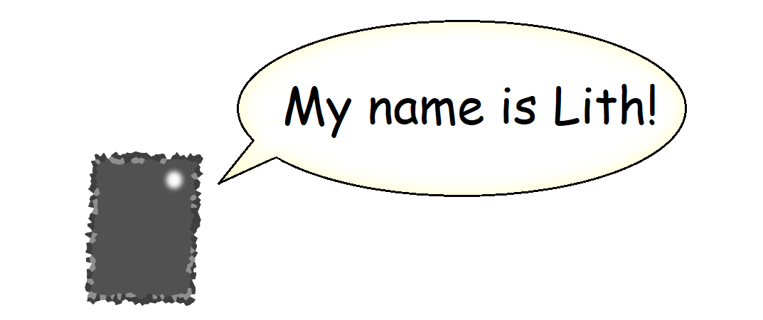

Slide 9
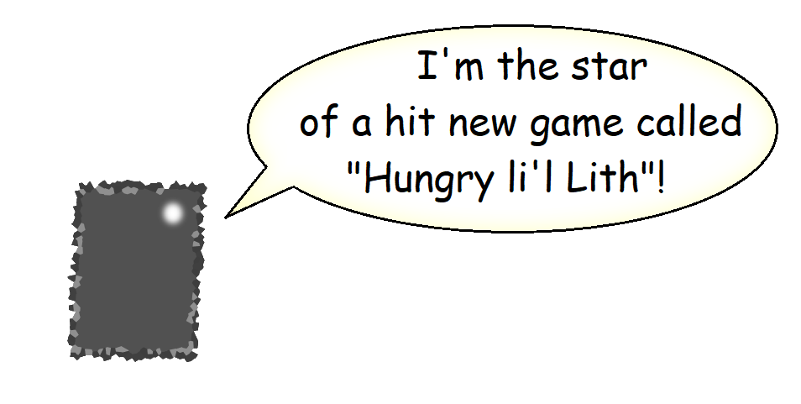

Slide 10
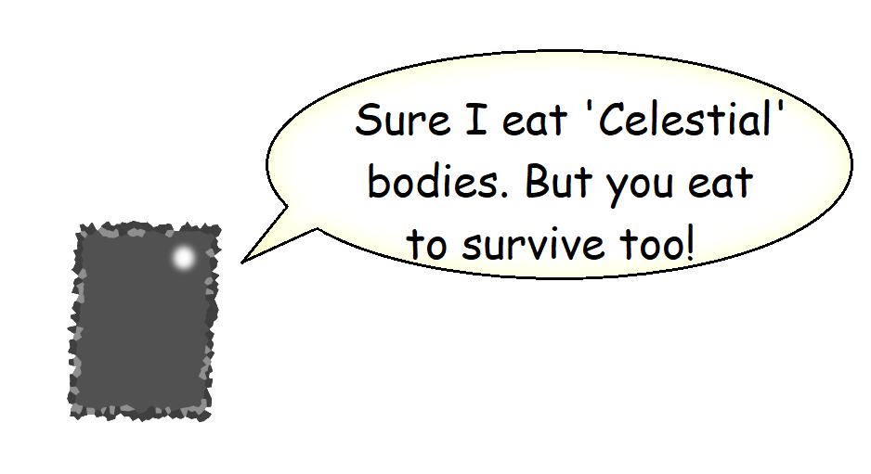

Slide 11
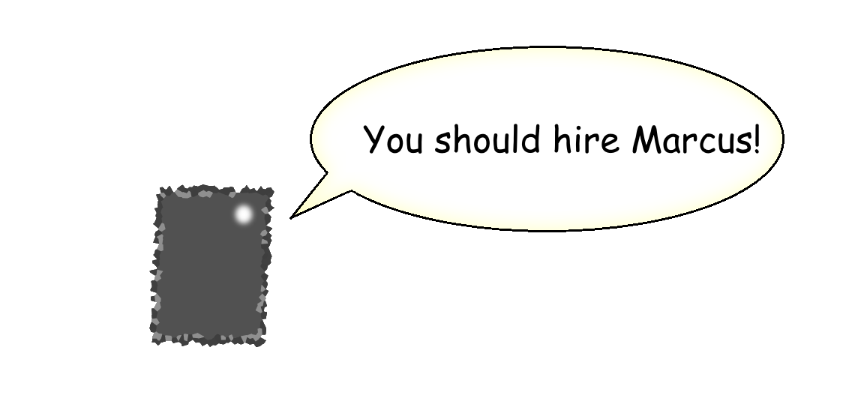

Slide 12
How H.l.L. was made:
Game:
HTML 5 Canvas + Vanilla JavaScript + CSS
Backend:
Java
Spring with Spring Security
Thymeleaf with Thymeleaf Extras
JPA and MySql plugins
Bootstrap is used for site presentation only.

Slide 13
My Process
Build numerous components
See where components work / don't work
Build subcomponents
Connect components / subcomponents
Refactor / Normalize

Slide 14
Notable Evolvement:
View-Loop system
function systemLoop() {
currentView.updateAndRender();
inputListener.update();
window.requestAnimationFrame(systemLoop);
}
function setGameView(data, gameView) {
switch (gameView) {
default:
case GameView.MAIN_MENU:
return function () { mainMenu(data); };
case GameView.PLAY:
return function () { play(data); };
case GameView.PAUSED:
return function () { pause(data); };
}

Slide 15
Known bugs
Scores can be resubmitted indefinitely
Lith touch/mouse pathfinding shake
Not logged in prohibited sign *fixed?
Maximum score is always the same
Too easy

Slide 16
Where to go?
Formations (sine wave, square wave, triangle wave, etc.)
Optimize spawn rate / level transition text / 'Celestial' scaling
Add level transition animations using current system's functions
Upgrades after each level
Infinite progression
'Dive' mode.

Slide 17
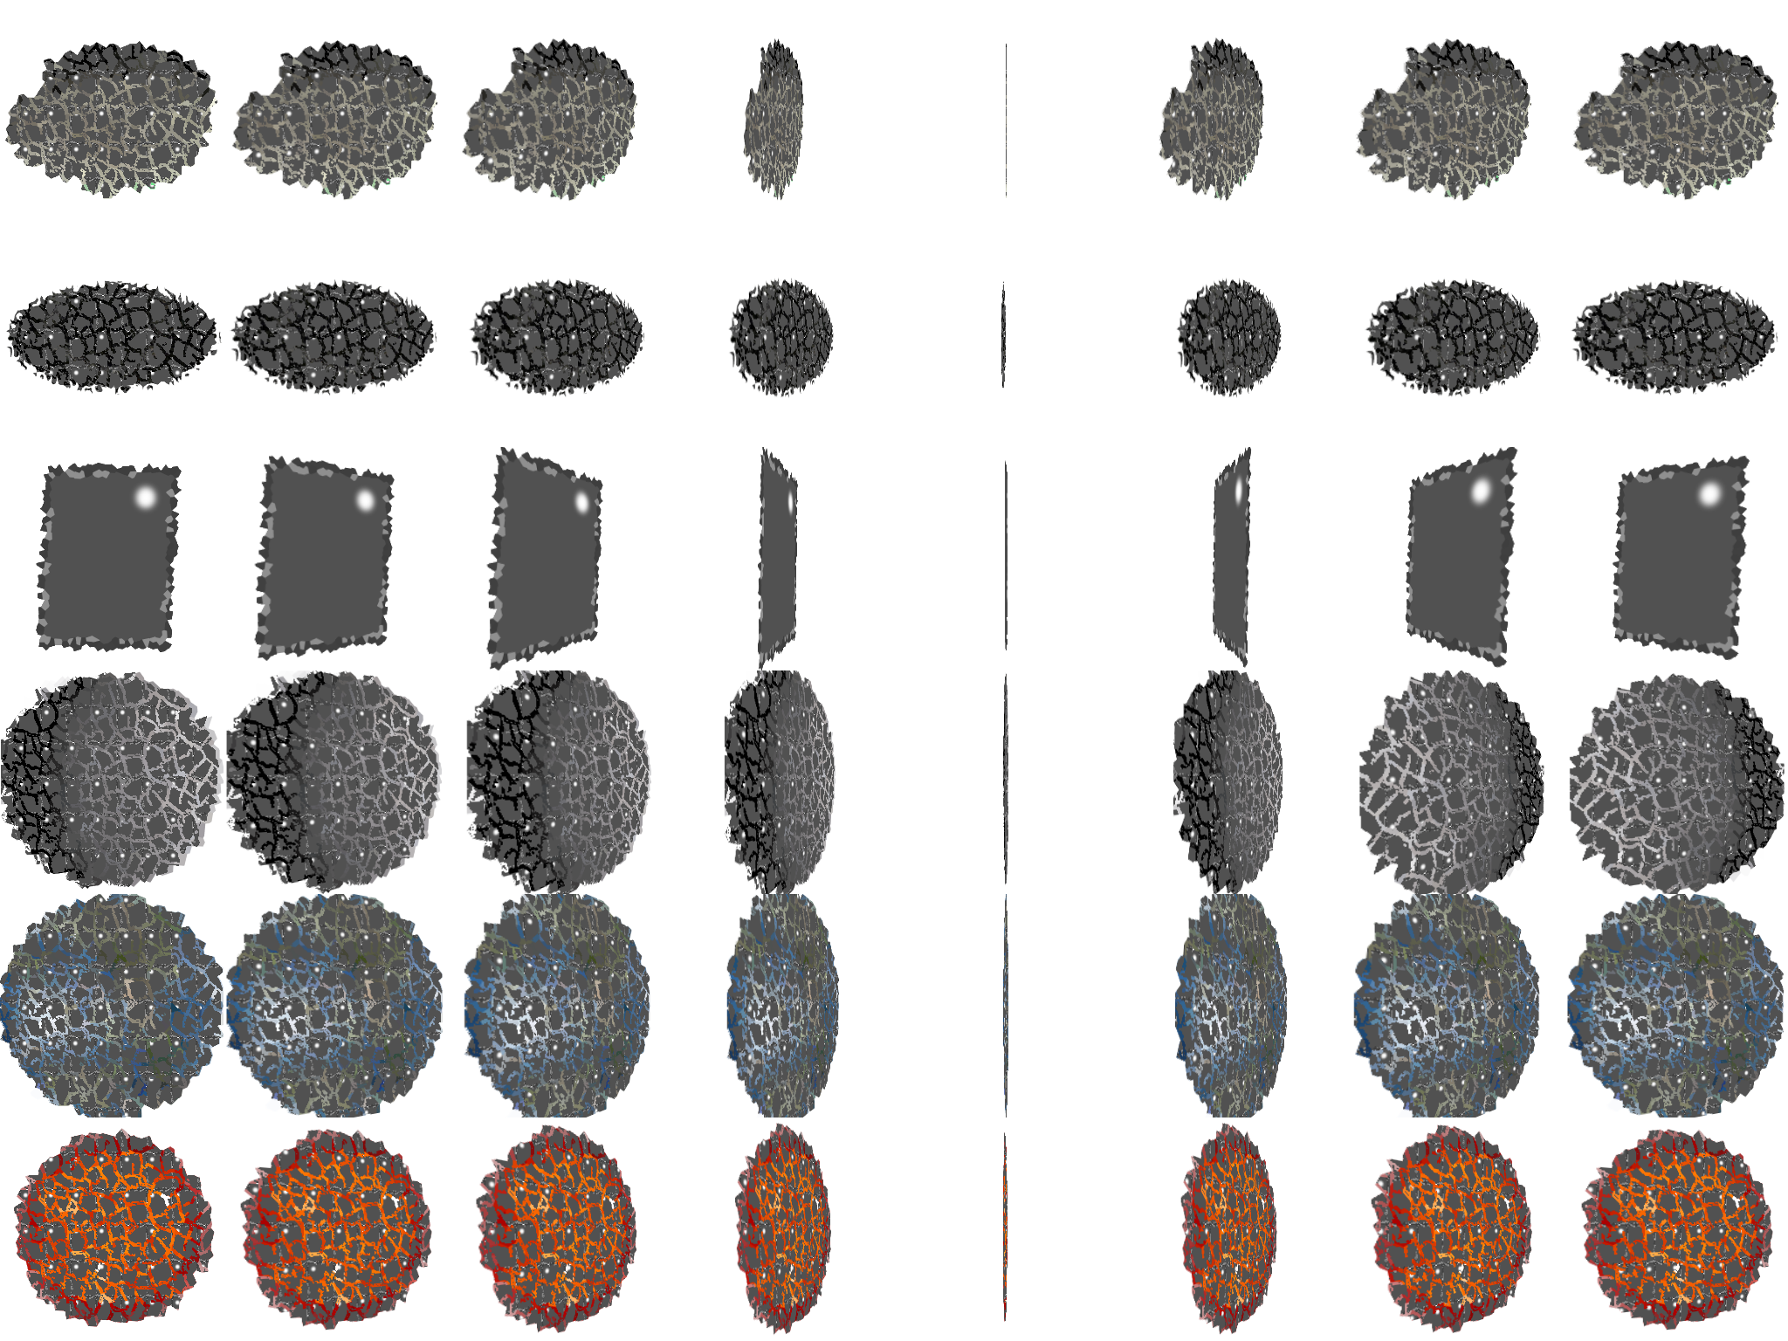
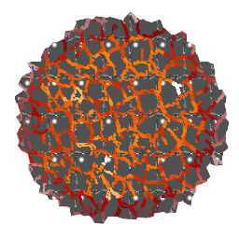
Optimizations needed
Grunt file wouldn't work!
Spritesheets in canvas?
Cross-browser support
Messed up my flipping process

Slide 18
Credits
Big thank you to Genesis 10 for this amazing opportunity!
Thank you to the Software Guild!
Thank you to my cohort peers for making this program feasible!
Thank you to Jerome Pullen for 'Flutter'
A huge thank you to my instructor Corbin March!

