Slide 1
Exercise form validator
Smarter Therapy, One Move at a Time.

Slide 2
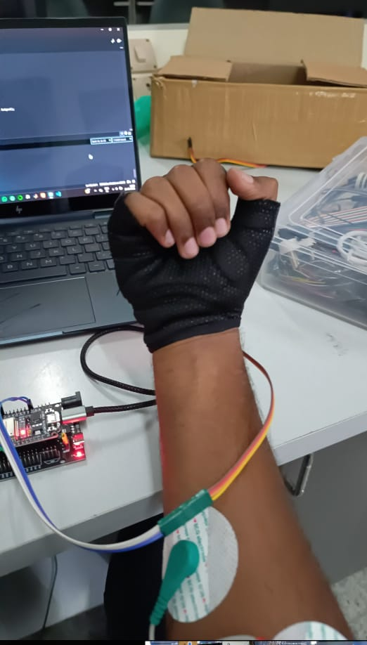
THE WHY?
Physiotherapy and guided exercise programs rely heavily on correct movement patterns to ensure recovery, prevent re-injury, and improve performance. However, continuous monitoring by practitioners is often impractical, leaving patients vulnerable to poor form and ineffective outcomes. Kinesis addresses this gap by introducing a compact, wearable, edge-AI powered prototype that validates exercise performance in real time.
Notes:
add pic that shows data analysis

Slide 3
01.
Focuses on Metrics,
Not Technique
Current drawbacks
02.
Generic Programming
03.
No Real-Time
Injury Prevention

Slide 4
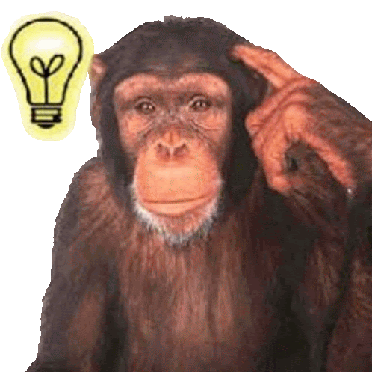
The IDEA
The device integrates Electromyography (EMG) sensors and an Inertial Measurement Unit (IMU) to capture both muscle activation and limb orientation during wrist curl exercises.
Data is processed locally on an ESP32 microcontroller running an Edge Impulse machine learning model to classify movements into four categories: good form, bad form, rest, and uncertainty.
Real-time feedback is delivered, enabling users to self-correct without practitioner supervision.

Slide 5
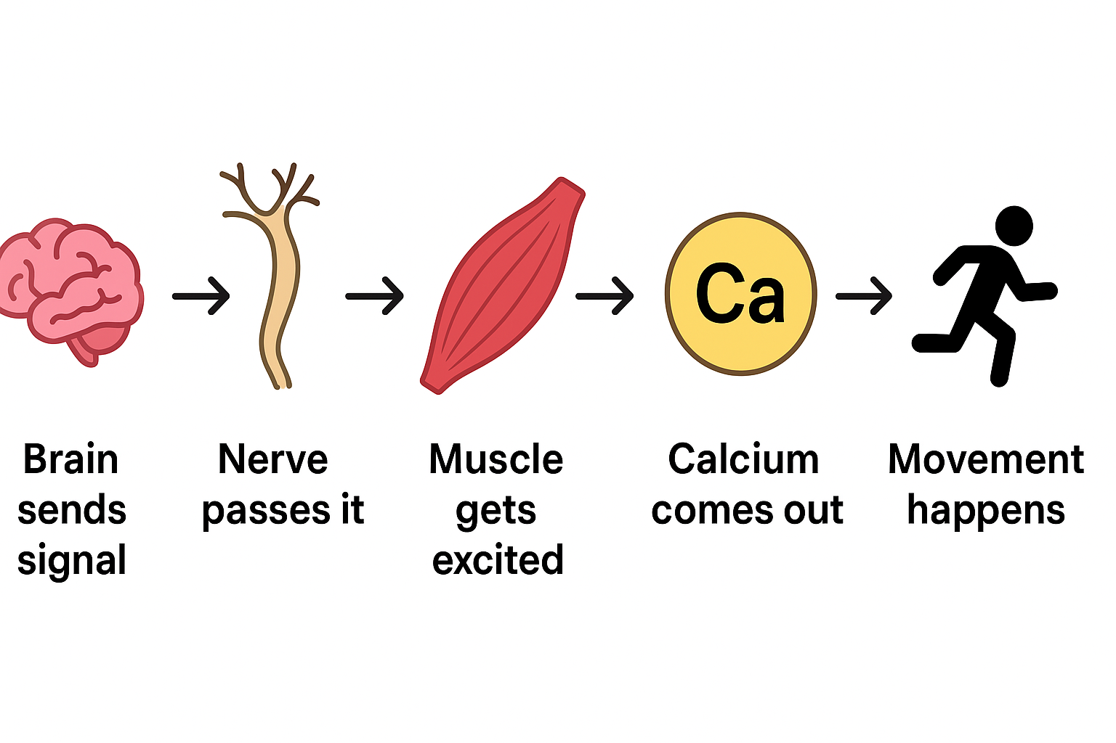
Principle of Working

Slide 6
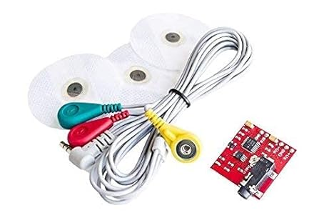
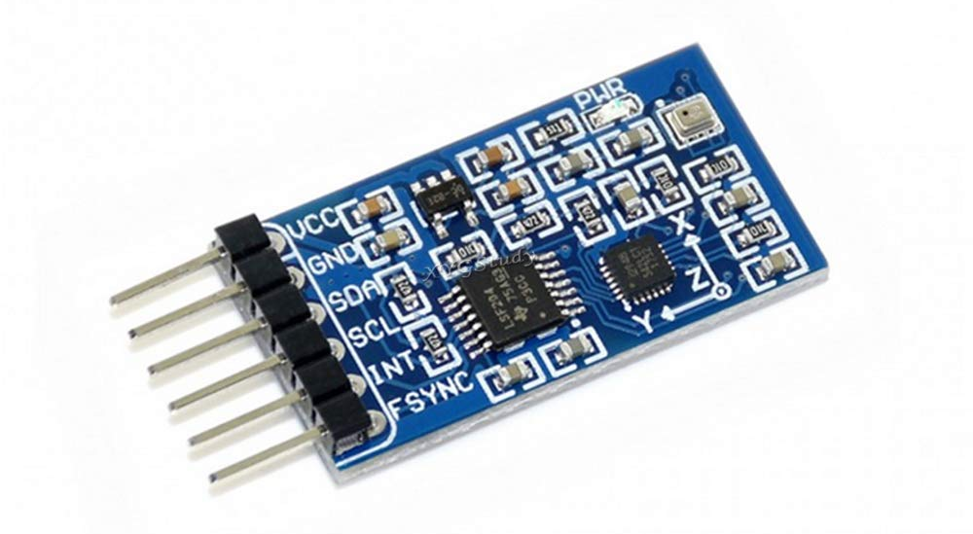
SENSORS
EMG Sensor
IMU Sensor
Measures the electrical activity of muscles when they contract.
Tracks motion, orientation, and acceleration of body parts.
Notes:
emg sensors
imu sensors

Slide 7
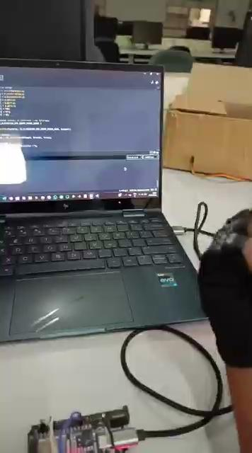
DEMO:

Slide 8
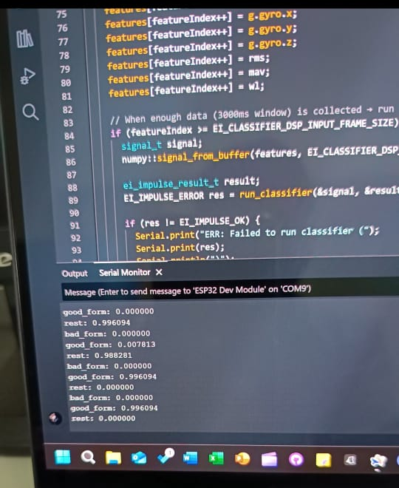
Display
Based on hand movement, the display shows the probability of if it is a good form, bad form, or if the hand is at rest.

Slide 9




Sustainable Development Goals

Slide 10
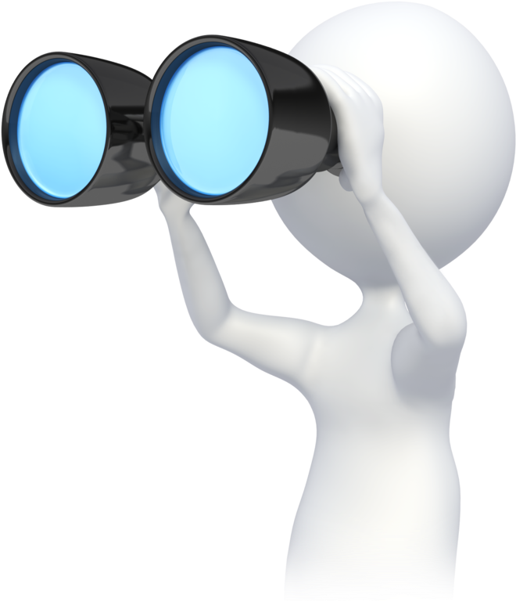
We would like to expand our vision to a full fledged smart clothing that tracks the posture and movement of all body parts
Visual and Augmented Reality can also be included to increase engagement and effectiveness of the user experience.
Add a main point
The system can also be available for general consumer use to correct postures before they lead to chronic pain
Future Scopes
Add a main point
Briefly elaborate on what you want to discuss.

Slide 11
Thank you!

