Slide 1
TRON PROGRAMMING CONTEST 2026 · RTOS APPLICATION
MedSight
An offline medication dispenser and adherence recorder.
Most dispensers release pills and assume the rest. This one measures who took them and how many came out.
21-55%
69.5%
1 in 6
Non-adherence among older patients on long-term medication. Amato et al., 2026; Scotti et al., 2026, across 128 studies.
Of 256 residents across 55 care homes had at least one medication error, a mean of 1.9 each, taking 8.0 medicines each. Barber et al., 2009.
People worldwide will be 60 or over by 2030, and that population doubles to 2.1 billion by 2050. WHO, 2025.
Entry 54916 · Dousik Manokaran · github.com/M-DOUSIK/MedSight

Slide 2
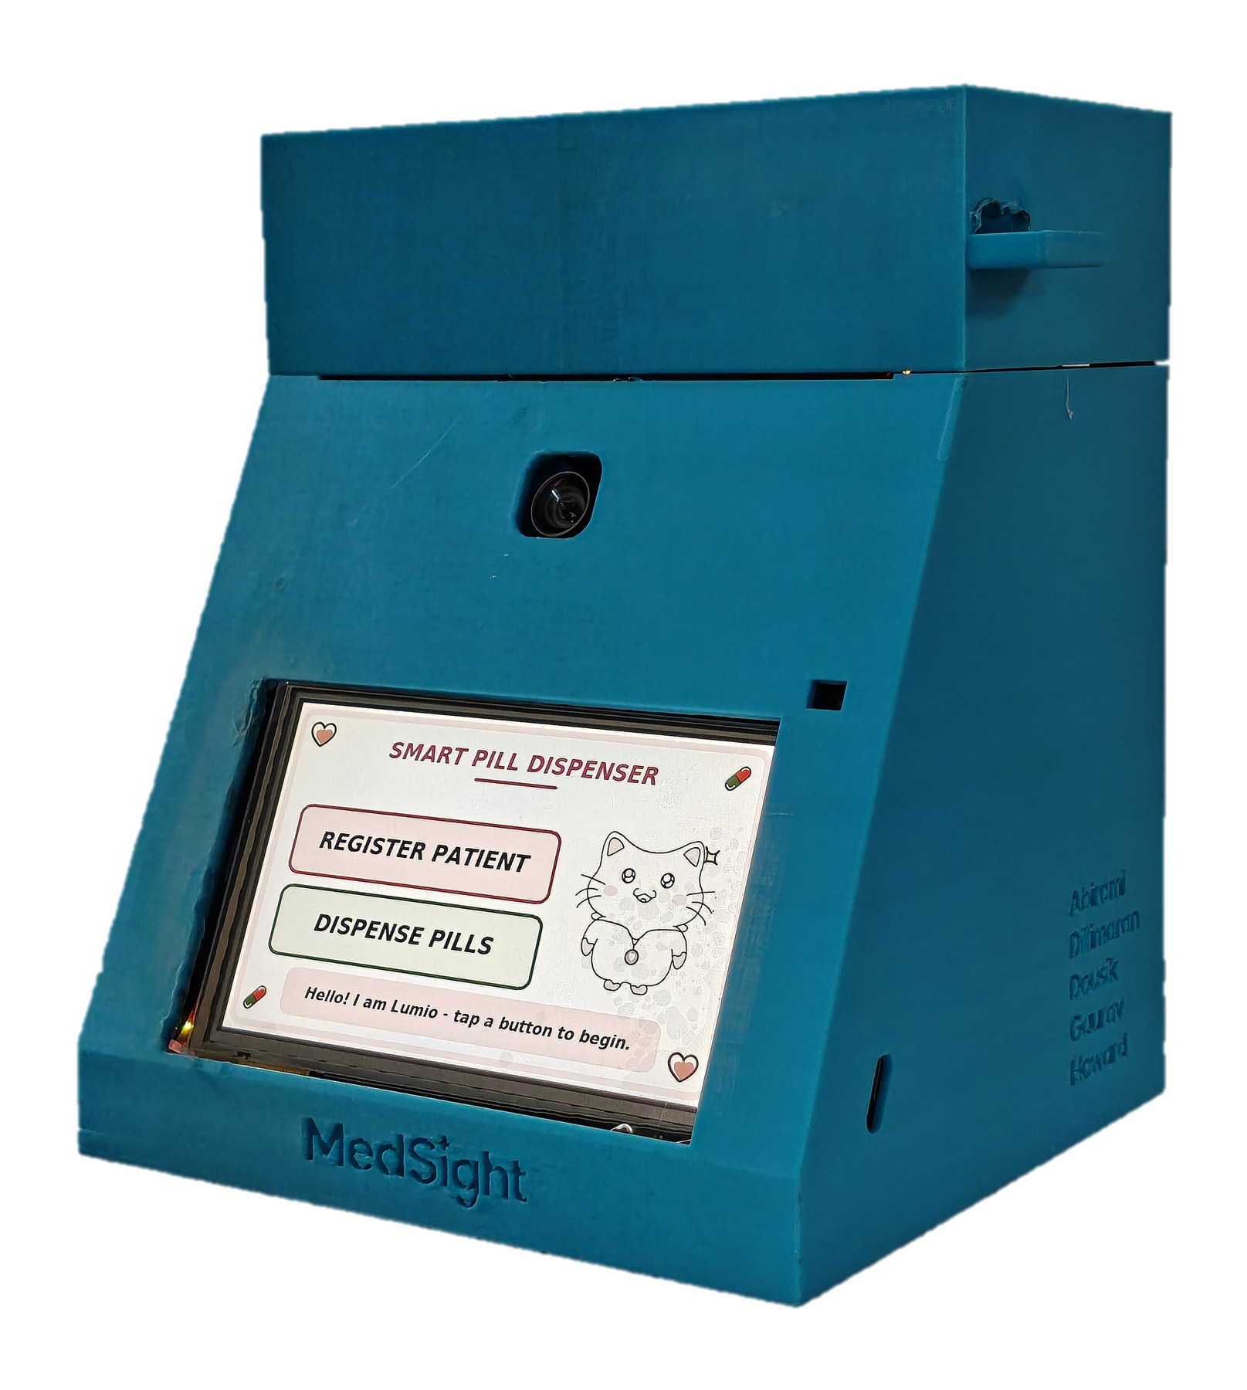
SYSTEM OVERVIEW
Single enrolment, then autonomous schedule execution
Identifies the patient by face, on the board, in 209 ms. The unit is shared; the schedule it applies is theirs.
Signals the dose window when the scheduler's alarm handler fires.
Drives a stepper turntable and counts each pill by the infrared sensor it passes in the chute.
Runs action recognition over the confirmation window, then requires the patient's own confirmation.
One device, many patients.
Each is known by face and carries their own schedule, up to four dose times a day.
Appends an audit record to the local card once the outcome is known.
2

Slide 3
DOSE SEQUENCE
Five stages, with the count taken from a sensor readout
01
The window opens
A µT-Kernel alarm handler fires once. The home screen names the patient; three short beeps.
02
Identification
CenterFace detects the face, MobileFaceNet embeds it, cosine match against the gallery. 209 ms.
03
Dispense
The turntable turns. Each pill passes the infrared sensor on the way down the chute: 17-46 ms.
04
Counted, not timed
With the mechanism attached the bar advances on each sensor pulse. The timed animation exists only in the simulation build, where there is no sensor to read.
05
Confirmation
Action recognition observes the window; the patient's button press remains the confirming action. One record to the card.
The log is written once, after the outcome is known: DISPENSE: <patient> <n> requested, <m> counted (OK). Never two claims about one event.
05

Slide 4
TASK ARCHITECTURE
Six tasks, with priorities derived rate-monotonically
PRI
TASK
PERIOD
WHY IT SITS THERE
5
Camera and ISP
1 ms
The only task tied to external hardware timing: it consumes each frame's statistics before the next arrives, about every 33 ms.
4
User interface
10 ms
A 10 ms poll and a 4 fps animation gate, an order of magnitude inside the roughly 100 ms at which input lag becomes noticeable.
3
AI
on demand
No deadline. Below the interface deliberately, so inference stays preemptible, which is what keeps touch alive during a capture.
2
SD logger
event-driven
Tolerates seconds of latency by construction. The asynchronous queue is why no caller ever waits on a 10 to 50 ms card write.
1
Heartbeat
500 ms
Lowest deliberately, so that a stopped LED means something above it is starving the system, which is the signal it should carry.
1
Alert
event-driven
Shares the lowest level: a buzzer that delays the camera task to finish a beep is a defect.
Three things deliberately did not get a task: dose scheduling is an alarm handler, action recognition runs on the existing AI task, and the dispenser runs synchronously on the interface because the part that must be asynchronous already is an interrupt handler.
4

Slide 5
µT-KERNEL UTILISATION
Six tasks, rate-monotonic priorities, a single kernel boundary
PRIMITIVE
WHAT IT DOES HERE
tk_cre_tsk
Six tasks, priorities derived rate-monotonically. The AI task sits below the interface deliberately, which is what keeps touch alive while the accelerator works.
89.6%
of wall-clock time asleep in WFI, waking about 980 times a second.
tk_cre_flg
tk_wai_flg
Inference is dispatched through an event flag: one blocking call distinguishes face found, no face, and no answer at all. A queue cannot say that.
85.6 / 63.0%
tk_cre_alm
tk_sta_alm
Dose scheduling is an alarm handler, not a task polling the clock. Polling would wake 8,640 times a day in order to act four times.
of the code and data regions used, 147 KB and 378 KB free.
tk_cre_mbf
tk_cre_mtx
The logger's queue, so no caller ever waits on an SD write, and the firmware's one mutex: the clock, which has two readers.
A single file reaches the kernel.
Every call above lives in ms_osal.c, behind an abstraction the rest of the firmware was written against.
low_pow()
The vendored idle hook ships empty. Ours executes WFI and accounts for the cycles, which is where the 89.6% comes from.
Real-time behaviour, power and memory footprint: the two figures on the right are measured, and the six tasks with their derived priorities are the third.
5

Slide 6
POWER MANAGEMENT
89.6% idle residency, and the two defects resolved
89.6%
The intake watch, in proportion
Idle falls to 7 to 50 per cent during the action-recognition window, against about 88 per cent either side.
4 doses x 30 s = 120 s
per 86,400 s day = 0.14%
0.9986 x 88% + 0.0014 x 10%
= 87.9% daily average
The headline figure describes the device at rest, and it is at rest 99.86 per cent of the time.
of wall-clock time in WFI, waking about 980 times a second. The vendored board package ships its idle hook empty; ours executes WFI and accounts for the cycles.
Sleep hung the board, and the interrupt mask was why. The idle path runs with a priority mask set and the system timer sits at the same value. A wake-up must be an exception that would preempt the current priority, and the architecture excludes one masking register from that judgement but not the other.
Sleep is a system-wide change, not a power tweak. It stops the clock of every peripheral, bus and memory whose low-power enable bit is clear. The framebuffer lives in affected banks, so the panel greyed out while every register said it was healthy.
It is a duty cycle, not a power measurement. The board supports instrumented power measurement and it was never wired up, so no figure in watts is claimed anywhere in this submission.
6

Slide 7
MEMORY ARCHITECTURE
Region utilisation and accelerator addressability
SECTION
BYTES
Where each region lives
On-chip SRAM, about 4.2 MB in six banks: code, data, the framebuffer, and the accelerator arena.
The arena is 220 KB, pattern-tested from a cold boot before anything was placed in it.
The face networks' working memory overlaps the framebuffer, which is why the display is blanked for the capture window.
The hand model needs 1,197,952 bytes: about 220 KB in the arena and about 978 KB spilled to external PSRAM.
Code
561,324 - 85.6% of the region, 147 KB free
Read-only data
334,456
Initialised data
684
Zero-initialised
656,488 - 63.0% of the region, 378 KB free
Hand-written code: about 11,800 lines across 28 files, excluding all vendored code and generated assets.
The first network run crashed with a bus fault: the generated code placed the weights in a RAM bank the accelerator's data masters have no physical connection to. Whether an address is valid and whether a given master can reach it are different questions, and only the bus matrix answers the second.
7

Slide 8
NEURAL NETWORK INVENTORY
Four networks executing on the Neural-ART accelerator
NETWORK
WHAT IT COMPUTES
ORIGIN
LICENCE
CenterFace
Detects a face and emits five landmarks with it, both mouth corners among them
STMicroelectronics
SLA0044
MobileFaceNet
Encodes the face crop as a 128-dimension embedding for cosine matching
STMicroelectronics
SLA0044
MediaPipe hand landmarks
21 keypoints, giving the fingertip position during the confirm window
Google, via ST's model zoo; selected, quantised and compiled here
Apache-2.0
Pill detector
Single-class detection in a mouth-centred region. Corroboration only
Trained by this team
AGPL-3.0, from the training framework
The pill detector corroborates and does not decide. Trained here on a public pill dataset and adapted to the accelerator. At the deployment distance a pill is about an 8-pixel object and per-frame detection is around 7%. It carries AGPL-3.0 because Ultralytics YOLOv8 trained it and that licence follows the weights, so the pipeline is published with them.
8

Slide 9
FACE RECOGNITION PIPELINE
209 ms end to end, invariant across captures
Camera frame
one capture, the display held still
CenterFace
face box and five landmarks
MobileFaceNet
a 128-dimension embedding
Normalise
L2, then quantise to int8
Cosine match
against the gallery, accepted at 0.65
209 ms
1111 ms
0.65
end to end, detector and embedder and the kernel IPC between them, identical to the millisecond across four captures with different faces and different detector confidences.
a failed capture: three detector passes and two 500 ms waits, which is the cost the retry screen is paying for.
the cosine accept threshold. It was deliberately not moved blind, because loosening it trades a recoverable false rejection for a false acceptance.
The invariance is the useful part: the runtime executes a fixed epoch schedule for a fixed input shape, so cost does not depend on image content, and holding the display still for the capture window is defensible rather than a stall. Match scores of 57 to 88 were measured for one person under varying illumination, rejecting them about one time in three; the retry screen recovered every case. Enrol in the light the device will be used in.
9

Slide 10
INTAKE VERIFICATION
Hand geometry decides; pill detection corroborates
Mouth landmarks
free, from the capture just taken
Region of interest
1.5 face widths, on the mouth
Hand model
presence and 21 keypoints
Fingertip distance
to the mouth, in face widths
Three frames
consecutive, then intake observed
INPUT
HAND PRESENCE
The pill detector was intended to carry the decision and cannot. At the deployment region of interest a pill is about an 8-pixel object and per-frame detection is about 7 per cent.
A face
0.0078
400 random images
never above 0.035
Skin-tone heuristics were evaluated first. None could separate a moving ear from a hand.
An ear, waved deliberately
does not fire
A hand at the mouth
about 0.50, and confirms
Measuring in face widths rather than pixels makes the geometry independent of how far the patient stands from the camera. The detector supplies two mouth corners and no lip contour, so the device cannot analyse expression: it measures one distance.
10

Slide 11
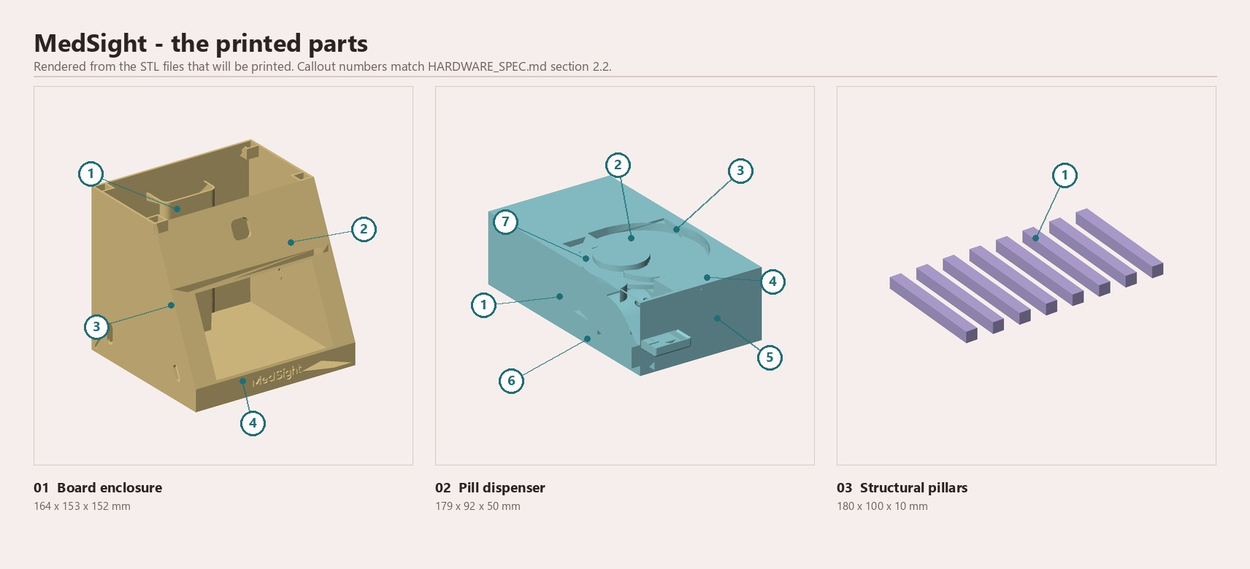
HARDWARE ARCHITECTURE
Eleven interconnects, and the sensor the count depends on
ITEM
PART
Processor
Cortex-M55 800 MHz + Neural-ART 1 GHz
Display
5 inch 800x480, GT911 touch
Camera
IMX335 via DCMIPP
Actuator
28BYJ-48 stepper via ULN2003A
Sensor
IR proximity on EXTI0
Audio
active piezo, five patterns
01 Board enclosure 1 housing shell · 2 port grid · 3 battery compartment · 4 brand plate
02 Pill dispenser 1 enclosure box · 2 carousel · 3 motor hub · 4 chute · 5 drawer · 6 sensor brackets · 7 divider
03 Structural pillars 1 pillar, eight off
Storage
microSD, the only storage
Power
5 V USB-C, runs on battery
It boots itself: a signed second-stage image in external flash, no debugger. A complete dispense has been run on battery alone.
11

Slide 12
PILL COUNTING
Count derived from interrupt timestamps
QUANTITY
MEASURED
Sensor idle level
HIGH, across 7 separate boots
Four trials, all 13 pills counted
5 of 5 3 of 3 3 of 3 2 of 2
Counted by the sensor rather than by the motor. A small sample, and not a reliability figure: the mechanism has miscounted and jammed outside these trials.
Real pill pulses
17 to 46 ms
Contact chatter
0 to 1 ms
Discrimination floor
8 ms, above every chatter event seen and under half the shortest real break
Longest legitimate pulse
1210 ms
Half-step period
2 ms, smooth and silent under load
Why the counter works. Pills slide rather than free-fall: a pulse is 17 to 46 ms.
One bound remains: 25 seconds since the last counted pill, restarted by every pill. A 1500 ms stall bound would leave 290 ms of margin against a measured 1210 ms legitimate break, on a device where tripping it means refusing a dose being delivered correctly. A working mechanism now runs as long as it needs, and a stopped one is caught inside one window.
12

Slide 13
CURRENT LIMITATIONS
Five open items, each with a defined approach
One turntable, so one medication. Next: the stacked modules already drawn in the hardware specification, plus a drug field in the record.
It cannot sense how full the turntable is. Next, and the least costly: a carer-entered fill count, decremented by counted pills.
A missed dose cannot leave the room. No radio in this build. Next, and top of the list: a carer alert over Wi-Fi and a patient-worn band.
The housing does not lock. Next: a lockable enclosure, tamper detection and a vibration sensor, so the log records when it was moved.
The face check can be shown a photograph. It does not test for a live face. Next: a passive liveness check on the same camera, before a match is accepted.
One thing to be clear about rather than plan around: the device counts pills out and corroborates a swallowing gesture. It cannot prove somebody swallowed, and no device of this class can, which is why the patient's button press stays the confirming action.
13

Slide 14
PLANNED WORK
Connectivity, physical security, then liveness detection
A carer-entered stock count. The least costly of these: today the first indication of an empty turntable is a dose that falls short.
A carer alert over Wi-Fi when a dose is missed, and a band that signals the patient one is due.
The band is the cheap half: a beacon saying only that a dose is due signals time, not identity.
The alert is the hard half: naming who missed which dose is health information leaving the device.
Both are proved as a separate companion unit first, then folded in on a flexible printed circuit.
Drug identity and multiple modules. The interface already draws slots B, C and D greyed out with a SOON label.
A lockable enclosure, tamper detection and a vibration sensor, logged rather than locking: a dispenser that stops working because it was jostled is a hazard.
A liveness check on the face match, so a printed photograph cannot pass it. Passive, on the camera and the accelerator already in use.
This build has no radio. Wi-Fi, Ethernet and BLE are never initialised, and no code path can transmit. Connectivity is planned work.
14

Slide 15
CONTRIBUTIONS
Attribution by contributor
WHO
WHAT
Dousik Manokaran
The firmware: the µT-Kernel migration, the six-task architecture and its priorities, the four networks on the accelerator, and the documentation
Howard Nikhil
The physical dispensing hardware: the turntable, the infrared pill counter, and the bench work the counting design rests on
Gaurav V R and Dillimaran K
The three-stage intake pipeline, detection, geometry and temporal decision, and the guarded state machine that refuses to certify an intake it cannot support
Abirami M
The visual identity: the mascot, and the artwork all twenty-two screens are cut from
Dr. G. Santhanamari and Dr. D. Selvakumar
Supervision, and two roadmap items: the vibration sensor for tamper detection, and the patient-worn alert band
µT-Kernel 3.0 is © TRON Forum and Ken Sakamura under T-License 2.1 / 2.2, and the board was supplied by the TRON Forum. Full attribution travels with the third-party inventory.
15

