Slide 1


Slide 2

Multi Food Image Detection and Classification

Slide 3
Group Members Introduction
Muhammad Danish
Student Id: bc220207791
A dedicated and enthusiastic student with full-stack development experience and a strong interest in technology and problem-solving.

Slide 4

INTRODUCTION OF PROJECT
A deep learning system that detects and classifies multiple food items (e.g., roti, rice, dal, salad) in a single image. It supports applications like diet monitoring, food delivery, and restaurant automation by providing fast, accurate, and automated food recognition using advanced image processing and a well-structured dataset.

Slide 5
Introduction & Problem Statement
Real meal images contain multiple items that current systems cannot fully detect.
Automated multi-food recognition is needed for diet and food service applications.
Manual food identification is slow and inconsistent.
Existing models lack reliable multi-food detection capability.

Slide 6
Objective of the Project
Develop a model that can detect and classify multiple food items in a single image.
Achieve accurate and reliable recognition using deep learning based object detection.
Build a well-prepared dataset to train and improve the model’s performance.
Enable real time food identification through a user-friendly application.

Slide 7
Dataset Overview
Categories: Chicken, Daal, Mixsweet, Naan, Rice, Roti, Salad, Yogurt.
Number of Images: Dataset includes 500+ multi-food images.
Annotation Method: All images annotated with bounding boxes using Roboflow.

Slide 8
Model Overview
Chosen Model: YOLOv5s (a fast and lightweight real-time object detection model).
Key Features: Single-stage detection, multi-scale predictions, high speed, and strong accuracy for small to medium objects.
Transfer Learning Strategy: Pretrained YOLOv5s weights fine-tuned on the custom multi-food dataset for improved performance.

Slide 9
Training Setup
Tools Used: Google Colab with NVIDIA Tesla T4 GPU, Python, PyTorch, Roboflow.
Training Parameters: 50–100 epochs, batch size 8-16, image size 640×640, SGD optimizer

Slide 10
Model Evaluation
High accuracy & real-time performance (mAP@0.5: 76.1%, 40–60 FPS)
Pre vs. Post tuning comparison
Metric | Before Fine-tuning | After Fine-tuning | Improvement
mAP@0.5 | 72.3% | 76.1% | +3.8%
Precision | 74.2% | 78.1% | +3.9%
Recall | 68.9% | 72.4% | +3.5%

Slide 11
Fine Tuning Techniques
Augmentation: Adjusted hue, saturation, brightness, rotation, scaling, and applied mosaic.
Other Strategies: Tested different epochs (50, 60, 70), batch sizes (8, 12, 16), class weights, and optimized anchor boxes.

Slide 12
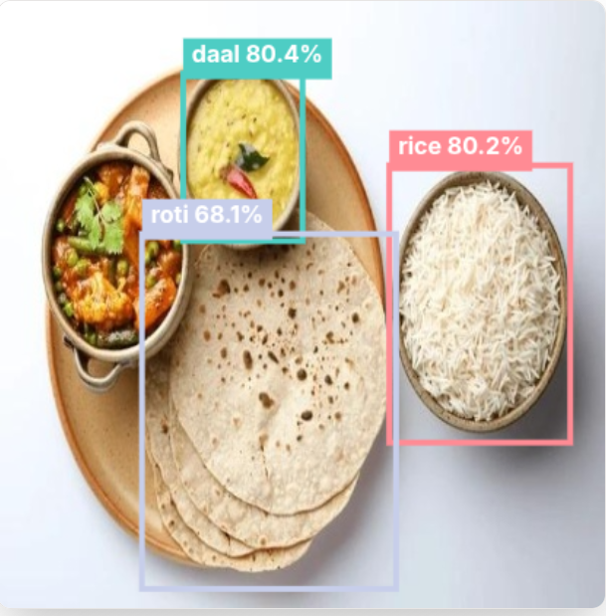
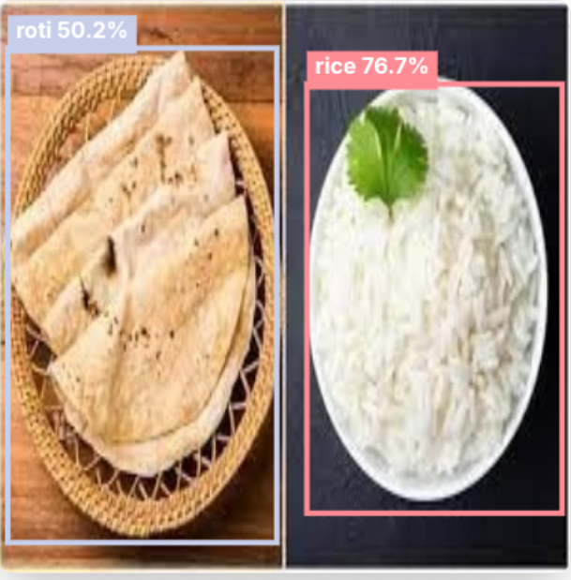
Sample Results

Slide 13
Challenges & Limitations
Technical Issues: Small objects and overlapping items are harder to detect accurately.
Dataset/Class Imbalance: Classes like Mix Sweet (35 samples) are underrepresented compared to Rice (309 samples), affecting model performance.
Resource Constraints: Limited GPU/CPU resources can slow training and restrict hyperparameter tuning.

Slide 14
Conclusion & Future Work
Summary of Outcomes
Trained YOLOv5 model for Pakistani multi-food detection
Achieved 76.1% mAP@0.5, real-time inference (<500ms)
Deployed browser-based web app with intuitive UI
Handles multiple food items with bounding boxes and confidence scores
Future Improvements
Expand dataset and add more food categories
Enhance accuracy for challenging classes (Daal, Chicken)
Implement mobile apps and real-time video detection
Add nutritional info, portion estimation, and recipe suggestions

Slide 15
Acknowledgments / Questions
Ultralytics, Colab, Vercel, open-source community
I welcome any questions or feedback!

