Slide 1

Velocity Nexus Prime: Comprehensive Vehicle Management System
Velocity Nexus Prime is a professional-grade vehicle management system designed to streamline modern dealership operations. Developed by Muhammad Danish Anwar & Abdul Manan Arif at Lahore Garrison University, this project showcases an end-to-end solution for inventory, sales, customer relationships, and business analytics.

Slide 2

Key Features: Driving Dealership Efficiency
Inventory Management
Sales Processing
Customer CRM
Real-time tracking of vehicles across multiple dealerships, ensuring accurate stock levels and availability.
Automated workflows for tax, commission, and final sales calculations, reducing errors and saving time.
Comprehensive management of customer profiles, purchase history, and lifetime value for personalized engagement.
Business Analytics
Robust Security
Real-time dashboards providing insights into sales trends, performance metrics, and operational efficiency.
Role-based access control with comprehensive audit logging, protecting sensitive data and ensuring compliance.

Slide 3



System Architecture: A Foundation of Modularity
The Velocity Nexus Prime system follows a strict 3-Tier Architecture to ensure modularity, scalability, and maintainability, separating concerns for optimal performance.
Presentation Tier (Frontend)
Business Tier (Backend)
Data Tier (Database)
Developed using Python Tkinter with custom dark theme UI components for an intuitive user experience.
Built with Python 3.8+ and a Service-Oriented Architecture, encapsulating core business logic.
Powered by Microsoft SQL Server 2019+, adhering to 3rd Normal Form for data integrity and efficiency.
Design Patterns Implemented
Singleton
Repository
Database Connection Manager.
Abstracts data access logic.
Service
Factory
Encapsulates business rules.
Standardizes UI creation.
Observer
Strategy
Real-time UI updates.
Flexible analytics calculations.

Slide 4
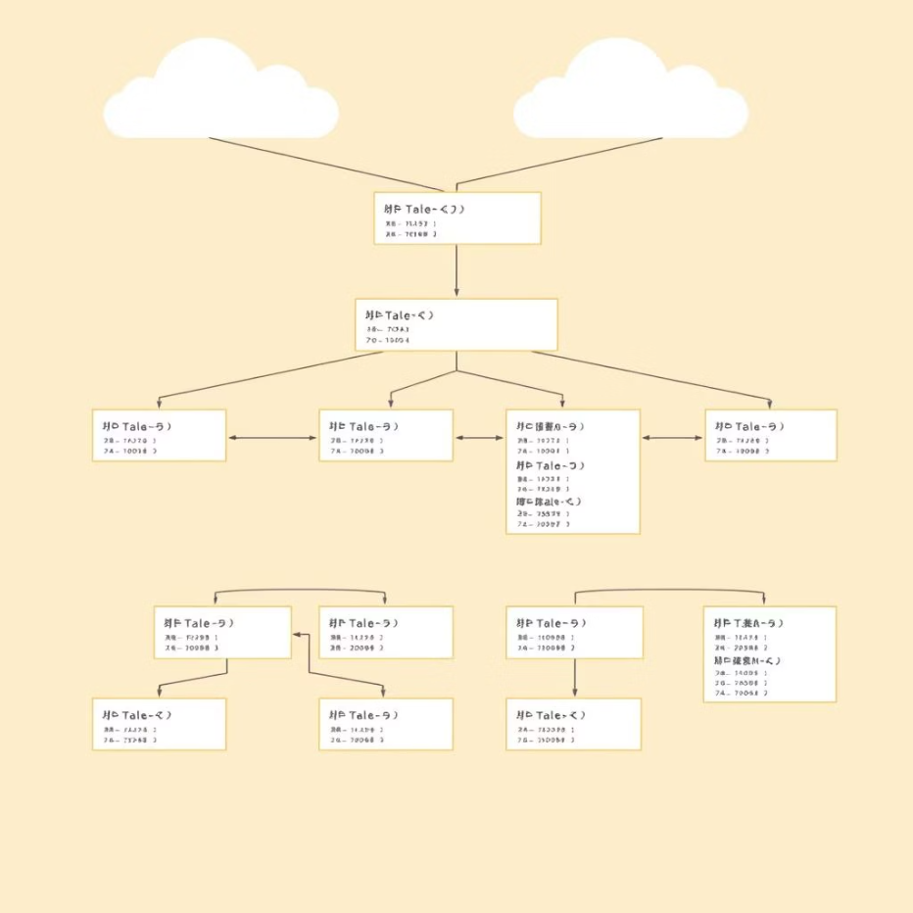
Database Architecture & Advanced SQL Logic
The database is the backbone of Velocity Nexus Prime, designed with meticulous adherence to BCNF principles and robust SQL implementations for data integrity and complex business logic.
Core Stored Procedures
Normalization Process (BCNF)
sp_ProcessCompleteSale
Handles entire sales transactions with ACID properties, including tax calculation (17% standard, 35% imported), commission, status updates, customer statistics, and audit logging.
sp_GenerateFinancialReport
Generates a comprehensive 3-part financial report (Summary, Payment Methods, Daily Trends) using UNION ALL.
SQL Functions
fn_CalculateDepreciation
Calculates current vehicle value based on age (5% per year) and mileage factors.
fn_CalculateCustomerLTV
Computes Customer Lifetime Value from past sales and projected future interactions.
01
1NF
Eliminated repeating groups.
02
2NF
Removed partial dependencies.
03
3NF
Removed transitive dependencies.
04
BCNF
Ensured every determinant is a candidate key.

Slide 5

Software Construction & Future Outlook
Adhering to crucial software development principles and employing rigorous testing, Velocity Nexus Prime is built for reliability and continuous improvement.
Layman's Laws of Software Development
Deployment & Academic Achievements
Changing Requirements
Anticipating and adapting to evolving project needs.
Hidden Complexity
Simplifying features without compromising underlying intricacy.
Debugging Time
Acknowledging and planning for the time investment in bug resolution.
Documentation Debt
Prioritizing clear and comprehensive documentation.
Deployment Pipeline: One-click LAUNCHER.bat script for easy setup.
Configuration Management: Utilizes python-dotenv for environment variables.
CI/CD: GitHub Actions configured for automated testing on every push.
Functional Completeness: 100% of requirements implemented (Sales, Inventory, CRM).
Performance: Sub-second response times for queries on over 1000 records.
Quality: Integrated 3-Tier Architecture with 6 robust Design Patterns.

