Slide 1
TREES
DISCRETE MATHEMATICS AND its APPLICATIONS

Slide 2
CONTENT
4.1
4.2
4.3
4.4
4.5
4.6
Introduction to Trees Application of Trees Tree Traversal
Trees and Sorting (Data structure)
Spanning Trees Minimum Spanning Trees

Slide 3
4.1 INTRODUCTION TO TREES
•
•
•
Define and recognize a tree Define and recognize a rooted tree Define and recognize a m-ary tree
CHAPTER 4 TREES

Slide 4
A Tree
A tree is a connected undirected graph with no simple circuit.
An undirected graph is a tree if and only if there is a unique simple path between any two of its vertices.
THEOREM: A tree with n vertices has n – 1 edges.
EXAMPLES
a b c
a b c
a
b
c
d
e
f
d
e
f
d
e
f
NOT A TREE
A TREE
NOT A TREE

Slide 5
A Rooted Tree
A rooted tree is a tree in which one vertex has been designated as the root and every edge is directed away from the root.
Different choice of root produce different rooted tree
EXAMPLES
f
g
a
c
a
b
d
d
b
c
e
b
d
a
e
f
g e
f
g
A TREE with root c
c
A TREE
A TREE with root a

Slide 6
Properties of Rooted Trees
Parent – A vertex other than root is a parent if it has one or more children
The parent of c is b
Children – If A is a vertex with successors B
and C, then B and C are the children of A.
The children of a is b, f and g
Siblings – Children with the same parent vertex.
h, i and j are siblings
Level – the length of the unique path from the root to a vertex
Vertex a is at level 0
Vertices d and e is at level 3
EXAMPLES
a
b
g
f
c
h
j
i
d
e
k l
m
Height – The maximum level of all the vertices
➢ The height of this tree is 3.

Slide 7
Properties of Rooted Trees
Ancestor of a vertex (v) – the vertices in the path from the root to this vertex excluding this vertex.
The ancestors of e are c, b and a
Descendent of a vertex (v) – vertices that have v as ancestor.
The descendants of b are c, d and e
EXAMPLES
a
b
g
f
c
h
j
i
Leaf – A vertex with no children
➢ The leaves are d, e, f, i, k, l and m
d
e
k l
m
A subtree rooted at g
Internal Vertices – vertices that have children
➢ The internal vertices are a, b, c, g, h and j
Subtree – A subgraph of the tree consisting of a root and its descendent and all edges incident to these descendent.

Slide 8
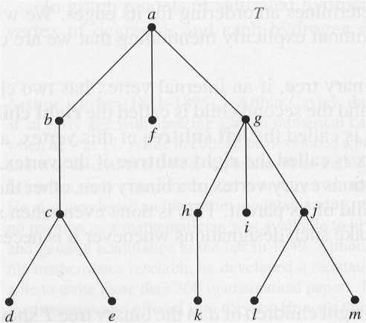
roo
internal
t
vertex
descendants of g
ancestor of
d
lea
parent of
f
d
child of
c
subtree
sibling of
d

Slide 9

m-ary Tree
A rooted tree is called an m-ary tree if every vertex has no more than
m children.
The tree is called a full m-ary tree if every internal vertex has exactly
m children.
A rooted m-ary tree is balanced if all leaves are at levels h or h-1.
EXAMPLES: m=4,i=internal node, n(total number of nodes) = mi + 1 =4*3+1=13
a
c
a
e
a
b
c d
b
e
c
d
b
d
f g
h i
j
k
l m
f
g e
A 3-ary TREE
f
g
A full 4-ary TREE
A full binary TREE

Slide 10
m-ary Tree
THEOREM 1: A full m-ary tree with i internal vertices contains
n = mi + 1 vertices
THEOREM 2: A full m-ary tree with
n −1
( m −1) n +1
i.
n vertices has i = internal vertices and leaves.
l =
m
m
ii. i internal vertices has ^{n = mi + 1} vertices and
iii. l leaves has _{ml −1} vertices and
n =
m −1
_{i = l −1} internal vertices.
m −1
THEOREM 3: There are at most height h.
_{m}h
leaves in an m-ary tree of

Slide 11
4.2 APPLICATION OF TREES
•
•
•
Introduce Binary Search Trees Introduce Decision Trees Introduce Game Trees
CHAPTER 4 TREES

Slide 12
Binary Search Trees
A binary tree in which each child of a vertex is designated as a right or left child
No vertex has more than one right child or left child
Each vertex is labeled with a key
Vertices are assigned keys so that the key of a vertex is both larger than the keys of all vertices in its left subtree and smaller than the keys of all vertices in its right subtree.
15
20
12 25
EXAMPLE
Binary search tree for the words mathematics, physics, geography, zoology, meteorology, geology, psychology, and chemistry using alphabetical order
•
•
•
mathematics
geography
physics
chemistry
geology
metereology
zoology
psycology

Slide 13
Decision Trees
A rooted tree in which each internal vertex corresponds to a decision, with a subtree at these vertices for each possible outcome of decision.
A=10
B=15
c-=20
The possible solutions of the problem correspond to the paths to the leaves of this rooted tree.
EXAMPLE
A Decision tree that orders the elements of the list a, b, c
a : b
a > b
a < b
a : c
b : c
a > c
a < c
b > c
b < c
b : c
c > a > b a : c
c > b > a
b > c
b < c
a > c
a < c
a > b > c
a > c > b
b > a > c
b > c > a

Slide 14
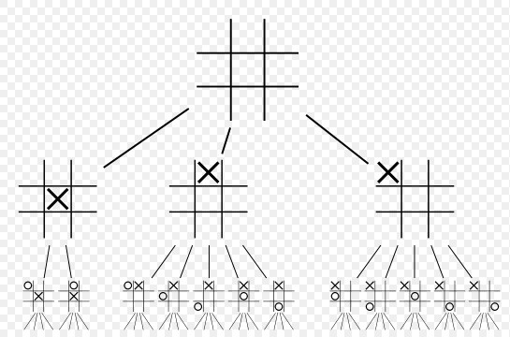
Game Trees
Use trees to analyze certain types of games
Vertices represent the positions can be in as it progresses
Edges represent legal moves between this position
Games tree is infinite if the games they represent never end
EXAMPLE
A Game tree that represents the first two
level of the tic-tac-toe
game.

Slide 15
4.3 TREE TRAVERSAL
Determine preorder traversal, inorder traversal and postorder traversal of an ordered rooted tree.
Determine the infix, prefix, and postfix form of an expression.
CHAPTER 4 TREES

Slide 16
Tree Traversal
Ordered trees are often used to restore data/info.
Tree traversal is a procedure for systematically visiting each vertex of an ordered rooted tree to access data.
If the tree is label by Universal Address System we can totally order the vertices using lexicographic ordering
– Example: 0 < 1 < 1.1 < 1.2 < 1.2.1 < 1.3 < 2 < 3 < 3.1 <
3.1.1 < 3.1.2 < 3.1.2.1 < 3.1.2.2 < 4 < 4.1
•
Tree traversal algorithm
– Preorder, inorder and postorder traversal

Slide 17
Preorder Traversal
Let T be an ordered rooted tree with root r.
Node=N,Left=L,right=R
NLR
If T consists only of r, then r is the preorder traversal of T.
If T1, T2, …, Tn are subtrees at r from left to right in T, then the preorder traversal begins by visiting r, continues by traversing T1 in preorder, then T2 in preorder, and so on until Tn is traversed in preorder.
r
STEP 1
Visit r
TIPS
Preorder Traversal:
Visit root, visit subtrees left to right
T1
T2
… Tn
STEP 2 STEP 3
Visit T1 in preorder Visit T2 in preorder
STEP n+1
Visit Tn in preorder

Slide 18
EXAMPLE: Preorder Traversal
a
d
b
c
e
f
g
h
i
j
k
m
l
n
o
p

Slide 19
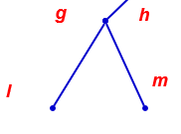
NLR
Node=g
Left=l
Right=m
Preorder=glm

Slide 20
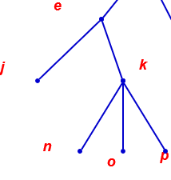
NLR
Node=e
Left=j
Right=k
Node=k
Left=n
Right=o
Righttt=p
Right child=knop
Left child=j
Node=e
ejknop

Slide 21
EXAMPLE: Preorder Traversal-NLR
a
a b e f c d g h i
• • • • • • •
T
b
d
c
e
f
k
m
g h
i
j
l
j
k
m
l
n
ITERATION 2
o
p
n
o
p
a
b e j
k
f c d g l m h i
• • • •
• • • • • • • •
a b c
• •
d
n
o
p
ITERATION 3
e
f
g h
i
k
a b e j k n o p f c d g l m h i
• • • • • • • • • • • • • • • •
j
m
l
n
ITERATION 4
o
p
ITERATION 1
The preorder traversal of T

Slide 22
Inorder Traversal -LNR
Let T be an ordered rooted tree with root r.
If T consists only of r, then r is the inorder traversal of T.
If T1, T2, …, Tn are subtrees at r from left to right in T, then the inorder traversal begins by traversing T1 in inorder, then visiting r, continues by traversing T2 in inorder, and so on until Tn is traversed in inorder.
r
STEP 2
Visit r
TIPS
Inorder Traversal: Visit leftmost subtree, Visit root,
Visit other subtrees left to right.
T1
T2
… Tn
STEP n+1
Visit Tn in inorder
STEP 1 STEP 3
Visit T1 in inorder Visit T2 in inorder

Slide 23
EXAMPLE: Inorder Traversal
a
d
b
c
e
f
g
h
i
j
k
m
l
n
o
p

Slide 24
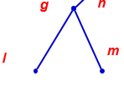
LNR
Inorder=lgm

Slide 25
LNR
In order=J e n k o p

Slide 26
EXAMPLE: Inorder Traversal
a
e b f a c g d h i
• • • • • • •
T
b
d
c
e
f
k
m
g h
i
j
l
j
k
m
l
n
ITERATION 2
o
p
n
o
p
j e
k
b f a c
l g m d h i
• •
• • • • •
• • • • •
b
a c
d
• •
n
ITERATION 3
_{o} p
j e n k o p b f a c l g m d h i
• • • • • • • • • • • • • • • •
ITERATION 4
e
f
g h
i
j
k
l
m
n
o
p
ITERATION 1
The inorder traversal of T

Slide 27
Postorder Traversal-LRN
Let T be an ordered rooted tree with root r.
If T consists only of r, then r is the postorder traversal of T.
If T1, T2, …, Tn are subtrees at r from left to right in T, then the preorder traversal begins by traversing T1 in postorder, then T2 in postorder, and so on until Tn is traversed in postorder and ends by visiting r.
r
STEP n+1
Visit r
TIPS
Postorder Traversal:
Visit subtrees left to right, Visit
root.
T1
T2
…
Tn
STEP 1 STEP 2 STEP n
Visit T1 in postorder Visit T2 in postorder Visit Tn in postorder

Slide 28
EXAMPLE: Postorder Traversal
a
d
b
c
e
f
g
h
i
j
k
m
l
n
o
p

Slide 29
LRN
postorder=lmg

Slide 30
LRN
post order=j n o p k e

Slide 31
EXAMPLE: Postorder Traversal
a
e f b c g h i d a
• • • • • • •
T
b
d
c
e
f
k
m
g h
i
j
l
j
k
m
l
n
ITERATION 2
o p
n
o
p
j
k
e
f b c
l m g h i
• • • •
d a
• •
• • •
• • •
b
c
d
a
•
•
n
ITERATION 3
o p
e
f
g h
i
k
j n o p k e f b c l m g h i d a
• • • • • • • • • • • • • • • •
j
m
l
n
ITERATION 4
o
p
ITERATION 1
The post order traversal of T

Slide 32
4.5 SPANNING TREES
•
Find spanning trees of a simple graph
CHAPTER 4 TREES

Slide 33
Spanning Trees
Let G be a simple graph. A spanning tree of G is a subgraph of
G that is a tree containing every vertex of G.
A simple graph is connected if and only if it has a spanning tree.
Applied in IP multitasking.
a b c
d
a b
c
d
Not Spanning tree
e
f
g
e
f
g
a b
c
d
Spanning tree
A simple graph
e
f
g

Slide 34
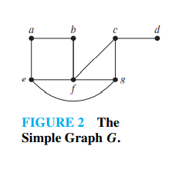
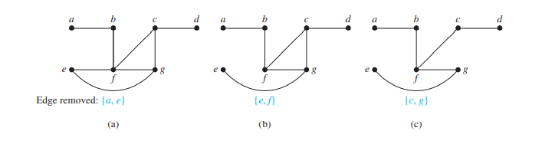

Slide 35
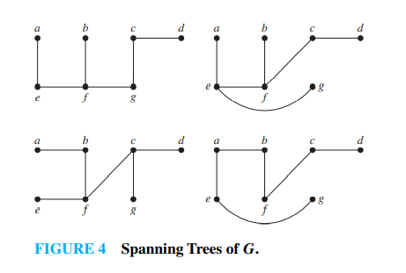

Slide 36
4.6 MINIMUM SPANNING TREES
•
Find minimum spanning tree using Prim’s algorithm
Find minimum spanning tree using Kruskal’s algorithm
•
CHAPTER 4 TREES

Slide 37
Minimum Spanning Trees
A minimum spanning tree in a connected weighted graph is a spanning tree that has the smallest possible sum of weights of it edges.
Two algorithms can be used:
Prim’s Algorithm
Robert Prim, 1957
Kruskal’s Algorithm
Joseph Kruskal, 1956

Slide 38
Prim’s Algorithm
Chose an edge with the least weight.
Include it in spanning tree, T.
Select an edge of least weight that is incident with a vertex of an edge in T.
If it does not create a cycle (simple circuit) with the edges in
T, then include it in T; otherwise discard it.
Repeat STEPS 3 and 4 until T contains n-1 edges.
There may be more than one minimum spanning tree for a given connected weighted simple graph.
If there are two edges with similar smallest weight, chose either one.

Slide 39
EXAMPLE: Prim’s Algorithm
c
CHOICE EDGE WEIGHT 1 {a, b} 7
SPANNING TREE
b
13 13
_{b} 10 _{d}
16
7
a
7
a
12
11
15
10
e
2
{a, d}
10
b
d
12
7 10
a b
FIGURE 1
The minimum spanning tree is given by:
c
3
{b, e}
11
d
7
a
10
11
e
b
12
d
4
{e, c}
12
c
7
a
b
12
d
10
11
e
7
a
10
11
e
Total weight = 40

Slide 40
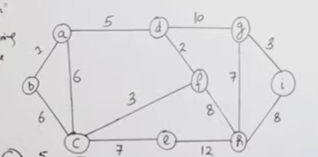
Prim’s Algorithm

Slide 41
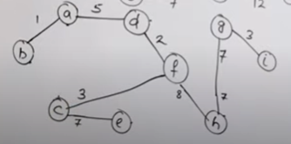
Final solution

Slide 42
Tree is a connected undirected graph with no simple circuits
CHAPTER 4 TREES
•
•
Trees have been employed to solve problems in a wide variety of disciplines.
SUMMARY

