Slide 1
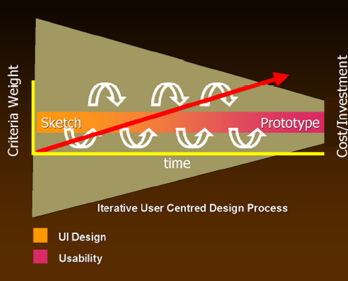
Sketching and Prototyping
Sketches / low / medium / high fidelity prototypes
as investment in design increases (red arrow), so does the formality of the criteria whereby concepts are reviewed or accepted
From design to evaluation
similarly, interface design (idea generation) progresses to usability testing (idea debugging and refinement)
From Design for the Wild, Bill Buxton (in press) with permission

Slide 2
Sketching and Prototyping
Early design
Brainstorm different representations
Choose a representation
Rough out interface style
Sketches & low fidelity paper prototypes
Task centered walkthrough and redesign
Fine tune interface, screen design
Heuristic evaluation and redesign Usability testing and redesign
Medium fidelity prototypes
High fidelity prototypes
Working systems
Limited field testing
Alpha/Beta tests
Late design

Slide 3
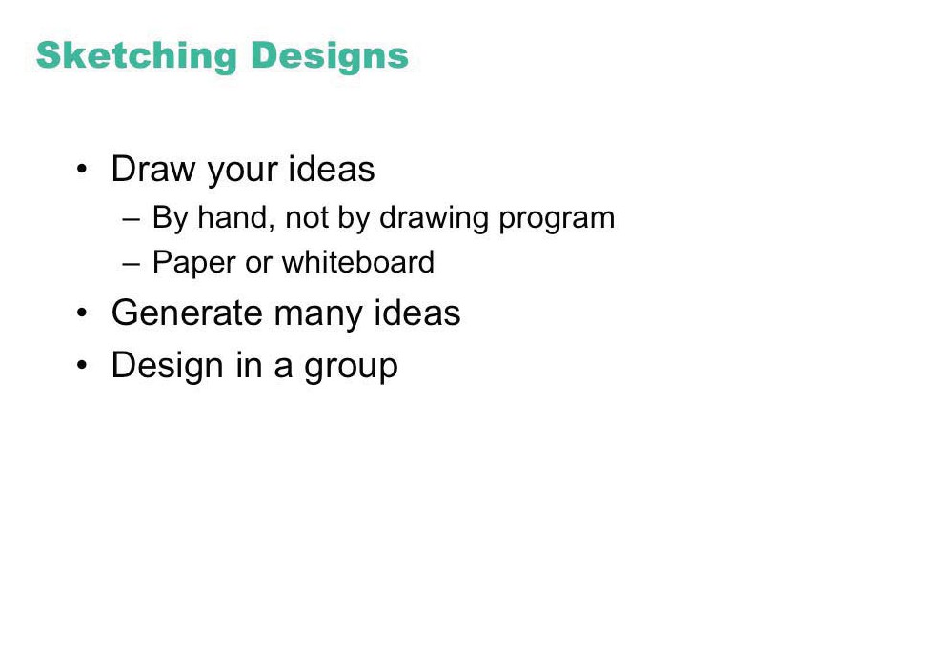

Slide 4
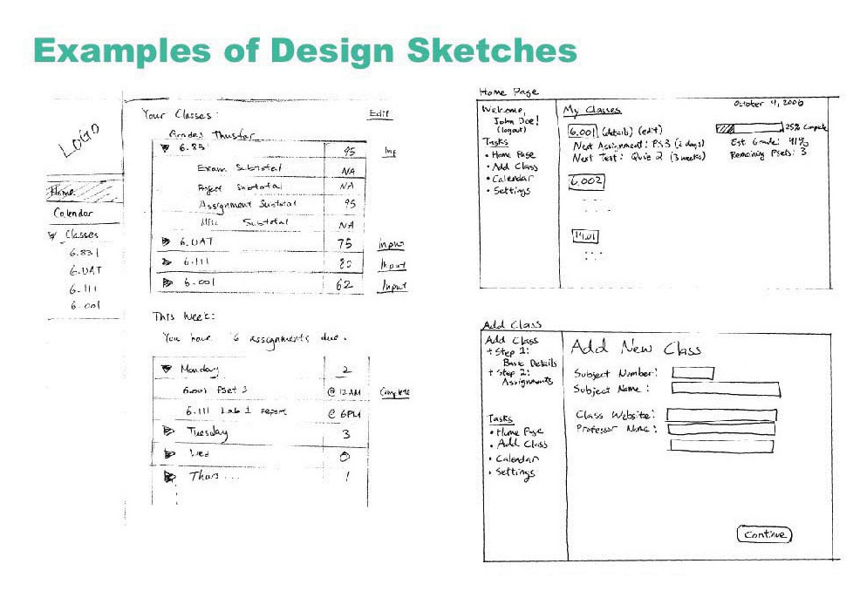
© MIT Students

Slide 5
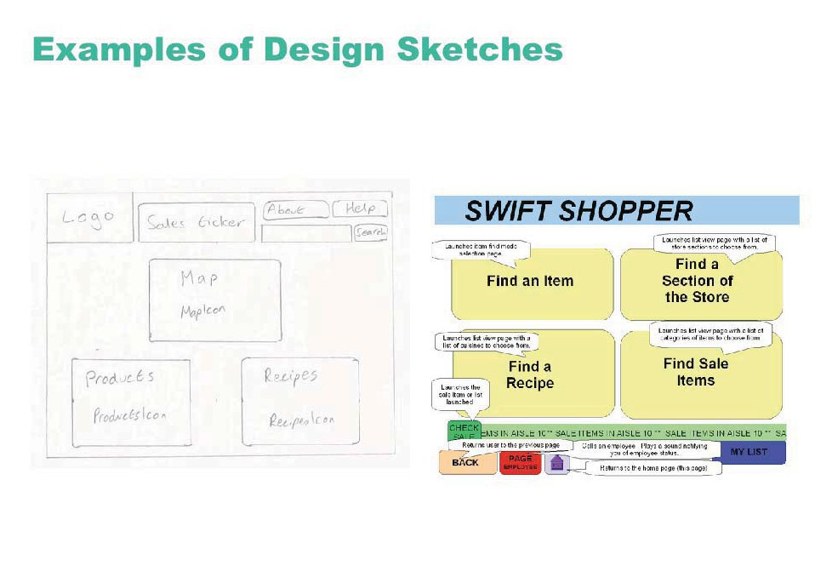
© MIT Students

Slide 6
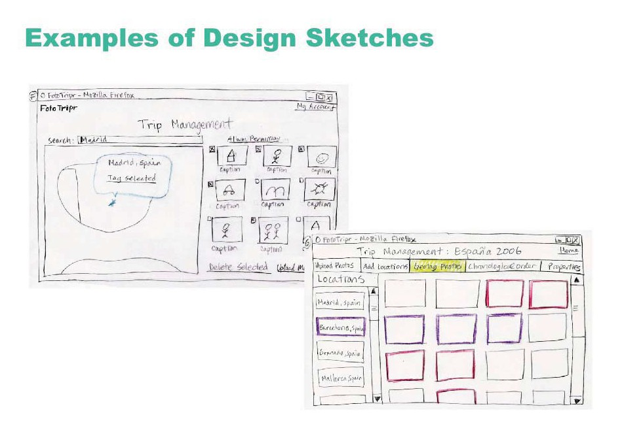
© MIT Students

Slide 7
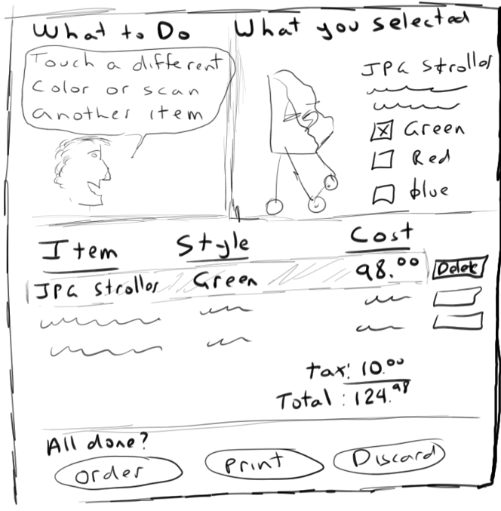

Slide 8
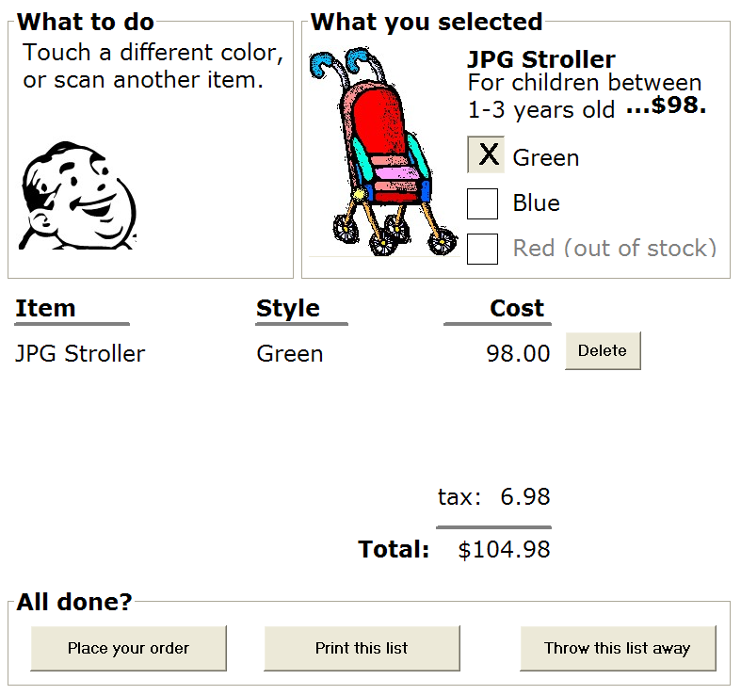

Slide 9
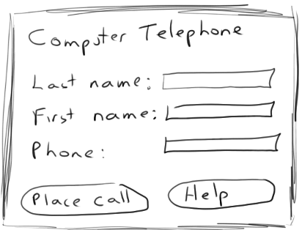
Sketches
drawing of the outward appearance of the intended system
crudity means people concentrate on high level concepts
but hard to envision a dialog’s progression
Contacts
Last Name:
First Name:
Phone:
Place Call
Help

Slide 10
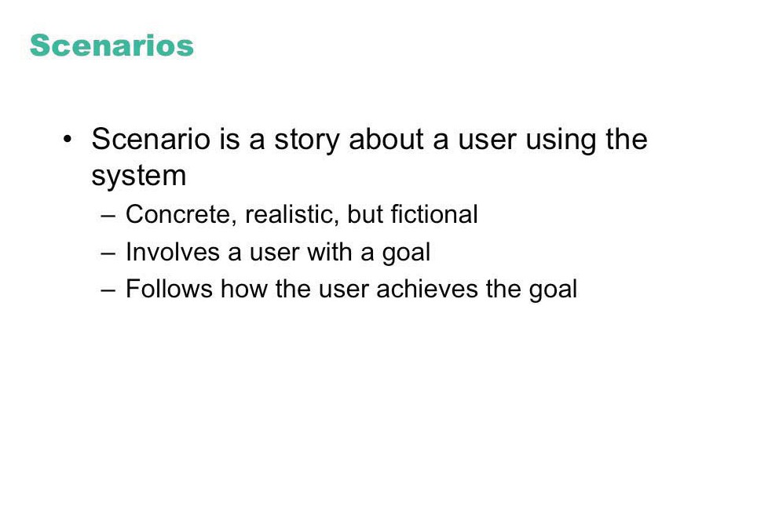

Slide 11
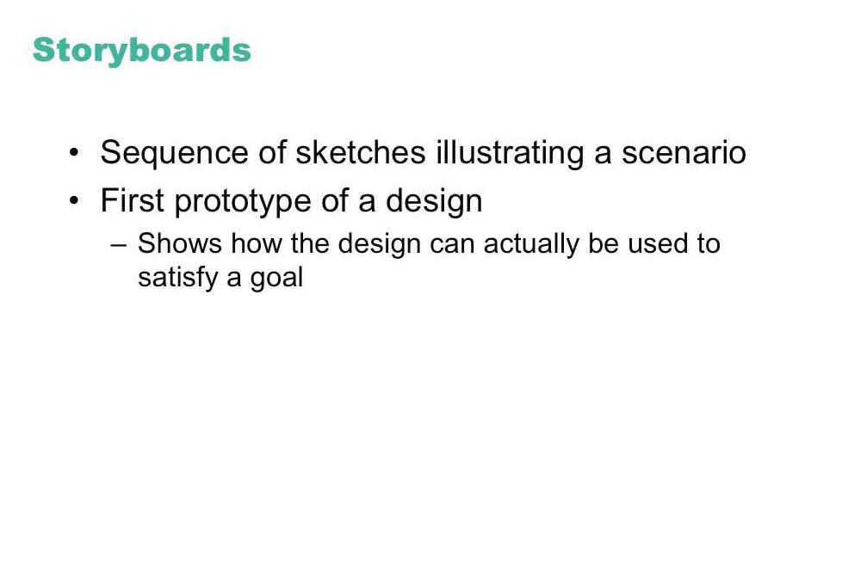

Slide 12
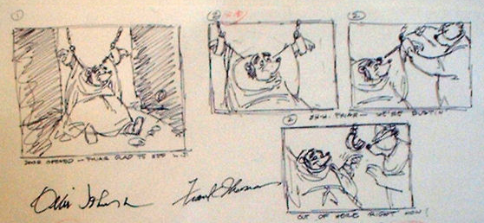
Storyboarding
a series of key frames as sketches
originally from film; used to get the idea of a scene
snapshots of the interface at particular points in the interaction
users can evaluate quickly the direction the interface is heading
Excerpts from Disney’s Robin Hood storyboard, www.animaart.com/Cellar/disneyart/90robin%20storyboard.jpg.html

Slide 13
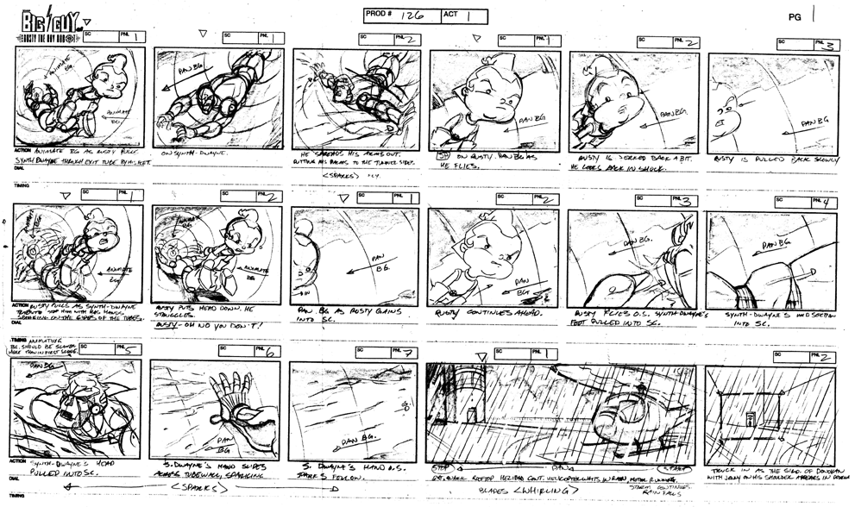
note how each scene in this storyboard is annotated
From www.michaelborkowski.com/storyboards/images/big_bigguy1.gif

Slide 14
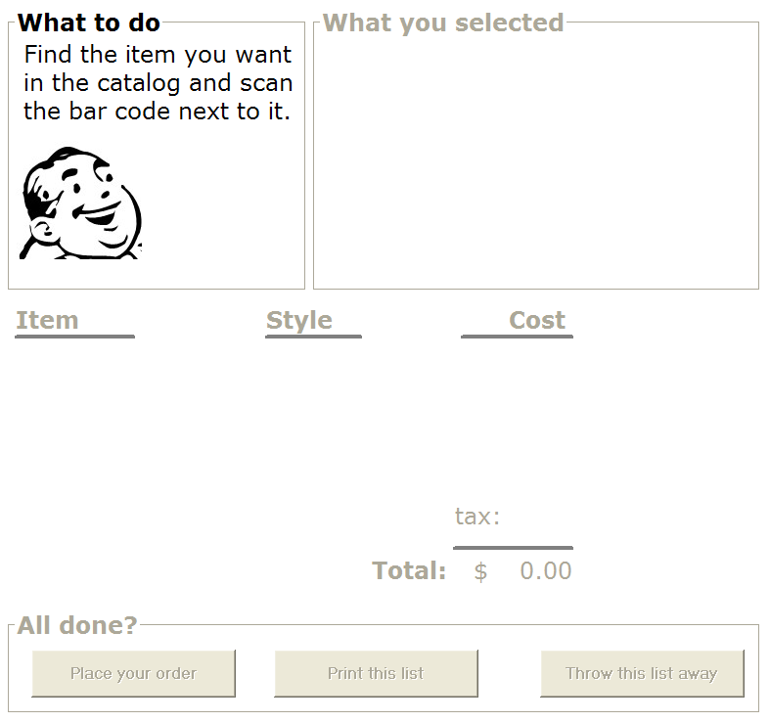


Initial screen
Scan the stroller ->
Change the color ->
Place the order ->

Slide 15
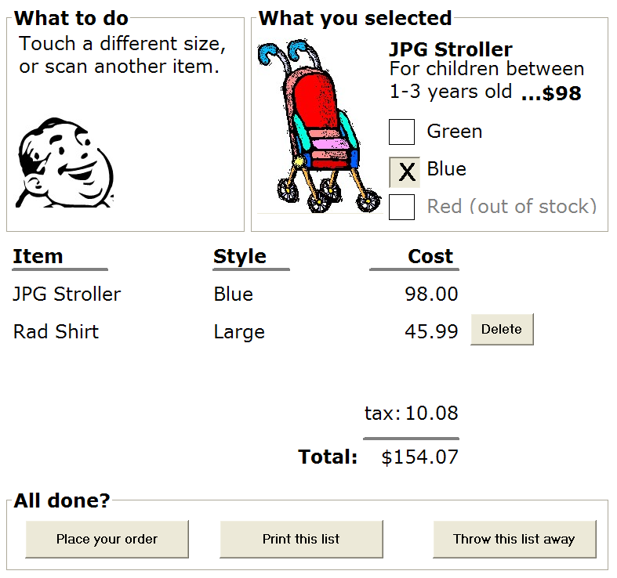
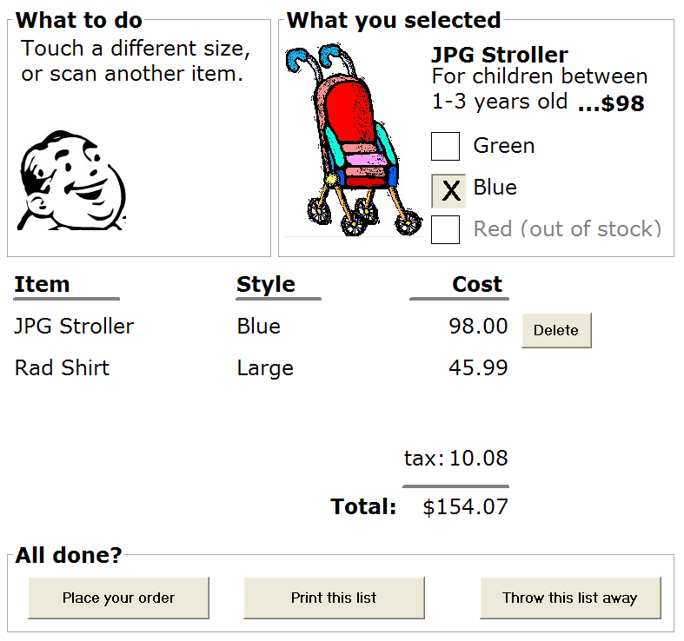
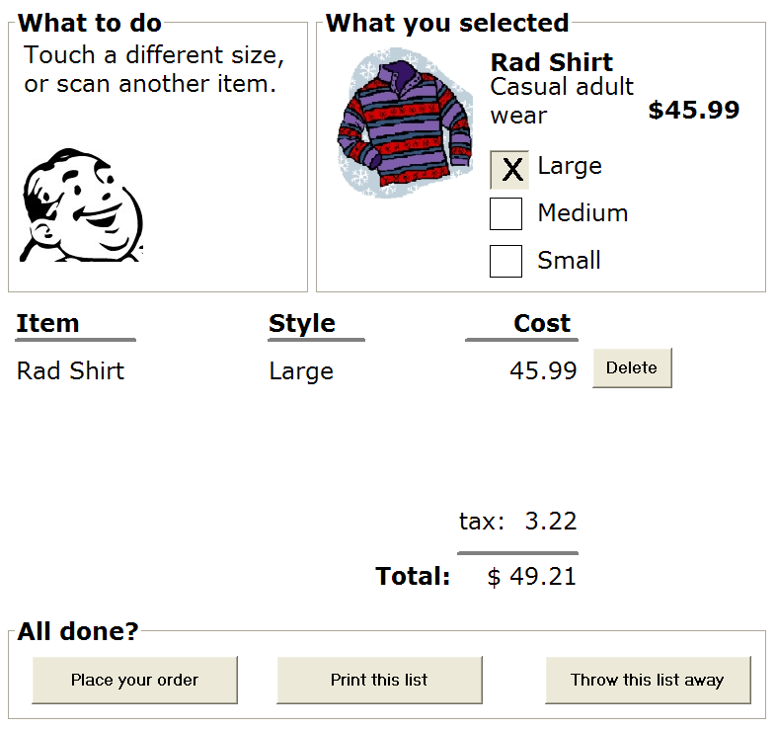
Alternate path…
Scan the shirt ->
Touch previous item ->
Delete that item->

Slide 16
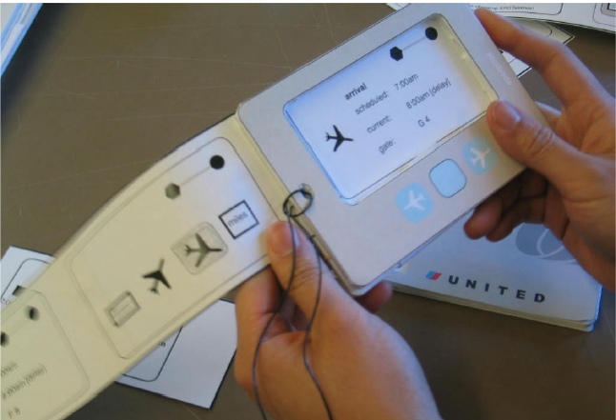
Storyboarding
Spotlight: an interactive foam core and paper sketch/storyboard
Credit: Sue-Tze Tan, Dept Industrial Design, University of Washington
From Design for the Wild, Bill Buxton
with permission

Slide 17
