Slide 1
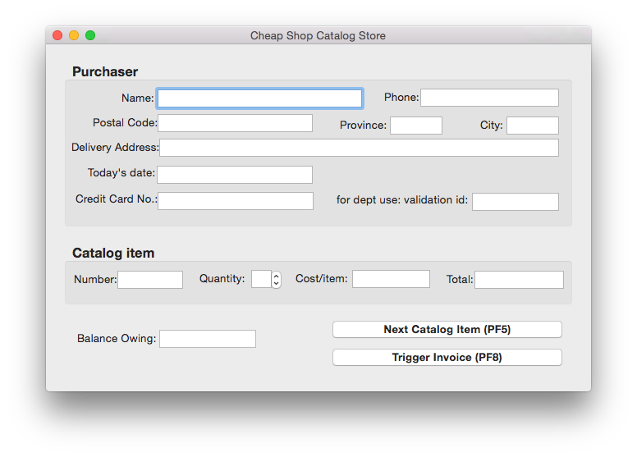
How do we know if our UI is good or bad?

Slide 2
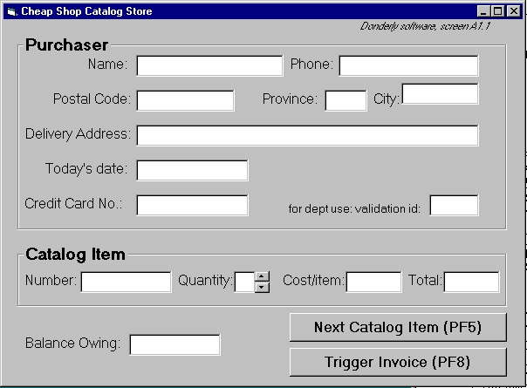
Fashion?

Slide 3
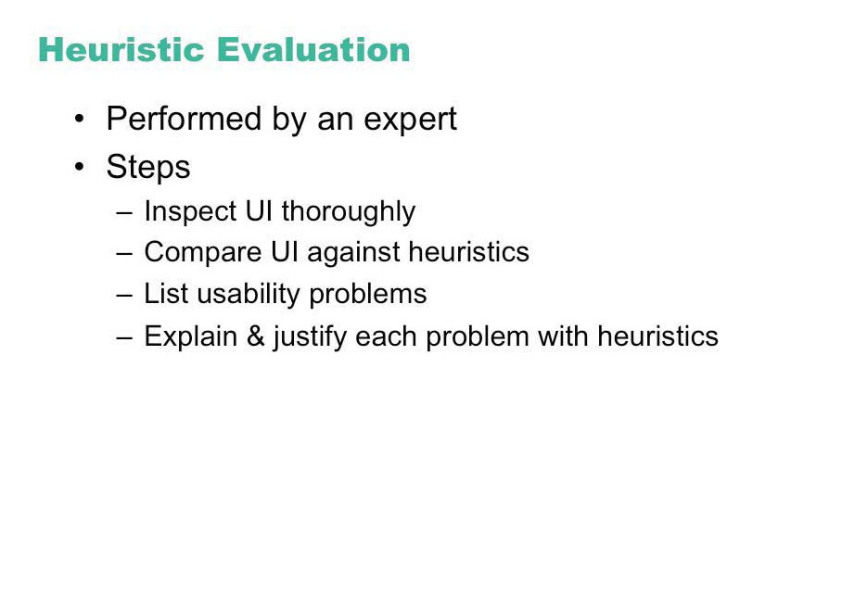

Slide 4
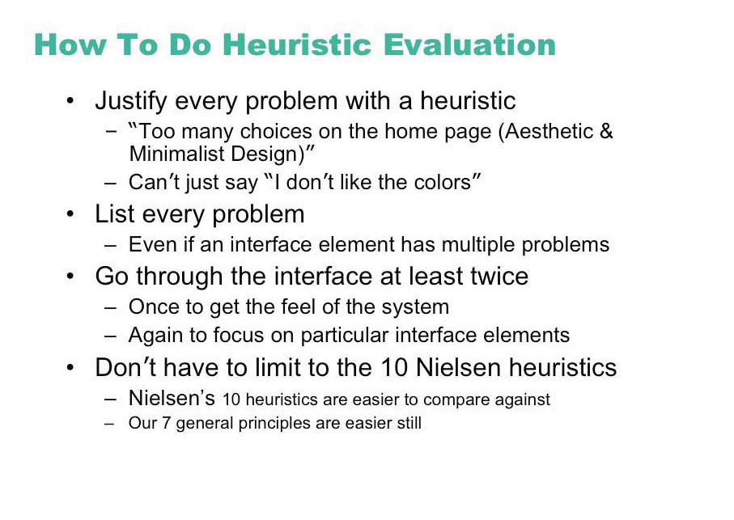

Slide 5
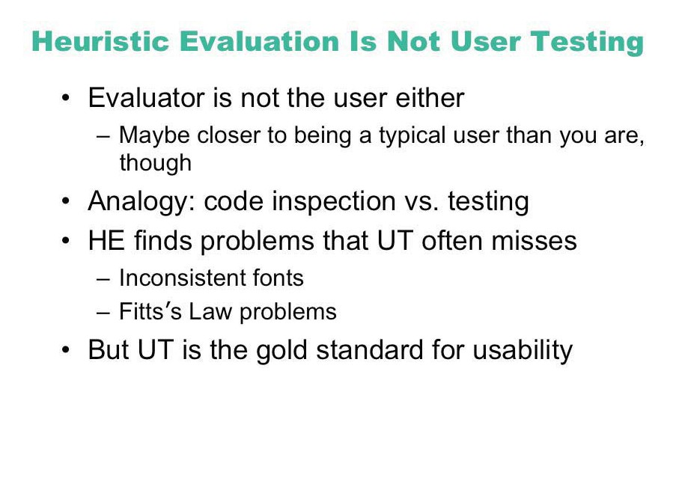

Slide 6
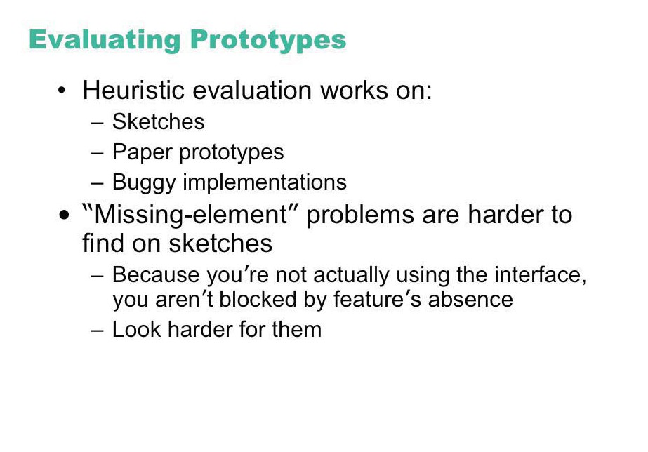

Slide 7
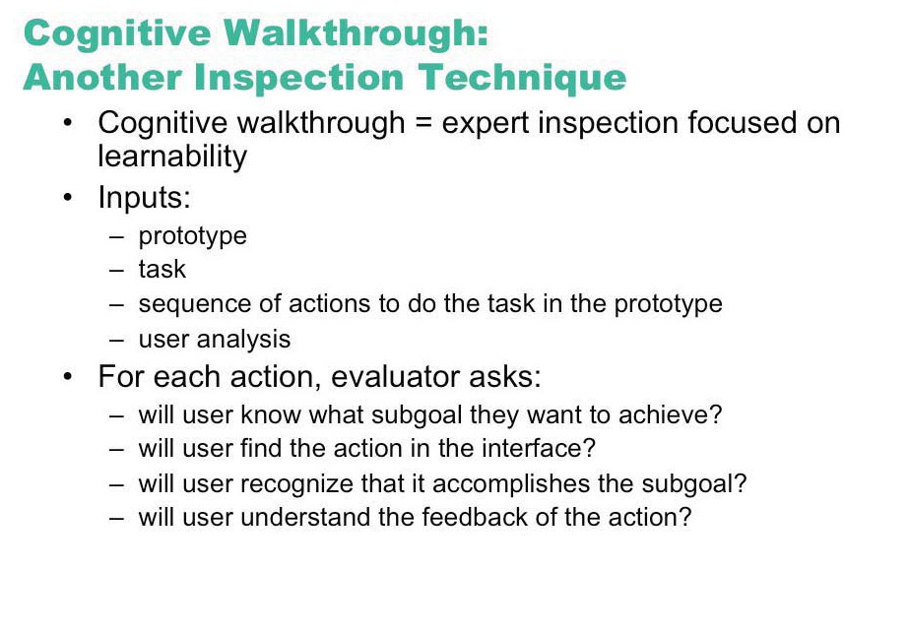

Slide 8
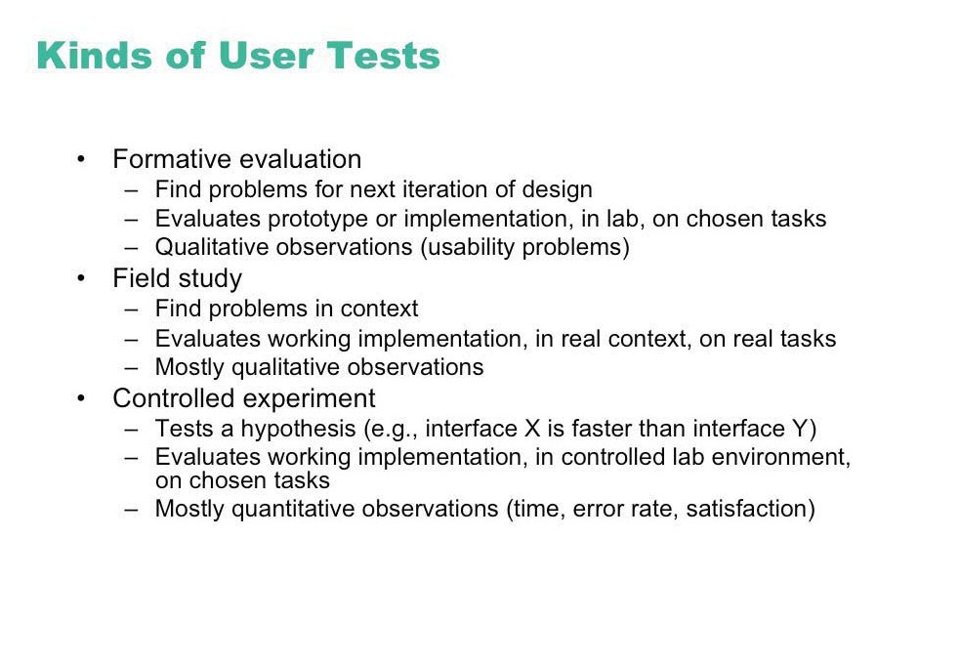

Slide 9
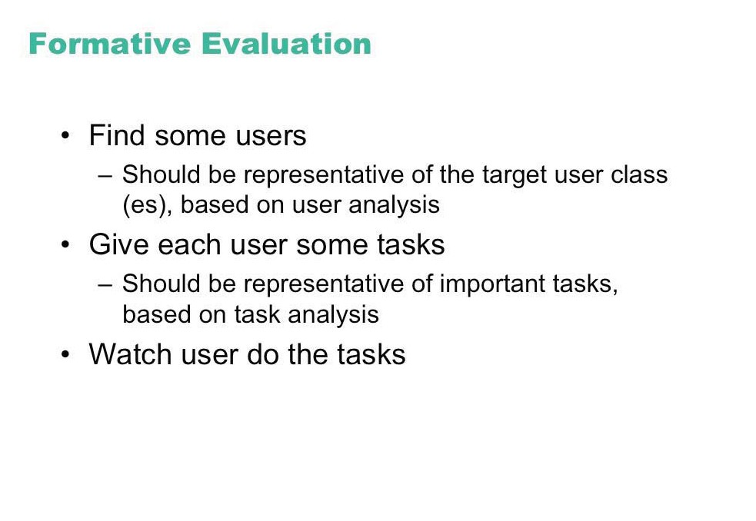

Slide 10

Naturalistic approach
Observation occurs in realistic setting
real life
Problems
hard to arrange and do
time consuming
may not generalize

Slide 11
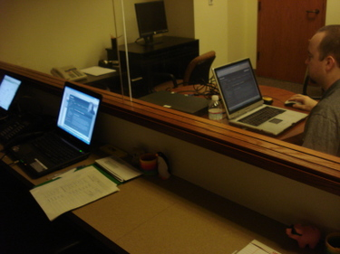
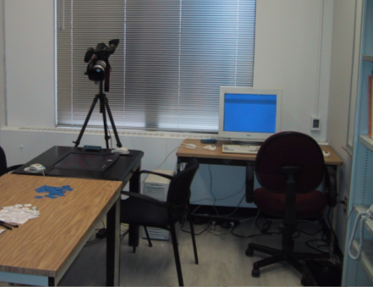
Usability engineering approach
Observe people using systems in simulated settings
people brought in to artificial setting that simulates aspects of real world setting
people given specific tasks to do
observations / measures made as people do their tasks
look for problem areas / successes
good for uncovering ‘big effects’

Slide 12


Simple observation method
User is given the task
Evaluator just watches the user
Problem
does not give insight into the user’s decision process or attitude

Slide 13
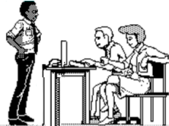
Constructive interaction method
Two people work together on a task
monitor their normal conversations
removes awkwardness of think-aloud
Co-discovery learning
use semi-knowledgeable “coach” and novice
only novice uses the interface
novice ask questions
coach responds
gives insights into two user groups
Oh, I think you clicked on the wrong icon
Now, why did it do that?

Slide 14
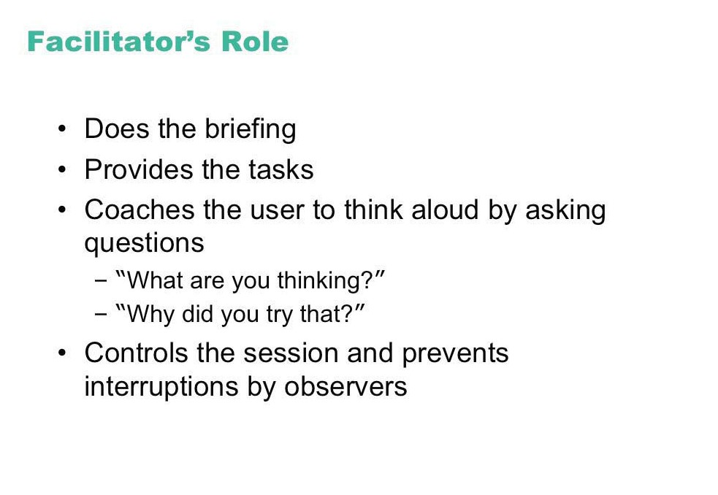

Slide 15
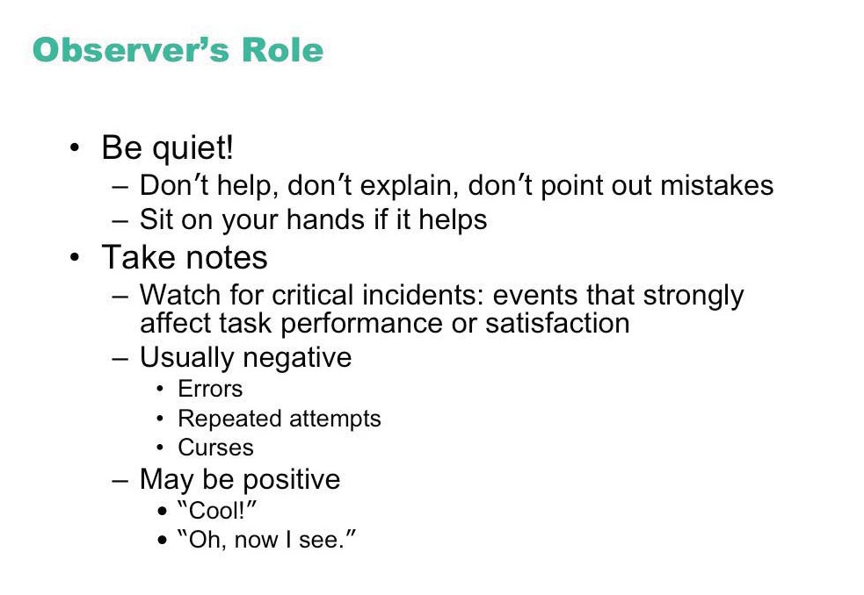

Slide 16
Videos
Think aloud (NYC subway)
http://www.youtube.com/watch?v=mfCQbZR-nhk
Critical incidents (DC subway)
http://www.youtube.com/watch?v=7TOsJCA7DHw

Slide 17
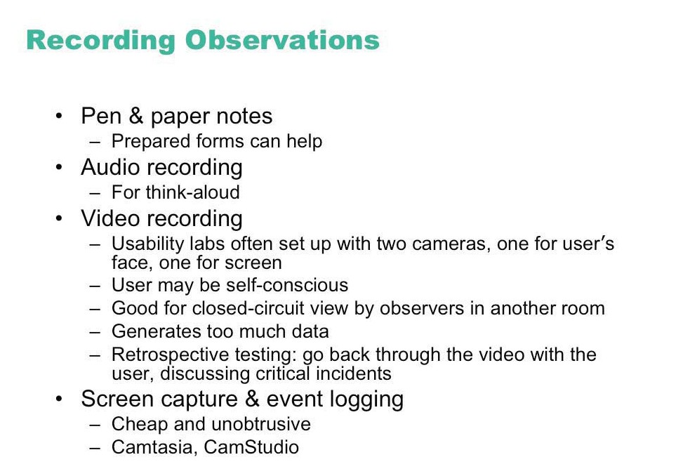

Slide 18
Coding sheet example...
tracking a person’s use of an editor
General actions
Graph editing
Errors
text scrolling image new delete modify correct miss editing editing node node node error error
Time
09:00
x
x
09:02
x
09:05
x
09:10
09:13

Slide 19
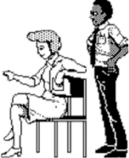
Retrospective testing interviews
Post-observation interview to
perform an observational test
create a video record of it
have users view the video and comment on what they did
clarify events that occurred during system use
excellent for grounding a post-test interview
avoids erroneous reconstruction
users often offer concrete suggestions
Do you know why you never tried that option?
I didn’t see it. Why don’t you make it look like a button?

Slide 20
Critical incident interviews
People talk about incidents that stood out
usually discuss extremely annoying problems with fervor
not representative, but important to them
often raises issues not seen in lab tests
Tell me about the last big problem you had with Word
I can never get my figures in the right place. Its really annoying. I spent hours on it and I had to…

Slide 21
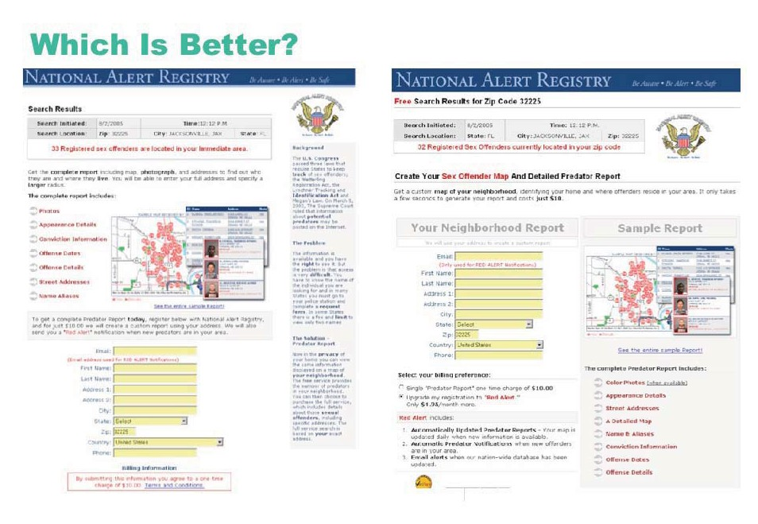
© National Alert Registry. All rights reserved.

Slide 22
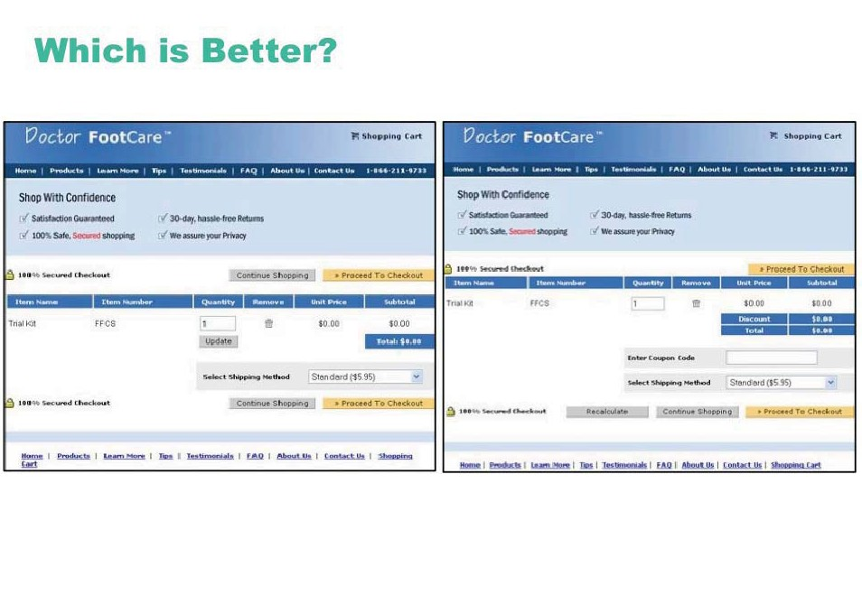
© source unknown. All rights reserved.

Slide 23
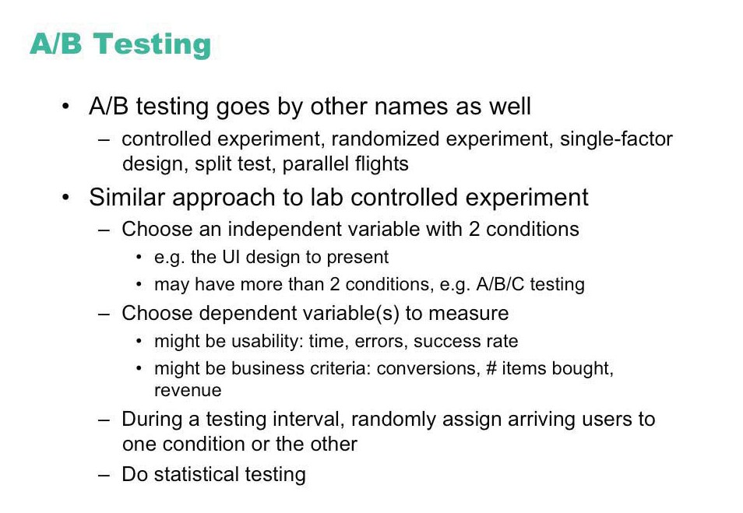

Slide 24
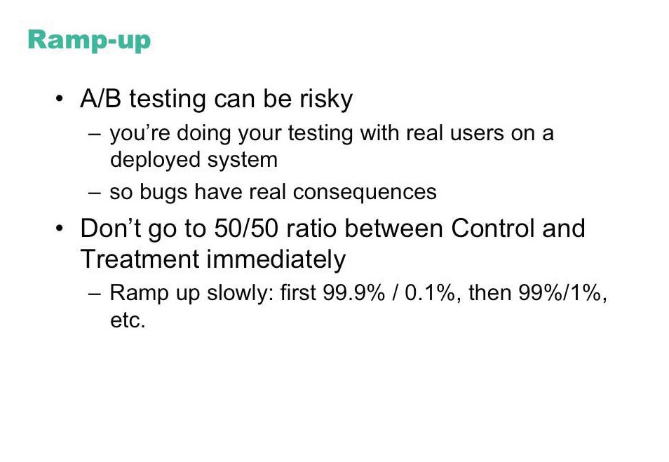

Slide 25
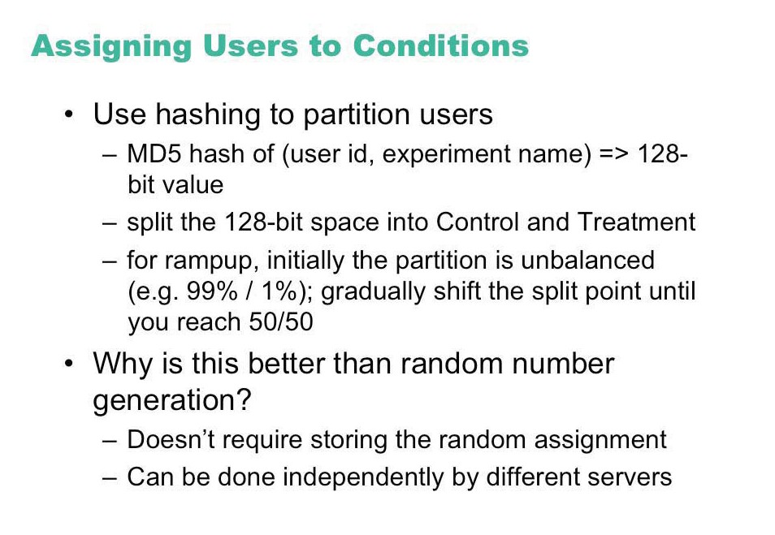

Slide 26
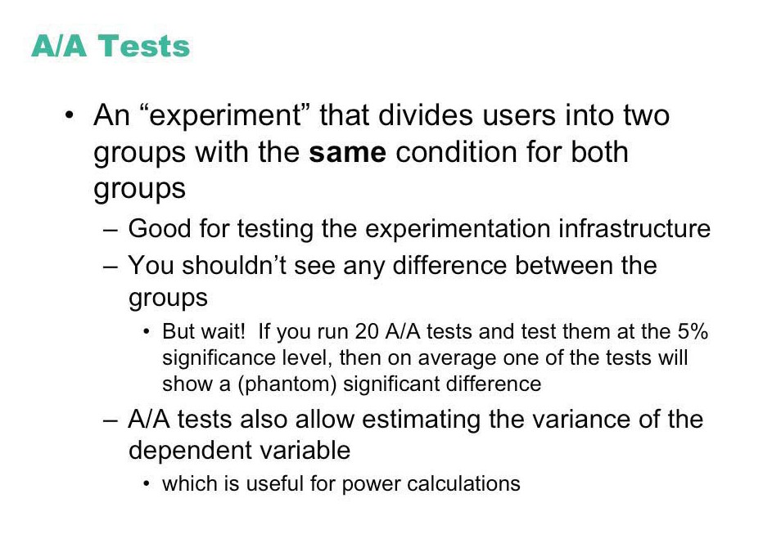

Slide 27
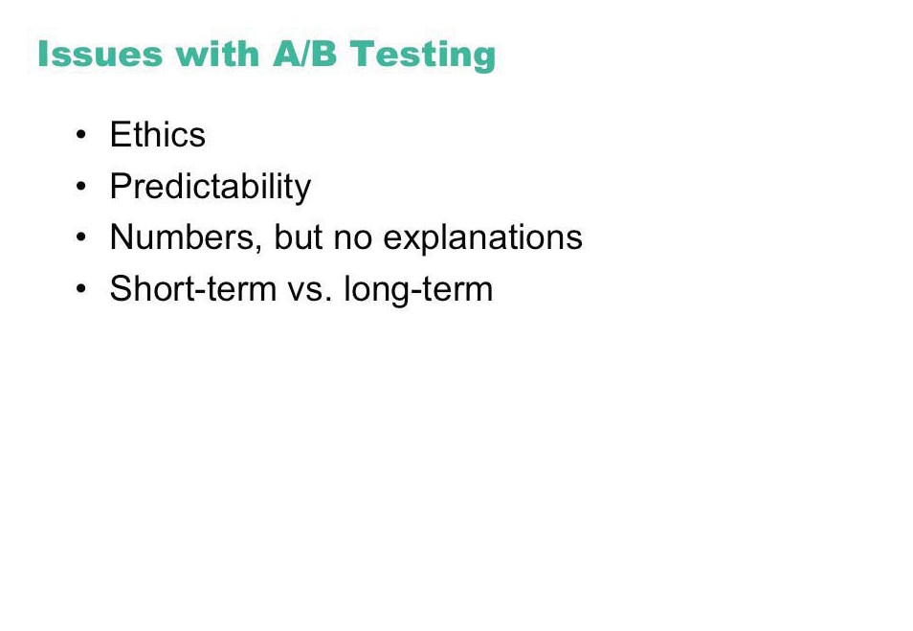

Slide 28
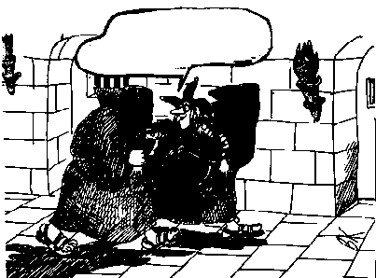
Ethics
...and to think that you want me to test it!!!

Slide 29
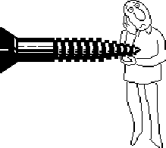
Ethics
Testing can be a distressing experience
pressure to perform, errors inevitable
feelings of inadequacy
competition with other subjects
Golden rule
subjects should always be treated with respect

Slide 30
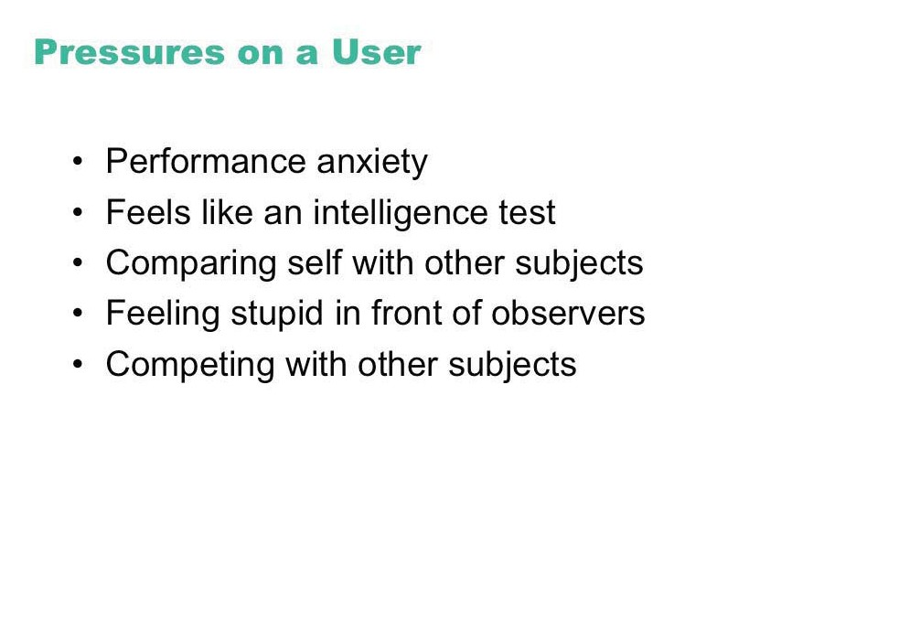

Slide 31
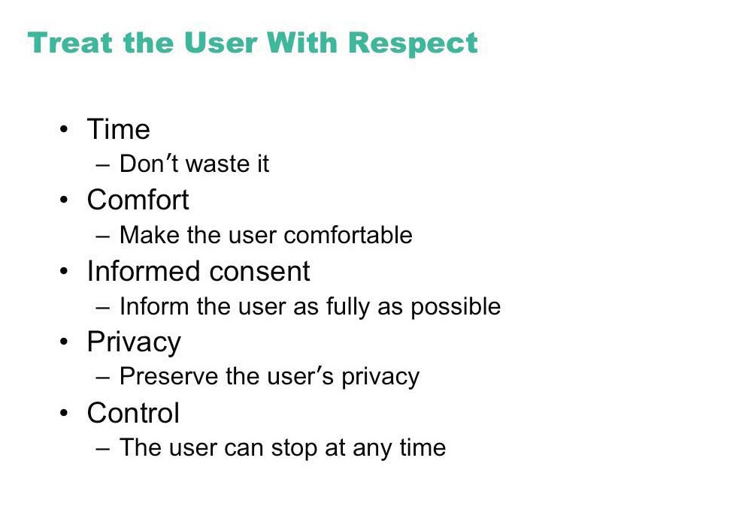

Slide 32
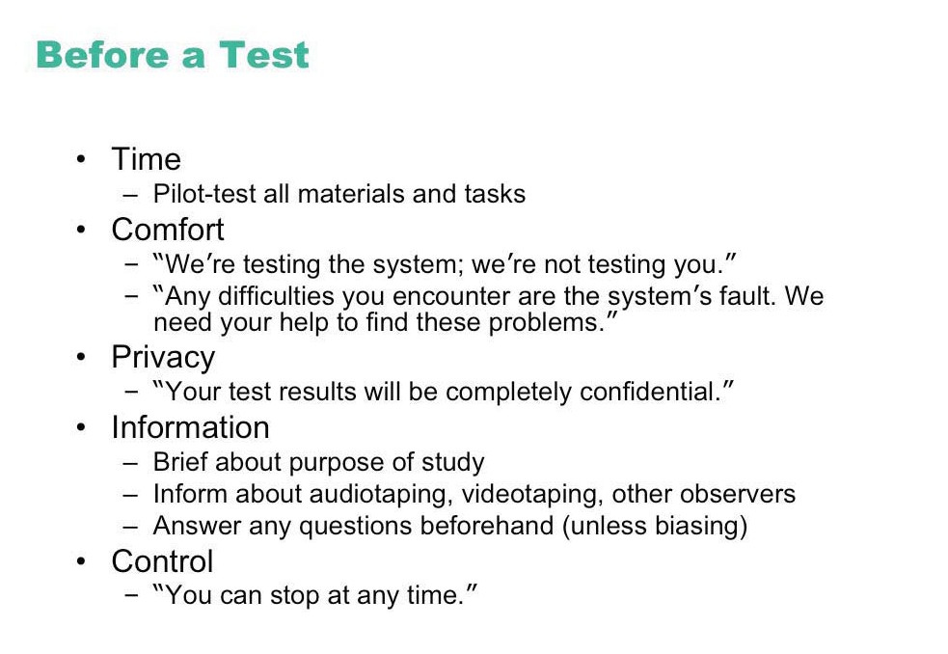

Slide 33
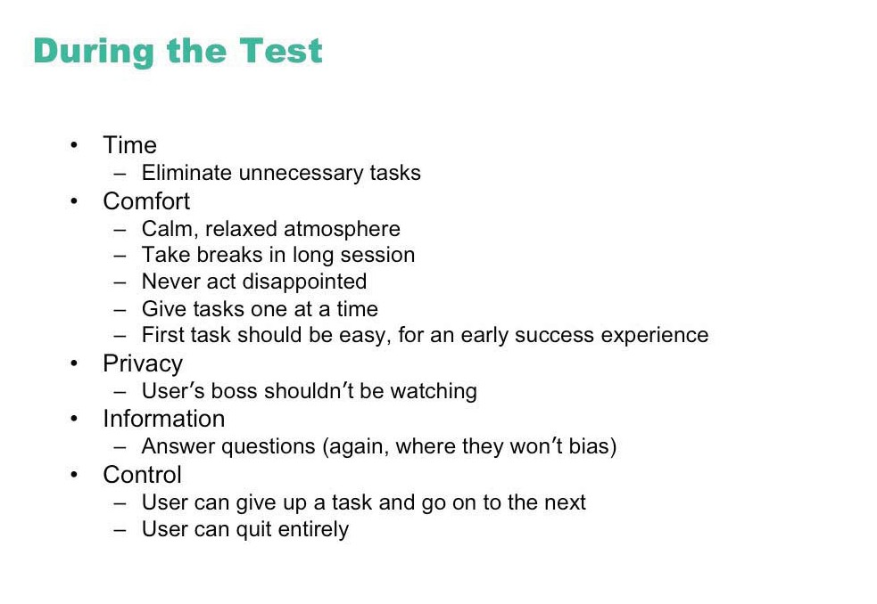

Slide 34
