Slide 1

Evaluation - Controlled Experiments
What is experimental design?
What is an experimental hypothesis?
How do I plan an experiment?
Why are statistics used?
What are the important statistical methods?
Slide deck by Saul Greenberg. Permission is granted to use this for non-commercial purposes as long as general credit to Saul Greenberg is clearly maintained. Warning: some material in this deck is used from other sources without permission. Credit to the original source is given if it is known.

Slide 2
Quantitative evaluation of systems
Quantitative:
precise measurement, numerical values
bounds on how correct our statements are
Methods
user performance data collection
controlled experiments

Slide 3

Collecting user performance data
Data collected on system use (often lots of data)
Exploratory:
hope something interesting shows up
but difficult to analyze
Targeted
look for specific information, but may miss something
frequency of request for on-line assistance
what did people ask for help with?
frequency of use of different parts of the system
why are parts of system unused?
number of errors and where they occurred
why does an error occur repeatedly?
time it takes to complete some operation
what tasks take longer than expected?

Slide 4
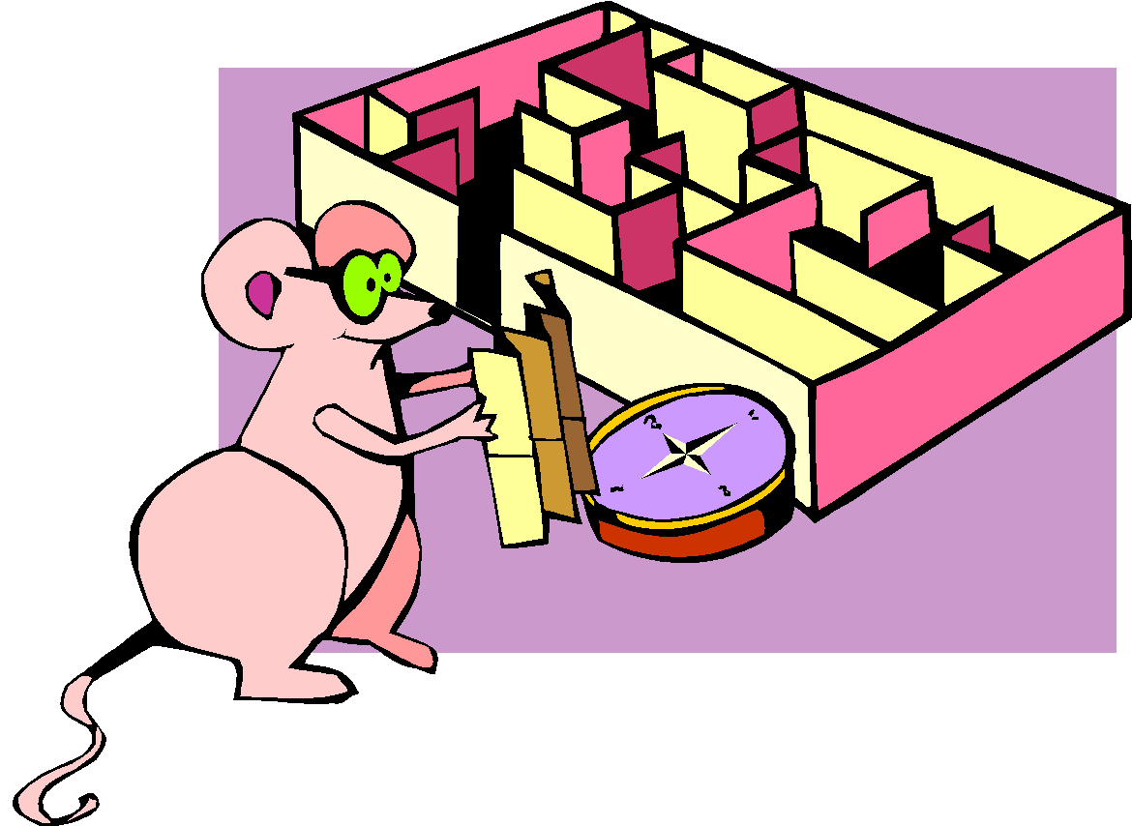
Controlled experiments
Traditional scientific method
Reductionist
clear convincing result on specific issues
In HCI:
insights into cognitive process, human performance limitations, ...
allows system comparison, fine-tuning of details ...

Slide 5
Controlled experiments
Strives for
lucid and testable hypothesis
quantitative measurement
measure of confidence in results obtained (statistics)
replicability of experiment
control of variables and conditions
removal of experimenter bias

Slide 6

A) Lucid and testable hypothesis
State a lucid, testable hypothesis
this is a precise problem statement
Example 1:
There is no difference in the number of cavities in children and teenagers using crest and no-teeth toothpaste when brushing daily over a one month period

Slide 7
A) Lucid and testable hypothesis
Example 2:
There is no difference in user performance (time and error rate) when selecting a single item from a pop-up or a pull down menu of 4 items, regardless of the subject’s previous expertise in using a mouse or using the different menu types”
File Edit View Insert
File
New
New
Edit
Open
Open
View
Close
Close
Insert
Save
Save

Slide 8
Independent variables
b) Hypothesis includes the independent variables that are to be altered
the things you manipulate independent of a subject’s behaviour
determines a modification to the conditions the subjects undergo
may arise from subjects being classified into different groups

Slide 9
Independent variables
in toothpaste experiment
toothpaste type: uses Crest or No-teeth toothpaste
age: <= 11 years or > 11 years
in menu experiment
menu type: pop-up or pull-down
menu length: 3, 6, 9, 12, 15
subject type (expert or novice)

Slide 10
Dependant variables
c) Hypothesis includes the dependent variables that will be measured
variables dependent on the subject’s behaviour / reaction to the independent variable
the specific things you set out to quantitatively measure / observe

Slide 11
Dependant variables
in menu experiment
time to select an item
selection errors made
time to learn to use it to proficiency
in toothpaste experiment
number of cavities
frequency of brushing
preference

Slide 12


Subject Selection
d) Judiciously select and assign subjects to groups
ways of controlling subject variability
reasonable amount of subjects
random assignment
make different user groups an independent variable
screen for anomalies in subject group
superstars versus poor performers
Novice
Expert

Slide 13

Controlling bias
e) Control for bias
unbiased instructions
unbiased experimental protocols
prepare scripts ahead of time
unbiased subject selection
Now you get to do the
pop-up menus. I think
you will really like them...
I designed them myself!

Slide 14

Statistical analysis
f) Apply statistical methods to data analysis
confidence limits:
the confidence that your conclusion is correct
“the hypothesis that computer experience makes no difference is rejected at the .05 level” means:
a 95% chance that your statement is correct
a 5% chance you are wrong

Slide 15

Interpretation
g) Interpret your results
what you believe the results really mean
their implications to your research
their implications to practitioners
how generalizable they are
limitations and critique

Slide 16
Planning flowchart for experiments
Stage 1
Stage 2
Stage 3
Stage 4
Stage 5
Problem
Planning
Conduct
Analysis
Interpret-
definition
research
ation
feedback
research
define
preliminary
data
interpretation
idea
variables
testing
reductions
literature
generalization
review
controls
data
statistics
collection
reporting
statement of
apparatus
hypothesis
problem
testing
procedures
hypothesis
select
development
subjects
experimental
design
feedback
Copied from an early ACM CHI tutorial, but I cannot recall which one

Slide 17
Statistical analysis
Calculations that tell us
mathematical attributes about our data sets
mean, amount of variance, ...
how data sets relate to each other
whether we are “sampling” from the same or different distributions
the probability that our claims are correct
“statistical significance”

Slide 18
Statistical vs practical significance
When n is large, even a trivial difference may show up as a statistically significant result
eg menu choice: mean selection time of menu a is 3.00 seconds; menu b is 3.05 seconds
Statistical significance does not imply that the difference is important!
a matter of interpretation
statistical significance often abused and used to misinform

Slide 19
Example: Differences between means
Condition one: 3, 4, 4, 4, 5, 5, 5, 6
Given:
two data sets measuring a condition
height difference of males and females
time to select an item from different menu styles ...
Question:
is the difference between the means of this data statistically significant?
Null hypothesis:
there is no difference between the two means
statistical analysis:
can only reject the hypothesis at a certain level of confidence
Condition two: 4, 4, 5, 5, 6, 6, 7, 7

Slide 20
Example:
mean = 4.5
3
2
Is there a significant difference between these means?
1
Condition one: 3, 4, 4, 4, 5, 5, 5, 6
0
3 4 5 6 7
Condition 1
Condition 1
3
mean = 5.5
2
1
Condition two: 4, 4, 5, 5, 6, 6, 7, 7
0
3 4 5 6 7
Condition 2
Condition 2

Slide 21

Problem with visual inspection of data
Will almost always see variation in collected data
Differences between data sets may be due to:
normal variation
eg two sets of ten tosses with different but fair dice
differences between data and means are accountable by expected variation
real differences between data
eg two sets of ten tosses for with loaded dice and fair dice
differences between data and means are not accountable by expected variation

Slide 22
T-test
A simple statistical test
allows one to say something about differences between means at a certain confidence level
Null hypothesis of the T-test:
no difference exists between the means of two sets of collected data
possible results:
I am 95% sure that null hypothesis is rejected
(there is probably a true difference between the means)
I cannot reject the null hypothesis
the means are likely the same

Slide 23
Different types of T-tests
Comparing two sets of independent observations
usually different subjects in each group
number per group may differ as well
Condition 1 Condition 2
S1–S20 S21–43
Paired observations
usually a single group studied under both experimental conditions
data points of one subject are treated as a pair
Condition 1 Condition 2
S1–S20 S1–S20

Slide 24
Different types of T-tests
Non-directional vs directional alternatives
non-directional (two-tailed)
no expectation that the direction of difference matters
directional (one-tailed)
Only interested if the mean of a given condition is greater than the other

Slide 25
T-test...
Assumptions of t-tests
data points of each sample are normally distributed
but t-test very robust in practice
population variances are equal
t-test reasonably robust for differing variances
deserves consideration
individual observations of data points in sample are independent
must be adhered to
Significance level
decide upon the level before you do the test!
typically stated at the .05 or .01 level

Slide 26
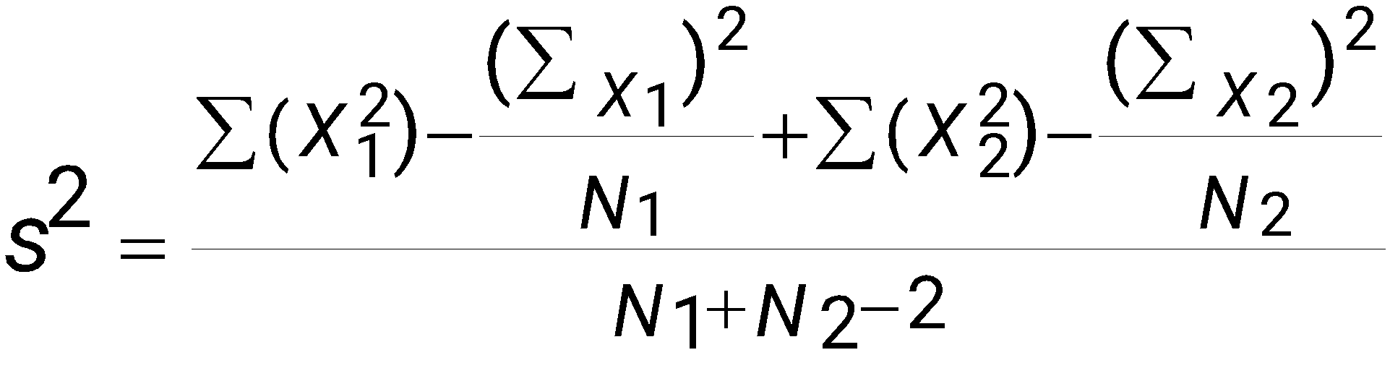
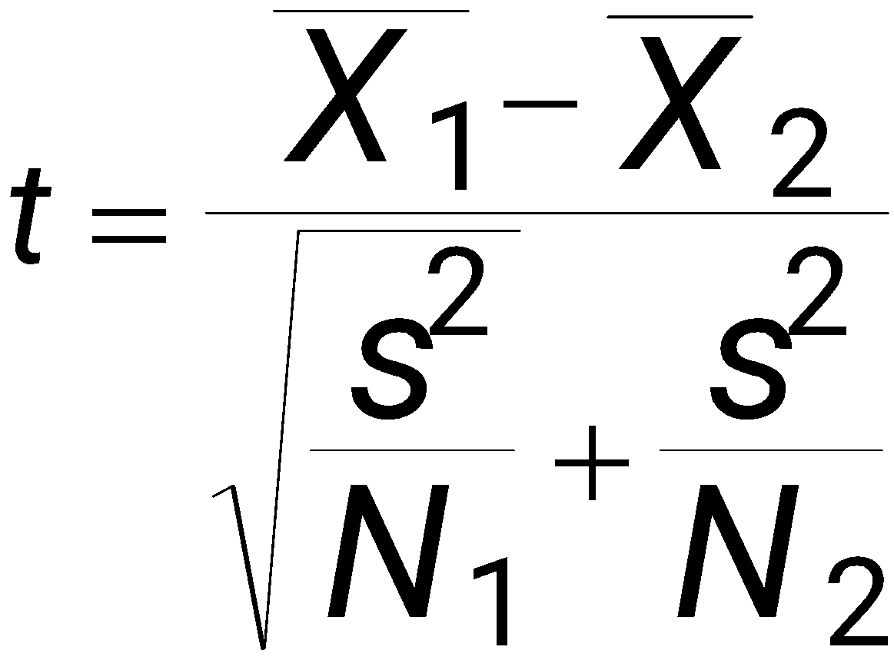
Two-tailed unpaired T-test
N: number of data points in the one sample
ΣX: sum of all data points in one sample
X: mean of data points in sample
Σ(X²): sum of squares of data points in sample
s²: unbiased estimate of population variation
t: t ratio
df = degrees of freedom = N1 + N2 – 2
Formulas

Slide 27
Level of significance for two-tailed test
df .05 .01
1 12.706 63.657
2 4.303 9.925
3 3.182 5.841
4 2.776 4.604
5 2.571 4.032
6 2.447 3.707
7 2.365 3.499
8 2.306 3.355
9 2.262 3.250
10 2.228 3.169
11 2.201 3.106
12 2.179 3.055
13 2.160 3.012
14 2.145 2.977
15 2.131 2.947
df .05 .01
16 2.120 2.921
18 2.101 2.878
20 2.086 2.845
22 2.074 2.819
24 2.064 2.797

Slide 28
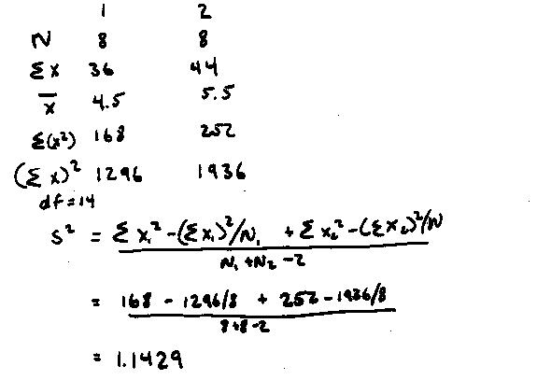
Example Calculation
x₁ = 3 4 4 4 5 5 5 6 Hypothesis: there is no significant difference
x₂ = 4 4 5 5 6 6 7 7 between the means at the .05 level
Step 1. Calculating s²

Slide 29
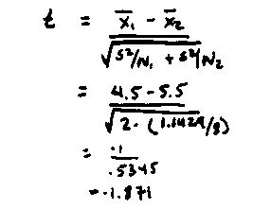
Example Calculation
Step 2. Calculating t

Slide 30
Example Calculation
df .05 .01
1 12.706 63.657
…
14 2.145 2.977
15 2.131 2.947
Step 3: Looking up critical value of t
Use table for two-tailed t-test, at p=.05, df=14
critical value = 2.145
because t=1.871 < 2.145, there is no significant difference
therefore, we cannot reject the null hypothesis i.e., there is no difference between the means

Slide 31
Two-tailed Unpaired T-test
Or, use a statistics package (e.g., Excel has simple stats)
Condition one: 3, 4, 4, 4, 5, 5, 5, 6
Condition two: 4, 4, 5, 5, 6, 6, 7, 7
Unpaired t-test
DF:
Unpaired t Value:
Prob. (2-tail):
14
-1.871
.0824
Group:
Count:
Mean:
Std. Dev.:
Std. Error:
one
8
4.5
.926
.327
two
8
5.5
1.195
.423

Slide 32
Significance levels and errors
Type 1 error
reject the null hypothesis when it is, in fact, true
Type 2 error
accept the null hypothesis when it is, in fact, false
Effects of levels of significance
high confidence level (eg p<.0001)
greater chance of Type 2 errors
low confidence level (eg p>.1)
greater chance of Type 1 errors
You can ‘bias’ your choice depending on consequence of these errors

Slide 33
Type I and Type II Errors
Type 1 error
reject the null hypothesis when it is, in fact, true
Type 2 error
accept the null hypothesis when it is, in fact, false
Decision
 | False | True
True | Type I error | ✓
False | ✓ | Type II error
“Reality”

Slide 34

Example: The SpamAssassin Spam Rater
A SPAM rater gives each email a SPAM likelihood
0: definitely valid email…
1:
2:
…
9:
10: definitely SPAM
SPAM likelihood
 1

Spam Rater
 3


5
 7
9
7

Slide 35



Example: The SpamAssassin Spam Rater
A SPAM assassin deletes mail above a certain SPAM threshold
what should this threshold be?
‘Null hypothesis’: the arriving mail is SPAM
<=X
 1

Spam Rater
 3


5
 7
>X
9
7

Slide 36
Example: The SpamAssassin Spam Rater
Low threshold = many Type I errors
many legitimate emails classified as spam
but you receive very few actual spams
High threshold = many Type II errors
many spams classified as email
but you receive almost all your valid emails
<=X
 1

Spam Rater
 3


5
 7
>X
9
7

Slide 37
Which is Worse?
Type I errors are considered worse because the null hypothesis is meant to reflect the incumbent theory.
BUT
you must use your judgement to assess actual risk of being wrong in the context of your study.

Slide 38
Significance levels and errors
There is no difference between Pie and traditional pop-up menus
What is the consequence of each error type?
Type 1:
extra work developing software
people must learn a new idiom for no benefit
Type 2:
use a less efficient (but already familiar) menu
Which error type is preferable?
Redesigning a traditional GUI interface
Type 2 error is preferable to a Type 1 error
Designing a digital mapping application where experts perform extremely frequent menu selections
Type 1 error preferable to a Type 2 error
Close
Open
New
Save
New
Open
Close
Save

Slide 39
Scales of Measurements
Four major scales of measurements
Nominal
Ordinal
Interval
Ratio

Slide 40

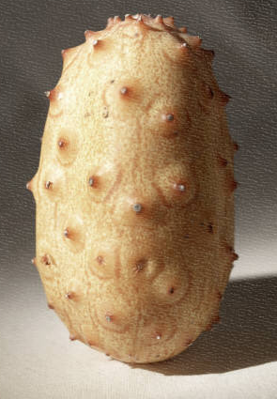
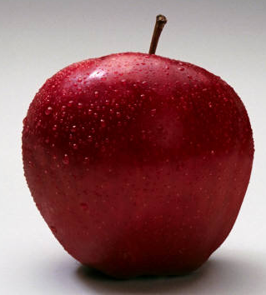
Nominal Scale
Classification into named or numbered unordered categories
country of birth, user groups, gender…
Allowable manipulations
whether an item belongs in a category
counting items in a category
Statistics
number of cases in each category
most frequent category
no means, medians…
With permission of Ron Wardell

Slide 41
Nominal Scale
Sources of error
agreement in labeling, vague labels, vague differences in objects
Testing for error
agreement between different judges for same object
With permission of Ron Wardell

Slide 42


Ordinal Scale
Classification into named or numbered ordered categories
no information on magnitude of differences between categories
e.g. preference, social status, gold/silver/bronze medals
Allowable manipulations
as with interval scale, plus
merge adjacent classes
transitive: if A > B > C, then A > C
Statistics
median (central value)
percentiles, e.g., 30% were less than B
Sources of error
as in nominal
With permission of Ron Wardell

Slide 43


Interval Scale
Classification into ordered categories with equal differences between categories
zero only by convention
e.g. temperature (C or F), time of day
Allowable manipulations
add, subtract
cannot multiply as this needs an absolute zero
Statistics
mean, standard deviation, range, variance
Sources of error
instrument calibration, reproducibility and readability
human error, skill…
With permission of Ron Wardell

Slide 44
Ratio Scale
Interval scale with absolute, non-arbitrary zero
e.g. temperature (K), length, weight, time periods
Allowable manipulations
multiply, divide
With permission of Ron Wardell

Slide 45
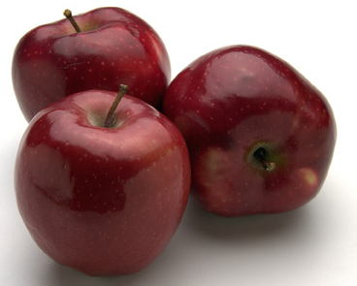
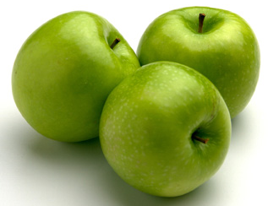
Example: Apples
Nominal:
apple variety
Macintosh, Delicious, Gala…
Ordinal:
apple quality
US. Extra Fancy
U.S. Fancy,
U.S. Combination Extra Fancy / Fancy
U.S. No. 1
U.S. Early
U.S. Utility
U.S. Hail
With permission of Ron Wardell

Slide 46
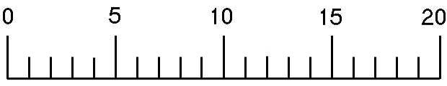
Example: Apples
Interval:
apple ‘Liking scale’ Marin, A. Consumers’ evaluation of apple quality. Washington Tree Postharvest Conference 2002.
After taking at least 2 bites how much do you like the apple?
Dislike extremely Neither like or dislike Like extremely
Ratio:
apple weight, size, …
With permission of Ron Wardell

Slide 47
Correlation
Measures the extent to which two concepts are related
eg years of university training vs computer ownership per capita
How?
obtain the two sets of measurements
calculate correlation coefficient
+1: positively correlated
0: no correlation (no relation)
–1: negatively correlated

Slide 48
Correlation
10
r² = .668
condition 1 condition 2
9
5
6
4
5
8
6
7
4
4
5
6
7
3
5
5
7
4
4
6
5
7
6
7
6
6
5
7
7
6
8
4
7
9
3
2.5
3
3.5
4
4.5
5
5.5
6
6.5
7
7.5
Condition 1
Condition 1

Slide 49
Correlation
Dangers
attributing causality
a correlation does not imply cause and effect
cause may be due to a third “hidden” variable related to both other variables
drawing strong conclusion from small numbers
unreliable with small groups
be wary of accepting anything more than the direction of correlation unless you have at least 40 subjects

Slide 50
Correlation
10
Pickles eaten per month
Salary per year (*10,000)
r² = .668
9
5
6
4
5
8
6
7
4
4
5
6
7
3
5
5
7
Salary per year (*10,000)
4
4
6
5
7
6
7
6
6
5
7
7
6
8
4
7
9
3
Which conclusion could be correct? -Eating pickles causes your salary to increase
-Making more money causes you to eat more pickles
-Pickle consumption predicts higher salaries because older people tend to like pickles better than younger people, and older people tend to make more money than younger people
2.5
3
3.5
4
4.5
5
5.5
6
6.5
7
7.5
Pickles eaten per month

Slide 51
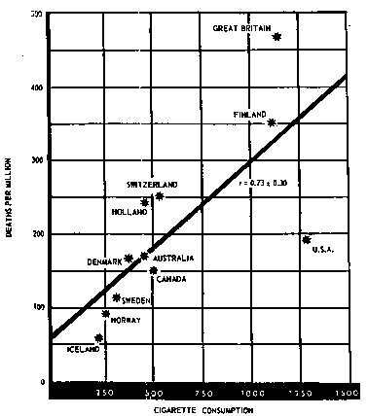
Correlation
Cigarette Consumption
Crude Male death rate for lung cancer in 1950 per capita consumption of cigarettes in 1930 in various countries.
While strong correlation (.73), can you prove that cigarrette smoking causes death from this data?
Possible hidden variables:
age
poverty

Slide 52
Other Tests: Regression
Calculates a line of “best fit”
Use the value of one variable to predict the value of the other
e.g., 60% of people with 3 years of university own a computer
10
y = .988x + 1.132, r2 = .668
y = .988x + 1.132, r2 = .668
9
condition 1 condition 2
5
6
8
4
5
6
7
4
4
7
5
6
Condition 2
3
5
6
5
7
4
4
5
7
5
6
7
6
6
7
7
4
6
8
7
9
3
3
4
5
6
7
Condition 1

Slide 53
Single Factor Analysis of Variance
Compares three or more means
e.g. comparing mouse-typing on three keyboards:
Possible results:
mouse-typing speed is
fastest on a qwerty keyboard
the same on an alphabetic & dvorak keyboards
Qwerty
Alphabetic
Dvorak
S1-S10
S11-S20
S21-S30

Slide 54
Analysis of Variance (Anova)
Compares relationships between many factors
Provides more informed results considers the interactions between factors
example
beginners type at the same speed on all keyboards,
touch-typist type fastest on the qwerty
Qwerty
Alphabetic
Dvorak
cannot
S1-S10
S11-S20
S21-S30
touch type
can
S31-S40
S41-S50
S51-S60
touch type

Slide 55
You know now
Controlled experiments can provide clear convincing result on specific issues
Creating testable hypotheses are critical to good experimental design
Experimental design requires a great deal of planning

Slide 56
You know now
Statistics inform us about
mathematical attributes about our data sets
how data sets relate to each other
the probability that our claims are correct
There are many statistical methods that can be applied to different experimental designs
T-tests
Correlation and regression
Single factor Anova
Anova

