Slide 1
Architectural Styles

Slide 2
Objectives
To review the definitions of software architecture and architectural style
To present several important architectural styles, including
  Layered
  Pipe-and-Filter
  Shared-Data
  Event-Driven
  Model-View-Controller
  Hybrid

Slide 3
Topics
Software architecture and architectural styles
Layered style
Pipe-and-Filter style
Shared-Data style
Event-Driven style
Model-View-Controller style
Hybrid architectures

Slide 4
Software Architecture
A software architecture is the structure of a program comprised by its major constituents, their responsibilities and properties, and the relationships and interactions between them.

Slide 5
Software Architecture Issues
Gross decomposition of system function
Allocation of functions to components
Component interfaces
Communication and interaction among components
Component and system properties: capacity, throughput, constraints
Reuse of common design styles

Slide 6
Architectural Styles
An architectural style is a paradigm of program or system constituent types and their interactions.

Slide 7
Layered Style Architectures
The program is partitioned into an array of layers or groups.
Layers use the services of the layer or layers below and provide services to the layer or layers above.
The Layered style is among the most widely used of all architectural styles.

Slide 8
Uses and Invokes
Module A uses module B if a correct version of B must be present for A to execute correctly.
Module A calls or invokes module B if A triggers execution of B.
Note that
  A module may use but not invoke another
  A module may invoke but not use another
  A module may both use and invoke another
  A module may neither use nor invoke another

Slide 9
Layer Constraints
Static structure—The software is partitioned into layers that each provide a cohesive set of services with a well-defined interface.
Dynamic structure—Each layer is allowed to use only the layer directly below it (Strict Layered style) or the all the layers below it (Relaxed Layered style).

Slide 10
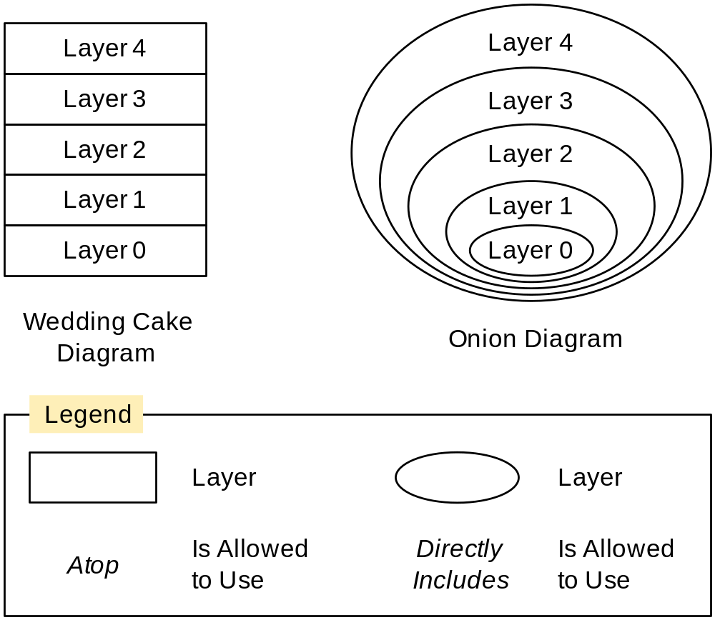
Representing Layers

Slide 11
Forming Layers
Levels of abstraction
  Example: Network communication layers
Virtual machines
  Examples: Operating systems, interpreters
Information hiding, decoupling, etc
  Examples: User interface layers, virtual device layers

Slide 12
Layered Style Advantages
Layers are highly cohesive and promote information hiding.
Layers are not strongly coupled to layers above them, reducing overall coupling.
Layers help decompose programs, reducing complexity.
Layers are easy to alter or fix by replacing entire layers, and easy to enhance by adding functionality to a layer.
Layers are usually easy to reuse.

Slide 13
Layered Style Disadvantages
Passing everything through many layers can complicate systems and damage performance.
Debugging through multiple layers can be difficult.
Getting the layers right can be difficult.
Layer constraints may have to be violated to achieve unforeseen functionality.

Slide 14
Pipe-and-Filter Style
A filter is a program component that transforms an input stream to an output stream.
A pipe is conduit for a stream.
The Pipe-and-Filter style is a dynamic model in which program components are filters connected by pipes.

Slide 15
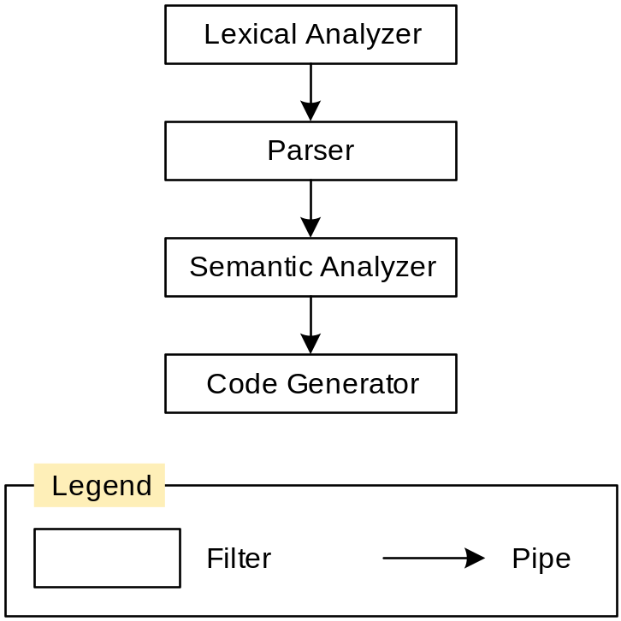
Pipe-and-Filter Example

Slide 16
Pipe-and-Filter Characteristics
Pipes are isolated and usually only communicate through data streams, so they are easy to write, test, reuse, and replace.
Filters may execute concurrently.
  Requires pipes to synchronize filters
Pipe-and-filter topologies should be acyclic graphs.
  Avoids timing and deadlock issues
A simple linear arrangement is a pipeline.

Slide 17
Pipe-and-Filter Advantages
Filters can be modified and replaced easily.
Filters can be rearranged with little effort, making it easy to develop similar programs.
Filters are highly reusable.
Concurrency is supported and is relatively easy to implement.

Slide 18
Pipe-and-Filter Disadvantages
Filters communicate only through pipes, which makes it difficult to coordinate them.
Filters usually work on simple data streams, which may result in wasted data conversion effort.
Error handling is difficult.
Gains from concurrency may be illusory.

Slide 19
Shared-Data Style
One or more shared-data stores are used by one or more shared-data accessors that communicate solely through the shared-data stores.
Two variants:
  Blackboard style—The shared-data stores activate the accessors when the stores change.
  Repository style—The shared-data stores are passive and manipulated by the accessors.
This is a dynamic model only.

Slide 20
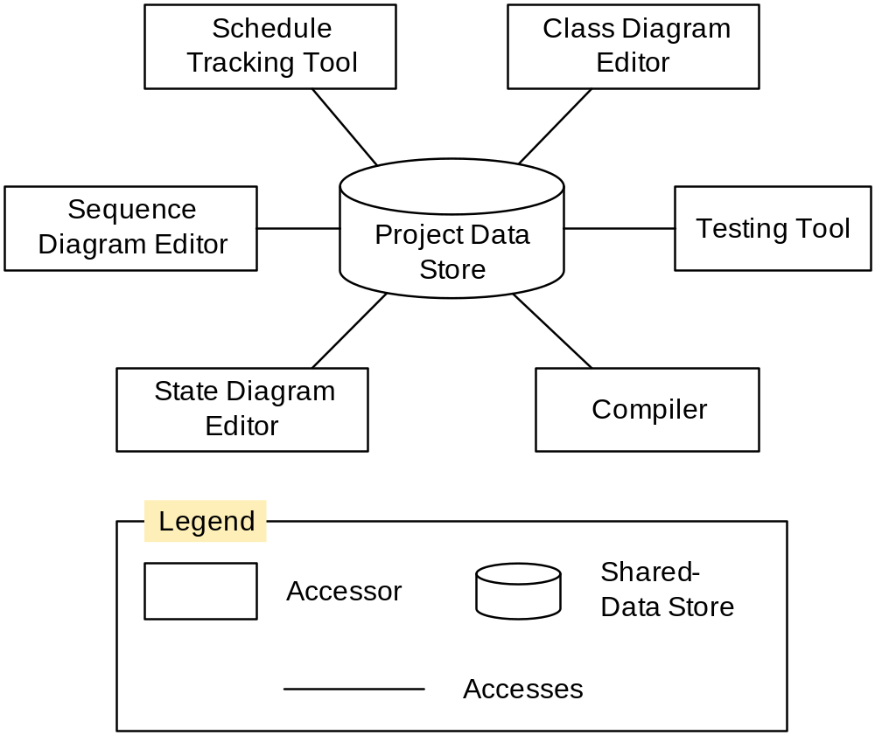
Shared-Data Style Example

Slide 21
Shared-Data Style Advantages
Shared-data accessors communicate only through the shared-data store, so they are easy to change, replace, remove, or add to.
Accessor independence increases robustness and fault tolerance.
Placing all data in the shared-data store makes it easier to secure and control.

Slide 22
Shared-Data Style Disadvantages
Forcing all data through the shared-data store may degrade performance.
If the shared-data store fails, the entire program is crippled.

Slide 23
Event-Driven Style
Also called the Implicit Invocation style
An event is any noteworthy occurrence.
An event dispatcher mediates between components that announce and are notified of events.
This is a dynamic model only.

Slide 24
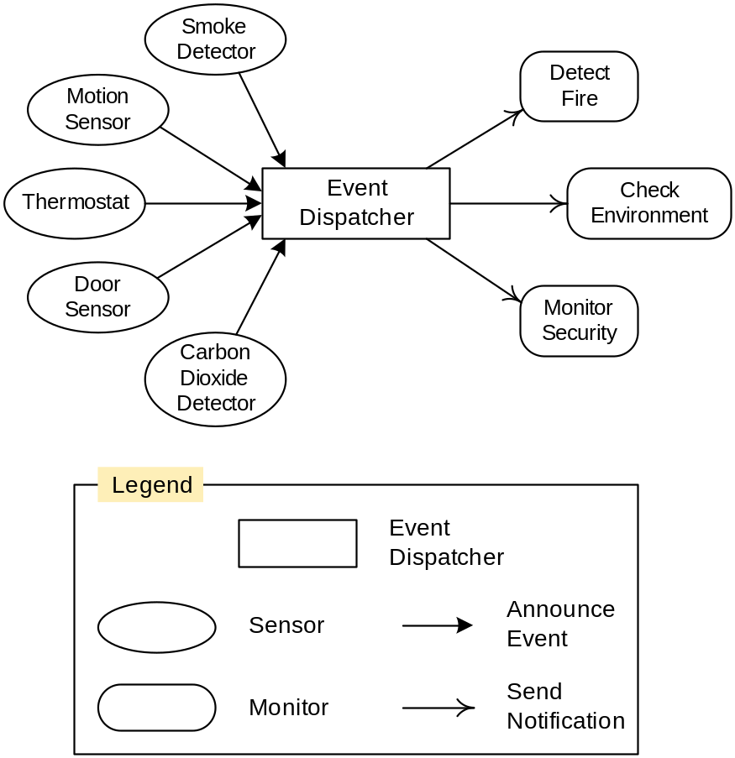
Event-Driven Style Example

Slide 25
Stylistic Variations
Events may be notifications or they may carry data.
Events may have constraints honored by the dispatcher, or the dispatcher may manipulate events.
Events may be dispatched synchronously or asynchronously.
Event registration may be constrained in various ways.

Slide 26
Event-Driven Style Advantages
It is easy to add or remove components.
Components are decoupled, so they are highly reusable, changeable, and replaceable.
Systems built with this style are robust and fault tolerant.

Slide 27
Event-Driven Style Disadvantages
Component interaction may be awkward when mediated by the event dispatcher.
There are no guarantees about event sequencing or timing, which may make it difficult to write correct programs.
Event traffic tends to be highly variable, which may make it difficult to achieve performance goals.

Slide 28
Model-View-Controller (MVC) Style
This style models how to set up the relationships between user interface and problem-domain components.
Model—A problem-domain component with data and operations for achieving program goals independent of the user interface
View—A data display component
Controller—A component that receives and acts on user input

Slide 29
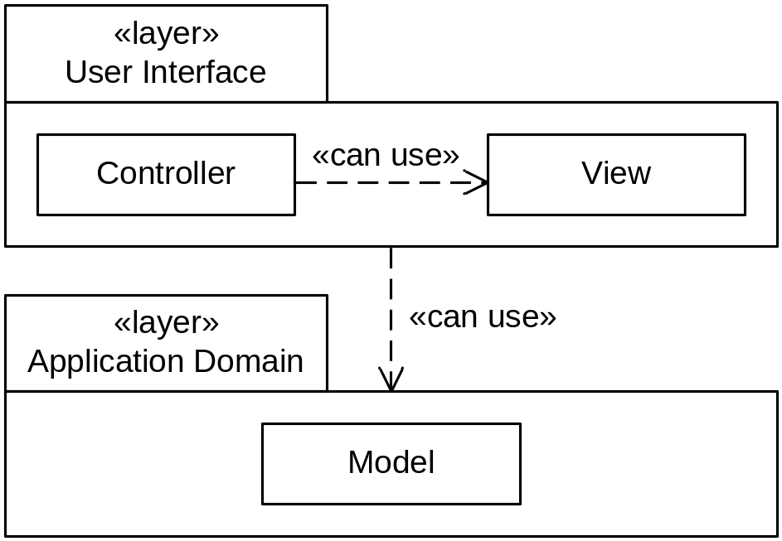
MVC Static Structure

Slide 30
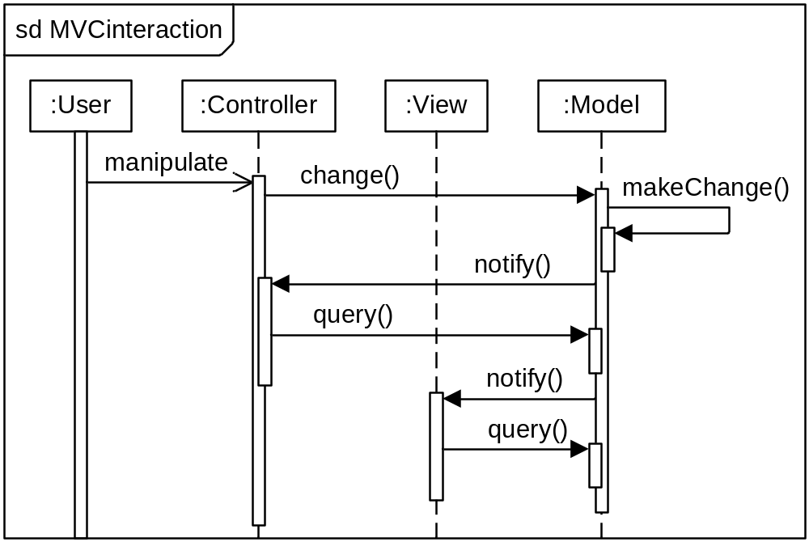
MVC Behavior

Slide 31
MVC Advantages
Views and controllers can be added, removed, or changed without disturbing the model.
Views can be added or changed during execution.
User interface components can be changed, even at runtime.

Slide 32
MVC Disadvantages
Views and controller are often hard to separate.
Frequent updates may slow data display and degrade user interface performance.
The MVC style makes user interface components highly dependent on model components.

Slide 33
Hybrid Architectures
Most systems of any size include several architectural styles, often at different levels of abstraction.
  An overall a system may have a Layered style, but the one layer may use the Event-Driven style, and another the Shared-Data style.
  An overall system may have a Pipe-and-Filter style, but the individual filters may have Layered styles.

Slide 34
Summary 1
In the Layered style program components are partitioned into layers and each layer is constrained to use only the layer or layers beneath it.
In the Pipe-and-Filter style components are filters connected by pipes.
In the Shared-Data style program components are modeled as one or more shared-data stores manipulated by one or more shared-data accessors.

Slide 35
Summary 2
In the Event-Driven style program components register with an event dispatcher than accepts announcement of events and notifies interested components that events have occurred.
In the Model-View-Controller style user interface view and controller components can use problem-domain model components that notify them when they change.

Slide 36
Summary 3
Architectures are usually composed of several styles, often at different levels of abstraction, that is, architectures are often hybrids of styles.

