Slide 1
Context of Software Product Design

Slide 2
Objectives
To explain how markets influence product types, which in turn influence design
To explain the product planning process
To describe the role and contents of a project mission statement
To list the variety of software requirements specifications
To describe the role and contents of an SRS

Slide 3
Topics
Markets and product categories
Product planning
Project mission statements
Software requirements specifications
Types of software requirements

Slide 4
Markets
A market is a set of actual or prospective customers who need or want a product, have the resources to exchange something of value for it, and are willing to do so.
Organizations study markets to
Choose which markets to sell to (target markets)
Choose what products to develop
Determine product features and characteristics

Slide 5
Product Categories
A product category is a dimension along which products may differ, for example
Target market size
Product line novelty
Technological novelty
Product categories help managers
Choose target markets
Choose products to develop
Choose product characteristics
A product’s place in a category influences its design specifications and the design process

Slide 6
Product Plans
Management must decide which products to develop.
This decision is documented in a product plan.
A product plan is a list of approved development projects, with start and delivery dates.

Slide 7
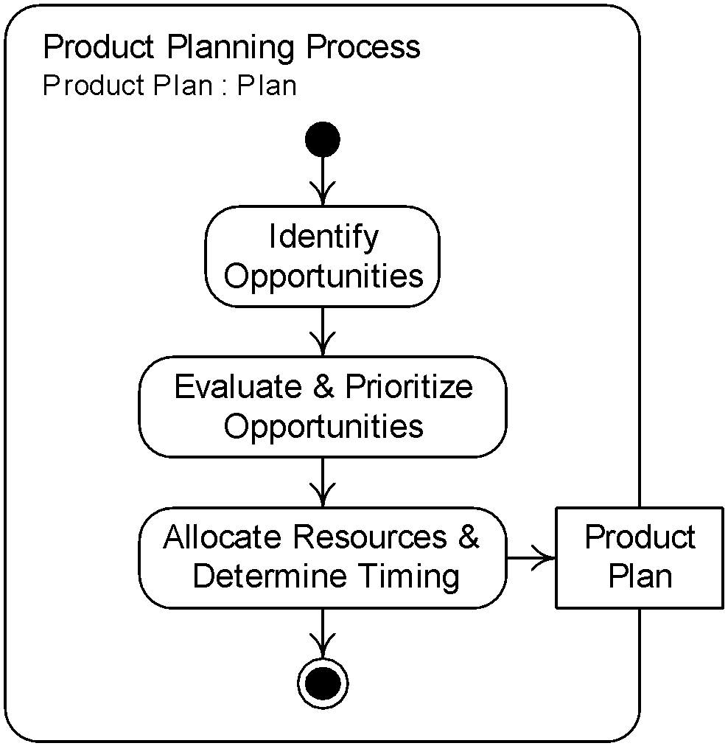
Product Planning Process

Slide 8
Identifying Opportunities
New product ideas come from
Customers
Developers
Entrepreneurs
Marketers
An opportunity funnel is a mechanisms for collecting product ideas from diverse sources.
Passive channels
Active channels
An opportunity statement is a brief description of a product development idea.

Slide 9
Evaluating and Prioritizing Opportunities
Management chooses to pursue opportunities based on
Competitive strategy
Market segmentation
Technology trajectories
Software reuse
Profitability
Managers attempt to form a well-balanced and complete product portfolio.

Slide 10
Alocating Resources and Determining Timing
Usually there are more good opportunities than an organization can afford to pursue.
Resources available for development are analyzed to determine which product to develop.
Resource availability also determines the start time and duration or projects.
The result is a product plan.

Slide 11
Project Mission Statement
A project mission statement is a document that defines a development project’s goals and limits.
A project mission statement
Launches a development project
States the software design problem
The project mission statement is the main input to the product design process.

Slide 12
Project Mission Statement Template
1. Introduction
2. Product Vision and Project Scope
3. Target Markets
4. Stakeholders
5. Assumptions and Constraints
6. Business Requirements

Slide 13
Introduction, Vision, and Scope
The introduction contains background information to provide context.
A product vision statement is a general description of the product’s purpose and form.
The project scope is the work to be done on a project.
Often only part of the product vision.
May list what will not to be done as well as what will be done.

Slide 14
Target Market and Stakeholders
A stakeholder is anyone affected by a product or involved in or influencing its development.
Product users and purchasers
Developers and their managers
Marketing, sales, distribution, and product support personnel
Regulators, inspectors, and lawyers
Developers must know the target market and stakeholders to build a product satisfying stakeholders’ needs.

Slide 15
Assumptions and Constraints
An assumption is something that developers take for granted.
Feature of the problem
Examples: target deployment environments, levels of user support
A constraint is any factor that limits developers.
Restriction on the solution
Examples: cost and time limits, conformance to regulations

Slide 16
Business Requirements
A business requirement is a statement of a client or development organization goal that a product must meet.
Time, cost, quality, or business results
Should be stated so that it is clear whether it is satisfied (quantitative goals)
Broad goals related to business, not detailed product specifications

Slide 17
Requirements Engineering
Requirements engineering is
creating, modifying, and managing
requirements over a product’s lifetime.
Requirements development is the portion of requirements engineering concerned with initially establishing requirements (aka product design).
Requirements management is the portion of requirements engineering concerned with controlling and propagating requirements changes.

Slide 18
SRS
A software requirements specification (SRS) is a document cataloging all the requirements for a software product.
The SRS should contain
A statement of the product design problem (may cite the mission statement)
A solution to the product design problem
An SRS is the output of the produce design process.

Slide 19
Technical Requirements
A technical requirement is a statement of a feature, function, capability, or property that a product must have (that is not a business requirement).
A functional requirement is a statement of how a program must map program inputs to program outputs.
A non-functional requirement is a statement that a software product must have certain properties.
A data requirement is a statement that certain data must be input to, output from, or stored by a product.

Slide 20
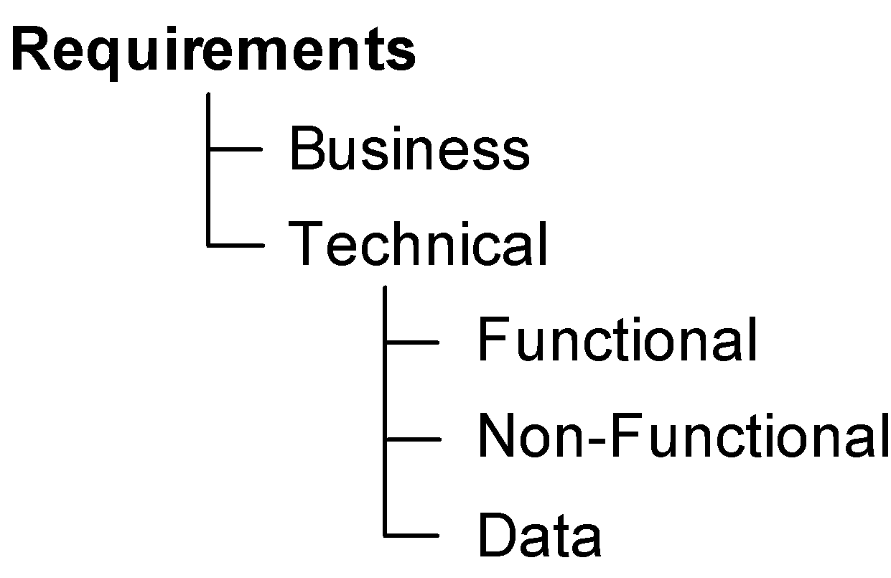
Requirements Taxonomy

Slide 21
Levels of Abstraction
A user-level requirement is statement about how a product must support stakeholders in achieving their goals or tasks.
An operational-level requirement is a statement about inputs, outputs, operations, characteristics, etc. that a product must provide, without reference to physical realization.
A physical-level requirement is a statement about the physical form of a product, its physical interfaces, or its data formats.

Slide 22
Interaction Design
Interaction design is the activity of specifying products that people can use effectively and enjoyably.
Dialog design—The dynamics of the interaction
Physical form design—The static characteristics and appearance of the interface (presentation)
Interaction design should be part of requirements development.

Slide 23
SRS Template
1. Product Description
1.1 Product Vision
1.2 Business Requirements
1.3 Users and Other Stakeholders
1.4 Project Scope
1.5 Assumptions
1.6 Constraints
2. Functional Requirements
3. Data Requirements
4. Non-Functional Requirements
5. Interface Requirements
5.1 User Interfaces
5.2 Hardware Interfaces
5.3 Software Interfaces

Slide 24
Summary
Markets influence product development decisions; product types influence product design.
Management performs a product planning process to produce a product plan listing development projects.
Projects are launched with a project mission statement that frames the product design problem.
The output of product design is an SRS that contains functional, non-functional, and data requirements stated at several levels of abstraction.
An interaction design is an essential part of an SRS.

