Slide 1
TCP Congestion Control
M. Umar 2021-SE-28
Abdul Haseeb 2021-SE-22

Slide 2
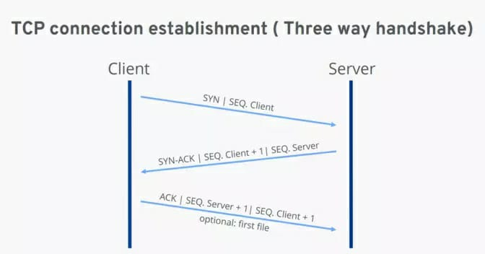
Introduction
TCP
Widely Used Internet Protocol
Reliable
Transfer data in An Ordered Way
Typical TCP Connection
What Is Congestion?
Overcrowding
Blockage
congestion in TCP (Transmission Control Protocol) occurs when there's too much data trying to flow through a network at the same time, causing a kind of traffic jam.

Slide 3
Congestion Window
Purpose?
imposes a constraint on the rate at which a TCP sender can send traffic into the network
Denoted by “cwnd”
Equation:
Where
LastByteSent: the sequence number of the last byte that the sender has sent.
LastByteAcked: the sequence number of the last byte that has been successfully acknowledged by the receiver.
cwnd (Congestion Window)
rwnd (Receiver Window)

Slide 4
Equation can also be Written as:
“ Unacknowledged Data ≤ min{cwnd, rwnd} ”
The equation essentially says that the difference between LastByteSent and LastByteAcked, which represents the amount of unacknowledged data in transit, should not exceed the minimum of the congestion window (cwnd) and the receiver window (rwnd).
What If
the TCP receive buffer is so large that the receive-window constraint can be ignored
Then the equation will be:
“ Unacknowledged Data ≤ min{cwnd} ”
Therefore,
the amount of unacknowledged data at the sender is solely limited by cwnd.

Slide 5
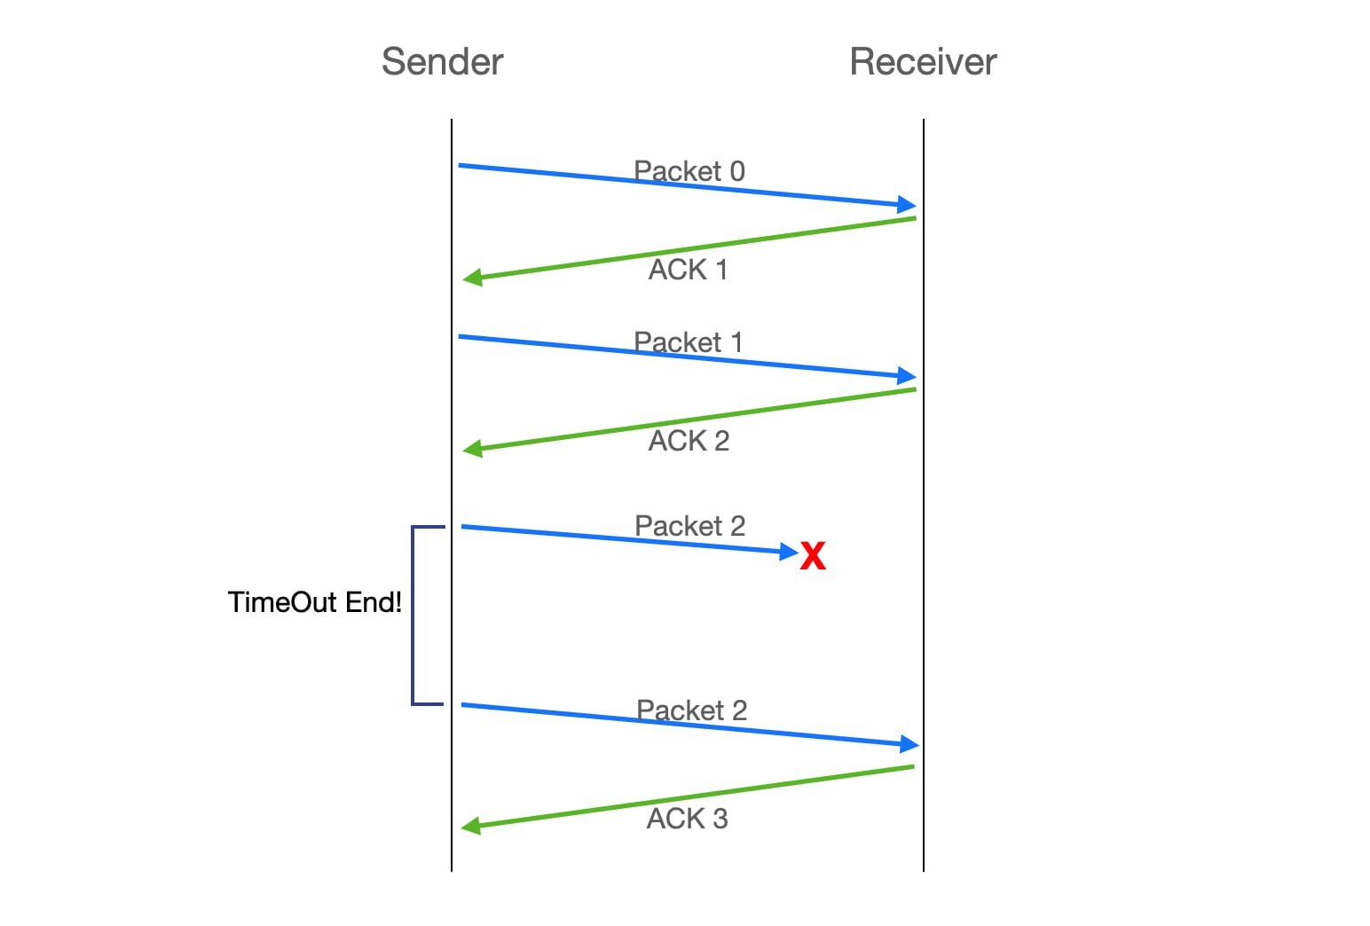
How a TCP sender perceives that there is congestion on the path?
Loss Event
Timeout
the receipt of four acknowledgments
(three duplicate ACKs followed by an additional original ACK)
Excessive Congestion
Router Buffers
Datagram
Congestion-Free Network
No Any Type Of Loss
TCP is said to be “ Self Clocking ”
Adjusts its sending rate based on the feedback it receives from the network, without relying on external timing mechanisms

Slide 6

How should a TCP sender determine the rate at which it should send?
If too fast,
(network will be congested)
If too slow,
(could under utilize the bandwidth in the network)
Question:
How then do the TCP senders determine their sending rates such that they don’t congest the network but at the same time make use of all the available bandwidth?
Guiding Principles:
Lost segment implies congestion
An acknowledged segment
Bandwidth probing

Slide 7
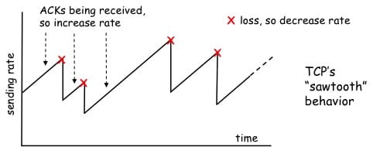
Lost segment implies congestion
Decrease congestion window size
Decrease sending rate
An acknowledged segment
congestion window size can be increased
Bandwidth probing
TCP congestion-control algorithm
The algorithm has three major components:
Slow start
Congestion avoidance
Fast recovery
Sawtooth behavior to find a balance between utilizing available bandwidth and avoiding congestion.

Slide 8
Slow Start
to efficiently probe the network's capacity and avoid congestion
cwnd is typically initialized to a small value of 1 MSS (Maximum Segment Size)
initial sending rate of roughly MSS/ RTT.
For Example:
if MSS = 500 bytes,
RTT = 200 msec
Result:
the resulting initial sending rate is only about 20 kbps.
Slow Start State
“Since the available bandwidth to the TCP sender may be much larger than MSS/RTT, the TCP sender would like to find the amount of available bandwidth quickly. This state is known as Slow Start State.”

Slide 9
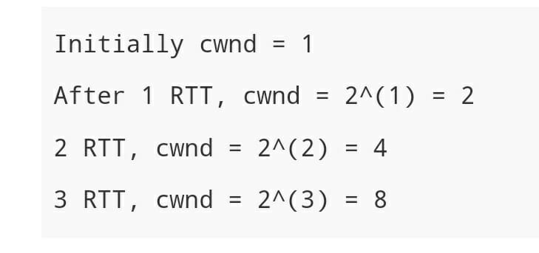
Grows Exponentially
Like;
After 3 RTT, cwnd will be 8.

Slide 10
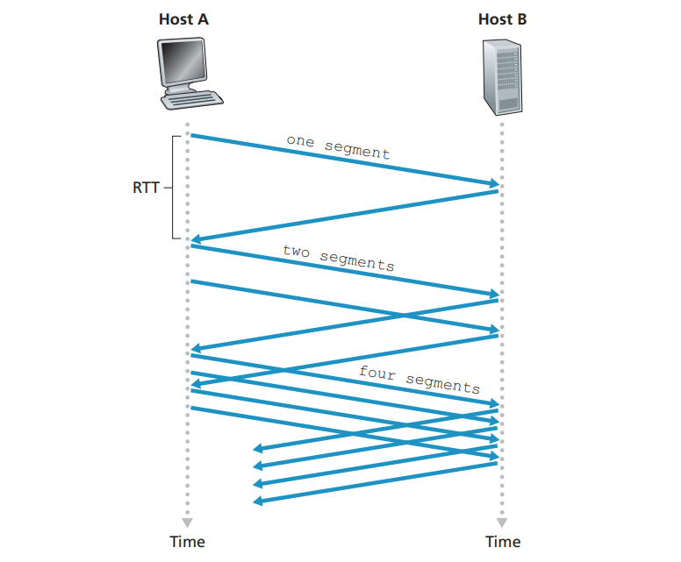
Slow Start

Slide 11
But when should this exponential growth end?
Loss Event(Timeout) ssthresh is updated to half the value of cwnd when the loss event occurred.
Reaching Slow Start Threshold (ssthresh)
Fast Retransmit and Three Duplicate ACKs
Example:
Let's consider an example where TCP is in slow start and has just transmitted a segment. With each acknowledgment received, cwnd doubles.
Suppose cwnd is currently 8 and the slow start threshold (ssthresh) is set to 16.
If the next acknowledgment is received without any loss events or reaching the threshold, cwnd becomes 16 (8 * 2).
If the next acknowledgment indicates a loss event (e.g., due to three duplicate ACKs), TCP performs a fast retransmit, and the congestion window may be adjusted based on the congestion control algorithm.
If, instead, the next acknowledgment is received without loss and cwnd reaches or exceeds 16, slow start ends, and TCP transitions into congestion avoidance mode.
Summary:
Initial Rate is Slow but ramps up exponentially fast.

Slide 12
Congestion Avoidance
follows the Slow Start phase
Linear Increase
Objective:
“The objective of congestion avoidance is to have a more cautious increase in cwnd to avoid potential congestion”.
Action:
“Instead of doubling cwnd every RTT, TCP adopts a linear increase by adding just one MSS per RTT when a new acknowledgment arrives. This ensures a more gradual and conservative growth in cwnd”.
For Example:
if MSS is 1,460 bytes and cwnd is 14,600 bytes, then 10 segments are being sent within an RTT.
Each arriving ACK (assuming one ACK per segment) increases the congestion window size by 1/10 MSS, and thus, the value of the congestion window will have increased by one MSS after ACKs when all 10 segments have been received.

Slide 13
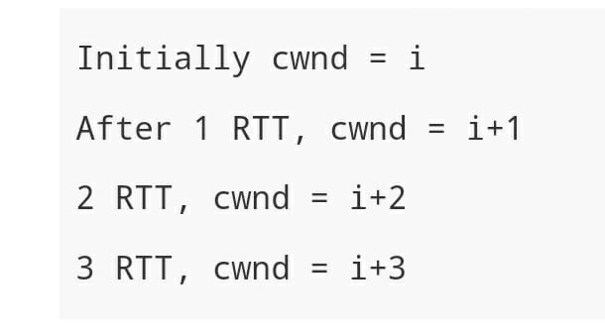
Example:
If we assume cwnd = 1 then after 3 RTT, cwnd will be 4

Slide 14
Question:
when should congestion avoidance’s linear increase (of 1 MSS per RTT) end?
Answer:
depend on the specific TCP congestion control algorithm in use.
However, the common condition is typically based on detecting network congestion.
Mostly Same As Slow Start:
Timeout (ssthresh is updated to half the value of cwnd when the loss event occurred)
Packet Loss
Triple Duplicate ACKs
Question:
When should the exponential increase switch to linear?
Answer:
When CongWin gets to 1/2 of its value before timeout.

Slide 15
Summary:
When CongWin is below Threshold, sender is in slow-start phase,
window grows exponentially.
When CongWin is above Threshold, sender is in congestion-avoidance phase,
window grows linearly.
When a triple duplicate ACK occurs, Threshold set to CongWin/2
and Congwin set to Threshold.
When timeout occurs, Threshold set to CongWin/2
and Congwin is set to 1 MSS.

Slide 16
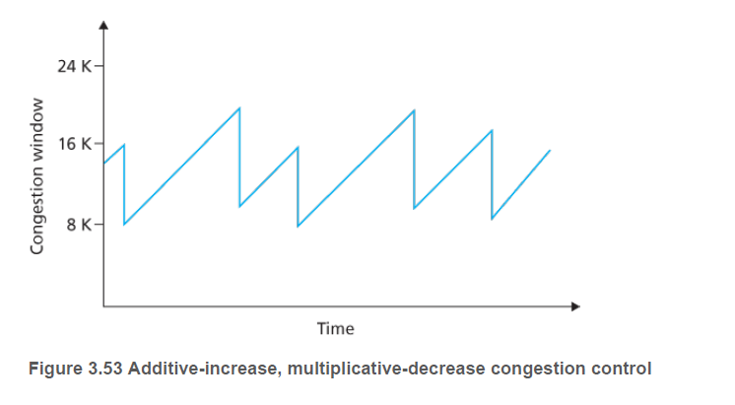
AIMD
Additive Increase, Multiplicative Decrease
Happens in Congestion Avoidance phase
Increase linearly by 1 MSS
Decrease by factor of 2
Illustrates the earlier “probing” concept [Sawtooth]

Slide 17
Fast Recovery
The actual recovery in case of packet loss
Can be initiated through both Slow Start and Congestion avoidance phases
When does it occur?
3 duplicate ACK messages are received
Actions:
Increase cwnd by 1 MSS for retransmission
Case 1: Timeout
Go back to Slow Start phase
Case 2: new ACK received
Go back to Congestion Avoidance

Slide 18
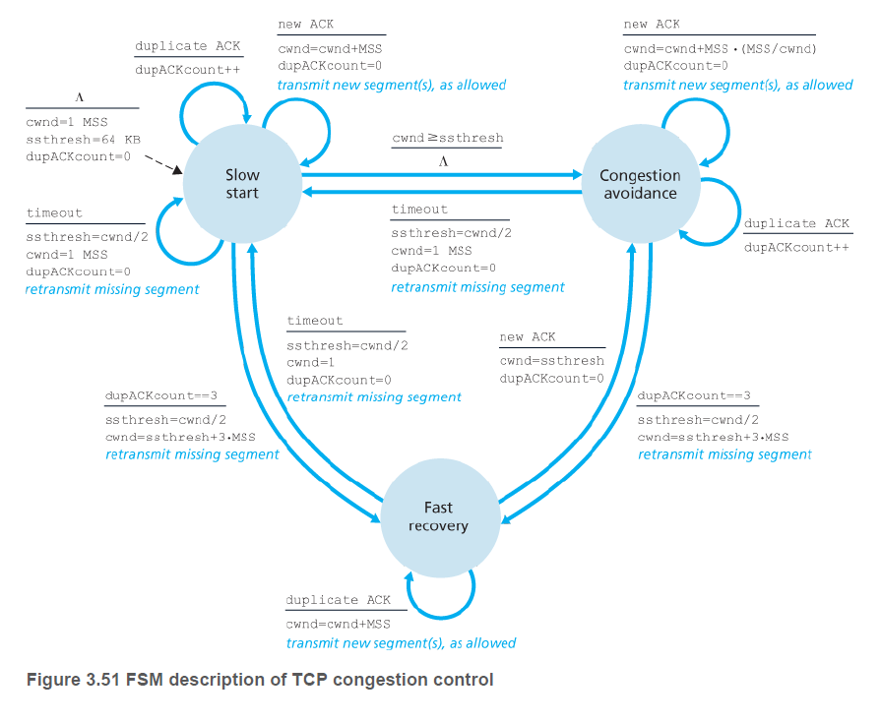

Slide 19
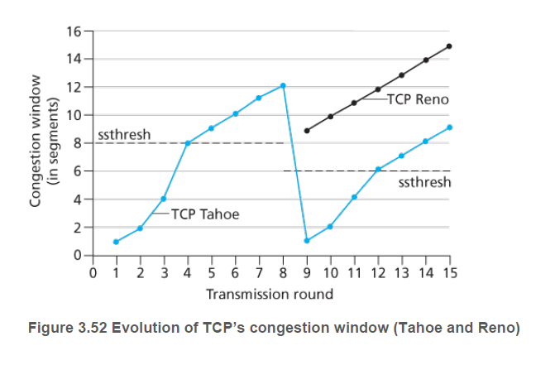
Different versions of TCP
TCP Tahoe
Older; No Fast Recovery, went straight into Slow Start
TCP Reno
Newer; Implemented Fast Recovery
Initial ssthresh = 8 MSS
Loss event at 12 MSS
Fast recovery: cwnd = (ssthresh/2) + 1
w/o fast recovery: cwnd = 1, ssthresh = cwnd/2

Slide 20
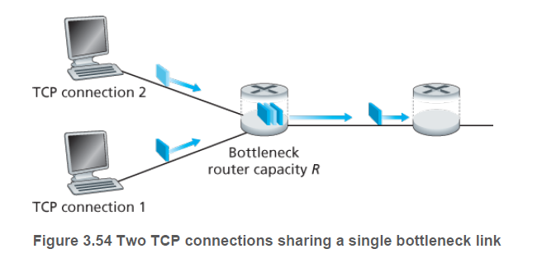
Fairness
Consider K TCP connections, bottleneck link of R bps
The mechanism would be fair if average transmission rate [approximately] = R/K
i.e., each connection gets equal share of the bandwidth

Slide 21
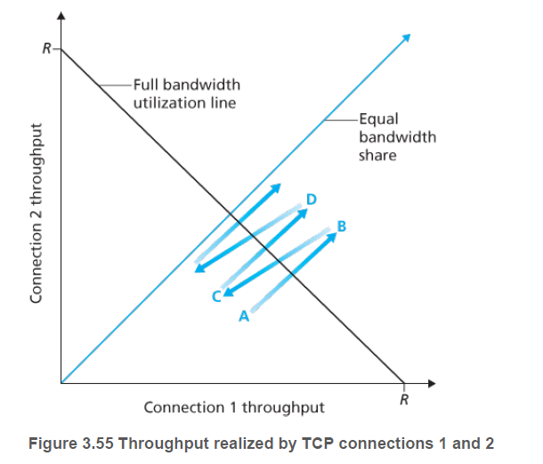
Is TCP congestion control fair?
Consider K TCP connections, bottleneck link of R bps, ignore slow start
Ideal sum of throughputs = R
Achieved throughputs should be near the intersection
A to B to C to D and so on
The connections eventually converge to equal sharing of bandwidth
Only an ideal scenario
In reality, multiple parallel connections are used

Slide 22
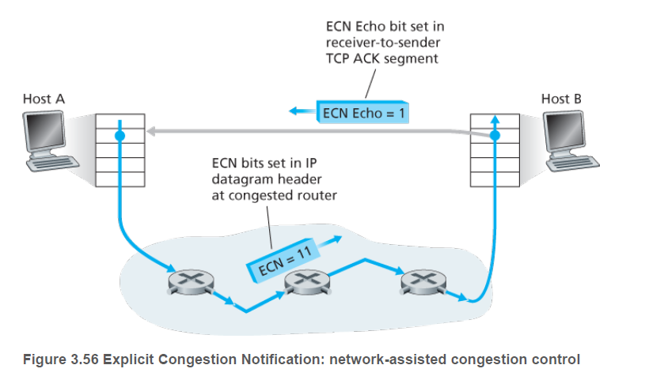
Explicit Congestion Notification (ECN)
“TCP sender receives no explicit congestion indications from the network layer, and instead infers congestion through observed packet loss.”
At the network layer, two bits in the Type of Service field of the IP datagram header are used for ECN
One setting of the bits indicates congestion
These are carried to the destination host
The sender is sent an Echo bit with the TCP ACK
The sender reacts by halving the cwnd [to prevent further congestion]

