Slide 1
Computer Networking Topic: IEEE 802.11 Frame Group Members: Iman Fatima(2021-SE-10) Khadeeja Rasti(2021-SE-53)

Slide 2
IEEE 802.11 Frame
IEEE 802.11 frame designed for wireless communication.
Shares similarities with Ethernet frames, the foundation of wired networks.
Serves as a data container for encapsulating information for transmission.

Slide 3
Mention of Similarities with Ethernet Frames:
Data Encapsulation: Both frames encapsulate data for transmission.
Addressing: IEEE 802.11 mirrors source/destination MAC addresses but expands with additional fields.
Error Detection: Both frames use error-checking mechanisms like CRC for data integrity.

Slide 4
Introduction to Specific Wireless Fields:
Address Fields: Multiple address fields in the 802.11 frame serve distinct purposes in wireless networks.
Sequence Numbers: Introduced for acknowledgment, distinguishing between original transmissions and retransmissions.
Frame Control Fields: Identifying frame types.

Slide 5
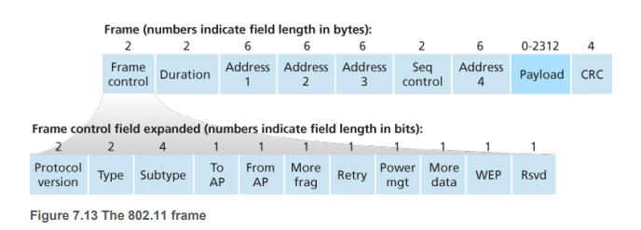
IEEE 802.11 Frame Structure

Slide 6
Payload and CRC
Importance of Payload in the Frame:
The payload is the heart of the IEEE 802.11 frame, containing data.
It plays a crucial role in transmitting information between devices in a wireless network.
Description of Payload Content:
Highlight that the payload can carry diverse content.
Although permitted to be up to 2,312 bytes, it typically holds smaller data, emphasizing efficiency.
Explanation of the 32-bit CRC:
The frame includes a 32-bit Cyclic Redundancy Check (CRC) for error detection.
Explain that CRC is vital in wireless LANs due to higher susceptibility to bit errors compared to wired LANs.

Slide 7
Address Fields Overview
Address 2:
Represents the MAC address of the transmitting station, providing identification for the source of the frame.
Address 1:
Signifies the MAC address of the intended receiver, enabling targeted delivery of the frame.
Address 3:
Designates the MAC address of the router interface, essential for internetworking and connecting the Basic Service Set (BSS) to other subnets.

Slide 8
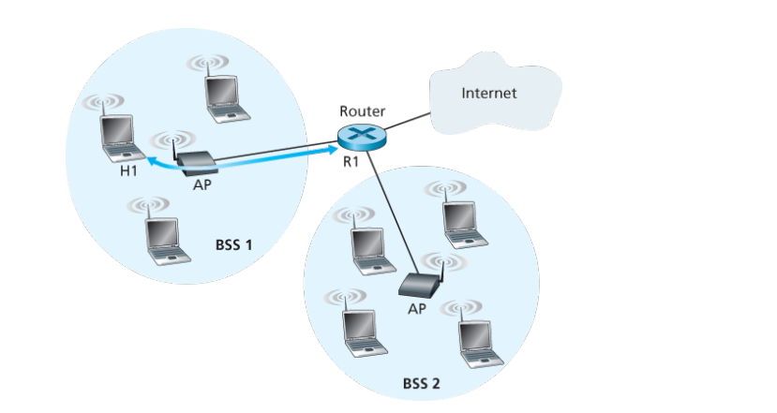
Diagram:

Slide 9
Internetworking Example:
R1 send datagram to H1:
The router, which knows the IP address of H1 (from the destination address of the datagram), uses ARP to determine the MAC address of H1, just as in an ordinary Ethernet LAN.
After obtaining H1’s MAC address, router interface R1 encapsulates the datagram within an Ethernet frame. The source address field of this frame contains R1’s MAC address, and the destination address field contains H1’s MAC address.
When the Ethernet frame arrives at the AP, the AP converts the 802.3 Ethernet frame to an 802.11 frame before transmitting the frame into the wireless channel.
The AP fills in address 1 and address 2 with H1’s MAC address and its own MAC address, respectively, as described above. For address 3, the AP inserts the MAC address of R1. In this manner, H1 can determine (from address 3) the MAC address of the router interface that sent the datagram into the subnet.

Slide 10
Internetworking Example:
When the wireless station H1 responds by moving a datagram from H1 to R1:
H1 creates an 802.11 frame, filling the fields for address 1 and address 2 with the AP’s MAC address and H1’s MAC address, respectively, as described above.
For address 3, H1 inserts R1’s MAC address. When the AP receives the 802.11 frame, it converts the frame to an Ethernet frame.
The source address field for this frame is H1’s MAC address, and the destination address field is R1’s MAC address.
Thus, address 3 allows the AP to determine the appropriate destination MAC address when constructing the Ethernet frame.

Slide 11
Why four fields used?
Functionality of the Fourth Address Field:
When a device (e.g., Device A) wants to communicate with another device (e.g., Device B) in the ad hoc network, and there's an intermediary device (e.g., Device C) acting as an access point, the fourth address field is used.
The fourth address field specifies the address of this intermediary device (Device C), ensuring that frames are properly routed through the ad hoc network.
This facilitates efficient communication within the ad hoc network, even if devices are not directly within range, as frames can be relayed through access points.

